Slide 1

Morphological gradient
It is the difference between the dilation and the erosion of an image.
Remember what is dilation?
Operate a maximizing operation causes bright regions within an image to “grow” (therefore the name dilation). For example:
Dilation

Slide 2

Remember what is erosion?
Operate a minimizing operation causes bright regions within an image to be reduced (therefore the name erosion).
Analogously to the example for dilation, now we get the opposite
Erosion

Slide 3



It is useful for finding the outline of an object
So now we can understand what is Morphological gradient :
Difference between dilatation and erosion, so we get :

Slide 4
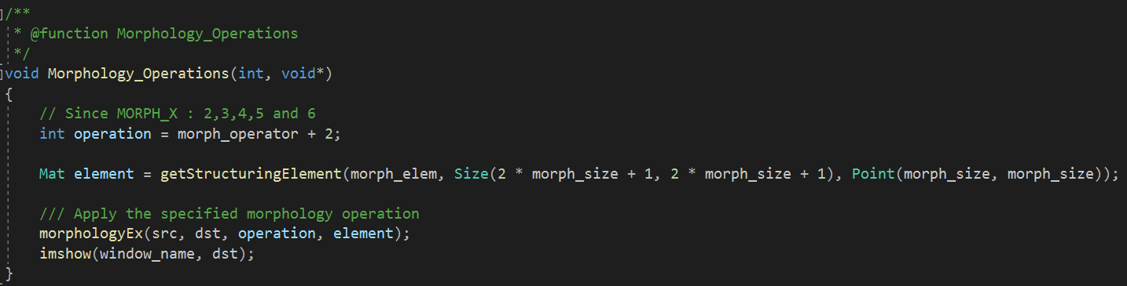

Slide 5
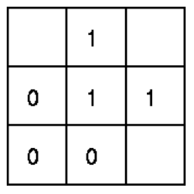
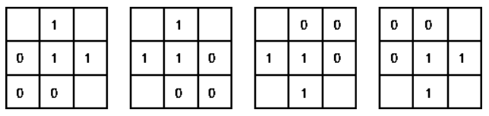


Hit-and-Miss Transform
Takes as input a binary image and a structuring element, and produces another binary image as output.
The hit-and-miss operation is performed by translating the origin of the structuring element to all points in the image, and then comparing the structuring element with the underlying image pixels. If exactly match foreground and background pixels in the image, then the pixel underneath the origin of the structuring element is set to the foreground color. If it doesn't match, then that pixel is set to the background color.
So if you want to find all the corner, you can rotate this structuring element end get finally:
Example of structuring element used in hit-and-miss operations that can be used to find corner points
1
Foreground pixel
Don’t care pixel
Background pixel

Slide 6
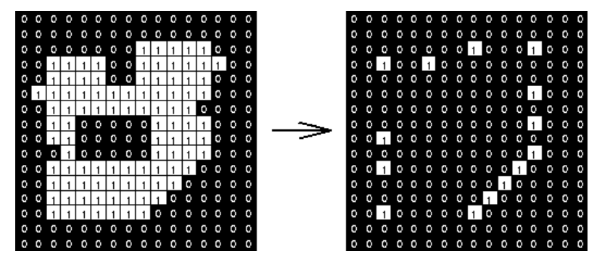
So, by translating to all pixels in the picture and find matches to the different elements we obtain:

Slide 7
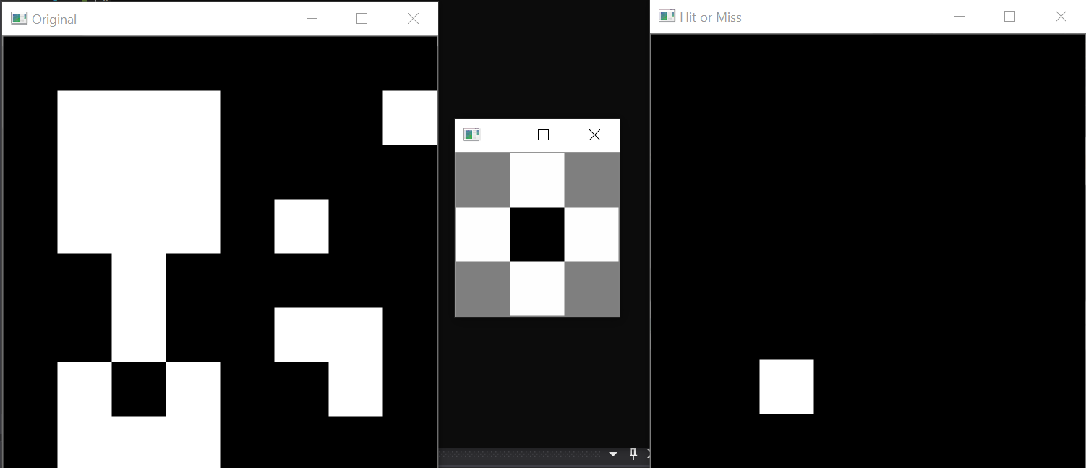
Another example:

Slide 8
