Slide 1
Grammar Compression

Slide 2
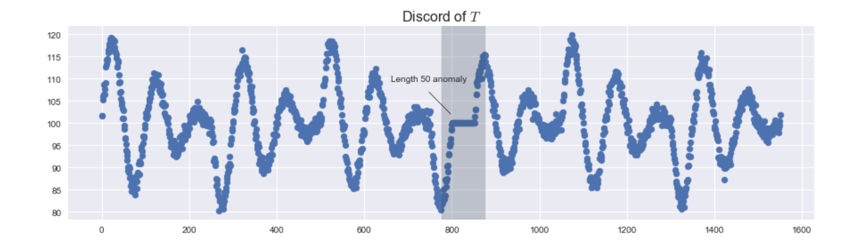
Brute Force Algorithm
Brute force algorithm:
Numerically computes furthest nearest neighbor
Not vectorized (in literature comparison; can be vectorized)

Slide 3
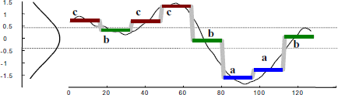
Symbolic Aggregate approXimation SAX
Converts data subsequences to letters using Piecewise Aggregate Approximation (PAA)
Letters are assigned based on pre-selected (pseudo-arbitrary) alphabet boundaries
Series of letters (usually 3-4) are combined into words
Anomaly Detecition with SAX
Check distance between words (using modified distance function)
Notes:
PAA just takes a subsequence and assigns it the mean value of the data points in the subsequence

Slide 4
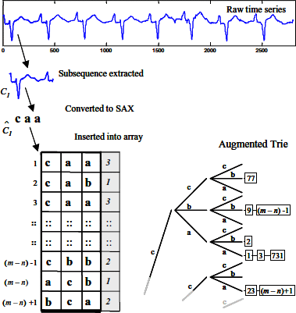
Heuristically Ordered Time Series SAX HOT SAX
Improves SAX by favorably looking up ”rare” words first
Reported 3,000x speedup on brute force algorithm
HOT SAX not vectorized
doing so may interfere with heuristic time savings?
I think it could be partially done (if necessary)…
Anomaly Detection with HOT SAX
Words are saved in a lookup trie
Rare words suggest anomalies; then distance is checked between words to confirm

Slide 5
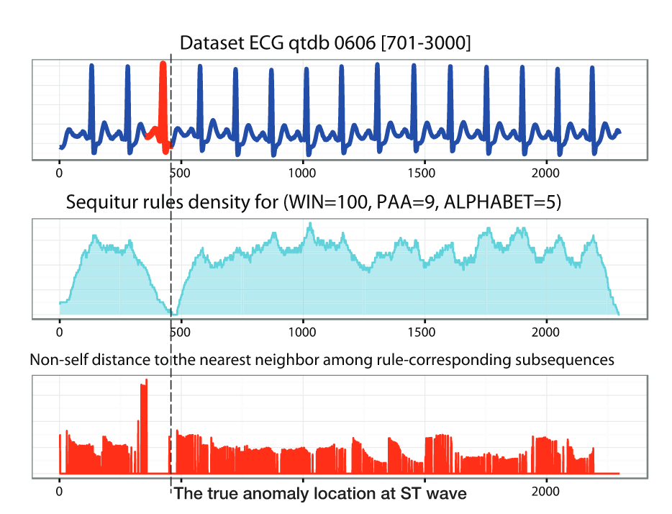
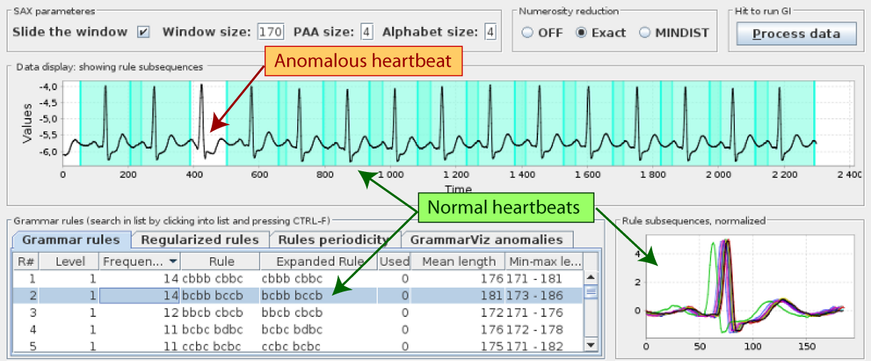
GrammarViz
Uses Rule Density Curve and Rare Rule Anomaly (RRA) as detection algorithms
Rule Density Curve: Number of grammar rules covering each point in time series
(does not explicitly calculate distances between subsequences)
RRA: follows procedure of HOT SAX but using grammar to inform the heuristic

