Slide 1
Introduction to Network Analysis
ULS Digital Scholarship Workshop
Understanding Networks, Part 1
January 24, 2024
Slides available at: bit.ly/pittdss-networks2024

Slide 2

Today’s Learning Goals
Become familiar with essential vocabulary and concepts related to network graphs and network analysis
Gain experience with Gephi’s interface and tools for analyzing and comparing networks
Rachel Starry
Head of Digital Scholarship Services
rachel.starry@pitt.edu

Slide 3
Your Interests?
What kinds of data or research materials do you want to explore using networks?
What disciplines are you coming from? What research questions do you want to explore?

Slide 4
Network Analysis
Networks: all about relationships
Network analysis: understanding the relationships

Slide 5
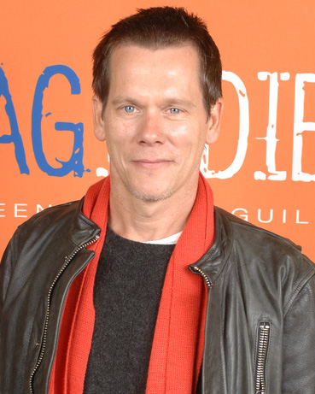
What is a “network”?
Example: Six Degrees of Kevin Bacon (and The Oracle of Bacon)
“a parlor game based on the six degrees of separation or small world concept”
Kevin
Bacon
Samuel L.
Jackson
(both appear in Trapped)
Charlize
Theron
(both appear in Astro Boy)
“Kevin Bacon,” by SAGIndie from Hollywood, USA - Flickr, CC BY 2.0

Slide 6
Network Terminology
A network is made up of nodes and edges.
Kevin
Bacon
edges
Samuel L.
Jackson
nodes
Charlize
Theron

Slide 7
Network Terminology
The degree of a node is the sum of the edges connected to it.
degree = 1
Kevin
Bacon
degree = 1
Samuel L.
Jackson
Charlize
Theron
degree = 2

Slide 8
What is “network analysis”?
Like the idea of Hollywood actors having a “Bacon number,” there are many ways to calculate the importance of nodes and to quantify the complex relationships between nodes.
Kevin
Bacon
Samuel L.
Jackson
Charlize
Theron

Slide 9
What is network analysis?
Some questions we can ask:
1. What are the most “important” nodes in my network?
2. How strongly connected is my network?
3. Are there detectable groups or communities of nodes in my network?
Three common methods:
Calculating network centrality (identifying the most “important” nodes in a network)
Calculating network density (the shape and overall connectedness of a network)
Calculating network modularity (whether nodes cluster into communities)

Slide 10
How is network analysis useful?
Common use-cases for network analysis:
Infrastructure vulnerabilities (engineering, urban planning)
Complex species interactions (ecology)
Social networks and the spread of disease (epidemiology)
Citation analysis (information science)
Social media analytics (anthropology, social work, advertising)
Socio-technical networks (communication)
Historical or literary relationships (humanities)
Molecular interaction networks (biology)

Slide 11
Network Centrality
or, “what are the most important nodes in my network?”

Slide 12
Network Centrality
Definition: measurement indicating the most important nodes
issue: what does “important” mean?

Slide 13

Network Centrality
Definition: measurement indicating the most important nodes
issue: what does “important” mean?
“people” by Colleen Cameron from the Noun Project

Slide 14
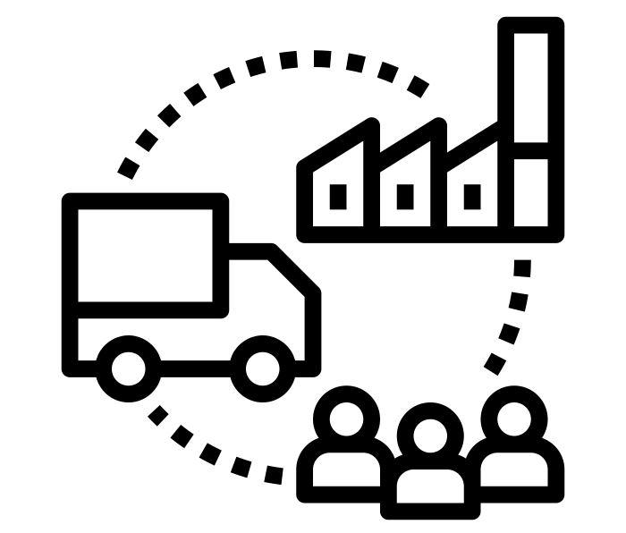
Network Centrality
Definition: measurement indicating the most important nodes
issue: what does “important” mean?
“people” by Colleen Cameron from the Noun Project
“Supply Chain” by Becris from the Noun Project

Slide 15
Network Centrality
Four kinds:
Degree centrality
Betweenness centrality
Closeness centrality
Eigenvector centrality

Slide 16
Degree Centrality
Four kinds:
Degree centrality: measures the sum of each node’s connections
Betweenness centrality
Closeness centrality
Eigenvector centrality

Slide 17
Degree Centrality
Example: Star Wars characters
When to use it:
When you have a mostly complete social network
To find individuals who could hold the most information (because they are directly connected to the most other nodes)

Slide 18
Degree Centrality
Example: Star Wars characters
When to use it:
When you have a mostly complete social network
To find individuals who could hold the most information (because they are directly connected to the most other nodes)
Caveats:
Don’t use it for ego-networks organized around one individual
Not ideal for social networks derived from literature

Slide 19
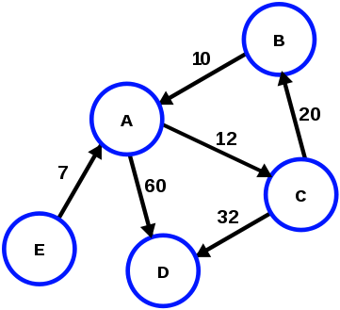
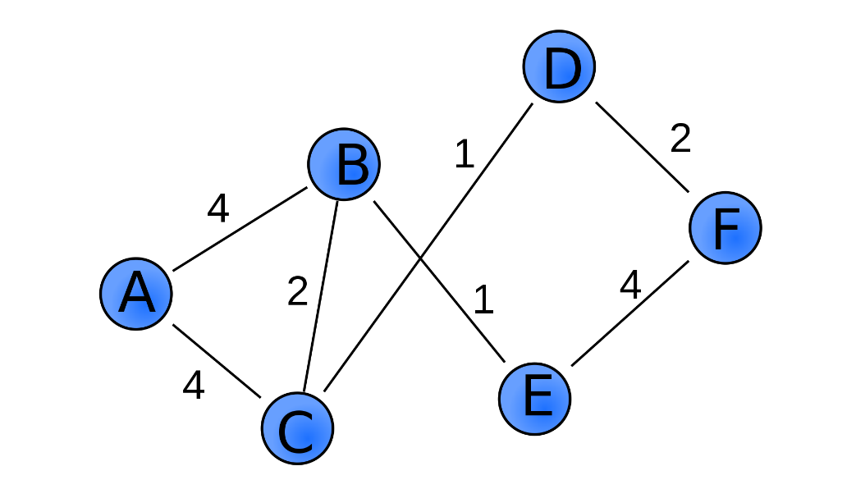
Degree Centrality
Weighted degree: combining edge weight with degree
Directed degrees: combining edge direction with degree (in-degree and out-degree)
Directed (and
weighted) graph
Weighted graph
“directed weighted graph,”
by Pluke, Wikimedia Commons, CC 0
“Weighted Graph,” by Pk0001, Wikimedia Commons, CC 0

Slide 20
Betweenness Centrality
Four kinds:
Degree centrality
Betweenness centrality: how many “shortest paths” across the network lead through each node
Closeness centrality
Eigenvector centrality

Slide 21
Betweenness Centrality
Example: The Force Awakens characters
When to use it:
To find which nodes are most important for holding the network together
To find which nodes have the most control over social, communication, travel, or transport networks (because more routes/information pass through them)

Slide 22
Betweenness Centrality
Example: The Force Awakens characters
When to use it:
To find which nodes are most important for holding the network together
To find which nodes have the most control over social, communication, travel, or transport networks (because more routes/information pass through them)
Caveats:
High betweenness does not mean someone who connects multiple clusters in a network necessarily holds the most information or influence themselves – they could be on the periphery of the clusters they bridge

Slide 23
Closeness Centrality
Four kinds:
Degree centrality
Betweenness centrality
Closeness centrality: average length of the “shortest path” between a given node and all other nodes in the network
Eigenvector centrality

Slide 24
Closeness Centrality
Example: Airline routes
When to use it:
To find key distribution points in delivery or transport network
To find “broadcasters” in a social network who can quickly communicate with others

Slide 25
Closeness Centrality
Example: Airline routes
When to use it:
To find key distribution points in delivery or transport network
To find “broadcasters” in a social network who can quickly communicate with others
Caveats:
Complicated in directed networks: shortest paths TO or FROM a node are different lengths, so one node can have high outgoing closeness and low incoming closeness

Slide 26
Eigenvector Centrality
Four kinds:
Degree centrality
Betweenness centrality
Closeness centrality
Eigenvector centrality: measures each node’s connection to other highly connected nodes (extension of degree centrality)

Slide 27
Eigenvector Centrality
Example: Google’s PageRank
When to use it:
A great all-around measure for how well-connected a node is
Caveats:
None (although caveats for degree centrality also apply somewhat)

Slide 28
2. Network Density
or, “how strongly connected is my network?”

Slide 29
Network Density
Definition: measurement indicating the percentage of potential connections that actually exist among nodes in a network
Network-level measurement
number of edges in network
number of possible edges in network

Slide 30
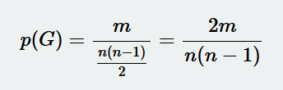
Network Density
Definition: measurement indicating the percentage of potential connections that actually exist among nodes in a network
Network-level measurement
for a network G made of n nodes and m edges:
number of edges in network
number of possible edges in network

Slide 31

Network Density
Definition: measurement indicating the percentage of potential connections that actually exist among nodes in a network
“family reunion” by Chunk Icons from the Noun Project

Slide 32

Network Density
Definition: measurement indicating the percentage of potential connections that actually exist among nodes in a network
“family reunion” by Chunk Icons from the Noun Project
“Bus” by Pierre-Luc Auclair from the Noun Project

Slide 33
3. Network Modularity
or, “are there detectable communities in my network?”

Slide 34
Network Modularity
Definition: calculation that identifies communities (“modularity classes”) in a network
Network-level measurement

Slide 35
Network Modularity
Example: Predicting communities – Belgian mobile call network
Caveats:
Doesn’t work (well) with weighted graphs
Doesn’t work (well) with directed graphs
In directed graphs, the edge direction significantly affects how a node (and community) is connected to rest of network
See also: Interactive Python notebook comparing community-detection algorithms for another famous dataset (Zachary’s Karate club)

Slide 36
Gephi Walkthrough

Slide 37
Gephi
“The Open Graph Viz Platform” gephi.org
Benefits of using Gephi for network analysis:
Free and open-source
Robust user community
Lots of plugins to extend functionality
Built-in calculations for centrality, density, and modularity
Import and export network data easily

Slide 38
Network Data
Gephi requires two files to create a network graph:
A list of nodes
A list of edges

Slide 39
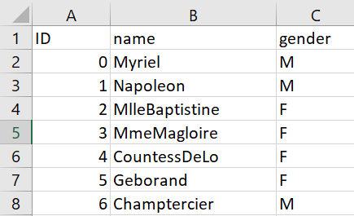
Network Data
Node lists require two attributes/columns:
List of objects (“name”)
List of unique identifiers (“ID”)
Optional: other attributes describing your nodes

Slide 40
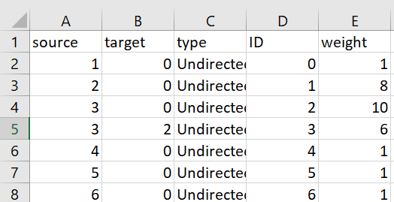
Network Data
Edge lists require two attributes/columns:
List of “source” nodes
List of “target” nodes
Optional: type (should be “directed” or “undirected”), weight

Slide 41
Gephi Walkthrough
Navigate to bit.ly/pittdss-networks2024 and download the repository as a .zip file.
Option #1: create a network graph from node and edge lists
Use the node and edge lists (.csv files) in the “Les Miserables Character Relationships” folder
Option #2: open a network graph file (in a supported file format)
Use any of the 4 example .gml or .graphml files from the repository

Slide 42
Gephi’s Limitations
Multimodal networks: nodes of different types
Example: actors & movies in Six Degrees of Kevin Bacon Database
Gephi cannot handle multimodal networks
Explicit vs. Inferred edges
Useful to consider whether edges in your network represent explicit connections or if they are inferred
Document your decisions when generating a network!

Slide 43
Tutorials and Resources
Gephi Tutorials:
Martin Grandjean, “Gephi Introduction”
Clément Levallois, “Simple Gephi Project from A to Z”
Gephi.org tutorials
Network Analysis Learning Resources:
Albert-László Barabási, “Network Science” (open textbook)
Scott Weingart, “Demystifying Networks” (digital humanities approaches)
Sources for Network Datasets:
Gephi wiki, datasets
Stanford Large Network Dataset Collection
François Briatte’s curated list of network datasets

Slide 44
Workshop Follow-up
Additional questions?
library.pitt.edu/ask-us
or send DSS an email at ULS-DigitalScholarshipServices@pitt.edu
Slides: bit.ly/pittdss-networks2024

