Slide 1

Context
Flex travel allocation
From Flex sales to individual journeys: the model, business findings, and decisions on revenue and capacity
Current situation
Flex is a pay-per-activation pass. Sales and activations are recorded, but the related journeys are not. Pricing and planning therefore rely on estimates.
The requirement
Assign every sale to passenger journeys with a date, time and direction, within the validity period and activation limit, in a consistent manner.
The solution
A tested PySpark model with controlled data handling, input checks and NPD / PRD environments, prepared for scheduled production.
Current assessment
Potential revenue impact if income followed journeys, and the capacity that sales-based planning may overestimate.
Forward planning
Promotion policy and sale-to-travel value models to support pricing and planning for the next production cycle.
Contents
business context, information used, model approach, findings and deployment
Executive summary first · recommendation
Notes:
~1 min. Flex is a pay-per-activation pass: we see sales and activations, not travels. The task was to reconstruct the travels, then use them to answer two questions: one on revenue, one on train capacity.

Slide 2
Executive summary
What was delivered, and the decisions it supports
A production-ready allocation model with clear findings on revenue and capacity
2,186,474
Passenger journeys allocated from 37,675 sales
EUR 6.2M
Potential revenue exposure (29.8%) if income followed actual travel
+44%
Excess peak seats under sales-based planning
-31%
Potentially avoidable trains per day at the same service level
EUR 2.1M
Estimated annual recovery from targeted promotion
■ Delivered: a tested PySpark model that converts each sale into dated outbound and return journeys and is ready for demonstration and scheduled production.
■ Revenue: if income were linked to journeys taken, current use would support EUR 14.7M versus EUR 20.9M sold. Most exposure is in Flex 80 and Flex 120.
■ Capacity: sales-based planning assumes 3.15M journeys versus 2.19M actual, resulting in 69.3% average use, 44% excess peak seats and 2,416 additional trains per day.
■ Promotion policy (MDP): promote Flex 80 and Flex 120 while cumulative use remains below approximately 88–89%. The estimated recovery is EUR 2.1M per year.
■ Sale-to-travel value model: expected value is EUR 399 per travel allocation versus EUR 344 per sale allocation, an increase of EUR 55 (CI 55–56). The principal issue is usage pricing, not activation.
Notes:
~2 min. Five numbers: the volume allocated, the revenue exposed if income followed travel, the seats and the trains over-provisioned by sales-based planning, and what a targeted promotion recovers. Everything after this is how we got there.

Slide 3
1 · Business purpose | What the model must provide
■ Assign each Flex sale to passenger journeys, including the date and hour.
■ Record the direction of travel: each activation represents one outbound and one return journey, with one passenger each.
■ Apply the subscription validity period and the product activation limit.
■ Resolve the different ticket-number formats used in sales and activation records.
■ Follow team standards: Spark-native processing, clear functions, governed input and output, and controlled configuration.
■ Deliver a production-ready notebook, supporting .py modules and this presentation.
Products in scope
Product | Activation limit | Validity
Flex 6 | 6 travel days | 1 month
Flex 10 | 10 travel days | 1 month
Flex 80 | 80 travel days | 12 months
Flex 120 | 120 travel days | 12 months
Success criteria
Every sales ticket matches one activation ticket.
Total passengers equal twice the number of valid activations.
The same input always produces the same flex_travels table.
Article codes S0256–S0259 (256–259). Each subscription applies to one route in both directions.
Notes:
~2 min. Four functional requirements, the team conventions, and how we know we met them. The products differ mainly in how many travel days they carry and over what window.

Slide 4
2 · Information used | Six source tables and one clear output
Information provided to the model
Result: flex_travels
Table | What it provides
Product definitions and activation limits | Products and activation limits
Purchased subscriptions and validity periods | Purchased subscriptions + validity
Product linked to each activation ticket | Product per activation ticket
Activation dates, times and validity | Activation timestamps and validity
Estimated outbound time differences | There-travel minute offsets
Estimated return time differences | Back-travel hour offsets
Column | Type | Description
ticket_number | Number | Sales ticket identifier
article_code_int | Number | Product code (256–259)
article_description_nl | Text | Product description
travel_direction | Number | 1 = outbound, 2 = return
travel_date | date | Local journey date
travel_hour | Number | Local journey hour (0–23)
travel_timestamp | Date and time | Estimated journey date and time
pax | Number | Passengers (1)
Result for the available data
2,186,474 journey records, divided equally between outbound and return travel.
Check: total passengers equal twice the number of valid activations.
Key fields used by the model
sales_flex: ticket number and product description,
sales value, sales date and validity period
activations_flex: activation ticket number and date,
sequence and UTC timestamp
article_code_flex: product code and maximum activations (N)
probability tables: possible time difference and likelihood
Notes:
~2 min. Six inputs in, one long table out. Cleaning only selects, renames and casts - no business logic. The invariant on the left is the smoke test that guards every run.

Slide 5
3 · Data preparation | From sales records to passenger journeys
Load sales and activations
ingestion.py
Match ticket records
ticket_matching.py
Apply validity rules
allocation.py
Estimate journey times
travel_timing.py
Create flex_travels (pax)
DataHandler
1 · Match ticket records
The activation ticket combines the four-digit sales year with the sales ticket number, padded to 19 digits. All 37,675 records match one to one.
2 · Apply eligibility rules
Keep only activations within the validity period and the permitted activation limit.
3 · Estimate journey times
Outbound and return times are estimated from the survey probability tables. Spark performs the matching without UDFs, using a fixed SEED for consistent results with inverse transform sampling technique,
4 · Create journey records
Each eligible activation becomes one outbound and one return record, with one passenger in each record, in the flex_travels table.
Assumptions and exceptions
Each activation represents two journeys: one outbound and one return, with one passenger each.
Activations outside the validity period or above maximum_activations_allowed are excluded.
Journey times are estimated from the probability tables; a fixed SEED in conf/config.py ensures consistent results.
Timestamps are stored in UTC and reported in Europe/Brussels time. The ticket year comes from sales_date.
Notes:
~3 min. Walk the flow left to right, then the assumptions: each one is a named, tested function, so changing it is a code change rather than a hidden edit.

Slide 6
4 · Modeling | Allocation model: a clear two-stage process
Stage 1 · assign eligible journeys consistently
Sales, activations and products
ingestion.py
Match ticket numbers
year + 19-digit number
Apply validity and limits
within product allowance
Create outbound + return
2 records per activation
Stage 2 · estimate journey times with a fixed SEED
Estimate outbound time
minutes_to_add
Estimate return time
hours_between
Convert UTC to Europe/Brussels
travel_date, travel_hour
flex_travels
outbound + return passengers
37,675 sales
all matched one to one
1,093,237 valid activations
within period and product limit
2,186,474 passenger journeys
one outbound + one return
Method in brief: eligible activations
The allocation model links sales, products
and activations through a common ticket number.
It keeps only records within the validity period
and product limit N. Retained records show
the paid travel days used for each ticket.
Method in brief: journey timing
The model uses the probability tables to estimate
realistic outbound and return times using inverse transform sampling technique. A fixed SEED produces consistent results, while SEED+1 provides
the return-time estimate. The same approach shows
expected passenger volumes by hour.
Notes:
~2 min. Stage 1 is deterministic bookkeeping: match, filter, fan out. Stage 2 samples the survey distributions by inverse transform through a broadcast range join - no Python UDF, fixed SEED (42), so the table is reproducible. The same probabilities also give the exact expected distribution and Monte-Carlo bands.

Slide 7
6 . Deployment | Run schema, environments and quality gates
Input tests
..._input_tests.py
Pipeline
..._pipeline.py
flex_travels
governed table
Analysis, demo, scenarios
..._analysis.py
■ Input tests run first and raise if errors_stopping_pipeline is non-empty, a bad load never reaches production.
■ The pipeline is non-interactive and deterministic; the analysis notebook is never part of the production run.
■ Notebooks are stored as .py in Databricks source format, so they are reviewable and versioned.
■ The environment widget selects NPD or PRD (default NPD); all I/O goes through DataHandler.from_config.
■ Local: PySpark 3.5.x needs Python >= 3.10, < 3.13 and a JDK (Java 17); quality gates are pytest, ruff and pre-commit.
■ Modeling (PRD): the estimation notebook fits Stage 1/2 and writes flex_model_parameters; the pipeline then scores units into flex_unit_scores in pure Spark (scipy / statsmodels only on the estimation cluster).
Environment (uv)
uv venv --python 3.11 .venv
uv pip install -r requirements-dev.txt
Tests & lint
.\.venv\Scripts\python -m pytest
.\.venv\Scripts\python -m ruff check .
pre-commit run --all-files
Notes:
~2 min. Same code local and on Databricks. The point: a fixed SEED plus schema tests means the figures in the next section are reproducible.

Slide 8
Questions for future sales:
whether a sale will activate, and when?
How can we estimate travel from sales that combines activated, inactive and breakage outcomes?
How can we promote the behavior to travel allocation rather than sale allocation?
Notes:
~1 min. Flex is a pay-per-activation pass: we see sales and activations, not travels. The task was to reconstruct the travels, then use them to answer two questions: one on revenue, one on train capacity.

Slide 9
4 · Modeling | Value model across sale, activation and travel
EUR 399
Expected value per travel allocation
EUR 344
Expected value per sale allocation
+EUR 55
Estimated increase per sale (CI 55–56)
~0%
Estimated breakage; activation usually occurs within 2–3 days
■ The model compares expected value per sale rather than only the cash collected at purchase.
■ Stage 1 uses a mixture cure model: logistic incidence estimates the share that will activate, and Weibull estimates when activation will occur.
■ Stage 2 uses a negative-binomial GLM to estimate journeys per active day.
■ The activation pattern has two clear periods: many same-day activations and another group after approximately three days.
Method in brief: expected value per sale
The mixture cure model estimates whether a sale
will activate, and Weibull estimates when.
The negative-binomial GLM then estimates travel.
Expected value combines activated, inactive
and breakage outcomes. The confidence interval (CI)
uses a 1,000-draw bootstrap.
Why it matters
The sale-to-travel allocation is financially sound: value is not lost during activation. The main commercial question is therefore usage pricing.
Notes:
~2 min. The MDP answers what to do with an existing sale; this model answers what a sale is worth under each regime. Both point at usage, not onboarding.

Slide 10
4 · Modeling | Promotion policy using the MDP
■ The Markov Decision Process (MDP) reviews each subscription according to its remaining travel-day allowance.
■ It compares the value of no action with the value of encouraging one additional activation at an incentive cost.
■ The model works backward through the remaining days using estimate_hazards and evaluate_transition in mdp_what_if.py.
Method in brief: annual recovery with the MDP
At each level of use, the MDP compares: continue
without promotion, or offer one additional activation.
It uses estimate_hazards and evaluate_transition
in mdp_what_if.py, with uplift = +0.10
and incentive = 25% of the per-day price.
Annual recovery is the difference in estimated
value with and without promotion.
Headline
Targeted promotion could recover approximately EUR 2.1M per year, or about one third of the gap. Promote Flex 80 and Flex 120 while cumulative use remains below approximately 88–89%; retain sales pricing for Flex 6 and Flex 10, which are already about 98% used.
Notes:
~2 min. Not all of the gap is recoverable: the policy only promotes where the extra activation is worth its incentive cost.

Slide 11
Question before promote travel activation:
How to evaluate the tradeoff between revenue risk and train capacity planning?
Notes:
~1 min. Flex is a pay-per-activation pass: we see sales and activations, not travels. The task was to reconstruct the travels, then use them to answer two questions: one on revenue, one on train capacity.

Slide 12
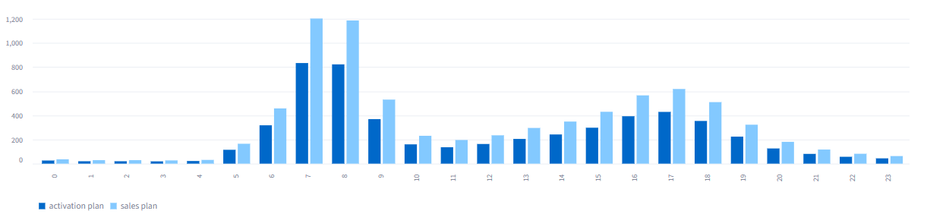
5 · Evaluation | Daily train requirement
7,894
Trains per day when planned from sales
5,478
Trains per day when planned from actual travel
-2,416
Fewer trains per day (-30.6%) at the same service level
369
Fewer trains at 07:00: 1,203 versus 834
Trains required per hour under each planning basis
■ The same planning rule is applied to both cases: an illustrative fleet of 500 seats per train at a maximum load of 80%, adjustable in the demonstration.
■ Planning from actual travel may reduce crew, energy and rolling-stock costs while maintaining the same service standard.
Calculation approach: trains per day
Hourly passenger demand is divided by capacity: 500
seats per train at an 80% target load. The hourly
requirements are then added for the daily total.
Sales planning requires 7,894 trains versus 5,478
from actual travel: 2,416 fewer, or 30.6%.
Notes:
~1.5 min. Translating the pax gap into trains: same sizing rule on both bases, so the difference is purely the phantom demand.

Slide 13
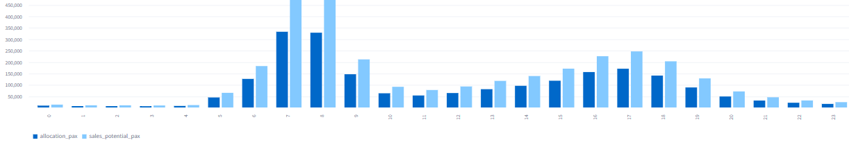
5 · Evaluation | Capacity based on actual travel
2,186,474
Passenger journeys allocated from actual use
3,153,652
Passenger journeys if every paid day were used
69.3%
Overall use of capacity planned from sales
+44%
Excess peak seats when capacity is based on sales
Passengers per hour: actual allocation compared with full-use planning
■ Sales-based planning assumes every paid day will be used: 3.15M potential journeys compared with 2.19M actual journeys.
■ The difference is greatest during commuter peaks: 333,000 actual passengers versus 481,000 planned at 07:00, with a similar pattern at 17:00.
■ Planning from actual allocation removes excess capacity, although an appropriate reserve is still required if use increases.
Calculation approach: peak capacity
The model compares hourly passenger demand
from actual allocation with full use of paid days.
The peak is 481,000 passengers under sales planning
versus 333,000 from actual allocation.
This is 44% additional capacity at 07:00.
Notes:
~2 min. Same under-use, seen from the operations side: sales-based planning buys seats for travels that are never taken.

Slide 14
5 · Evaluation | Revenue exposure by product
EUR 20.9M
Current sales revenue: full price paid in advance
EUR 14.7M
Revenue if income reflected journeys taken
EUR 6.2M · 29.8%
Potential revenue exposure from unused travel days
Calculation approach: revenue exposure
For each subscription, the sales value is divided
by the permitted number of activations. That value
is multiplied by the travel days used and compared
with the original sales revenue. The result is
EUR 20.88M less EUR 14.65M: EUR 6.23M, or 29.8%.
Each 1% of non-payment adds
about EUR 0.15M.
■ Exposure is concentrated in the longer passes: Flex 120 uses approximately half of its days, while Flex 6 and Flex 10 use nearly all of theirs.
■ The figures use illustrative data. The non-payment rate remains an assumption that requires validation.
Notes:
~2 min. This is the test of whether the allocation is useful: it answers a real pricing question. The gap is under-use, not error.

Slide 15
5 · Evaluation | Balancing capacity and revenue
■ Both effects result from unused travel days. Products with the greatest revenue exposure also create the greatest opportunity to reduce planned capacity.
■ Flex 120: approximately half of its days are unused, affecting about 50% of revenue and planned capacity. Highest priority.
■ Flex 80: approximately 23% on both measures. Medium priority.
■ Flex 6 and Flex 10: 1–2% on both measures. Retain sales pricing.
The action that supports both objectives
Targeted promotion can improve revenue and capacity use at the same time by encouraging customers to take journeys they have already purchased.
Product | Use | Revenue / capacity effect | Recoverable | Priority
Flex 6 | 99% | 1.0% | — | Low
Flex 10 | 98% | 2.3% | — | Low
Flex 80 | 77% | 23.3% | EUR 0.77M | Moderate
Flex 120 | 50% | 50.3% | EUR 1.32M | High
Notes:
~2 min. The key point: one ranking, not two. Flex 120 is first on both counts, so a single action list serves both goals.

Slide 16
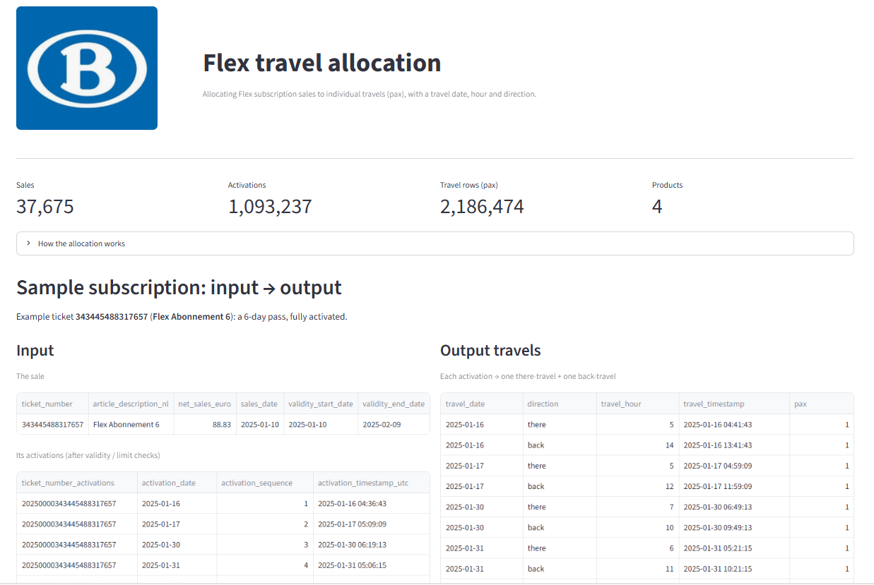
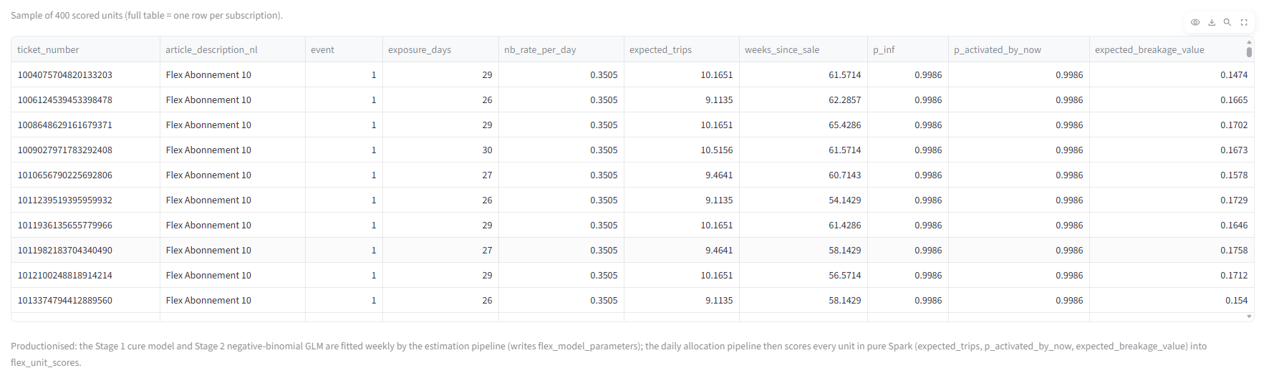
6 · Deployment | Demo app: one subscription, input to output
■ Shows a sample subscription end to end: the sale and its activations, then the resulting there / back travels.
■ Also shows the global distributions by product, date and hour x direction.
■ Reads small precomputed artifacts, so it is fast and needs no Spark.
■ Includes the revenue-risk and what-if charts, plus the travel-allocation value model and the flex_unit_scores output (per-subscription scores).
Run it
# 1. regenerate the artifacts
python precompute_demo.py
# 2. run the app
python -m streamlit run
streamlit_app/app.py
Notes:
~1 min. Live demo if time allows: pick a subscription, show input and the allocated travels, then the global charts.

Slide 17
Recommendation | Actions by product and next steps
Flex 120
High · 50% used
– Retain sales pricing; activation pricing would reduce revenue by about half.
– Plan capacity from actual demand: approximately 50% less than the sales-based plan.
– Prioritise promotion: estimated value EUR 1.32M.
– Estimated migration value: +EUR 144 per sale.
Flex 80
Medium · 77% used
– Retain sales pricing.
– Plan capacity from actual demand: approximately 23% less than the sales-based plan.
– Conduct a targeted promotion pilot: estimated value EUR 0.77M.
– Estimated migration value: +EUR 114 per sale.
Flex 10 and Flex 6
Low · approximately 98–99% used
– Retain sales pricing; activation pricing is broadly revenue-neutral.
– Capacity is already well aligned; no action is required.
– Estimated migration value remains positive: +EUR 12 / +EUR 9 per sale.
Principles for all products
Across products
– Do not adopt activation pricing where unused travel days are high.
– Plan capacity from actual demand; the benefit increases with under-use.
– The principal commercial issue is usage pricing, not activation or onboarding.
01 · Implement
Schedule the pipeline in PRD, with input tests as a mandatory control and with monitoring and alerts.
02 · Validate and refine
Compare the allocation with actual ticketing / AFC data and refine timezone and DST handling.
03 · Run a controlled pilot
Use an A/B test for Flex 80 and Flex 120 to measure the actual uplift and incentive cost.
04 · Expand
Add route and capacity information for occupancy analysis, then extend the approach to other products.
■ Decision requested: approve the scheduled production run and fund the promotion pilot for Flex 80 and Flex 120, with approximately EUR 2.1M per year at stake.
■ Migration is appropriate to pursue, expected value increases by EUR 55 per sale, estimated breakage is near zero, and the EUR 20.9M travel-allocation obligation is expected to conclude within approximately three weeks.
■ Not recommended: pursuing the remaining EUR 4.1M of structural under-use or changing the pricing of Flex 6 and Flex 10, which are already approximately 98% used.
Notes:
~2 min. One list, ordered by priority, and two asks: the production schedule and the pilot budget.

