Slide 1
TURKISH RESTAURANTS IN NEW YORK CTY
Prepared By RACHID SAHLI

Slide 2
Introduction
This final project will reveal the best locations for Turkish restaurants throughout New York City. Food trade is the most growing industry in New York. This City is a major metropolitan area with more than 8.4 million people. During the late nineteenth and early twentieth centuries, Turkish tourist want to spend some days in New York City, but he wants to locate in a place where he can find his home food, so he decides to look for the best Turkish restaurants but how he can do that?.
So I will analyze New York area to find him what he need and answer his questions.. This report explores New York City's neighborhoods and neighborhoods with the best Turkish restaurants.
So, where located the best rated Turkish restaurant ?

Slide 3
DATA
In order to answer the above questions, data on New York City neighborhoods, boroughs to include boundaries, latitude, longitude, restaurants, and restaurant ratings and tips are required. New York City data containing the neighborhoods and boroughs, latitudes, and longitudes will be obtained from the data source: https://cocl.us/new_york_dataset New York City data containing neighborhood boundaries will be obtained from the data source: https://data.cityofnewyork.us/City-Government/Borough-Boundaries/tqmj-j8zm All data related to locations and quality of Turkish Restaurant will be obtained via the Foursquare API utilized via the Request library in Python.

Slide 4
Methodology
collect the New York City data from https://cocl.us/new_york_dataset
Using Foursquare API we will find all venues for each neighborhood.
Filter out all venues that has Turkish Restaurants.
Then, Find Rating, Tips and Likes count for each Turkish Restaurants using Foursquare API.
Using rating for each restaurant, we will sort that data.
Finally, Visualize the Ranking of neighborhoods using folium library (python)

Slide 5
Problem Statement
1. What are the best locations for Turkish cuisine in New York City?
2. Where would I go in New York City to have the best Turkish food?

Slide 6
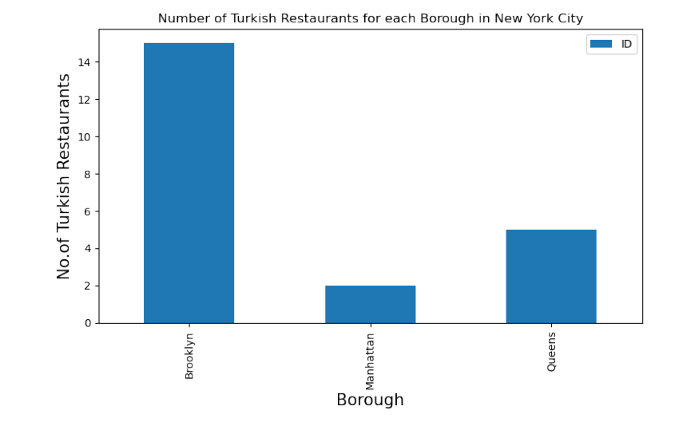
In this Bar chart The most Turkish restaurants located in the borough of Brooklyn.

Slide 7
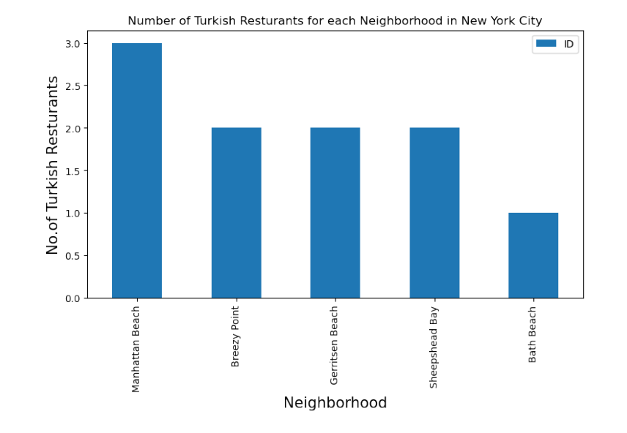
Neighborhoods of New York Manhattan Beach has the big number of Turkish restaurants

Slide 8
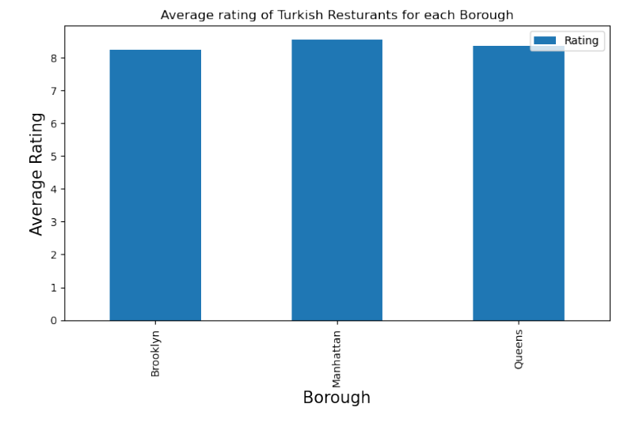
In this BAR CHART The Boroughs like Brooklyn and Queens provide less average rating of Turkish restaurant but Manhattan has high average ratings.

Slide 9
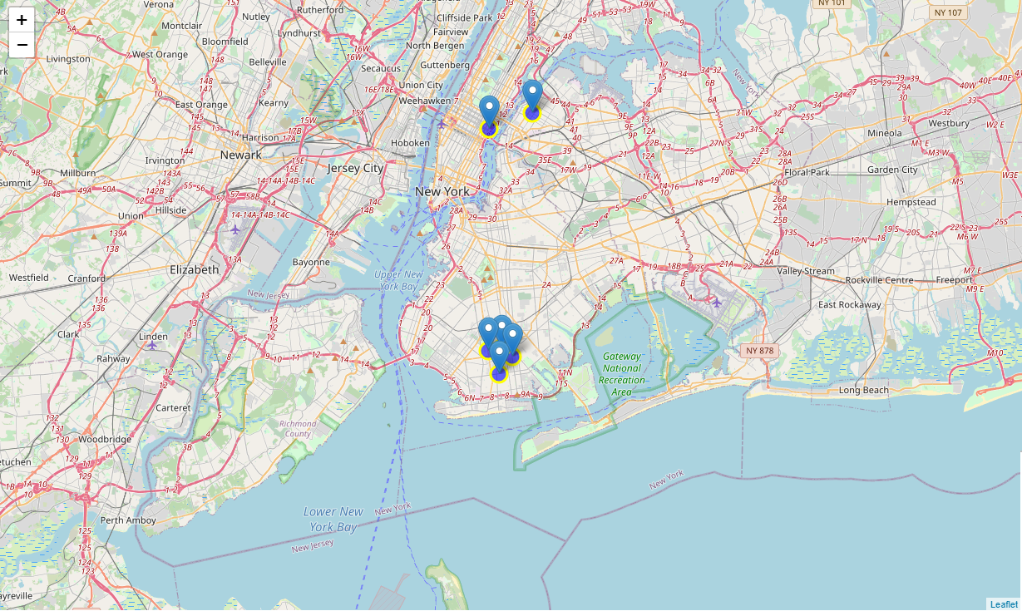
Conclusion Manhattan has the best rated Turkish restaurants on average

