Slide 1






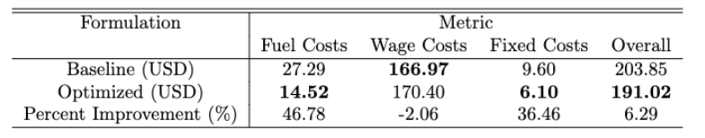




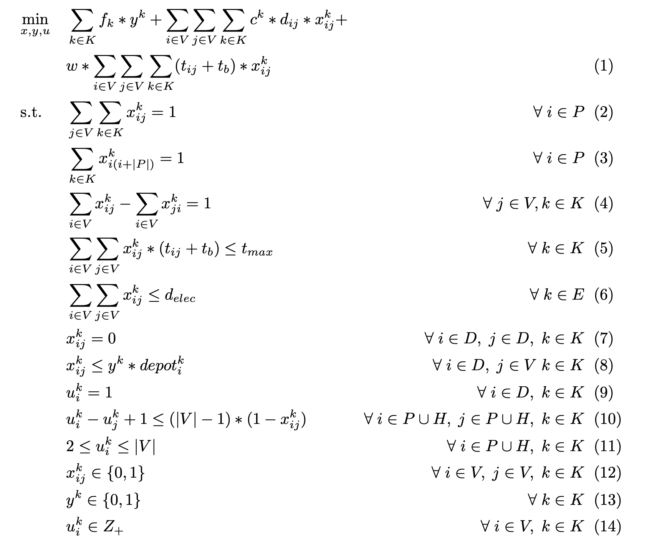






Optimizing inter-hospital patient transfer (IHT) routing
Max Petruzzi (MBAn)
Rachit Jain (MBAn)
Executive summary
What are the data?
What is the impact?
Reduced fuel costs for inter-hospital patient transfer company by 47% compared to baseline model (6% of total direct costs). Optimized route and deployment of ambulances, both electric and gas, to minimize direct costs.
Real-life Raw Data
Coordinates of Boston, MA hospitals
Number of staffed beds at each hospital
Fuel & electricity costs (EV) per distance traveled
Processed Data
Distance & time matrix between hospitals
(TravelTime API)
Intelligently Synthesized Data
Patient transfer demand proportional to staffed beds
Vehicle maintenance cost & driver wages
Created a non-optimization baseline model with which we could quantify the impact of our optimization:
Baseline based on current standard practice → includes ambulances being assigned to “regions” and dispatcher assigning transfers in real time
Problem statement
Fictional patient transport company based in Boston
Given: pre-determined demand of patient transfers
Goal: optimize vehicle route of each ambulance in fleet to minimized direct costs to the company
E.g.)
Fuel & electricity costs $∝$ distance traveled
Driver wages $∝$ travel time
Maintenance costs $∝$ # ambulances deployed
46.78% reduction in fuel costs from baseline
(includes electricity costs for our electric ambulances)
What are the key findings?
If you had another week, what would you do?
Why do we care?
Modify the formulation to improve computation speeds → increase scale of patient demand
Quantify by how much we lowered emissions:
From our reduction of total distance traveled
From our utilization of electric vehicles
Allow ambulances to start and end at different depots, incorporating notion of depot capacity
Add time windows that ambulance must arrive at hospital
Add time variable to prioritize certain patients over others
1.3M inter-hospital transfers/year (3.5% of all admissions)
Crucial for delivering quality outcomes
Patient requires specialized care not available at the referring hospital
However, the transfer process produces additional risk
e.g.) unstable vitals, injury/discomfort during transport
Reducing direct costs creates more capital
Can be invested in improvements and innovations to reduce risks to patients and improve health outcomes
15.071—The Analytics Edge Fall 2019
15.093—Optimization Fall 2022

