Slide 1
SESSION 21 DEVOPS CAPSTONE
TrackTonic
A music listening tracker, shipped with a full DevOps pipeline
Rachit | 24BCS10139
FastAPI + PostgreSQL + Docker + GitHub Actions + Terraform + Kubernetes + Helm + Prometheus/Grafana

Slide 2
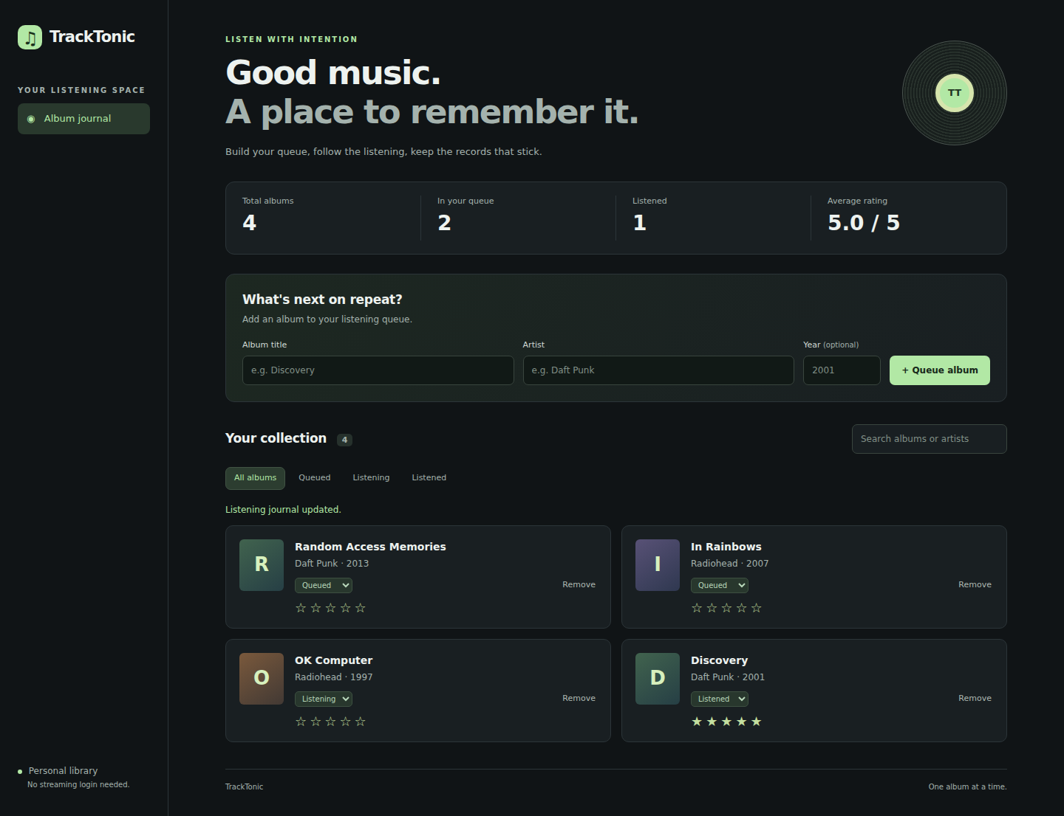
M1 - APPLICATION
What TrackTonic does
Queue albums, track what is playing, log listens with a 1-5 rating
Stack
FastAPI + SQLAlchemy + Alembic backend, PostgreSQL 16
Vanilla JS single-page frontend served by nginx
Prometheus metrics on /metrics, Grafana dashboard
API (4+ REST endpoints)
GET/POST /api/albums, PATCH status + rating, DELETE
Readiness /ready and liveness /health probes
Responsive UI verified at 390px and 320px widths

Slide 3
ARCHITECTURE
How the pieces fit
Browser
nginx frontend
(UID 101)
FastAPI backend
(UID 10001)
PostgreSQL 16
(PVC + Secret)
Alembic
migration Job
Prometheus scrapes backend:8000/metrics every 5s -> Grafana dashboard (pre-provisioned, anonymous read for demo)
Design choices
Every request flows browser -> ingress -> frontend -> backend -> Postgres; migrations run as a Helm pre-upgrade Job, with an init container gating backend start.
Images are built once, SHA-tagged, scanned, and only then promoted - Compose and kind run the exact scanned image.

Slide 4
M3 + M5 - GIT & CI/CD
Every push runs the full pipeline
GitHub Actions on branch session-21-capstone-rachit-24bcs10139
git push
pytest (18 tests)
frontend build
terraform validate
+ LocalStack
docker build
(SHA tags)
Trivy gate
HIGH/CRITICAL
push GHCR
kind deploy
+ browser proof
Latest run: all 4 jobs green (run 38833116664)
pytest 18/18 - frontend build - terraform-local-proof - build-scan-publish-demo
Images published: ghcr.io/rachit-suresh/tracktonic-backend:<sha> and tracktonic-frontend:<sha>
The pipeline then deploys the scanned images to a throwaway kind cluster and uploads real evidence
(logs, kubectl output, Playwright screenshots) as the tracktonic-proof-<sha> artifact.

Slide 5
M4 - DOCKER
Small, non-root, reproducible images
Backend image
Multi-stage: dependencies build into a venv in a
separate stage; runtime stage carries no pip
Runs as uid 10001, slim Debian base
Healthcheck hits /ready
docker compose up --build runs the whole stack
Frontend image
Multi-stage: node build -> nginxinc/nginx-unprivileged
Runs as uid 101 on port 8080
Static bundle only - no Node in the runtime image
Compose health gates: db healthy -> backend ready -> frontend

Slide 6
M6 - SECURITY SCANNING
Trivy gates before anything ships
The gate
Both images scanned on every push
Severity HIGH + CRITICAL, exit code 1
Publish to GHCR happens only after both scans pass
No secrets in git - Postgres password comes from a Secret
What the scan caught (and the fix)
pip's own vendored libraries (msgpack, urllib3,
setuptools) were flagged via its bundled SBOM
-> runtime image now ships no pip at all
Unfixed Debian base CVEs are ignored explicitly;
anything with a released fix still fails the build

Slide 7
M8 - KUBERNETES + HELM
One chart deploys the whole product
Chart features
Postgres with PersistentVolumeClaim + Secret
Pre-upgrade Alembic migration Job + init gate
Readiness/liveness probes on every workload
HPA: 2-6 replicas at 70% CPU
nginx ingress on tracktonic.local
Proven on kind (from CI evidence)
kubectl get pods: backend x2, frontend x2, postgres,
prometheus, grafana all Running; migrate Completed
helm list shows the deployed release
Ingress serves the app; break-and-repair of a Service
captured via EndpointSlice diffs

Slide 8
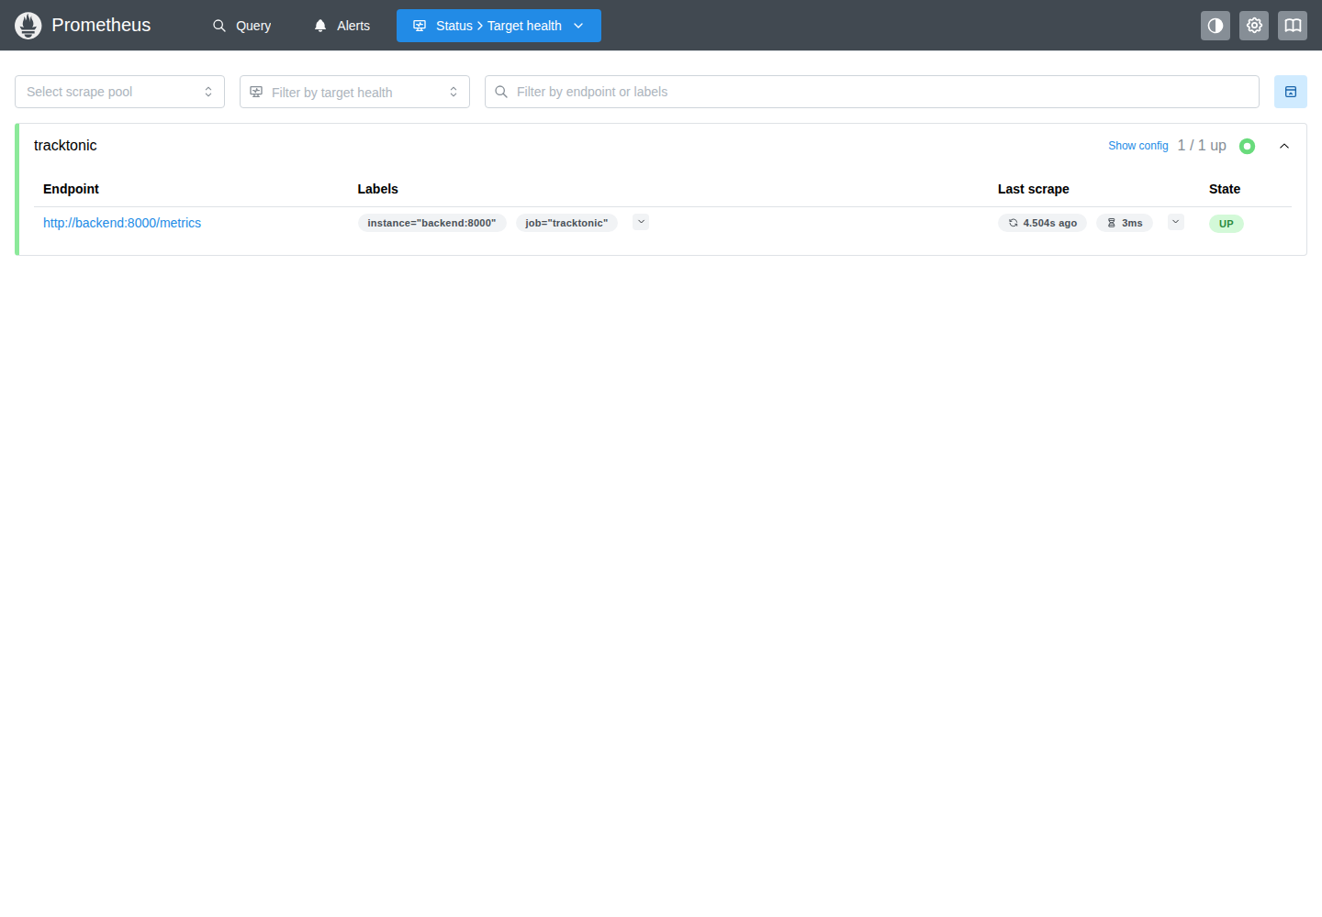
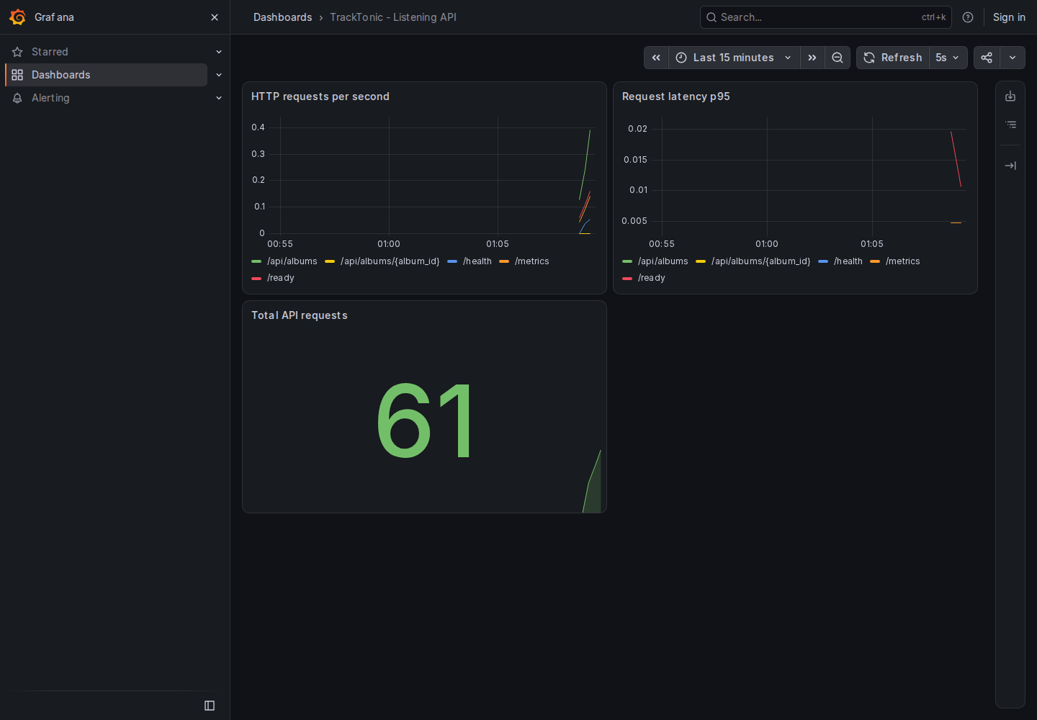
M9 - OBSERVABILITY
Prometheus scrapes, Grafana shows
Targets UP - tracktonic_http_requests_total counter + latency histogram per endpoint - 5s scrape interval

Slide 9
M7 - TERRAFORM
AWS design, validated and lifecycle-tested
terraform/
VPC + EKS module design for the real deployment
terraform fmt / init / validate run in CI on every push
No credentials committed
terraform-localstack/
Same lifecycle applied locally against LocalStack
Full apply + destroy log uploaded as CI evidence
(artifact tracktonic-local-infra-<sha>)

Slide 10
M10 - LIVE DEMO
Commit -> pipeline -> deployment update
1. Change the app
and push
2. Watch Actions:
tests + scans
3. New SHA image
lands in GHCR
4. helm upgrade pulls
the new image
5. UI + Grafana
show the change
Talking points
Why the gate order matters: scan before publish, deploy only what was scanned
Why migrations are a Job, why probes differ (/health vs /ready), how HPA reacts under load
How a broken Service selector was diagnosed with EndpointSlices and repaired

Slide 11
EVIDENCE
Everything above is reproducible
Links
Repo + branch: github.com/rachit-suresh/devops-heros (session-21-capstone-rachit-24bcs10139)
Green CI run: github.com/rachit-suresh/devops-heros/actions/runs/38833116664
Artifacts: tracktonic-proof-<sha> (runtime logs, screenshots, kubectl output, Prometheus/Grafana captures)
tracktonic-local-infra-<sha> (terraform validate + LocalStack apply/destroy)
Images: ghcr.io/rachit-suresh/tracktonic-backend:<sha> | ghcr.io/rachit-suresh/tracktonic-frontend:<sha>
App dir: session21-python/Rachit-24bcs10139/tracktonic (README.md has the full runbook)

