Slide 1
Exploratory
Data
Analysis

Slide 2

Initial Assumptions¶
• 1: Claimed, 0: Not Claimed
• Unit of Duration: Days
• Unit of Net Sales and Commission is USD
• Value of 0 in Commission: No commission was charged
Observations from Initial Data Exploration¶
• Duration, Net Sales and Commission are Right Skewed
• There are 4 numerical columns and 6 categorical columns and a target column

Slide 3


How many Claims were made?
Observation
Data is Imbalanced as
the number of customers who have not made any claim is 67 times the number of customers who have made the claim
Recommendation
To make payment of claims more affordable for the company, we need to pool low risk clients i.e. customers who have low probability of claiming in the future

Slide 4
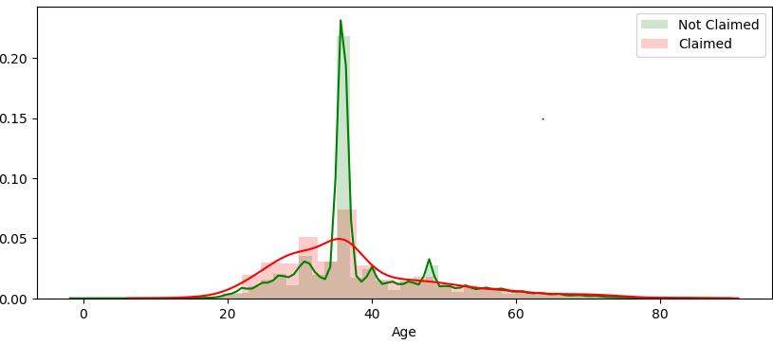
Does Age affect the Claim likelihood?
Insight
Age group of 30-40 years tends to claim more
Assumption:
2.5% of customers above the age group of 70 years could have bought Travel Medical Insurance for medical tourism
Recommendation:
As the age increases, the risk to the insurance company increases. We see that the claim ratio (11%) is low for the higher age group.
To offset this effect we can charge high premium for higher age groups.

Slide 5
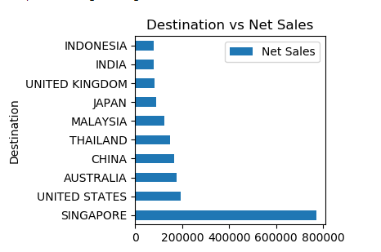
Net Sales according to the destination
Insight: Company earned the most by the travellers of Singapore.
Insight : Insurance company can now try increasing net sales for other destinations too by giving some extra rebates
*Total Sales = Net Sales + Commission

Slide 6
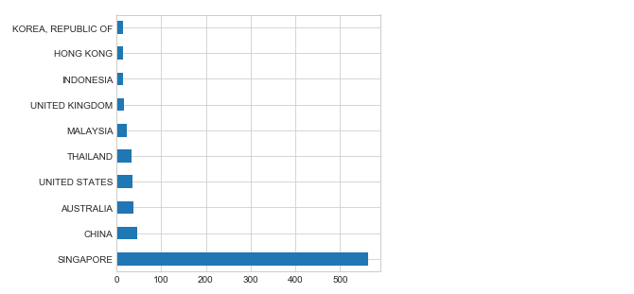
Claim counts by Destination
Insight: Travellers to Singapore, China Australia and USA have claimed the highest
Recommendation: We should charge higher premium for travel to these countries
Future:
1. High risk customers travelling to Singapore, South Africa and USA have majorly bought the insurance from online channel
2. We will be able to analyse the data if we know the source location and purpose of travel.

Slide 7
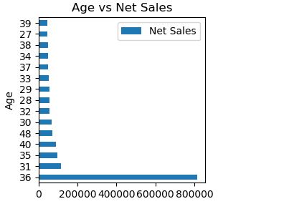
Net Sales according to the Age Group
Insight: Company earned the most by the customers having age 36.
Insight : Insurance company can now try increasing net sales for age groups by offering new rebates for other groups.
*Total Sales = Net Sales + Commission

Slide 8
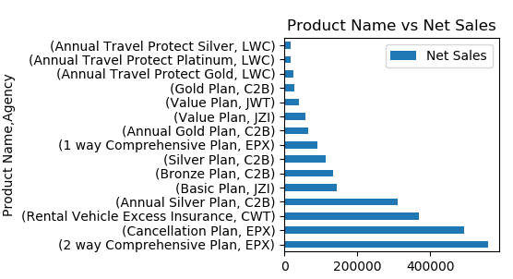
Which are the top 15 product along with agency bought by the customer?
Observation
2 way comprehensive plan (is the most preferred plan followed by cancellation plan and Rental Vehicle Excess Plan
Let us further deep dive into these products to see which products carry high risk and which are low risk products

Slide 9
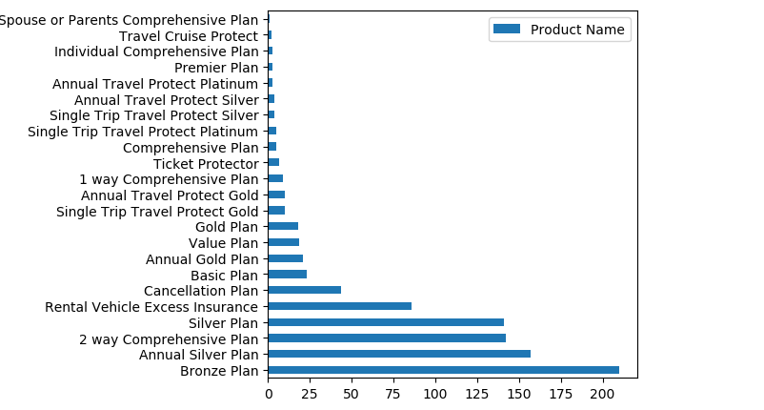
Which product has the highest no of claims passed ?
Observation
- Bronze Plan ,Annual Silver Plan are the two products having highest number of claims.

Slide 10
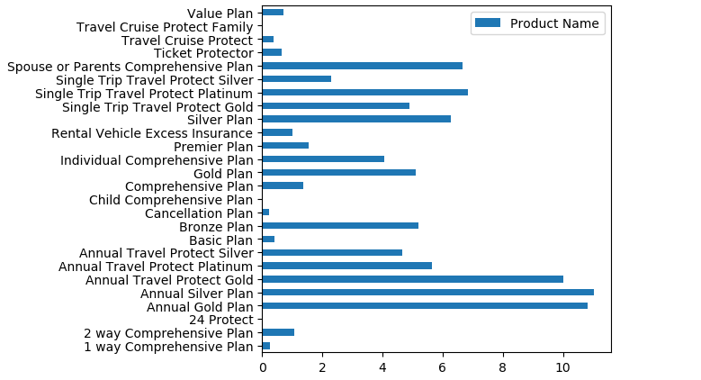
Which product has the highest claim rate passed ?
Observation
Annual Silver Plan , Annual Gold Plan has one of the highest claim rates of around 11% and 10% respectively.

Slide 11
What is their Claim Pattern?
 | Top 5 Claimed Products | Top 5 Least Claimed Products
Average Age of customer who make claims | 36 years | 45 years
Destination most visited by people who make the claim | Singapore | Thailand (25%), USA (11%), China (10%)
Where did they buy insurance from? | From Airlines (94%) through Online channel (100%) | From Travel Agency (91%) through Online channel (93%)
Avg. Net Sales and Avg. Commission charged to them | Net Sales: 167.53 Commission: 46.23 | Net Sales: 33.08 Commission: 3.80
Median Duration of Travel | 364 days | 28 days

Slide 12
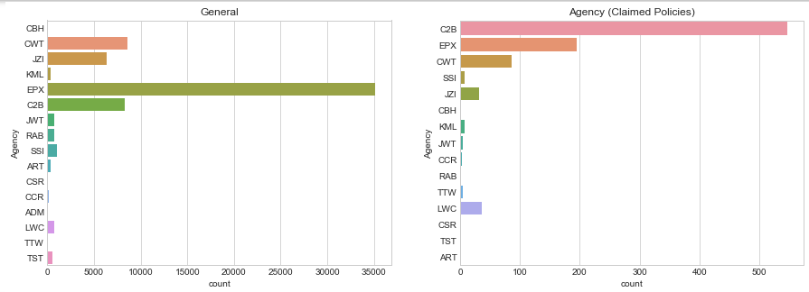
Which are the top 10 Agencies preferred by the Customers of Safe Travel, Inc?
EPX is the most preferred agency followed by C2B, CWT and JZI
But the ,most number of claims are insured from C2B followed by EPX and CWT.
Observation

Slide 13
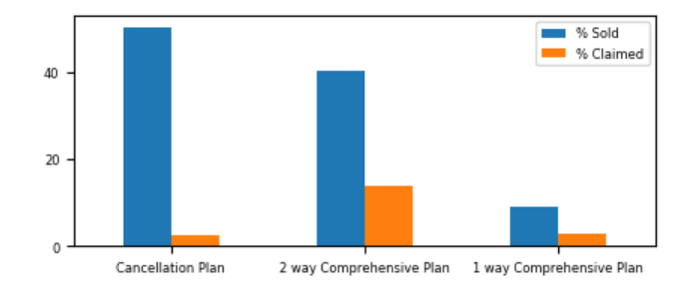
EPX
Which are the products sold by them? What is their claim rate?
EPX is a Travel Agency which is into low risk products with the highest claim rate being 13.8% for 2 way comprehensive plan
Average Net Sales | 28.59 | 53.95 | 33.97
Average Commission | 0.28 | 0.19 | 0.64
Distribution Channel | Online (100%) | Online (98.6%) | Online (66.17%)
Destination | Thailand (33%), US (11%), China (10%) | China (28%), US (17%), Thailand (12%) | China (29%), US (21%), Singapore (18%), Thailand (13%)
Average Age | 34 years | 37.5 years | 62 years
- EPX is preferred for travel to China, Thailand and US amongst the higher age range
- 1 way comprehensive plan preferred by the older age group, making it a high risk product
Distribution channel is online
- Since these are low cost products, online channel helps reduce the paperwork cost

