Slide 1
tBits
tBits Implementation
for
Project Documentation Management
Water & Waste Water SBU
Tata Projects Limited
VSP – Project Deliverables
BY
TransBit Technologies
303, Dwarka, Thakur Mansion Lane, Somajiguda, Hyderabad,India
Date – June 17th 2008

Slide 2
tBits-ITS will be used for streamlining the complete communication, records management & document management for various participants in the project.
AIMS & OBJECTIVES –
Documentation Management
Maintain the Document Register, manage all documents, versions, index, search & reuse.
Transmittals
Automate the process of transmittals to clients & fields – including the usage of online tBits for sharing files in secure manner.
Online Collaboration
Share & retrieve files, view files in web-browser, redline, add comments, annotate files etc. including with inbuilt chat.
Business Reporting
Automate the process of business reporting, proactively track the issues, schedules, deliverables, automatically send reminders, perform escalations if required etc.

Slide 3
The document register is managed by the document controller. All the actions of the various team members & those of document controller are recorded.
PROCESS FLOW & TRANSMITTALS CREATION
Process Flow
Workflow involved in drawings management
All the documents that are to be transmitted to the client are updated into the document register. These automatically have the status of "Pending Transmittal".
We select all the documents with “Pending Transmittal” status & “Create Transmittal”.
The moment the transmittal is created, its logged in the transmittals BA with all the details - as circulation & all relevant documents are linked.
The changes are also made in the transcript of the document register.
The transcript of the deliverable in the document register shows the complete set of transactions done to complete the deliverable.
Status flow:
Active → Pending Transmittal→ Submitted to Client → Commented by Client → Approved as noted → Approved.
Other features in the offering – Create PDF automatically for transmittal & email, pick attachments at the time of creating transmittals, business reports.

Slide 4
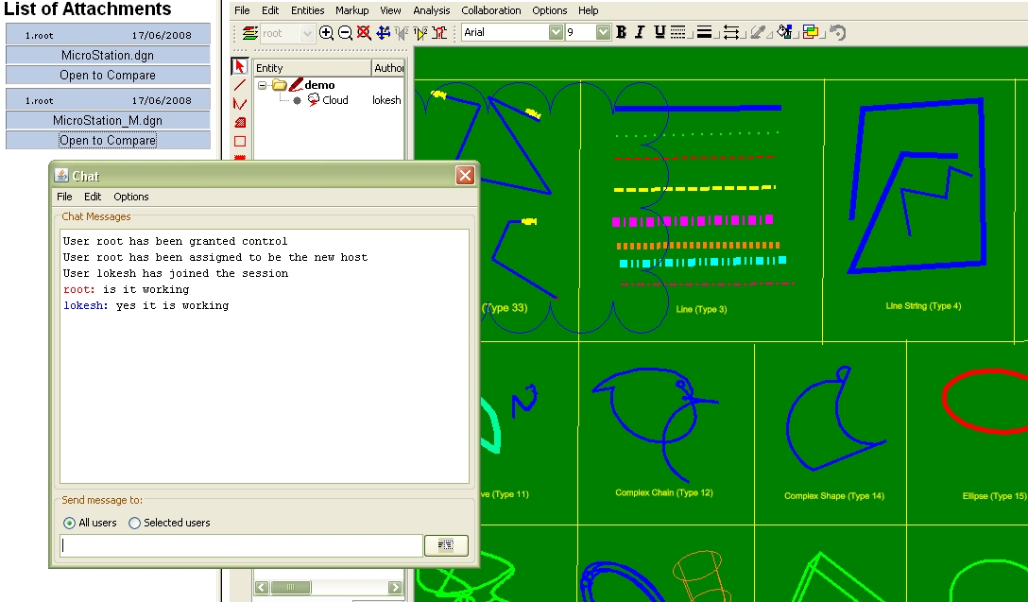
tBits can be used for online markup, redlining & collaboration to discuss the drawings & take actions.
ONLINE COLLABORATION, MARKUP, REDLINING IN tBits

Slide 5
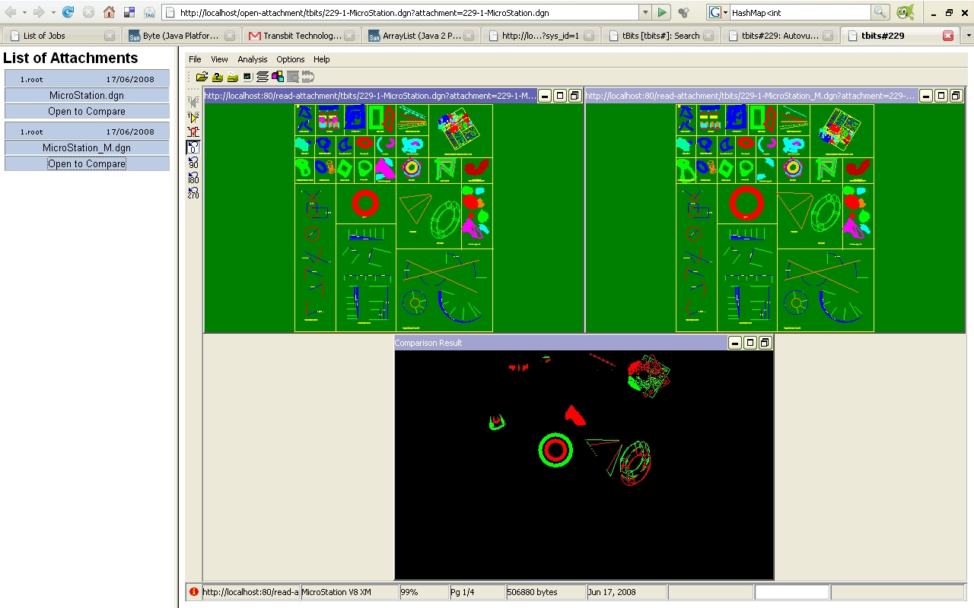
tBits can be used for online markup, redlining & collaboration to discuss the drawings & take actions.
ONLINE COLLABORATION – Difference between two drawings – Formats Supported: dwg, dgn, pdf, jpg etc.

Slide 6
tBits generates business reports automatically & circulate the same to users as per pre-defined frequency.
BUSINESS REPORTING
Daily Reports
Overdue documents, tasks, assignments etc.
Things assigned by me & things assigned to me.
Weekly Reports
Overdue Report – Overdue Submissions.
Activity Report – Received, transmitted etc. % completion of the project.
Upcoming Submissions
Drawings approved by the client but not circulated to the field.
Approved / Approved as noted documents.

Slide 7
tBits generates business reports automatically & circulate the same to users as per pre-defined frequency.
WAY FORWARD
Implementation
The solution is available as a hosted solution on www.tpl.mytbits.com
The solution – based on the comments that we received today – is expected to go live on 18.6.2008 – midnight.
Existing Data Migration & others
Udayakiran – along with Bhaskar – will ensure that all existing documents shared between the participants are migrated into the system.
Udayakiran will be available for giving training to the users & solve their problems.
External participants can be added into the system & they will be provided free training & support by TransBit Technologies – Triveni & Paharpur.
MS Outlook Plugin – will be installed in your machine to help you perform actions as classification, approvals etc online.

Slide 8
tBits - demonstration
& Suggestions
Q&A

