Slide 1


Team Details
  Team name: TERRAVOW
  Team leader name: RACHIT GUPTA
  Problem Statement: Sustainability & Social Impact +
  Manufacturing: Intelligent Operations and Efficiency

Slide 2
AI FOR GREENER FACTORIES
TerraVow
Healthy machines.
Cleaner factories.
Growth that lasts.
AI that links machine health to pollution, tells operators what to fix and when, and shows greener alternatives with the incentives that can pay for them.
Gemini
Cloud Run
Firestore
Cloud run link
https://terravow-qqd2ckoqhq-el.a.run.app/
Repo link
https://github.com/rachitGupta-ai/TerraVow
Demo video link
[Contact]
Notes:
Open with the hook, slowly: everything in this room was made in a factory. Phones, medicines, the clothes we are wearing. Factories are the growth engine of the world, and they are also among its biggest polluters. TerraVow is the bridge between the two. It links the health of a machine to the pollution it creates, tells the operator what to fix and when, and shows greener options with the incentives that can pay for them. We built it on Google Cloud with Gemini, and every number you will see comes from a deterministic engine, not from the model. In the next three minutes we will show the problem, the product running, and why you can trust it.

Slide 3
THE PARADOX :
TerraVow
Factories grow the world, and they are among its biggest polluters
THE GROWTH ENGINE
THE COST
~15%
Share of 2019 global GHG emissions, by sector
of world GDP is manufacturing value added
16-17%
of India's GDP is manufacturing
35.4%
of India's manufacturing output comes from MSMEs
Industry: 24% direct, 34% once electricity is attributed to the factories that use it.
Sources: World Bank NV.IND.MANF.ZS (2025); IPCC AR6 WGIII SPM B.2.1 (2019); PIB 14 Oct 2026 and 14 May 2026. Manufacturing value added and the IPCC industry sector are different scopes.
2
Notes:
Here is the paradox. On the left, the growth engine: manufacturing is about 15 percent of world GDP according to the World Bank, 16 to 17 percent of India's GDP according to the Press Information Bureau, and in India small and medium enterprises make about 35 percent of manufacturing output. On the right, the cost. The IPCC says industry produced 24 percent of global greenhouse gas emissions in 2019, and 34 percent once the electricity factories use is attributed to them. That makes it the largest end-use share. And carbon is only one part: factories also release into air, water, chemicals and soil. Caveat for the careful: the World Bank figure is manufacturing only, the IPCC figure is the wider industry sector, so the two shares are not like for like. The point is that both are true, and factories cannot simply switch off.
Sources:
World Bank: https://data.worldbank.org/indicator/NV.IND.MANF.ZS
IPCC AR6 WGIII SPM B.2.1: https://www.ipcc.ch/report/ar6/wg3/chapter/summary-for-policymakers/
PIB manufacturing: https://www.pib.gov.in/PressNoteDetails.aspx?ModuleId=3&NoteId=160457&id=160457
PIB MSME: https://static.pib.gov.in/WriteReadData/specificdocs/documents/2026/may/doc2026514869801.pdf

Slide 4
THE HIDDEN CAUSE
TerraVow
The hidden cause: worn machines quietly burn more and leak more
KILN K-4 OVER 12 MONTHS | ILLUSTRATIVE
SMALL SNAGS, BIG CONSEQUENCES
Health score (0-100)
A worn seal
Air leaks in. The burner works harder.
A drifting burner
Soot builds up. Fuel and NOx rise.
A clogged filter
The fan strains. Emissions per tonne climb.
Effluent, m3 per day
5-20% lower energy bills with good O&M
US DOE estimate for federal sites. Direction, not a promise for any one plant.
Left: Kiln K-4, synthetic demo fleet, illustrative engine model (not a measurement). Right: US DOE FEMP O&M Best Practices Guide, Release 3.0 (US federal sites).
3
Notes:
Here is the part nobody sees. A worn seal lets air in, a drifting burner makes soot, a clogged filter forces the fan to work harder. Each one is a small maintenance snag, and each one makes the machine burn more fuel and release more per tonne of output. On the left is a kiln from our synthetic demo fleet. Over twelve months its health score falls from the high seventies to 28, and its effluent per day climbs from the healthy baseline of 800 cubic metres to about 918. That is an illustrative model, not a measurement, and we say so on every screen. For an outside anchor: the US Department of Energy estimates that operations and maintenance programs aimed at energy efficiency can save 5 to 20 percent on energy bills without significant capital. That is a US federal-sites guide, so read it as direction, not a promise for any one plant.
Sources:
US DOE FEMP O&M Best Practices Guide: https://www1.eere.energy.gov/femp/pdfs/OandM.pdf
Prototype figures: TerraVow engine (prototype/app/engine.py) on seeded machine K-4, GET /api/machines/K-4/health, run 2026-10-18

Slide 5
THE GAP TODAY
TerraVow
Today's tools cannot connect a deferred repair to a pollution event
Maintenance systems
ESG and carbon accounting
Compliance and monitoring
Plain LLM chatbot
CMMS / EAM, predictive maintenance
Scope 1/2/3 ledgers
EHS workflow, CEMS
Ask a general model
WHAT IT DOES
WHAT IT DOES
WHAT IT DOES
WHAT IT DOES
Tracks downtime and work orders
Reports what was already emitted
Above or below the limit, right now
Fluent, quick answers
BLIND SPOT
BLIND SPOT
BLIND SPOT
BLIND SPOT
Blind to emissions cost
Industry averages, not your machine
Not why, and often self-reported
Numbers you cannot audit
Nobody connects "we deferred this repair" to "we just created avoidable emissions and cost"
And factories cannot just shut down. They need a practical path that keeps output growing while they get cleaner.
Category-level assessment from docs/competitive-landscape.md and docs/overview.md. Individual vendors may differ.
4
Notes:
So why does this go unseen? Because each team owns one piece. Maintenance systems track work orders and downtime cost, not emissions. ESG and carbon-accounting tools report what you already emitted, using industry-average factors rather than the state of your machine. Compliance and monitoring tools tell you whether a reading is above or below a limit, not why. And a plain chatbot sounds confident but cannot show a calculation you can audit. Nobody connects 'we deferred this repair' to 'we just created avoidable emissions and cost'. And the factory cannot simply stop. Output, jobs and customers depend on it. It needs a practical path that keeps it running while it gets cleaner. These categories come from our competitive review; vendor claims there should be re-verified before quoting.
Sources:
docs/competitive-landscape.md and docs/overview.md in the TerraVow repo (category-level assessment; vendor positioning to be re-verified)

Slide 6
THE SOLUTION
TerraVow
TerraVow is the bridge: from machine health to cleaner, funded upgrades
1
2
3
4
5
Report
Health
Pollution
Greener options
Funded payback
Snags logged per machine model
Score and remaining life
Air, water, chemical, soil
Machines and process changes
India incentives, MSME or large
Safety gate
Audit trail
Numbers you can trust
Vetoes any option that raises total emissions or merely moves pollution from air to water.
Every recommendation and closure is written to a hash-chained log.
Gemini reasons and writes. A deterministic engine computes every figure.
Prototype scope: Requirements 18-30 (Python/FastAPI). See roadmap for what is not built.
5
Notes:
This is TerraVow in one line of flow. Step one, people on the shop floor report snags against a specific machine model. Step two, a deterministic engine turns that snag history into a health score and an estimate of remaining life. Step three, the health score is linked to pollution intensity across air, water, chemical and soil. Step four, TerraVow recommends greener machines and process changes. Step five, it shows payback with the Indian incentives that may apply, for a small enterprise or a large one, and labels what is unverified. Underneath all of it sit three promises: a safety gate that vetoes anything that adds or merely moves pollution, an audit trail you can verify, and a clean split where Gemini reasons and writes while the engine does the maths.
Sources:
docs/overview.md, docs/product-features.md (TerraVow repo)

Slide 7
DIFFERENTIATION: USP of the proposed solution
TerraVow
Not another CMMS, ESG ledger or chatbot: TerraVow connects the dots
Capability
Maintenance / CMMS
ESG and carbon
EHS and CEMS
Plain chatbot
TerraVow
Per-machine health from snag history
●
○
○
○
●
Links health to air, water, chemical, soil
◐
○
◐
○
●
Greener option with payback
○
○
○
◐
●
India incentive-adjusted (MSME / large)
○
○
○
○
◐
Auditable, deterministic numbers
●
●
◐
○
●
Veto on fixes that move pollution
○
○
○
○
●
● built ◐ partial or illustrative ○ not offered
Where we are behind: maintenance vendors have large fleets of real sensor data; we have a synthetic demo fleet.
Category-level assessment (our judgement) from docs/competitive-landscape.md; individual products vary. Legend: full = built, partial = limited or illustrative, none = not offered.
15
Notes:
How are we different? We assessed five neighbouring categories. Predictive-maintenance and CMMS tools know machine health but do not price pollution or recommend greener alternatives. ESG and carbon accounting are ledger-grade for what you have emitted, but they use average factors, not your machine's state. EHS and monitoring tools capture readings and paperwork, but not the why. A plain chatbot can suggest ideas but cannot give you auditable numbers or a safety veto. TerraVow combines per-machine health, pollution linkage, greener options with payback, Indian incentive adjustment, deterministic auditable numbers, and a hard veto in one flow. In the interest of honesty: predictive-maintenance vendors have large data moats we do not, and our incentive row is only partial because the scheme values are illustrative. This table is a category-level judgement from our competitive review, not a claim about any one vendor.
Sources:
docs/competitive-landscape.md in the TerraVow repo (categories and vendor sources linked there; re-verify before quoting)

Slide 8
INDUSTRIES
TerraVow
One flow, four industries, each with its own AI-built template
Textile dyeing & finishing
Metals: steel & foundry
Chemicals & fertiliser
Mining & mineral processing
AIR
WATER
CHEMICAL
AIR
WATER
SOIL
AIR
WATER
CHEMICAL
AIR
WATER
SOIL
SOIL
SAMPLE MODELS
SAMPLE MODELS
SAMPLE MODELS
SAMPLE MODELS
Bosch Industrial UL-S 6000
Thermax Heatpac TH-1100
Thies iMaster
Tenova Walking-Beam Reheat Furnace WB-200
Inductotherm Power-Trak 5000
Danieli Digimelter
GEA Niro SD-25
Alfa Laval NX 4000
thyssenkrupp Granulation Drum GD-4
FLSmidth Rotary Kiln RK-4.0
Caterpillar G3516
Metso Nordberg HP5
On India's regulator list: CPCB flags 17 highly polluting categories, including dyes, fertiliser, iron and steel and cement. 4,578 such units reported (Dec 2022).
Domains from prototype/data/industries.json. Catalogue is sample data. CPCB: Rajya Sabha Starred Q101, 15 Dec 2022 (sansad.in).
6
Notes:
The same flow works across four heavy industries, and each declares which pollution domains it touches. Textile dyeing and finishing is air, water and chemical. Metals, steel and foundry, is air, water and soil. Chemicals and fertiliser touches all four. Mining and mineral processing is air, water and soil. The prototype ships a sample catalogue of twenty machine models, five per industry. It is sample data, not an authoritative manufacturer database, and labelled that way. If a model is missing, the user adds it manually and Gemini with Google Search looks up the specs. These are also industries India's pollution regulator watches closely: the Central Pollution Control Board lists seventeen highly polluting categories including dyes, fertiliser, iron and steel, and cement, and 4,578 highly polluting units were reported in a December 2022 parliamentary answer.
Sources:
CPCB 17 categories, Rajya Sabha Q101: https://sansad.in/getFile/annex/258/AS101.pdf?source=pqars
prototype/data/industries.json, catalogue.json (TerraVow repo)

Slide 9
HOW IT WORKS
TerraVow
Seven steps from a photo to a recorded, pollution-aware decision
1
2
3
4
5
6
7
Assess
Cost of waiting
Footprint
Explain
Safety gate
Verify
Record
Gemini reads the photo and notes
Extra fuel, CO2 and rupees per day
Carbon per unit of output
Plain words for each audience
ALLOW, ASK or BLOCK
After-repair evidence check
Hash-chained audit entry
One rule across all seven steps: Gemini reads, reasons and explains; the deterministic engine computes every number; the safety gate can veto any option.
Source: prototype UI tabs and README user flows. All figures are deterministic engine estimates, labelled illustrative.
6

Slide 10
HOW IT WORKS
TerraVow
Architecture: Gemini for language, a deterministic engine for numbers
TerraVow API | FastAPI on Cloud Run
Gemini 2.5 Flash
AI Studio or Vertex AI
structured output, bounded retry
Workflow
reporter, resolver, snag history
Deterministic engine
health, lifespan, intensity, economics
Browser
single-page app
HTTPS
Google Search grounding
specs and alternatives
Decision Gate
hard veto, then confidence
cache_once
Gemini at most once per key
Works without a Gemini key: generic templates and curated alternatives.
Rule
Gemini never computes a number. It drafts, looks up and explains. The engine validates and calculates.
Firestore (in-memory fallback)
templates, snags, alternatives, incentives, hash-chained audit
Specified in the full design, not in the demo path: Vertex AI Agent Engine, BigQuery, Vertex AI Search, Pub/Sub, Cloud Storage. Java reference engine runs separately.
Source: docs/system-architecture.md and prototype/README.md. Live Cloud Run and Firestore wiring is checked via /api/health (gemini_mode, store_backend) before submission.
11
Notes:
Here is how it fits together, simplified. A single-page app talks to one FastAPI service, designed for Cloud Run. Inside it, a workflow layer handles reporters and resolvers; a deterministic engine computes health, lifespan, pollution intensity and economics; the Decision Gate vets every recommendation; and a cache-once layer decides when Gemini is allowed to be called at all. Gemini 2.5 Flash, through AI Studio or Vertex AI, drafts templates, looks up specs with Google Search grounding, and suggests alternatives. Firestore stores everything, with an in-memory fallback so the demo runs anywhere. Being honest about the Google stack: Gemini, Google Search grounding, Firestore and Cloud Run are what the prototype uses. BigQuery, Vertex AI Search, Agent Engine, Pub/Sub and Cloud Storage are in the full design, and a Java reference engine exists, but they are not in the demo path.
Sources:
docs/system-architecture.md; prototype/README.md 'What actually runs' and 'What is NOT built'; prototype/deploy.sh

Slide 11
TECH STACK
TerraVow
Built on Google's stack, honest about what we did not use
Component
Technology
Used?
Backend API
FastAPI (Python)
Yes
Data validation
Pydantic
Yes
LLM
Gemini 2.5 Flash via google-genai
Yes
Grounding
Gemini Google Search tool
Yes
Storage
Firestore, or in-memory fallback
Yes
Frontend
Vanilla JS single-page UI
Yes
Hosting
Cloud Run, or local uvicorn
Yes
Java engine
Spring Boot 3.4, Java 17
Yes
Testing
pytest 151, JUnit + jqwik 490
Yes
Source: README.md tech stack and prototype/README.md. Java Decision_Gate tests pending import fixes.
12

Slide 12
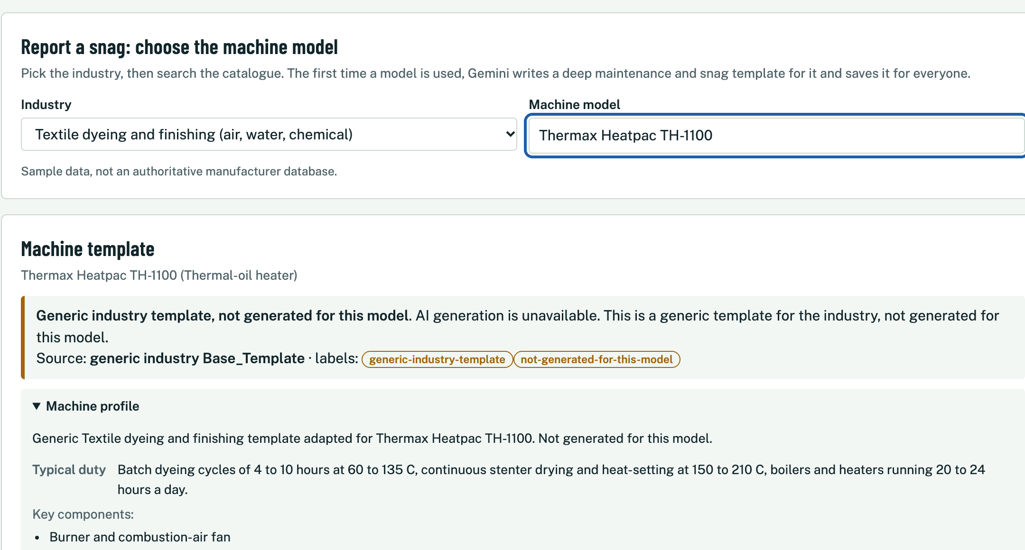
LIVE PRODUCT WALKTHROUGH
TerraVow
Step 1 | Report: pick a machine, get a form built for that exact model
1
Search or add
Autocomplete over 20 sample models. Not listed? Add it; Gemini with Google Search looks up specs.
2
Form built for the model
First use triggers a Gemini template: 6+ job types, 12+ snag types, 8+ parameters. Cached.
3
Privacy by default
Emails and phone numbers are stripped from free text before storage.
Industry
Model
Template
Snag form
Guidance
Screenshot of the local prototype with Gemini not configured: the generic fallback template is shown and labelled. Sample catalogue data.
7
Notes:
Now the product, running. This is the Report a snag tab. The reporter picks an industry and searches the catalogue, with autocomplete. If the model is not listed, they add it manually, and Gemini with Google Search grounding looks up the public specs, flagged as AI retrieved and unverified. The first time any user opens a model, Gemini drafts a deep template: at least six job types, twelve snag types, eight operating parameters and the pollutant capture fields for that industry. It is generated once and cached, so the next user gets it instantly. In this screenshot Gemini is not configured, so you are seeing the fallback: a clearly labelled generic industry template. The product still works end to end. Free text is cleaned of phone numbers and emails before it is saved.
Sources:
Live prototype screenshot (local run, Gemini not configured). docs/user-flow.md Reporter journey; docs/product-features.md sections 2-4

Slide 13
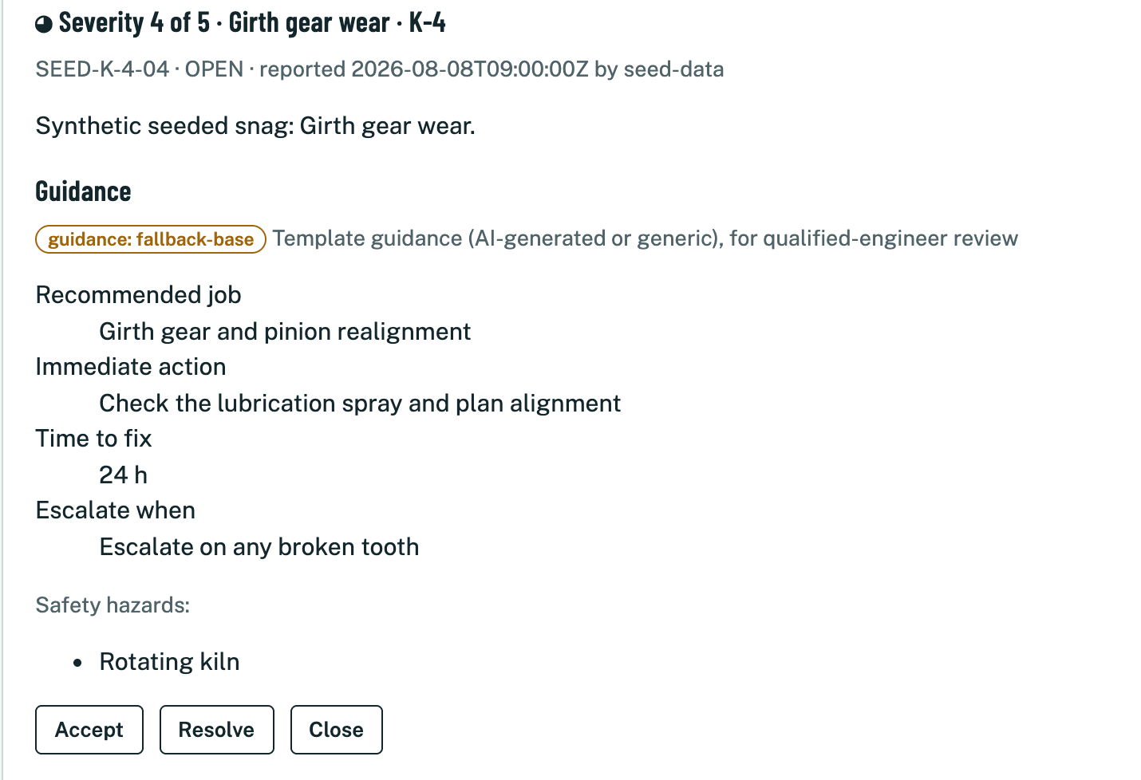
LIVE PRODUCT WALKTHROUGH
TerraVow
Step 2 | Resolve: worst snags first, with guidance for the fix
1
Severity-first queue
Each card: recommended job, immediate action, time to fix, hazards, escalation.
2
Close recomputes health
Closing replays history and updates score, lifespan and pollution, plus an audit entry.
3
Honest about access
No auth in the demo. The role switch guides the workflow; it is not a security control.
WORKFLOW STATES (EACH TRANSITION IS AN APPEND-ONLY EVENT)
OPEN
ASSIGNED
RESOLVED
CLOSED
Screenshot of the local prototype. Seeded snags are synthetic. No authentication in the prototype: the role switch is workflow guidance only.
8
Notes:
Next, the resolver. The queue lists open and assigned snags with the highest severity first. Each card carries guidance: the recommended job, the immediate action, time to fix, safety hazards and when to escalate. The resolver accepts, resolves with notes, downtime and cost, then closes. Closing is where the loop pays off: it recomputes the machine's health from its full snag history and writes an audit entry. Honest note: the Reporter and Resolver switch is workflow guidance, not access control. The prototype has no authentication, and a production system would add proper role-based access. These are synthetic seeded snags, labelled as such.
Sources:
Live prototype screenshot (local run). docs/user-flow.md Resolver journey; docs/product-features.md section 5

Slide 14
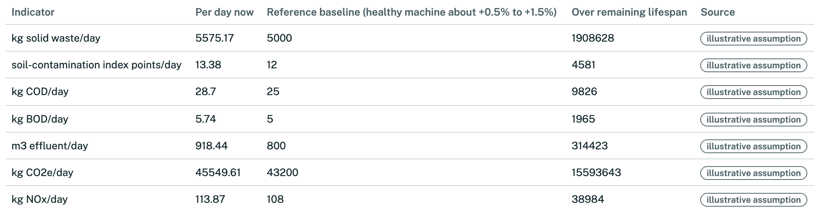
LIVE PRODUCT WALKTHROUGH
TerraVow
Step 3 | Health, remaining life and pollution now move together
28.4 / 100
~342 days
Health over the last 12 months (0-100)
health band: Critical
estimated remaining life (range 257-428)
Computed by the engine, never by the LLM
Kiln K-4, synthetic demo fleet. Health, lifespan and intensity are illustrative engine outputs, not measurements or certification.
9
Notes:
This is where TerraVow earns its name. Every closed or open snag feeds a deterministic health score. For Kiln K-4 in our synthetic fleet it is 28.4 out of 100, Critical. From that and the machine's age against its design life, the engine estimates about 342 days of remaining life, with a range, and labels it as an estimate, not a prediction of failure. The table links health to pollution intensity across air, water and soil: effluent is about 918 cubic metres a day against an 800 healthy reference. The chart shows health over twelve months, and the pollution trend mirrors it. All of this is plain code, with a visible How this is calculated panel. The language model never computes these numbers. Everything is labelled illustrative.
Sources:
Live prototype screenshots (local run) of GET /api/machines/K-4/health; formulas in prototype/app/engine.py; docs/product-features.md sections 7-8

Slide 15
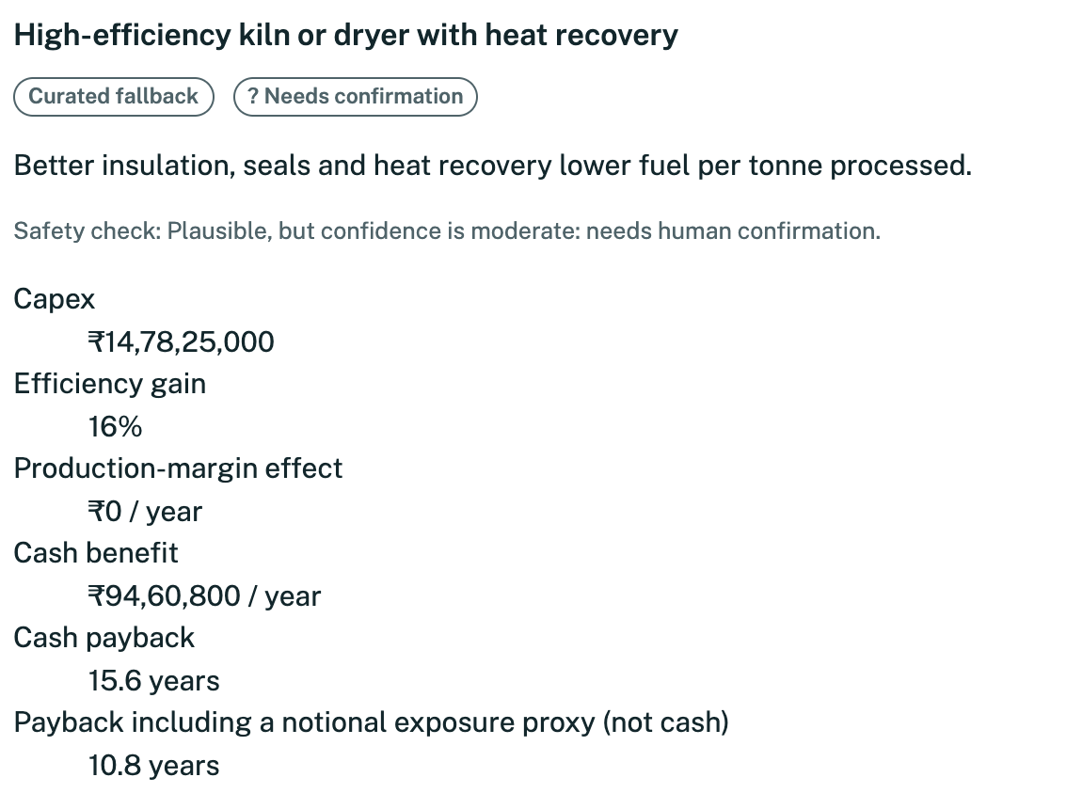
LIVE PRODUCT WALKTHROUGH
TerraVow
Step 4 | Greener options with honest paybacks and India incentives
1
Three kinds of change
Machine swaps, operating-process changes and assembly-stage changes, curated or Gemini-suggested.
2
Two paybacks, no spin
Cash payback and payback with an exposure proxy. Beyond design life is shown, not capped.
3
MSME or Large
Toggle recomputes incentive-adjusted capex. Real-named schemes are UNVERIFIED; subsidy values are demo-synthetic.
4
Gate badge on every item
MSME-adjusted capex
₹14,28,25,000
Adjusted cash payback
15.1 years
With exposure proxy
10.4 years
Needs confirmation (ASK) in the demo: a human decides, nothing auto-approves.
Screenshot of the local prototype (curated fallback alternatives, Gemini not configured). Capex, benefits and incentive values are illustrative; schemes UNVERIFIED.
10
Notes:
Last step in the walkthrough: Sustainability. For the selected machine, TerraVow lists greener machine alternatives, operating changes and assembly-stage changes. For each it shows capex, cash benefit and two paybacks: cash payback, and payback including a notional exposure proxy that is not cash. It does not hide bad news: this electric drive shows a payback beyond the 25-year design life on cash alone, around 28.8 years even after the illustrative incentive. A toggle switches between small, MSME, and large enterprise and recomputes incentive-adjusted capex and payback. India schemes in the demo are mostly qualitative and marked UNVERIFIED or illustrative; the quantified subsidies are demo-synthetic values and are labelled that way. Every option passes the Decision Gate, and in this demo each one lands on Needs confirmation, meaning a human decides.
Sources:
Live prototype screenshot (local run) of POST /api/machines/K-4/recommendations, MSME; prototype/app/engine.py candidate_economics; docs/user-flow.md Sustainability journey

Slide 16
TECHNICAL MERIT
TerraVow
Technical depth: generate once per model, serve everyone
1
2
3
4
5
6
Read store
Join flight
Re-read
Call Gemini
create_if_absent
Return
hit returns now
one leader per key
double-checked read
max 3 tries, 10 rules
loser discards
generated or cache-hit
Gemini off, slow or invalid
deterministic fallback template
never stored
Double-checked read
Single flight
Final guard
Fail safe
Never calls Gemini if a result just landed.
Waiters share the leader's outcome, even a failure.
create_if_absent keeps exactly one document.
Persist error is generated-unsaved; fallback is never cached.
Honest limit: one stored document is guaranteed; the cross-replica lease is not built, so two replicas may both pay for a Gemini call.
Source: docs/system-architecture.md and prototype/app/cache_once.py. Cross-replica lease is specified but not yet built.
12
Notes:
This is the technical heart. Generating a deep, model-specific template with Gemini is slow and costs tokens, so it must happen at most once per model, even when many users arrive at once. Step one: read the store; a hit returns immediately. Step two: on a miss, join a single flight, so one request becomes leader and the others wait and share its result. Step three: the leader re-reads the store, a double-checked read. Step four: only now call Gemini, up to three attempts, validating against ten structural rules and sending the errors back as a hint. Step five: create-if-absent is the final guard; if another writer won, ours is discarded and we return theirs. Step six: return generated or cache-hit. If Gemini is unavailable, or the output stays invalid, a deterministic fallback template is returned and never stored, so a bad day cannot poison the cache. Being straight about limits: this guarantees one stored document, but the cross-replica lease is not built yet. Two replicas could both call Gemini; only one result is kept.
Sources:
docs/system-architecture.md 'Cache-Once Create-If-Absent Sequence'; docs/user-flow.md 'Template Ensure Cache Sequence'; prototype/app/cache_once.py

Slide 17
WHY AI
TerraVow
Why AI, and why you can trust it: Gemini reasons, the engine calculates
GEMINI REASONS AND WRITES
VALIDATE
THE ENGINE CALCULATES
Drafts the per-model template
Looks up specs (Google Search)
Suggests alternatives as low-high ranges
Explains results in plain language
Schema and 10 template rules
Bounds and finiteness
Drop invalid, never clamp
Midpoint of ranges
Bounded retry and timeout
Health score and lifespan
Pollution intensity per domain
Capex, benefit, payback
Incentive adjustment
Gate verdict
No Gemini key? Everything still runs: generic industry template, curated alternatives, the same engine and the same gate. Every fallback is labelled on screen.
Source: docs/system-architecture.md. Gemini 2.5 Flash with structured output, bounded retry (1-5, default 3) and per-attempt timeouts.
13
Notes:
Why is Gemini essential here, and why can you trust the output? Machine templates differ by model and by industry: a jet dyeing machine and a rotary kiln fail in completely different ways. Nobody can hand-write thousands of those taxonomies, but Gemini can draft one for any model, grounded with Google Search for specs. It also suggests greener alternatives and explains results in plain language. But the model never computes. Everything it returns passes through validation: schema checks, bounds, and a rule that invalid candidates are dropped, never quietly clamped into something else. Gemini gives ranges; the engine takes the midpoint and calculates capex, avoided emissions and payback. On the right, the engine owns health, lifespan, intensity, economics and the gate verdict. And if there is no Gemini key at all, the product degrades to a generic template and curated alternatives, with the same engine and the same gate.
Sources:
docs/system-architecture.md 'Deterministic-Numbers-vs-LLM Boundary' and 'Graceful Degradation'; prototype/app/engine.py, gemini_client.py

Slide 18
TRUST AND SAFETY
TerraVow
Responsible by design: a hard veto that no confidence score can override
Hard veto
WHAT THE USER SEES
1
ALLOW
Allowed by the safety check
Total emissions up, or pollution moved air to water?
ASK
Needs confirmation
Confidence
2
BLOCK
Blocked by the safety check
0.80 and up: ALLOW | 0.60 and up: ASK | else BLOCK
AROUND THE GATE
Trust cap
✓ Labels: estimate, illustrative, not a certification
✓ PII stripped from free text
✓ AI options: vendor validation required
✓ Demo: nothing reaches ALLOW; a human decides
✓ No auth in the demo, stated on screen
3
Low data trust can only lower the verdict
Audit
4
Hash-chained entry written before the response
Source: prototype/app/gate.py and docs/user-flow.md. Thresholds as built: allow >= 0.80, ask >= 0.60. Outputs are advisory, not certification.
14
Notes:
Safety here is structural, not a disclaimer. Every recommendation passes the Decision Gate in a fixed order. First, a hard veto: if the option would increase total emissions, or merely shift pollution from one medium to another, say from air into water, it is blocked, however confident the model is. Second, confidence: at or above 0.80 allow, at or above 0.60 ask a human, below that block. Third, a trust cap that can only lower a verdict. Fourth, an audit entry is written to a hash-chained log before the response returns. In the demo, nothing reaches Allow: AI-suggested options carry confidence 0.55 and curated ones 0.70, so a person always confirms. Around the gate: estimate and illustrative labels everywhere, personal data stripped from free text, vendor validation required for AI suggestions, and plain honesty that the demo has no authentication.
Sources:
docs/overview.md 'Decision Gate'; docs/user-flow.md Sustainability journey; prototype/app/gate.py; prototype/README.md

Slide 19
IMPACT (ILLUSTRATIVE)
TerraVow
Illustrative impact: one Critical kiln, and what each fix would be worth
28.4 / 100
health: Critical
PAYBACK IN YEARS, MSME, INCENTIVE-ADJUSTED (DESIGN LIFE 25 YEARS)
~342 days
estimated life left
+14.8%
effluent vs healthy reference (~118 m3/day)
+5.4%
CO2e vs healthy reference (~2.3 t/day)
Dry-stack tailings + water recycling
No payback. Shown, not hidden.
Start with dust suppression
Shortest payback, lowest capex.
All figures: synthetic demo fleet, curated illustrative alternatives, demo-synthetic MSME subsidy, illustrative pollution baselines. Not a measurement, quotation or advice.
16
Notes:
A worked example from the synthetic demo fleet, so treat every number as illustrative. Kiln K-4 has fallen to a health of 28.4, Critical, with roughly 342 days of estimated life left. Against its healthy reference it is running about 14.8 percent higher on effluent, around 118 cubic metres a day, and 5.4 percent higher on CO2e, roughly 2.3 tonnes a day. Now the options, for a small enterprise with the illustrative MSME subsidy. Dust suppression and closed-circuit grinding pays back in about 5.7 years on cash and 3.4 including the exposure proxy. A high-efficiency kiln about 15 years; remanufacture about 22; an electric drive reaches 28.8 years on cash, beyond the design life, though about 12.9 including the exposure proxy. And dry-stack tailings with water recycling has no payback at all. We show that rather than hide it, because trust is the product. Prioritising by health and payback is how a plant with limited capital chooses where to start.
Sources:
Prototype run: GET /api/machines/K-4/health and POST /api/machines/K-4/recommendations (MSME), 2026-10-18; prototype/app/engine.py. Demo-synthetic MSME subsidy; curated illustrative alternatives.

Slide 20
MARKET AND BUSINESS MODEL
TerraVow
Where it lands: India's MSMEs and its highly polluting units
BUSINESS MODEL HYPOTHESES | NOT YET VALIDATED
7.47 crore
35.4%
1
Plant subscription
Priced per machine tracked. Reporter and resolver seats included.
MSMEs in India (all sectors)
of India's manufacturing output is MSME
2
Upgrade advisory
Turn gated, incentive-adjusted plans into funded projects with partners.
4,578
17
3
Vendor and financier partnerships
highly polluting units reported by SPCBs / PCCs (Dec 2022)
CPCB categories of highly polluting industry
Greener-equipment suppliers and green-finance lenders pay for qualified leads.
No market-size or revenue figure is claimed beyond the sourced counts.
Sources: PIB backgrounder 14 May 2026 (MSME counts include services and trade); Rajya Sabha Starred Q101, 15 Dec 2022. Business model is a hypothesis; no revenue claims.
17
Notes:
Who is this for? India is the natural first market because the incentive logic is built in. The Press Information Bureau reports more than 7.47 crore MSMEs, across manufacturing, services and trade, contributing about 35 percent of manufacturing output. The pollution regulator has identified seventeen highly polluting categories and 4,578 such units, as of a December 2022 parliamentary answer. Those units are our beachhead; MSME clusters are the long tail. We are deliberately not quoting a total addressable market in dollars: we have not found a number we can defend, and we would rather leave it out than invent one. On the right is our business-model hypothesis, not yet validated: a per-machine subscription for plants, an advisory and financing partnership that turns verified upgrade plans into funded projects, and vendor partnerships. Pricing is to be tested with pilot plants.
Sources:
PIB MSME backgrounder: https://static.pib.gov.in/WriteReadData/specificdocs/documents/2026/may/doc2026514869801.pdf
CPCB categories and unit count (Rajya Sabha Q101): https://sansad.in/getFile/annex/258/AS101.pdf?source=pqars

Slide 21
ROADMAP
TerraVow
Roadmap: what is built, what is next, and what we have not claimed
DONE
NEXT
LATER
• 4 industries, 20-model sample catalogue
• AI template, cache-once (single process)
• Reporter and Resolver workflow
• Health, lifespan, pollution engine
• Alternatives, incentives, Decision Gate
• Hash-chained audit; 151 tests passing
• Cross-replica lease (Firestore)
• Request deadline and waiter cap
• Verify India schemes with authorities
• Real role-based access control
• Measure template depth and latency
• Show grounding citations in the UI
• Sensor ingestion (Pub/Sub, BigQuery)
• Regulation retrieval (Vertex AI Search)
• Agent Engine orchestration
• Integrity gate: source and baseline checks
• Supply-chain footprint passport
• Calibrate against real machine data
Out of scope for now: official certification and a public registry. Scores are evidence records, not certificates.
Source: prototype/README.md and docs/system-architecture.md. Test result from a local pytest run on 2026-10-18: 151 passed.
18
Notes:
A straight view of where we are. Done: four industries, a twenty-model sample catalogue, the cache-once AI template, the reporter and resolver workflow, the deterministic health, lifespan and pollution engine, sustainable alternatives with incentives, the Decision Gate and a hash-chained audit trail. The prototype has 151 automated tests and we ran them all green. Next, in priority order: the cross-replica lease so only one replica ever calls Gemini for a key, a request deadline and waiter cap, verifying every India scheme with its issuing authority, real role-based access, and measuring template depth and latency with a live key. Later: sensor ingestion, regulation-grounded retrieval, the data integrity gate that checks sources and baselines, and a supply-chain footprint passport. And what is out of scope for now: official certification and a public registry. The score is an evidence record, not a certificate.
Sources:
prototype/README.md ('What is NOT built'); docs/system-architecture.md ('Not Yet Implemented', 'Multi-Replica Safety'); pytest run: 151 passed (2026-10-18)

Slide 22
TERRAVOW
Fix the machine.
Cut the smoke.
Keep the growth.
Factories will keep growing. TerraVow makes sure the growth is clean.
Try it
https://terravow-qqd2ckoqhq-el.a.run.app/
Read it
https://github.com/rachitGupta-ai/TerraVow
Demo video link
[Contact]
We are looking for: one pilot plant in a highly polluting sector | help verifying India scheme terms | your feedback
Notes:
Close with the line. Factories will keep growing, and they should: they are how the world makes things. What changes is how. Fix the machine, cut the smoke, keep the growth. TerraVow gives every plant a way to see what a worn machine is really costing, in rupees and in emissions, to choose a greener fix that a human approves, and to see how incentives could pay for it. What we need next: a pilot plant in a highly polluting sector, help verifying India scheme terms with the issuing authorities, and your feedback today. Please try it live. The link, the repo and the video are on the screen. Thank you.

Slide 23
APPENDIX
TerraVow
Appendix A | Component map, as built
Browser
index.html + vanilla JS
FastAPI main.py (app, startup seeding, /api/health) + routes_ext.py (all /api endpoints)
DOMAIN MODULES
industries.py
4 industries, domains, model_key
catalogue.py
search, manual entry
templates.py
validate, form schema, base templates
snags.py
submit, redact, transitions, queue
sustain.py
alternatives, incentives, gate use
engine.py
health, lifespan, intensity, economics
SHARED SERVICES
cache_once.py
Gemini at most once per key
gemini_client.py
template, specs, alternatives
gate.py
hard veto, then confidence
store.py
memory or Firestore, create_if_absent
seed.py
idempotent seeding and reset
EXTERNAL AND STORAGE
Gemini 2.5 Flash + Google Search grounding
AI Studio or Vertex AI; structured output, bounded retry
Storage: Firestore, or in-memory fallback
industries, catalogue, templates, snag_history, snags, alternatives, incentives, seed_meta, audit (hash-chained)
Source: docs/system-architecture.md (Component Map). Simplified into layers for legibility; the full-resolution diagram is in docs/deck/assets/.
21
Notes:
Backup slide for technical questions. This is the as-built component map of the Python prototype, drawn as layers. The single-page app calls FastAPI routes. Below them sit the domain modules: industries, catalogue, templates, snags, sustainability, and the deterministic engine. Underneath are the shared services: cache_once, which is the only path to Gemini for templates, specs and alternatives; the Gemini client; the Decision Gate; the store with memory and Firestore backends; and idempotent seeding. Externally there is Gemini 2.5 Flash with Google Search grounding, and nine Firestore collections. The full Mermaid rendering is in docs/deck/assets/diagram_components.png.
Sources:
docs/system-architecture.md component map (full Mermaid render: docs/deck/assets/diagram_components.png)

Slide 24
APPENDIX
TerraVow
Appendix B | Data model: nine collections, one audit chain
industries
catalogue
templates
key: id
key: industry--manufacturer--model
key: model_key--schema version
4 industries, their pollution domains and default baselines. Never reset.
20 sample models (5 per industry) plus manual entries. Illustrative economics.
AI documents only; fallbacks are never stored. Model, time, grounding recorded.
snag_history
snags
alternatives
key: machine_id
key: SNG-12hex
key: model_key--country--version
Machine header: tag, install year, model. 6 seeded fleet machines.
Status OPEN to CLOSED, append-only events, redacted answers. 7 seeded open.
AI suggestions cached per model and country. Curated fallback.
incentives
seed_meta
audit
key: country--scheme_id
key: anchor | incentives | complete
key: AUD-timestamp-hex
9 seeded: 7 real-named UNVERIFIED, 2 demo-synthetic ILLUSTRATIVE.
Anchor date and seed version. Drives idempotent seeding and reset.
Append-only. entry_hash = sha256(prior hash + entry). Kept on reset.
Arrows: foreign-key style links (industry, model_key, machine_id). Full ER diagram: docs/deck/assets/diagram_datamodel.png
Source: docs/system-architecture.md. Catalogue is sample data; seeded snags and incentives are synthetic or illustrative.
22
Notes:
Backup slide on data. Nine collections hold everything. Industries and the sample catalogue are reference data. Templates and alternatives are the cached AI outputs, and both refuse to store any document whose source is not AI, so a fallback can never poison the cache. Snag history holds one header per machine and snags hold the append-only event log. Incentives are seeded and labelled unverified or illustrative. Seed metadata drives idempotent seeding and demo reset, and the audit collection is an append-only hash chain that survives a reset. The full entity-relationship diagram is in docs/deck/assets/diagram_datamodel.png.
Sources:
docs/system-architecture.md Data Model and Collection Details (full ER render: docs/deck/assets/diagram_datamodel.png)

Slide 25
APPENDIX
TerraVow
Appendix C | The four user flows, step by step
Reporter
Pick industry
Search or add model
Template via cache-once
Pick or register machine
Fill dynamic form
Validate + redact
Guidance card
Resolver
Severity-first queue
Accept: OPEN to ASSIGNED
Resolve: notes, downtime, cost
Close: RESOLVED to CLOSED
Audit entry
Health recomputed
Health
Select machine
Replay snag history
Health score
Remaining lifespan
Pollution intensity
12-point timeline
Sustainability
Machine + MSME or Large
Current usage
AI (cached) or curated options
Economics in engine
Decision Gate
Incentives applied
Adjusted payback
Source: docs/user-flow.md, condensed. Blue = Gemini involved, green = deterministic engine, amber = fallback, red = safety gate. Full flowcharts in docs/deck/assets/.
23
Notes:
Backup slide with the four flows from the repo's user-flow document, condensed into lanes. Reporter: choose an industry, search or add the machine, get the template through the cache-once path, pick or register an instance, fill the dynamic form, validation and redaction, then a guidance card. Resolver: open the severity-first queue, accept, resolve with notes, downtime and cost, close, which writes the audit entry and recomputes health. Health: replay the snag history, compute score, lifespan, pollution intensity and a twelve-point timeline. Sustainability: choose machine and enterprise size, get cached AI or curated alternatives, compute economics in the engine, pass the Decision Gate, apply incentives, show adjusted payback. Blue steps involve Gemini, green steps are the deterministic engine, amber steps are fallbacks and red steps are the safety gate. The complete flowcharts are in docs/user-flow.md and rendered in docs/deck/assets/diagram_*.png.
Sources:
docs/user-flow.md (full Mermaid renders: docs/deck/assets/diagram_reporter.png, diagram_resolver.png, diagram_health.png, diagram_sustain.png)

Slide 26
APPENDIX
TerraVow
Appendix D | API surface
Method
Path
Purpose
GET
/api/industries
Four industries and their pollution domains
GET
/api/catalogue/search
Scoped, accent-insensitive search (max 10)
POST
/api/catalogue/manual
Add a model; Gemini + Google Search looks up specs
POST
/api/template/ensure
Cache-once get-or-generate template (Gemini only if absent)
GET
/api/template/{key}
Fetch stored template; never calls Gemini
POST
/api/instances
Register a machine instance
POST
/api/snags
Submit snag: validated, redacted, guidance returned
GET
/api/resolver/queue
Open and assigned snags, severity first
POST
/api/snags/{id}/accept|resolve|close
Role-gated transitions; close recomputes health
GET
/api/machines/{id}/health
Score, lifespan, pollution intensity, 12-point timeline
POST
/api/machines/{id}/recommendations
Alternatives, economics, gate verdicts, incentives
GET
/api/incentives
India schemes by industry and enterprise size
GET
/api/health | /api/registry
Service status | audit hash-chain integrity
POST
/api/demo/reset
Restore seeds, keep audit and cached templates
Source: prototype/README.md. 422 = validation, 403 = wrong role, 409 = invalid transition, 429 = cap reached.
24
Notes:
Backup slide listing the HTTP API. Industries and catalogue; the template ensure endpoint, which is the cache-once entry point, and a fetch-only twin that never calls Gemini; machine instances and snags with the role-gated accept, resolve and close transitions; the resolver queue; health, which returns score, lifespan, pollution and a twelve-point timeline; recommendations and incentives; and system endpoints for health, demo reset and audit chain integrity. All write endpoints validate every field and return field-level errors.
Sources:
prototype/README.md 'API Endpoints'; docs/system-architecture.md 'Key API Endpoints'

Slide 27
APPENDIX
TerraVow
Appendix E | Risks and honest limitations
LIMITATIONS OF THE PROTOTYPE
Incumbents add emissions modules
• Health, intensity, economics use illustrative assumptions; not calibrated on real machines
• Catalogue is 20 sample models; seeded snag histories are synthetic
• India incentives mostly UNVERIFIED; quantified subsidies are demo-synthetic
• No authentication; role switch is workflow guidance
• Cache-once is single-process safe; cross-replica lease not built
• Cached AI alternatives never expire; latency not yet measured live
• Java reference engine is separate from the Python demo path
• Not an official certification; outputs need qualified-engineer review
MITIGATION
Win on the joined-up flow, the safety veto and India incentive logic.
Cold start on real data
MITIGATION
Pilot plants; start from snag logs people already keep.
Over-trust in AI output
MITIGATION
Engine-only numbers, hard veto, labels, human confirmation.
Source: prototype/README.md, docs/product-features.md, docs/competitive-landscape.md.
25
Notes:
Backup slide on what we have not done and what could go wrong. On the left, limitations of the prototype: the numbers are illustrative models, the catalogue is sample data, India incentives are mostly unverified, there is no authentication, cache-once is not safe across replicas yet, cached AI alternatives never expire, template latency has not been measured with a live key, and the Java reference engine is separate from the Python demo path. On the right, product risks and how we would address them: incumbents adding emissions modules, cold-start on real data, and over-trust in AI output. Our mitigations are the deterministic engine, the gate, the labels and human confirmation.
Sources:
prototype/README.md 'What is NOT built' and 'Honesty'; docs/product-features.md section 10; docs/competitive-landscape.md 'Where we have real competitors'

