Slide 1
JANUARY
APRIL
JULY
S | M | T | W | T | F | S
1 | 2 | 3 | 4 | 5 | 6 | 7
8 | 9 | 10 | 11 | 12 | 13 | 14
15 | 16 | 17 | 18 | 19 | 20 | 21
22 | 23 | 24 | 25 | 26 | 27 | 28
29 | 30 | 31
S | M | T | W | T | F | S
 |  |  |  |  |  | 1
2 | 3 | 4 | 5 | 6 | 7 | 8
9 | 10 | 11 | 12 | 13 | 14 | 15
16 | 17 | 18 | 19 | 20 | 21 | 22
23 | 24 | 25 | 26 | 27 | 28 | 29
30
S | M | T | W | T | F | S
 |  |  |  |  |  | 1
2 | 3 | 4 | 5 | 6 | 7 | 8
9 | 10 | 11 | 12 | 13 | 14 | 15
16 | 17 | 18 | 19 | 20 | 21 | 22
23 | 24 | 25 | 26 | 27 | 28 | 29
30 | 31
FEBRUARY
MAY
AUGUST
S | M | T | W | T | F | S
 |  |  | 1 | 2 | 3 | 4
5 | 6 | 7 | 8 | 9 | 10 | 11
12 | 13 | 14 | 15 | 16 | 17 | 18
19 | 20 | 21 | 22 | 23 | 24 | 25
26 | 27 | 28
S | M | T | W | T | F | S
 | 1 | 2 | 3 | 4 | 5 | 6
7 | 8 | 9 | 10 | 11 | 12 | 13
14 | 15 | 16 | 17 | 18 | 19 | 20
21 | 22 | 23 | 24 | 25 | 26 | 27
28 | 29 | 30 | 31
S | M | T | W | T | F | S
 |  | 1 | 2 | 3 | 4 | 5
6 | 7 | 8 | 9 | 10 | 11 | 12
13 | 14 | 15 | 16 | 17 | 18 | 19
20 | 21 | 22 | 23 | 24 | 25 | 26
27 | 28 | 29 | 30 | 31
2023 CALENDAR DESIGN BY ZASIM NEUPANE
MARCH
JUNE
SEPTEMBER
S | M | T | W | T | F | S
 |  |  | 1 | 2 | 3 | 4
5 | 6 | 7 | 8 | 9 | 10 | 11
12 | 13 | 14 | 15 | 16 | 17 | 18
19 | 20 | 21 | 22 | 23 | 24 | 25
26 | 27 | 28 | 29 | 30 | 31
S | M | T | W | T | F | S
 |  |  |  | 1 | 2 | 3
4 | 5 | 6 | 7 | 8 | 9 | 10
11 | 12 | 13 | 14 | 15 | 16 | 17
18 | 19 | 20 | 21 | 22 | 23 | 24
25 | 26 | 27 | 28 | 29 | 30
S | M | T | W | T | F | S
 |  |  |  |  | 1 | 2
3 | 4 | 5 | 6 | 7 | 8 | 9
10 | 11 | 12 | 13 | 14 | 15 | 16
17 | 18 | 19 | 20 | 21 | 22 | 23
24 | 25 | 26 | 27 | 28 | 29 | 30

Slide 2
6 MONTHS CALENDAR DESIGN
BY RACHITA ADHIKARI
S | M | T | W | T | F | S
1 | 2 | 3 | 4 | 5 | 6 | 7
8 | 9 | 10 | 11 | 12 | 13 | 14
15 | 16 | 17 | 18 | 19 | 20 | 21
22 | 23 | 24 | 25 | 26 | 27 | 28
29 | 30 | 31
S | M | T | W | T | F | S
 |  |  |  |  |  | 1
2 | 3 | 4 | 5 | 6 | 7 | 8
9 | 10 | 11 | 12 | 13 | 14 | 15
16 | 17 | 18 | 19 | 20 | 21 | 22
23 | 24 | 25 | 26 | 27 | 28 | 29
30
JANUARY
APRIL
S | M | T | W | T | F | S
 |  |  | 1 | 2 | 3 | 4
5 | 6 | 7 | 8 | 9 | 10 | 11
12 | 13 | 14 | 15 | 16 | 17 | 18
19 | 20 | 21 | 22 | 23 | 24 | 25
26 | 27 | 28
S | M | T | W | T | F | S
 | 1 | 2 | 3 | 4 | 5 | 6
7 | 8 | 9 | 10 | 11 | 12 | 13
14 | 15 | 16 | 17 | 18 | 19 | 20
21 | 22 | 23 | 24 | 25 | 26 | 27
28 | 29 | 30 | 31
FEBRUARY
MAY
S | M | T | W | T | F | S
 |  |  | 1 | 2 | 3 | 4
5 | 6 | 7 | 8 | 9 | 10 | 11
12 | 13 | 14 | 15 | 16 | 17 | 18
19 | 20 | 21 | 22 | 23 | 24 | 25
26 | 27 | 28 | 29 | 30 | 31
S | M | T | W | T | F | S
 |  |  |  | 1 | 2 | 3
4 | 5 | 6 | 7 | 8 | 9 | 10
11 | 12 | 13 | 14 | 15 | 16 | 17
18 | 19 | 20 | 21 | 22 | 23 | 24
25 | 26 | 27 | 28 | 29 | 30
MARCH
JUNE

Slide 3
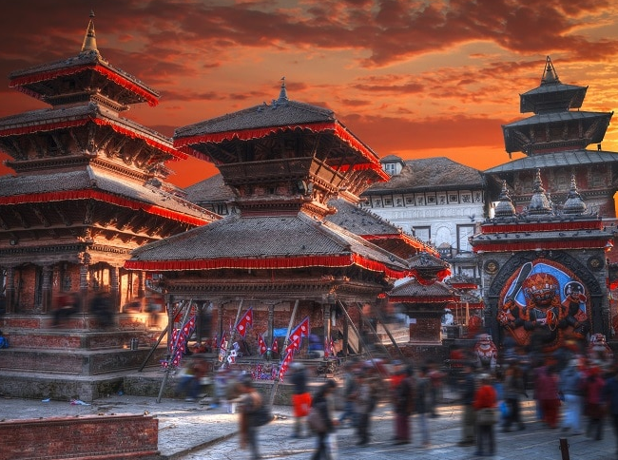
2023 CALENDAR DESIGN BY BIRAJ RIJAL
January
February
March
S | M | T | W | T | F | S
1 | 2 | 3 | 4 | 5 | 6 | 7
8 | 9 | 10 | 11 | 12 | 13 | 14
15 | 16 | 17 | 18 | 19 | 20 | 21
22 | 23 | 24 | 25 | 26 | 27 | 28
29 | 30 | 31
S | M | T | W | T | F | S
 |  |  | 1 | 2 | 3 | 4
5 | 6 | 7 | 8 | 9 | 10 | 11
12 | 13 | 14 | 15 | 16 | 17 | 18
19 | 20 | 21 | 22 | 23 | 24 | 25
26 | 27 | 28
S | M | T | W | T | F | S
 |  |  | 1 | 2 | 3 | 4
5 | 6 | 7 | 8 | 9 | 10 | 11
12 | 13 | 14 | 15 | 16 | 17 | 18
19 | 20 | 21 | 22 | 23 | 24 | 25
26 | 27 | 28 | 29 | 30 | 31
April
May
June
S | M | T | W | T | F | S
 |  |  |  |  |  | 1
2 | 3 | 4 | 5 | 6 | 7 | 8
9 | 10 | 11 | 12 | 13 | 14 | 15
16 | 17 | 18 | 19 | 20 | 21 | 22
23 | 24 | 25 | 26 | 27 | 28 | 29
30
S | M | T | W | T | F | S
 | 1 | 2 | 3 | 4 | 5 | 6
7 | 8 | 9 | 10 | 11 | 12 | 13
14 | 15 | 16 | 17 | 18 | 19 | 20
21 | 22 | 23 | 24 | 25 | 26 | 27
28 | 29 | 30 | 31
S | M | T | W | T | F | S
 |  |  |  | 1 | 2 | 3
4 | 5 | 6 | 7 | 8 | 9 | 10
11 | 12 | 13 | 14 | 15 | 16 | 17
18 | 19 | 20 | 21 | 22 | 23 | 24
25 | 26 | 27 | 28 | 29 | 30

