Slide 1
Steganography Secure data hiding in images using steganography
CAPSTONE PROJECT
Presented By: Rachita Chakraborty
Student Name : Rachita Chakraborty
College Name : Narula Institute of Technology
Department : Computer Science and Business Systems
Current Year of Study : 3rd

Slide 2
OUTLINE
Problem Statement
Technology used
Wow factor
End users
Result
Conclusion
Git-hub Link
Future scope

Slide 3
Problem Statement
Develop a secure image steganography system that embeds encrypted data into digital images without degrading quality, using robust methods to resist detection and attacks from hackers.

Slide 4
Technology used
Libraries : CV2, OS, string
Platform: python IDLE

Slide 5
Wow factors
This secure image steganography system not only hides encrypted data within images but also ensures minimal quality loss, making the embedded information virtually undetectable. Using advanced cryptographic and steganographic techniques, it enhances security while resisting brute-force attacks, making it a groundbreaking solution for covert data transmission.

Slide 6
End users
Cybersecurity professionals
Government agencies & defense organizations
Journalists & whistleblowers
Enterprises handling confidential data
Individuals requiring secure communication

Slide 7
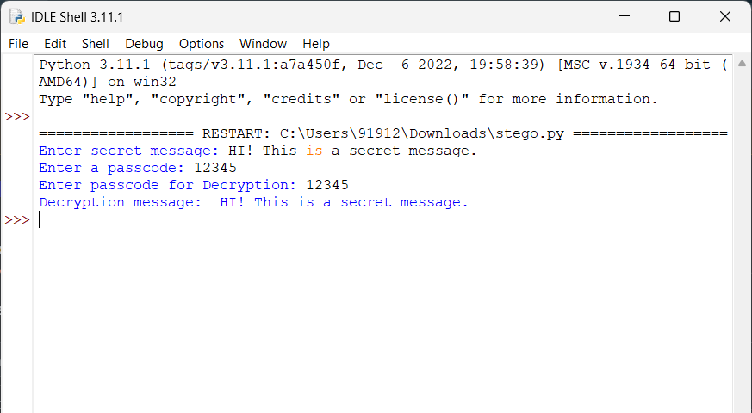
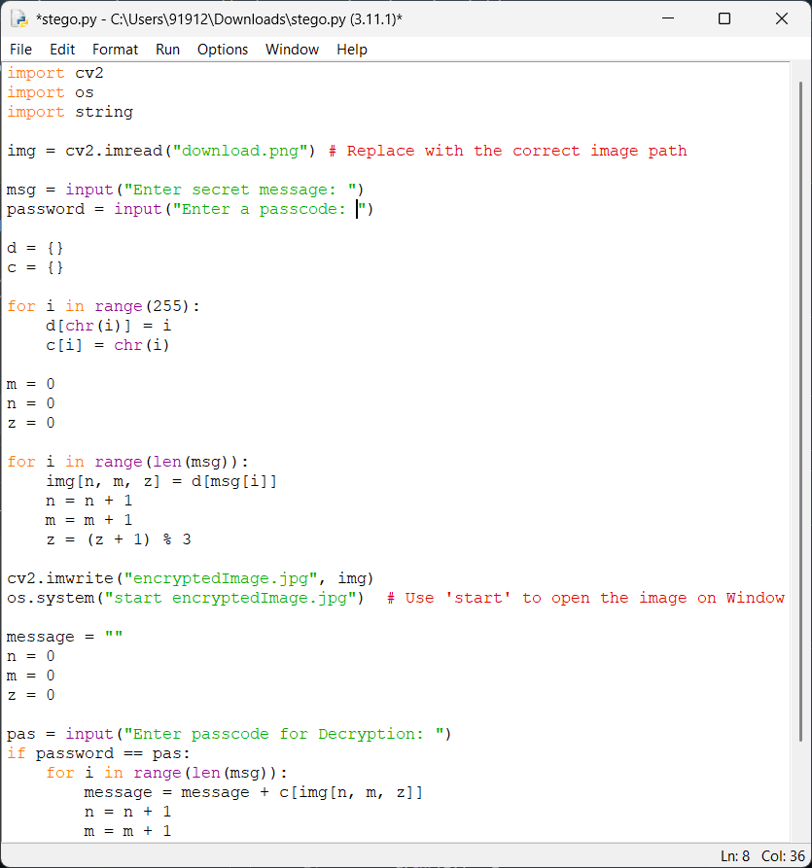

Results

Slide 8
Conclusion
The secure image steganography system effectively combines encryption and steganographic techniques to provide a robust solution for covert communication. By embedding encrypted data without noticeable image degradation, it ensures high security and resistance to detection.
This approach maintains visual integrity while strengthening data confidentiality and integrity, making it ideal for cybersecurity, law enforcement, and secure messaging. Its adaptability to evolving threats makes it a valuable tool for secure data transmission in various sensitive applications.

Slide 9
GitHub Link
https://github.com/rachitac1/Steganography

Slide 10
Future scope(optional)
Integration with AI for adaptive steganography techniques
Development of real-time detection-resistant models
Expansion to video and audio steganography for broader applications
Implementation in secure cloud-based communication systems
Enhanced resistance to steganalysis using deep learning-based adversarial techniques

Slide 11
THANK YOU

