Slide 1

Diabetes Diagnosis
Sunday, May 15, 2017
Team Members : Team Name :
Anjani Nalla Analytical Miners
Rachit Choksi
Dinesh Kota
Ajitesh Janaswamy
Akshay Kadari

Slide 2
Business Understanding Phase

Slide 3
Dataset Description
Dataset : Pima Indians Diabetes Database
This dataset is originally from the National Institute of Diabetes and Digestive and Kidney Diseases.
Several constraints were placed on the selection of these instances from a larger database. In particular, all patients here are females at least 21 years old of Pima Indian heritage.
Relevant papers : Smith, J.W., Everhart, J.E., Dickson, W.C., Knowler, W.C., & Johannes, R.S. (1988). Using the ADAP learning algorithm to forecast the onset of diabetes mellitus. In Proceedings of the Symposium on Computer Applications and Medical Care (pp. 261--265). IEEE Computer Society Press.

Slide 4
Attributes
Pregnancies: Number of times pregnant
Glucose: Plasma glucose concentration a 2 hours in
an oral glucose tolerance test
BloodPressure: Diastolic blood pressure (mm Hg)
SkinThickness: Triceps skin fold thickness (mm)
Insulin: 2-Hour serum insulin (mu U/ml)
BMI: Body mass index (weight in kg/(height in m)^2)
DiabetesPedigreeFunction: Diabetes pedigree function
Age: Age (years)
Outcome: Class variable (0 or 1)

Slide 5
Business objectives :
To predict, based on diagnostic measurements, whether
a patient has diabetes and find out the common
symptoms for providing accurate analysis .
Analytical Strategy :
The following data mining/statistical methods will be used to
perform various data mining tasks:
EDA(Description)
Regression analysis techniques (Estimation & Prediction)
K-Nearest Neighbor Algorithm and Decision Trees(lassification).
k-Means Clustering(Clustering)

Slide 6
Data Understanding
Phase

Slide 7
Handling Missing Values
There are missing values available in Glucose,
BloodPressure, SkinThickness, Insulin, BMI attributes.
Unknown values for Pregnancies variable can not be
counted as missing values.
We have imputed values in above mentioned
attributes using “norm.predict” method of
Mice library.

Slide 8
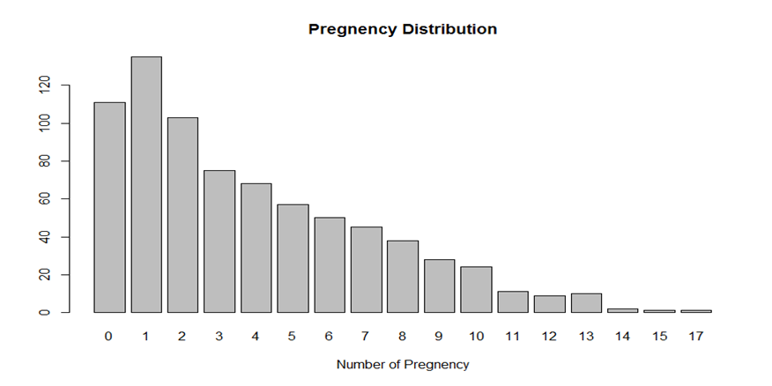
Data Visualization
Bar chart for Pregnancies attribute.
Skewness in 0.75. The data is right skewed.

Slide 9
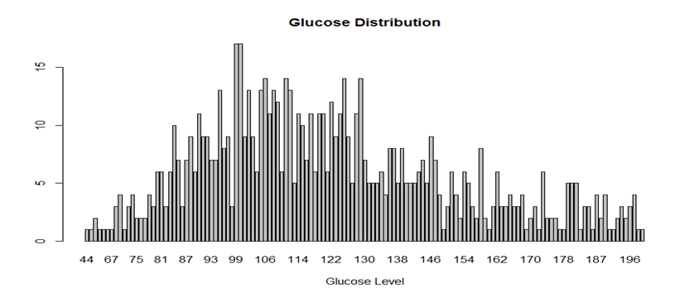
Data Visualization
Bar chart for Glucose attribute.

Slide 10
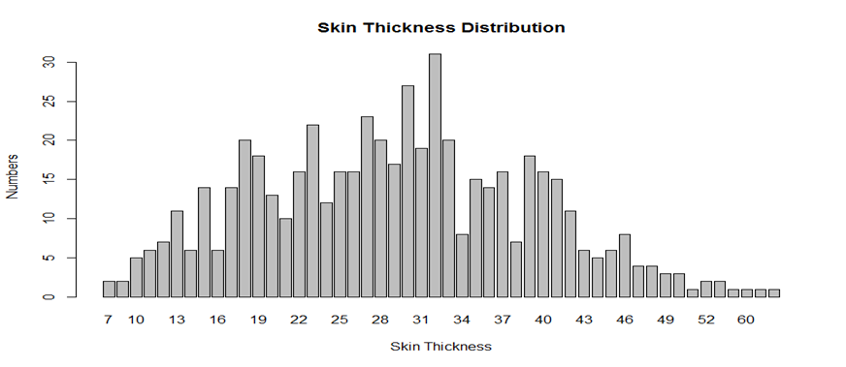
Data Visualization
Bar chart for Skin Thickness attribute.

Slide 11
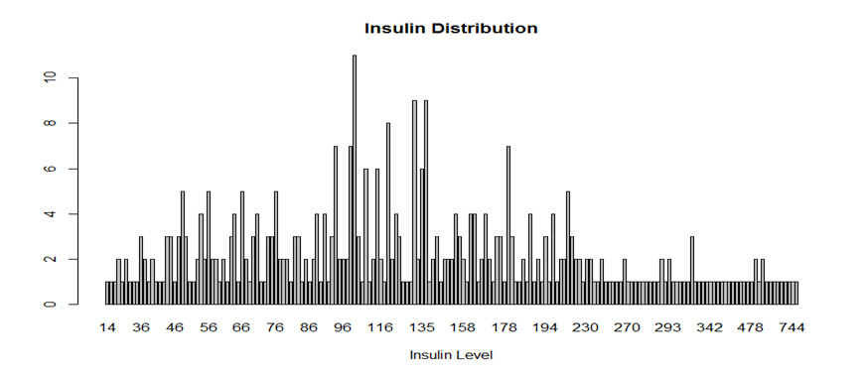
Data Visualization
Bar chart for Skin Thickness attribute.
Skewness is 0.77. The data is Right skewed.

Slide 12
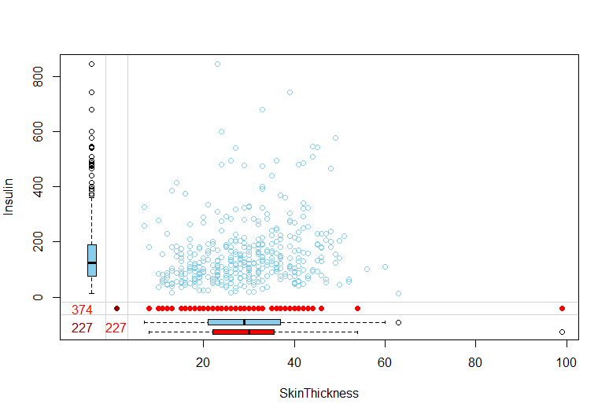
Margin Plots
The plot shows distribution of Insulin with Skin Thickness

Slide 13
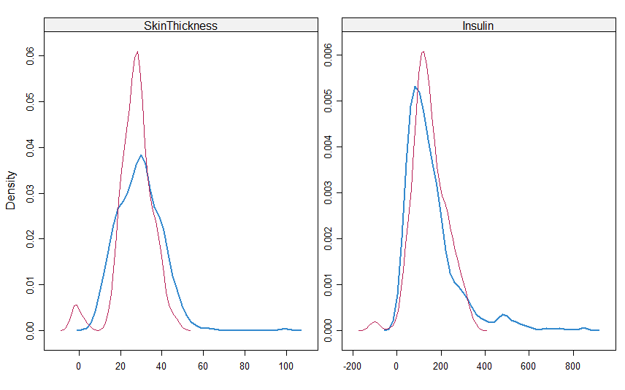
Imputation Graph
This graph shows imputation of all the skin thickness and Insulin.
Magenta showing the imputed data and blue showing the observed data.

Slide 14
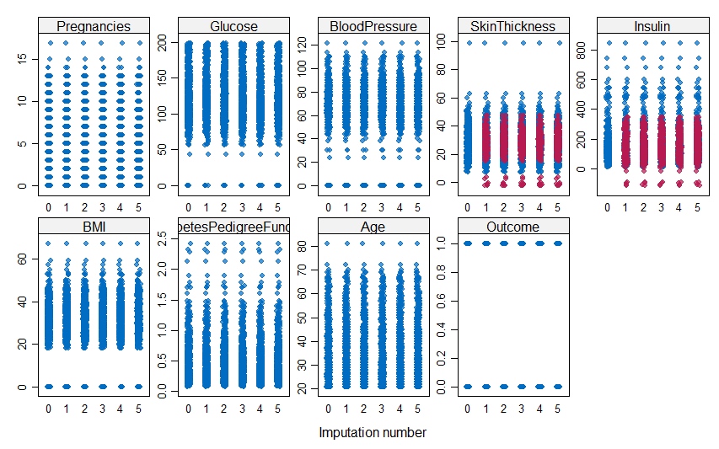
Strip plot
Stripplot shows one dimensional scatter plots for individual data points

Slide 15
Number of outliers
count(boxplot.stats(diabetes$BloodPressure)$out)
BloodPressure - 14
Pregnancies – 4
Glucose- 0
Skin Thickness – 4
Insulin – 24
BMI – 8
Pedigree – 28
Age - 9

Slide 16
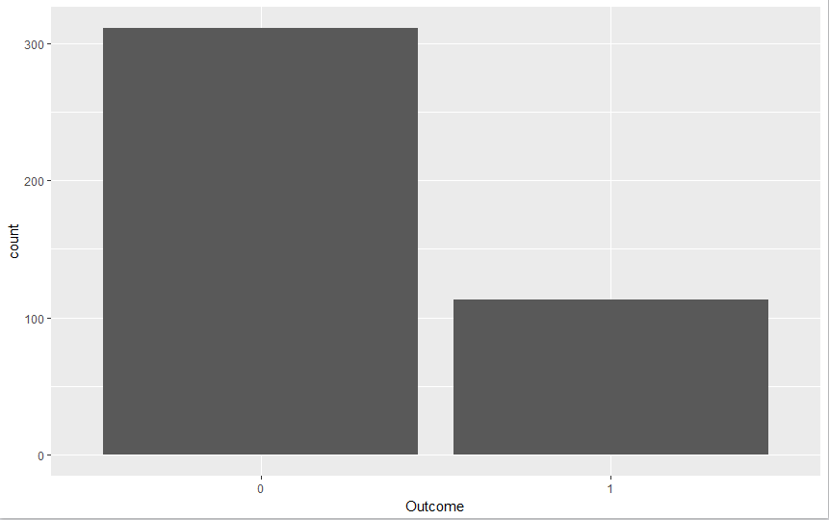
Qplot Outcomes
Qplot PregnanciesLessThan3 vs Outcome
Greater proportion of women with pregnancies less than 3 are not diabetic.

Slide 17
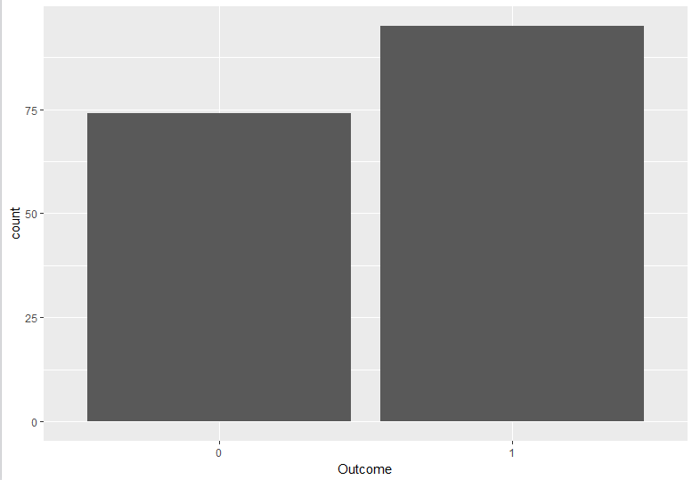
Qplot outcomes
Qplot PregnanciesGreaterThan6 vs Outcome
women are more likely to get diabetes with number of pregnancies > 6

Slide 18
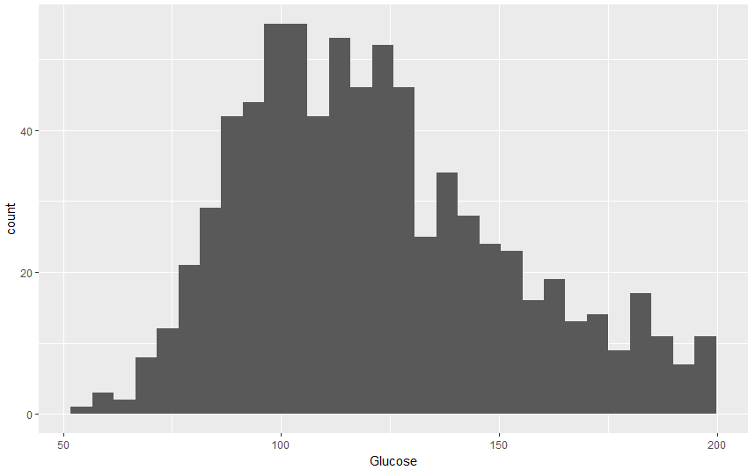

Qplot GlucoseGreaterthan 50
women with glucose levels > 150 have 75% chance of getting diabetes.

Slide 19
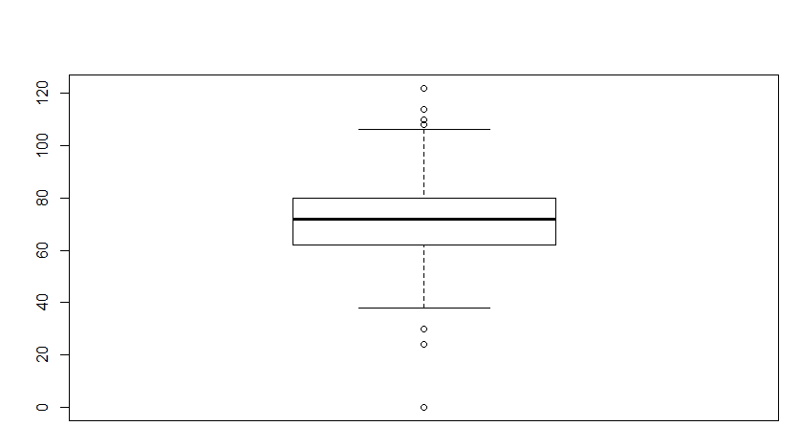
Outliers Bloodpressure
count(boxplot.stats(diabetes$BloodPressure)$out)

Slide 20
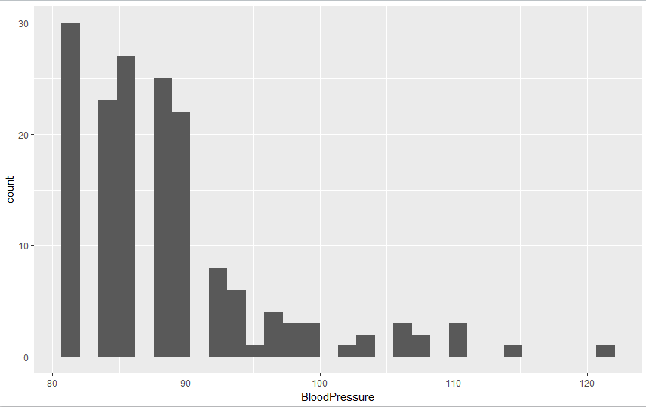

Qplot BP>80
Women with BP > 80 are 47% more likely to get diabetes.

Slide 21
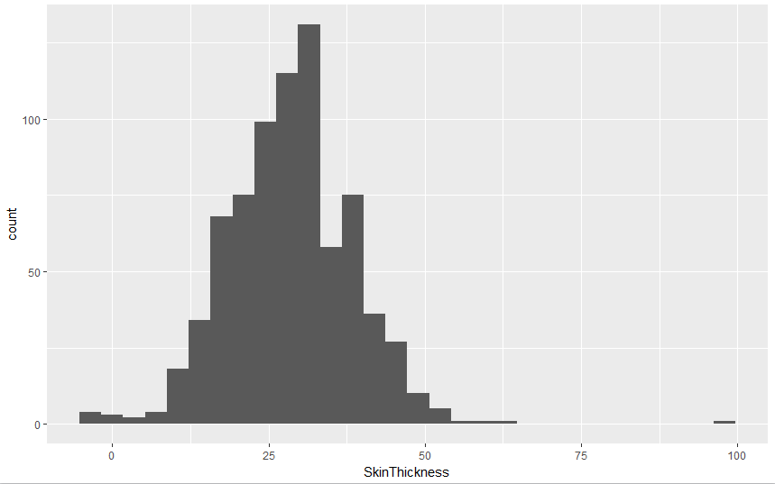
Qplot skin Thickness
with skinthickness greater than 25, a women is 43.5% likely to get diabetic.

Slide 22
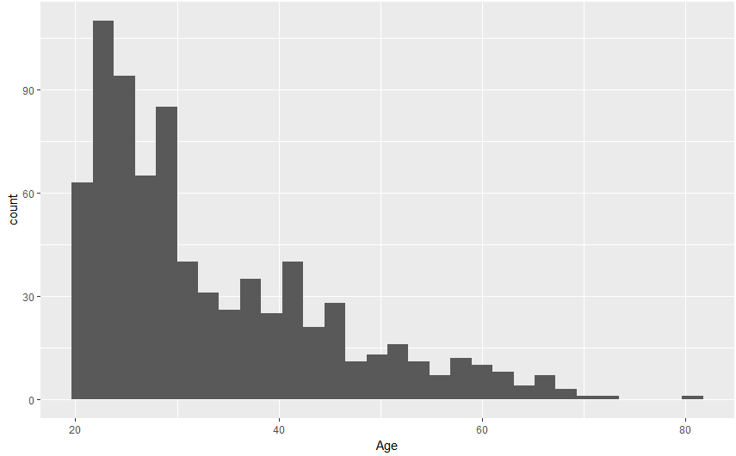

Qplot Age
Women with age greater than 30 years and above has approximately 50% chance to get diabetes

Slide 23
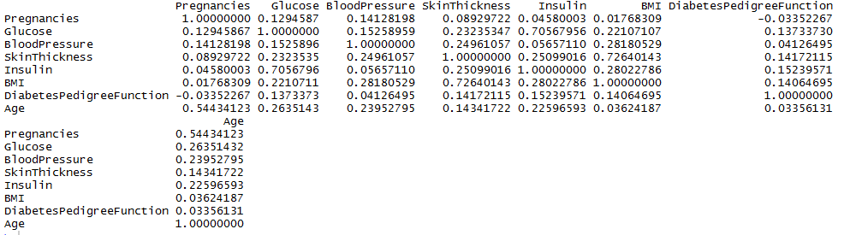
Correlational value
cor(numericData)
(Insulin, Glucose) and (BMI, SkinThickness) are highly correlated.
One in each is considered for further analysis.

Slide 24
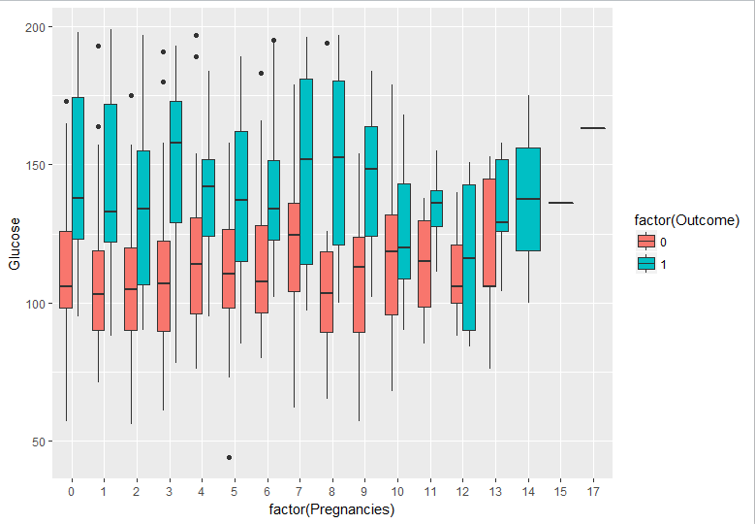
Gplot for Pregnancies vs glucose
For every pregnancy people with higher glucose levels are prone to diabetes
If glucose levels are greater than 150 then the number of pregnancies does not matter. You are always prone to diabetes.
Even though a women have more than 5 pregnancies, they can still not be diabetic if their glucose levels are less than 100

Slide 25
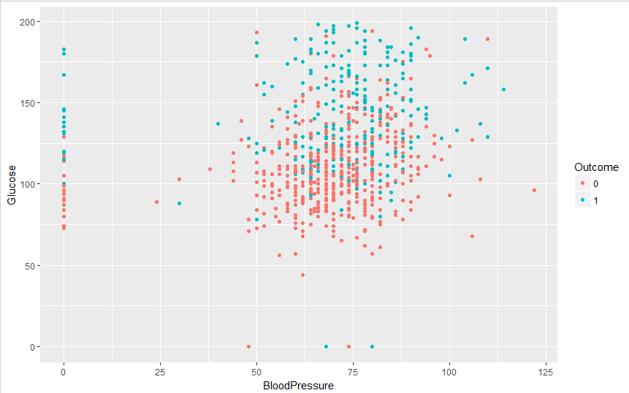
Gplot BP vs Glucose
It is evident that for high BP and High glucose, chances of getting diabetes is also high

Slide 26
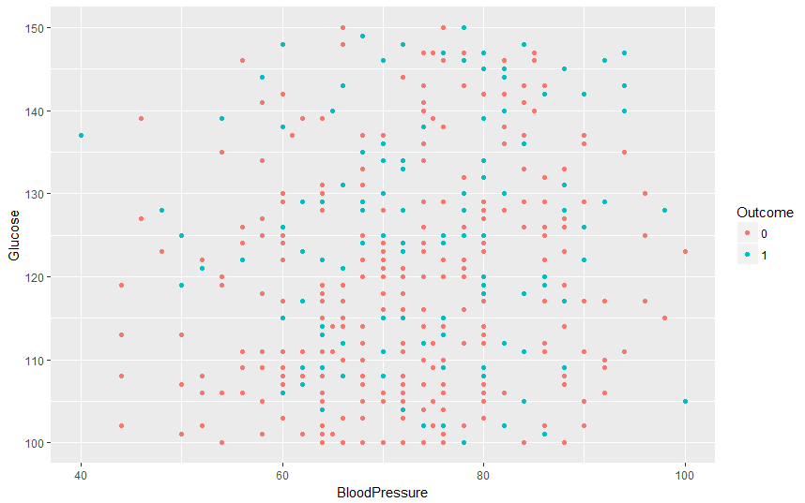
Selective Gplot for glucose vs BP
This portion seems to be equally scattered. Analysing further we found that women are 40% more likely to get diabetes, which is comparatively high even with medium levels of glucose and BP.

Slide 27
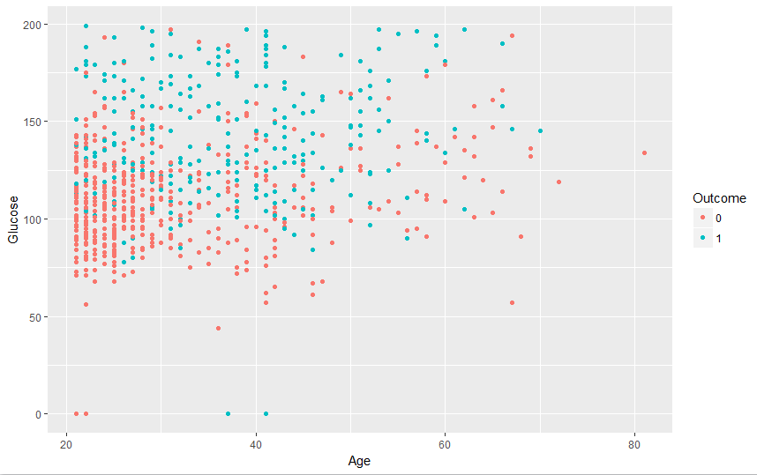
Gplot age vs glucose
In the above range a women is 40% more likely to get diabetes, which is comparatively high even with medium levels of glucose.

Slide 28
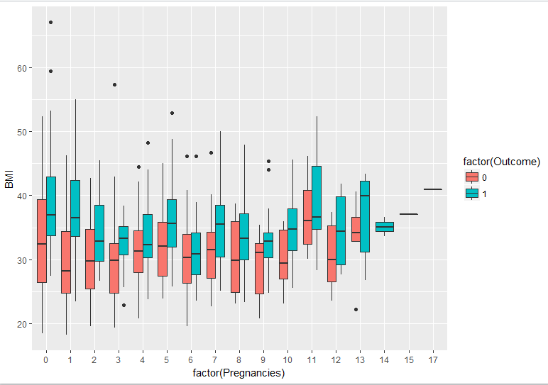
Gplot BMI vs Pregnancies
For every pregnancy level higher BMI women are prone to be diabetic

Slide 29
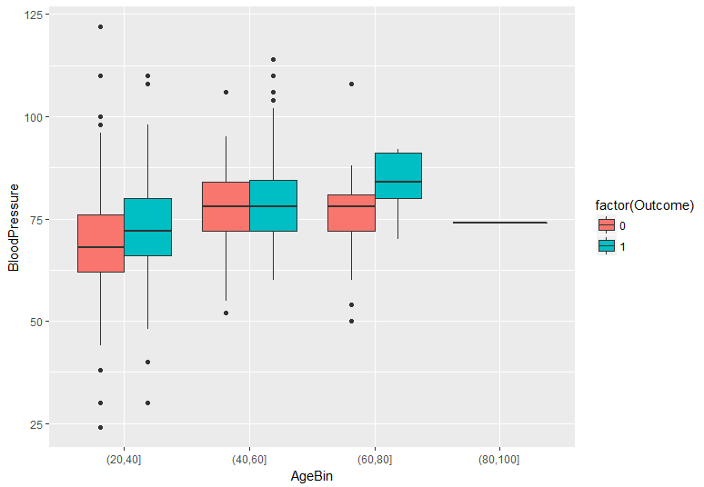
Gplot Age vs BloodPressure
Women of age group 60-80 and high BP are highly prone to diabetes

Slide 30
Data
Preparation
Phase

Slide 31
Data Transformation
Z-score standardization:
diabetes$Glucose <- (diabetes$Glucose - mean(diabetes$Glucose))/sd(diabetes$Glucose)
In PIMA dataset some variables tend to have ranges that vary greatly from each other.
Hence, we normalized numeric variables, in order to standardize the scale of effect each variable has on the results

Slide 32
Outlier Detection
The Z-score method for identifying outliers states that a data value is an outlier if it has a Z-score that is either less than −3 or greater than 3. Variable values with Z-scores much beyond this range may bear further investigation.
We have performed outlier detection following below command and found no outliers for any of the attributes.
Glucose_outliers <- subset(diabetes, diabetes$Glucose > 3 & diabetes$Glucose < -3)
nrow(Glucose_outliers)

Slide 33
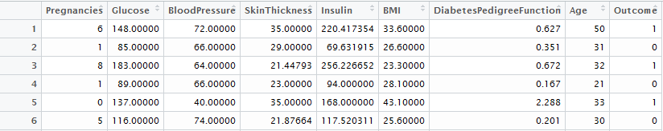
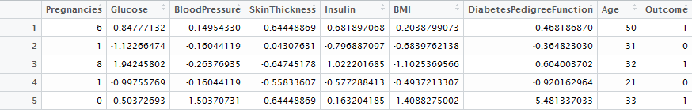
Data Transformation
Normal Data:
After Z-score standardization:

Slide 34
Binning
We have applied Binning to transform a continuous characteristic into a finite number of intervals.
Ex: Binning for Age attribute
AgeBin < cut(diabetes$Age,c(0,20,40,60,80,100))
levels(AgeBin)
"(0,20]" "(20,40]" "(40,60]" "(60,80]" "(80,100]"

Slide 35
Correlational value
cor(numericData)
(Insulin, Glucose) and (BMI, SkinThickness) are highly correlated.
Hence, we will ignore Insulin and Skin Thickness in further analysis.

Slide 36
Test & Training Data Eveluation
We have partitioned the actual data into training & test data set based on below mentioned criteria.
We performed Chi-Squared test to find if the test data set represents the actual data set or not.

Slide 37
Modeling
Phase

Slide 38
Modeling Techniques
Data mining methods may be categorized as either supervised or unsupervised.
The most common unsupervised data mining method is clustering.
Decision trees, Neural networks, and k-nearest neighbors are exampes of supervised methods.

Slide 39
Modeling Techniques
In Supervised methods there is a particular prespecified target variable.
As PIMA dataset is already having prespecified target variable “Outcome”, we are applying only supervised methods.

Slide 40
Logistic Regression Model
# Call:
# glm(formula = diabetes$Outcome ~ ., family = "binomial", data = diabetes)
# Deviance Residuals:
# Min 1Q Median 3Q Max
# -2.6243085 -0.6983904 -0.3647185 0.6555557 2.5760516
# Coefficients: (3 not defined because of singularities)
# Estimate Std. Error z value Pr(>|z|)
# (Intercept) -2.96363544 0.59849695 -4.95180 0.0000007353126 ***
# Pregnancies 0.10329897 0.06395154 1.61527 0.1062523
# Glucose 1.18724881 0.20028194 5.92789 0.0000000030686 ***
# BloodPressure -0.15308594 0.10641272 -1.43861 0.1502623
# SkinThickness 0.04970297 0.12693784 0.39155 0.6953881
# Insulin -0.16040255 0.12711312 -1.26189 0.2069890
# BMI 0.40927815 0.16216080 2.52390 0.0116060 *
# DiabetesPedigreeFunction 0.29033789 0.10138161 2.86381 0.0041858 **
# Age 0.03931113 0.01965668 1.99989 0.0455125 *
# PregnancyBin(5,10] -0.13048790 0.39825941 -0.32765 0.7431797
# PregnancyBin(10,15] -0.46905458 0.76426048 -0.61374 0.5393894
# PregnancyBin(15,20] 10.55053744 882.74395837 0.01195 0.9904639
# AgeBin(40,60] 0.05346419 0.40891635 0.13075 0.8959762
# AgeBin(60,80] -1.93548037 0.85629930 -2.26028 0.0238036 *
# AgeBin(80,100] -15.88902538 882.74391439 -0.01800 0.9856392
# Glucose2 0.07226117 0.32122957 0.22495 0.8220168
# BMI2 0.71049916 0.30149877 2.35656 0.0184452 *
# Age40to60 NA NA NA NA
# Preglessthan5 NA NA NA NA
# Age20to40 NA NA NA NA
# Signif. codes: 0 ‘***’ 0.001 ‘**’ 0.01 ‘*’ 0.05 ‘.’ 0.1 ‘ ’ 1
# (Dispersion parameter for binomial family taken to be 1)
# Null deviance: 993.48391 on 767 degrees of freedom
# Residual deviance: 690.47882 on 751 degrees of freedom
# AIC: 724.47882
# Number of Fisher Scoring iterations: 13

Slide 41
From the above output it is evident that the significant variables are Glucose, BMI, DiabetesPedigreeFunction and Age

Slide 42
Decision Trees
Decision Tree is an attractive classification method.
It is a collection of decision nodes, connected by branches, extending downward from the root node until terminating in leaf nodes.

Slide 43
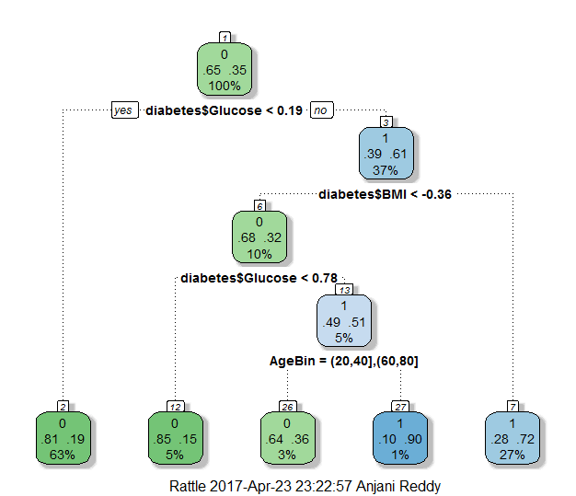
Decision Trees

Slide 44
Derivatives from Decision Trees
Observations from the decision tree in previous image:
Of the total population 63% of the population have glucose values <0.19(standardized value) and 81% of these are not diabetic.
Patients who are having greater Glucose values > 0.19(standardized value) i.e., 37% of the overall population have greater chances of having diabetes.
Among those patients, if their BMI values are <0.36, Glucose values are <0.78 , there is 5% chances that they wont have a diabetes.
Among those patients, if their BMI values are <0.36, Glucose values are >0.78 and they are coming into [20,40] age bin then there are 3% chances that they wont have a diabetes and if they are into [60,80] age bin there is 1% chances that they will have a diabetes.
Among those 27% patients whose BMI is >0.36 there are 72% chances that they will have a diabetes.

Slide 45
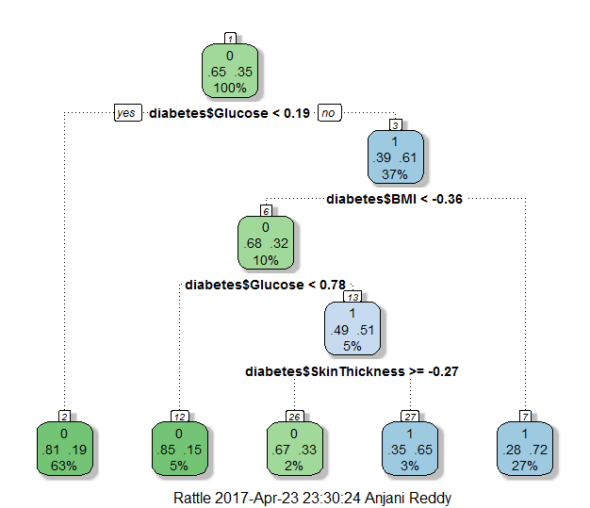
Decision Trees

Slide 46
Derivatives from Decision Trees
Observations from the decision tree in previous image:
Of the total population 63% of the population have glucose values <0.19(standardized value) and 81% of these are not diabetic.
Patients who are having greater Glucose values > 0.19(standardized value) i.e., 37% of the overall population have greater chances of having diabetes.
Among those patients, if their BMI values are <0.36, Glucose values are <0.78 , there are 85% chances that they wont have a diabetes.
Among those patients, if their BMI values are <0.36, Glucose values are >0.78 and with skinthickness values > -0.27 then there are 65% chances that they have diabetes
Among those 27% patients whose BMI is >0.36 there are 72% chances that they will have a diabetes.

Slide 47
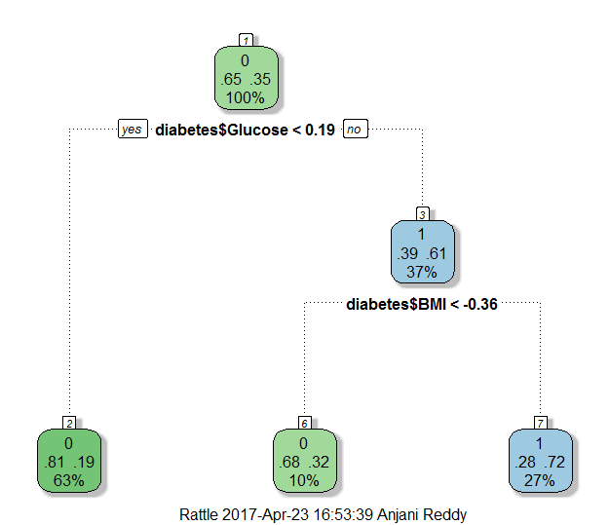
Decision Trees on subsets

Slide 48
Derivatives from Decision Trees
Observations from the decision tree in previous image:
Of the total population 63% of the population have glucose values <0.19(standardized value) and 81% of these are not diabetic.
Patients who are having greater Glucose values > 0.19(standardized value) i.e., 37% of the overall population have greater chances of having diabetes.
Among those patients, if their BMI values are <-0.36 there are 68% chances that they wont have a diabetes.
Among those 27% patients whose BMI is >0.36 there are 72% chances that they will have a diabetes.

Slide 49
KNN Modelling
This model is 0.77% Accurate

Slide 50
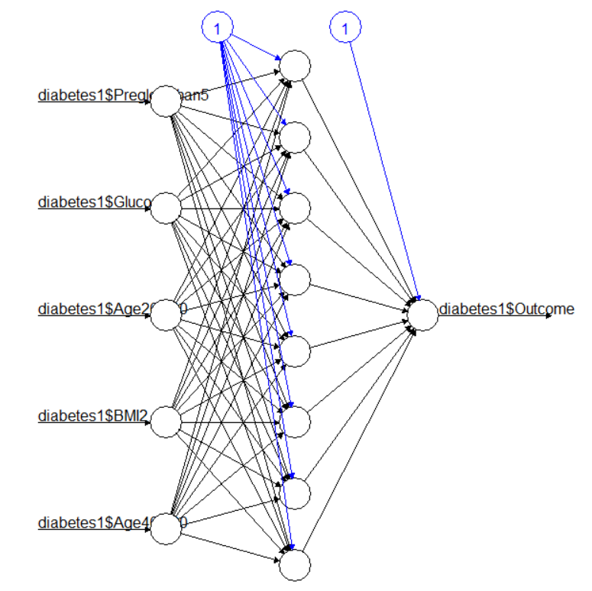
Neural Networks

Slide 51
Evaluation & Deployment
Phase

Slide 52
Effectiveness of Model
After the split, We have 538 rows in training model and 230 rows in the testing model.
We have performed various classification algorithm like Decision Tree, Neural Networks, KNN.
According to the dataset, KNN is the best suited algorithm.

Slide 53
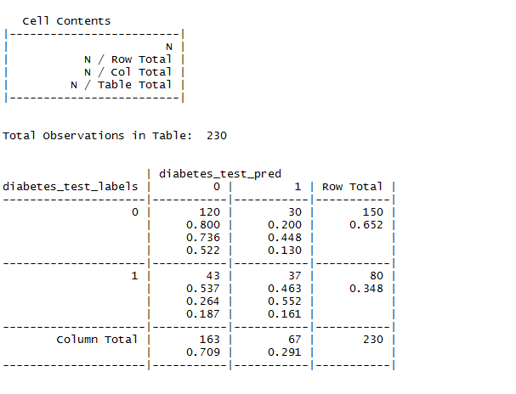
Cross-table of the Model

Slide 54

Accuracy of the Model

Slide 55

Sensitivity & Specificity

Slide 56
Misclassification cost adjustment
Evaluating the concerns of incorrect classification:
False positive - a patient without diabetes in actual but predicted positive does not lead to any expense but considering other case it is expensive.
False negative – a patient with diabetes in actual but predicted negative can turn out to be expensive.

Slide 57
Results helpful to solve Business Problems
Conclusions resulted from previous algorithm can help us in
Predict patients who are prone to diabetes [ with 68.3% accuracy].
Finding out the attribute ranges which most likely causes diabetes [ Glucose ].
Reduce the post dieses expenses by finding out the symptoms at early stage.

Slide 58
Further Improvements & Additional Work
The prediction and results can be further improved by learning & implementing following below mentioned ways:
Better approach to clean the data & better ways to deal with missing values.
Better ways to split the data into training and test models
Using improved algorithms leading to the better accuracy of the model

Slide 59
Other deployment method- Predictor system
Predictor system usually learns from the past for which historical data is obtained and analyzes the resulting pattern.
Historical data provides information on the specific pattern of learning the data. Learning from the past provides knowledge about future to some extent.
The past values of attributes which caused diabetes are stored in the database and are used to find out the patients who are prone to diabetes.

