Slide 1
SPARKANS SPRINT 2

Slide 2
TEAM MATES
Rachit Dalal (Scrum Master) Derek Chapman Nisha Rani Sushant Patankar Swathy Hari Prasad

Slide 3
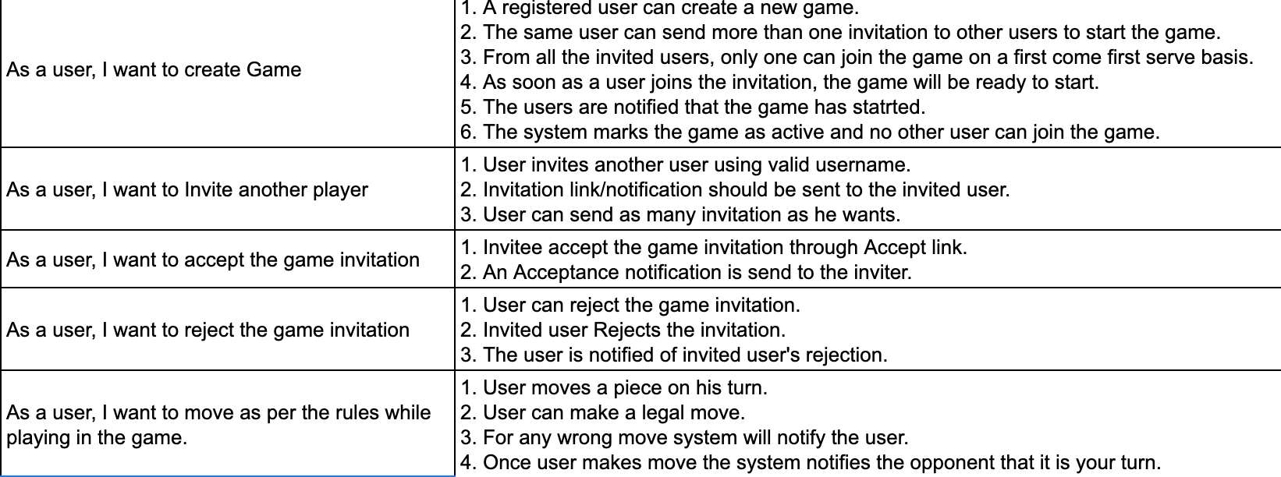
USER STORIES
MOSCOW Rule - “Should have” Priority

Slide 4
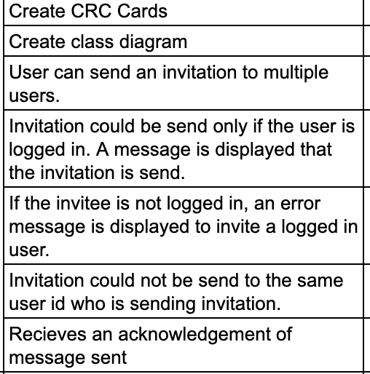
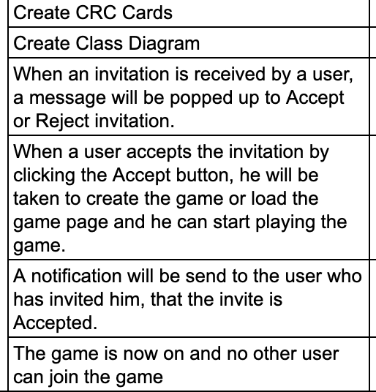
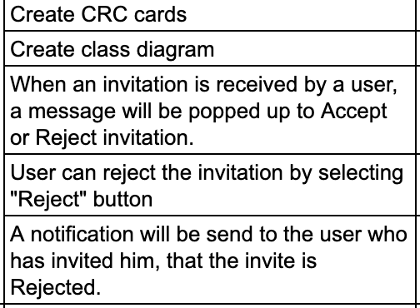
USER TASKS:

Slide 5
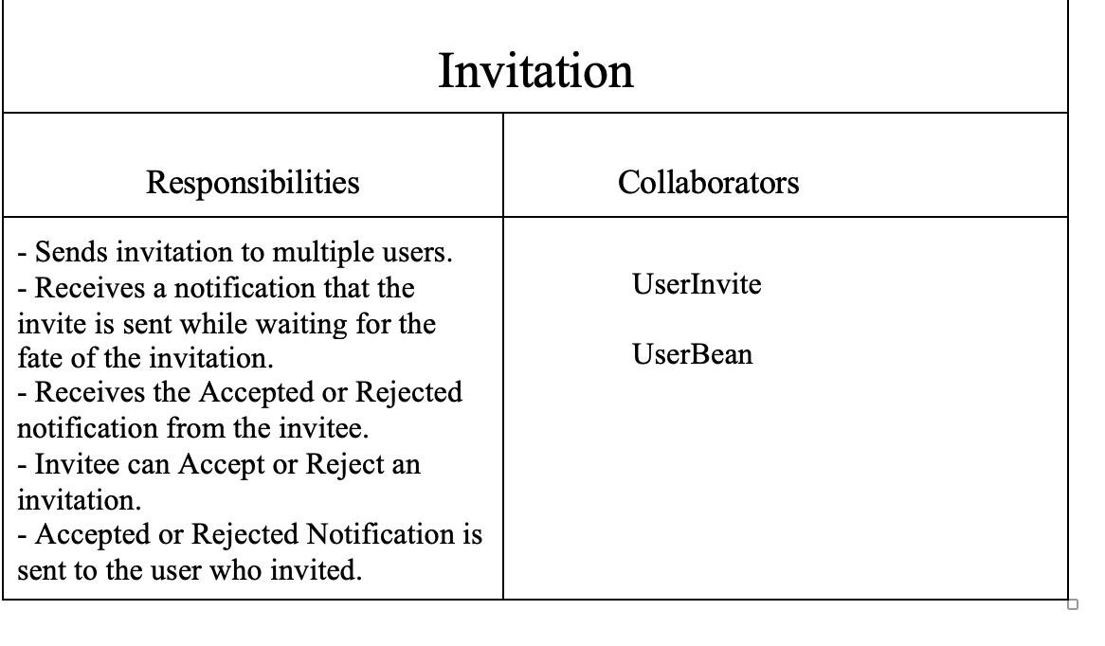
CRC Cards

Slide 6
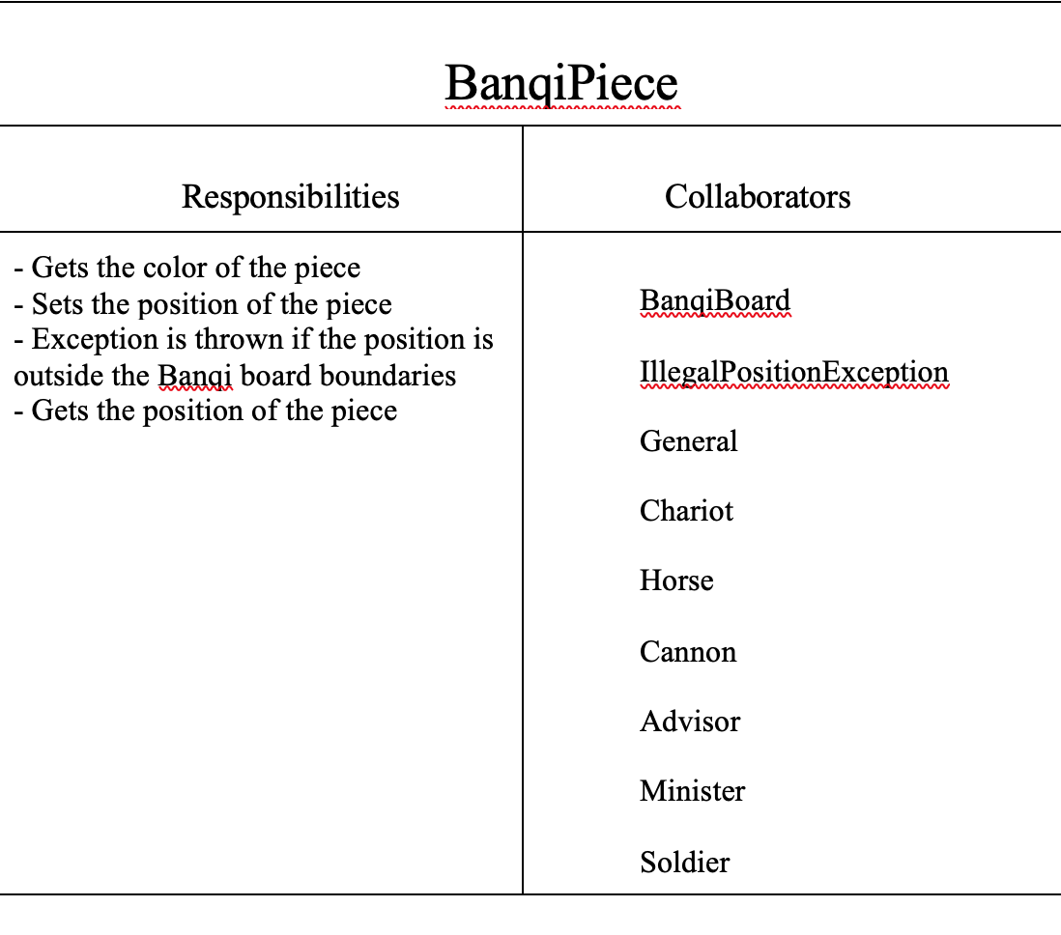
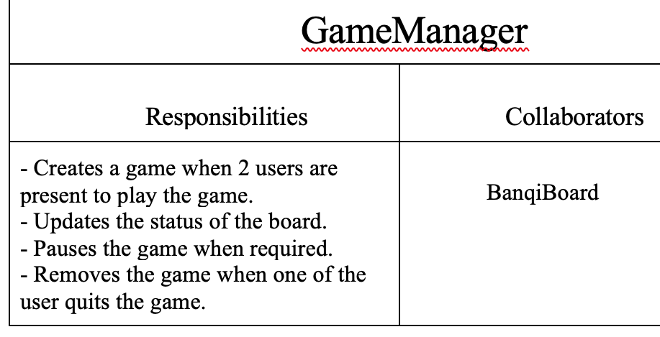
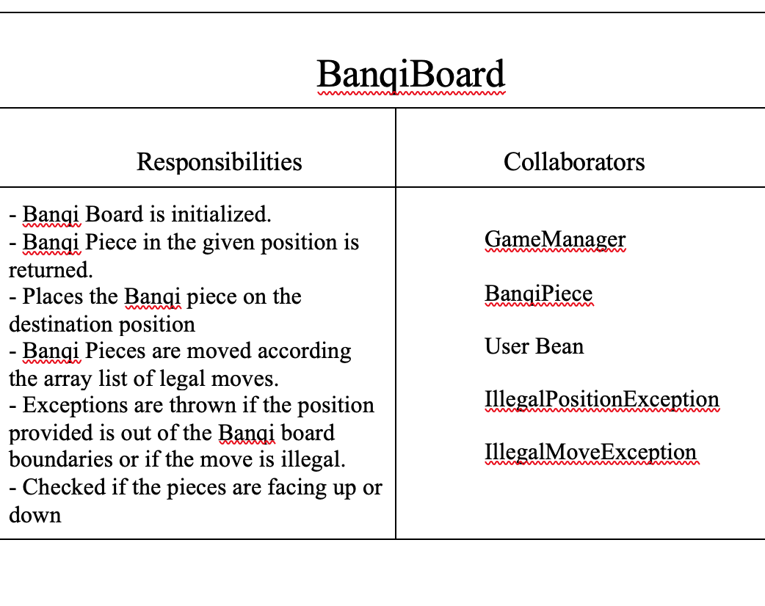
CRC Cards Contd..

Slide 7
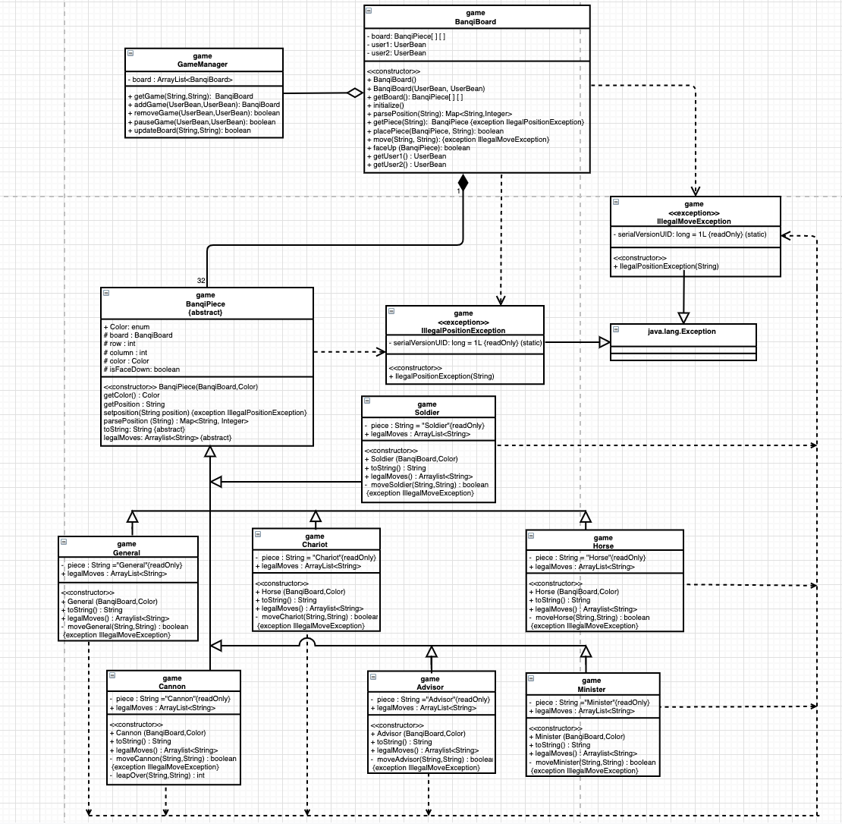
Class Diagram

Slide 8
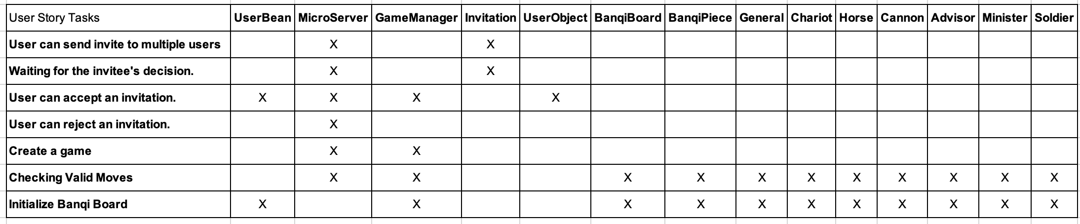
Traceability Matrix

Slide 9
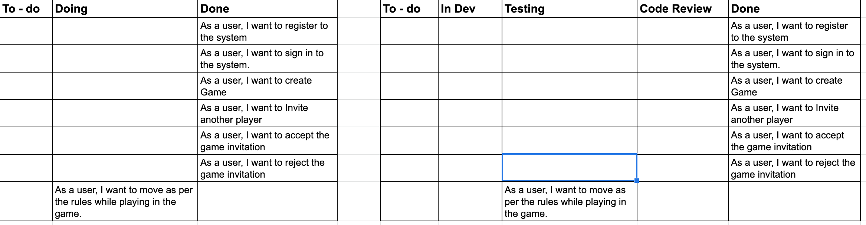
KANBAN BOARD
Latest for the week : 10/28 - 11/03

Slide 10
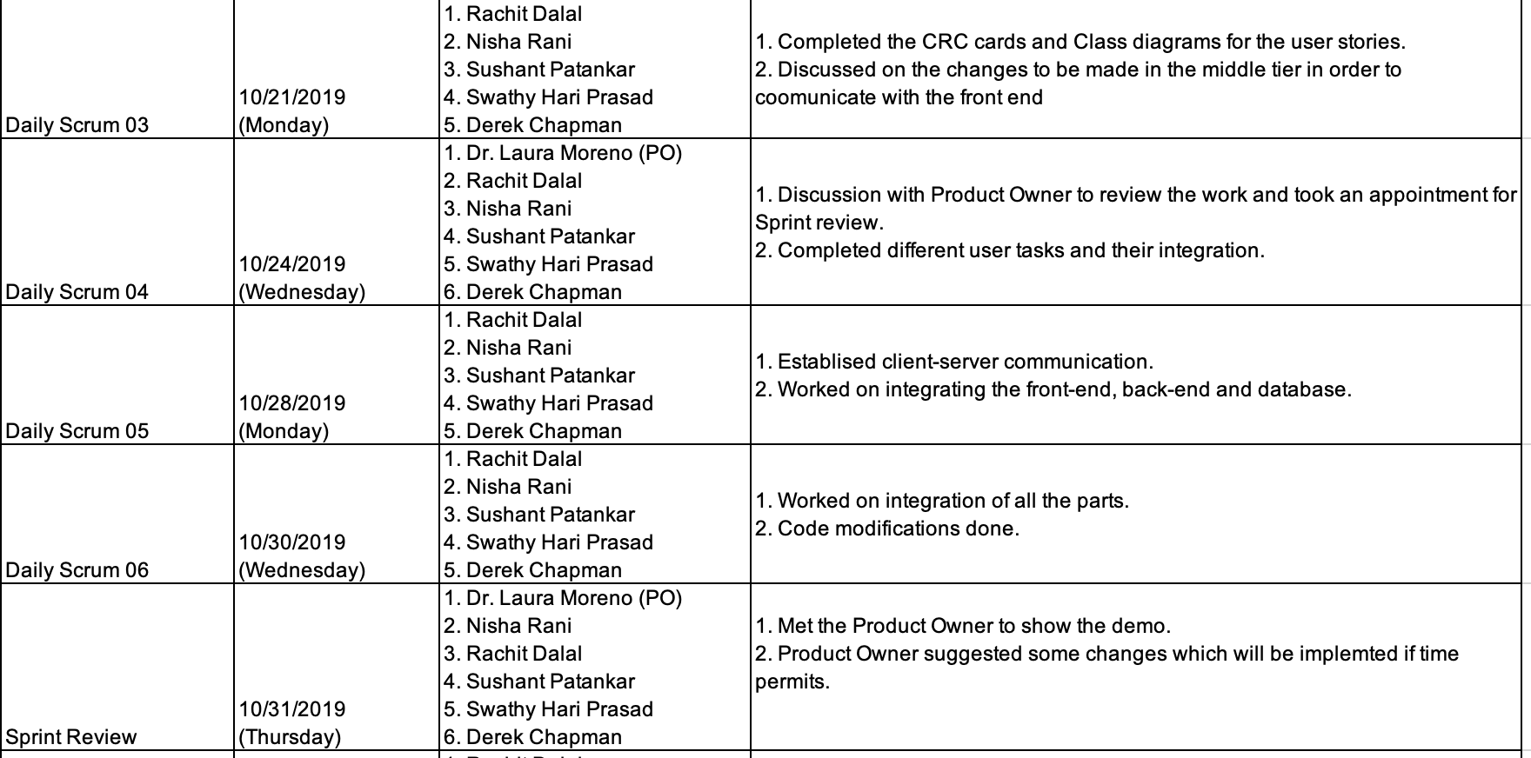
Scrum Ceremonies

Slide 11
Scrum Retrospective
What went well:
1. Co-ordination among team members helped towards stabilization.
2. Using Excel sheets for tracking made it easier.
3. Tried improving quality during each integration.
4. After each scrum meeting, code refactoring was performed.
Need to improve:
1. Equal distribution of work is required going forward.
2. We underestimated many tasks.
3. More importance given to functionalities than aesthetics.

Slide 12
Development Manual : Server
Building and Running the Server:
Building:
To build the server you must have Maven installed.
"mvn package" will run tests and build the server-*.jar file.
run "mvn clean" followed by "mvn package" to be sure you have only the latest version of the server built.
Running:
To run the server use "java -jar server-*.jar" on the .jar file located in /server/target/
If you're in a bash environment the "run" script at the project root will build and run the server.
The server runs on localhost:31406

Slide 13
Development Manual : Client
This project was generated with Angular CLI version 8.3.8.
Development server : Run ng serve for a dev server. Navigate to http://localhost:4200/. The app will automatically reload if you change any of the source files.
Code scaffolding : Run ng generate component component-name to generate a new component. You can also use ng generate directive|pipe|service|class|guard|interface|enum|module.
Build : Run ng build to build the project. The build artifacts will be stored in the dist/ directory. Use the --prod flag for a production build.
Running unit tests : Run ng test to execute the unit tests via Karma.
Running end-to-end tests : Run ng e2e to execute the end-to-end tests via Protractor.
Further help:
To get more help on the Angular CLI use ng help or go check out the Angular CLI README.

Slide 14
Thank You!!

