Slide 1
SPARKANS SPRINT 3

Slide 2
TEAM MATES
Rachit Dalal (Scrum Master) Derek Chapman Nisha Rani Sushant Patankar Swathy Hari Prasad

Slide 3
BANQI
4 x 8 board or half of Chinese board.
All the pieces are shuffled and randomly allocated face-down to squares on the board.
Main moves involved are:
Flipping a piece to reveal it.
Moving a piece horizontally or vertically.
Capturing an opponent’s piece.
Cannon moves are different - It should always fly horizontally or vertically.
The Capture moves are done according to the ranking of pieces except in case of General, Soldier and Cannon.
General -> Chariot -> Horse -> Cannon, Advisor -> Minister -> Soldier

Slide 4
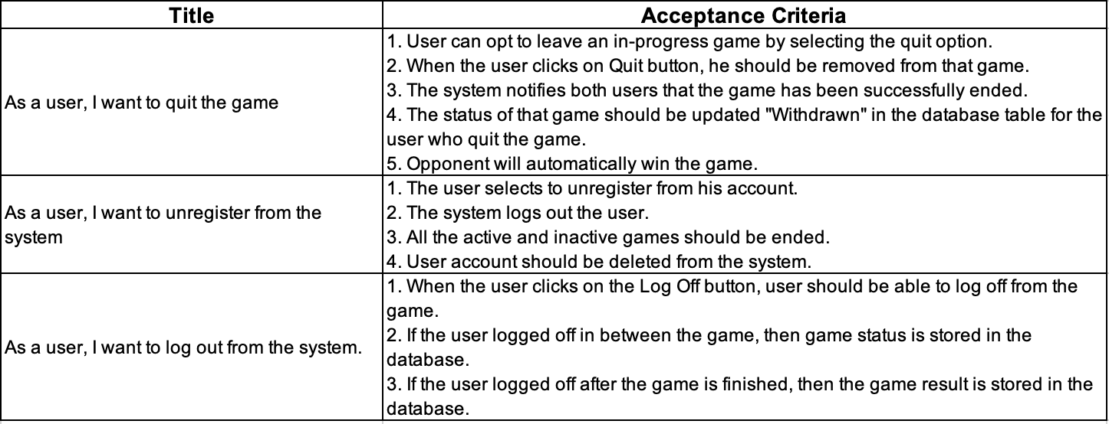
USER STORIES
MOSCOW Rule - “Could have and Won’t have until later” Priorities

Slide 5
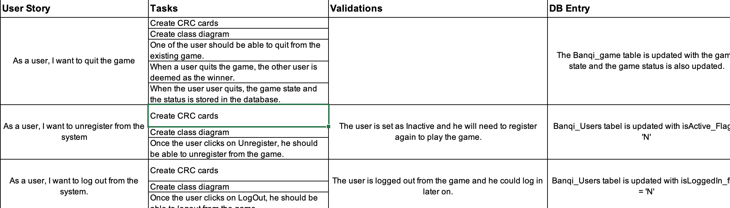
USER TASKS:

Slide 6
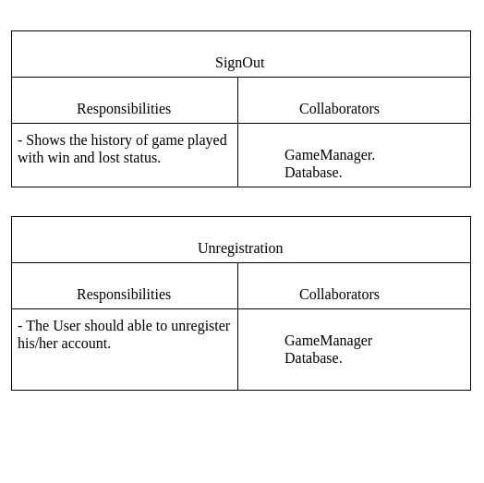
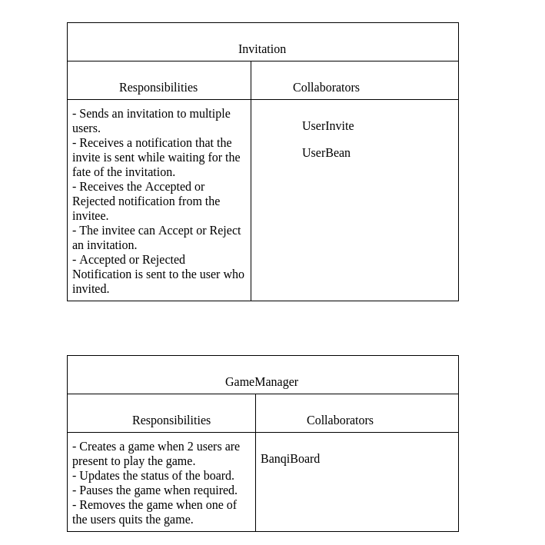
CRC CARDS

Slide 7
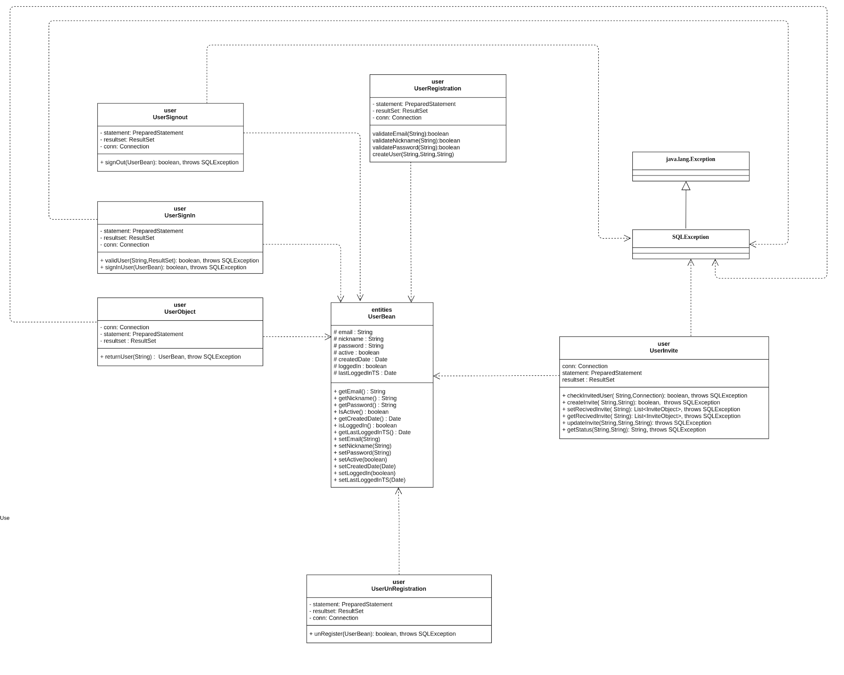
CLASS DIAGRAM

Slide 8
DESIGN PATTERN USED
Facade - Game Manager
Controller - MicroServer
Singleton - Angular Services
Observer - UI side implementation

Slide 9
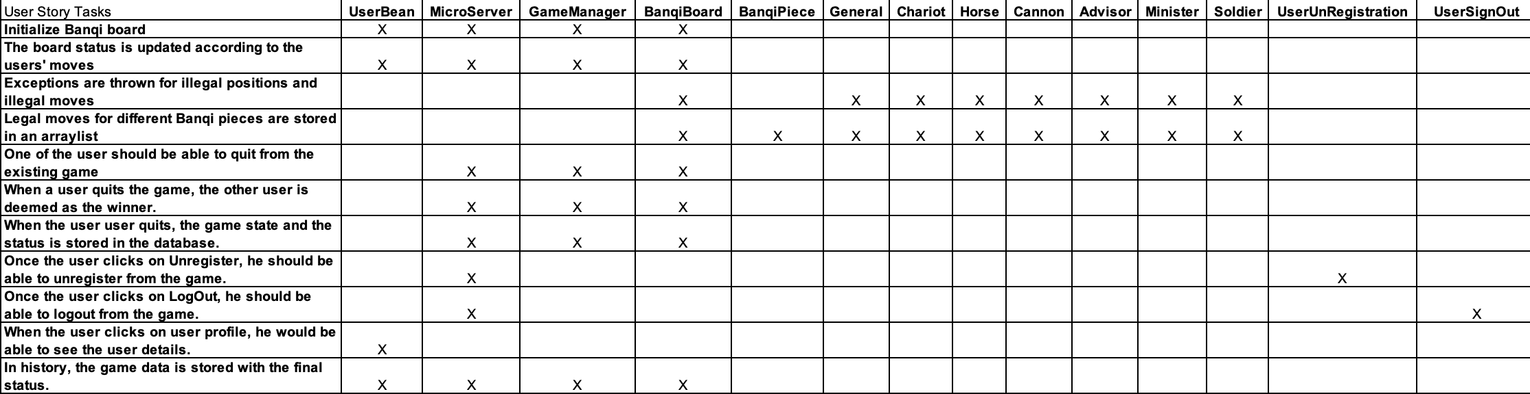
TRACEABILITY MATRIX

Slide 10
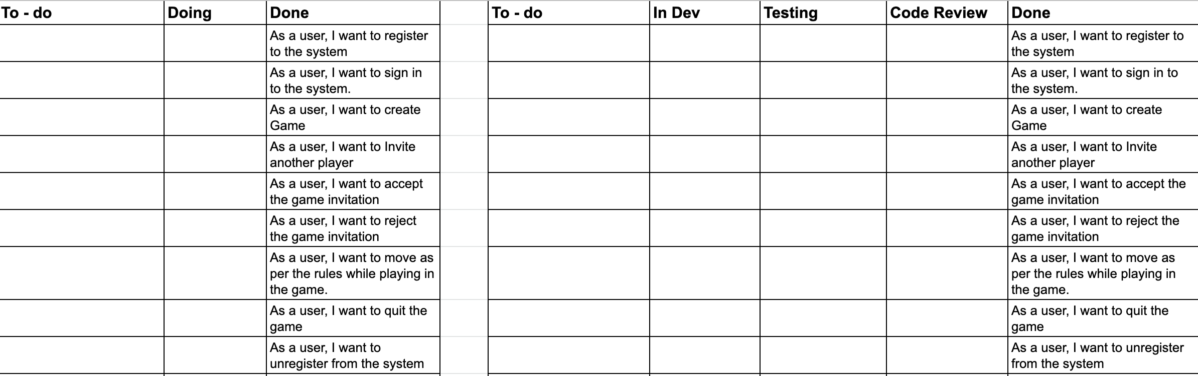
KANBAN BOARD LATEST FOR THE WEEK : 12/02 - 12/08 - COMPLETED ALL THE TASKS AND PUSHED TO DONE

Slide 11
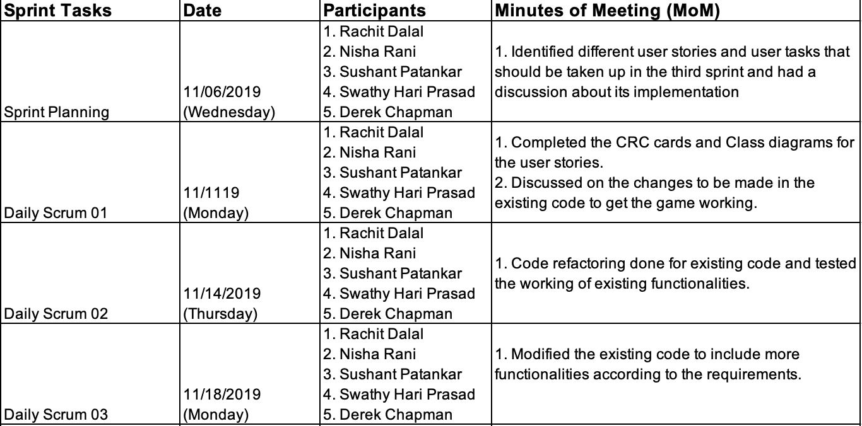
SCRUM CEREMONIES

Slide 12
SCRUM RETROSPECTIVE
What went well:
1. Co-ordination and equal work distribution among team members made this sprint much easier.
2. Using Excel sheets for tracking made tracking easier.
3. Tried improving quality during each integration.
4. Code refactoring was performed.
5. Unit test cases implemented effectively.
6. Aesthetics of UI is taken care of.

Slide 13
DEVELOPMENT MANUAL : SERVER
Building and Running the Server:
Building:
●To build the server you must have Maven installed.
●"mvn package" will run tests and build the server-*.jar file.
●run "mvn clean" followed by "mvn package" to be sure you have only the latest version of the server built.
Running:
●To run the server use "java -jar server-*.jar" on the .jar file located in /server/target/
●If you're in a bash environment the "run" script at the project root will build and run the server.
●The server runs on localhost:31406

Slide 14
DEVELOPMENT MANUAL : CLIENT
This project was generated with Angular CLI version 8.3.8.
Development server : Run ng serve for a dev server. Navigate to http://localhost:4200/. The app will automatically reload if you change any of the source files.
Code scaffolding : Run ng generate component component-name to generate a new component. You can also use ng generate directive|pipe|service|class|guard|interface|enum|module.
Build : Run ng build to build the project. The build artifacts will be stored in the dist/ directory. Use the --prod flag for a production build.
Running unit tests : Run ng test to execute the unit tests via Karma.
Running end-to-end tests : Run ng e2e to execute the end-to-end tests via Protractor.

Slide 15
Thank You
DEMO TIME…

