Slide 1
Sparkans
CS414 - Object oriented Design

Slide 2

Rachit dalal (scrum master)
Nisha rani
Swathy hari prasad
Sushant patankar
Derek Chapman
We are here:

Slide 3
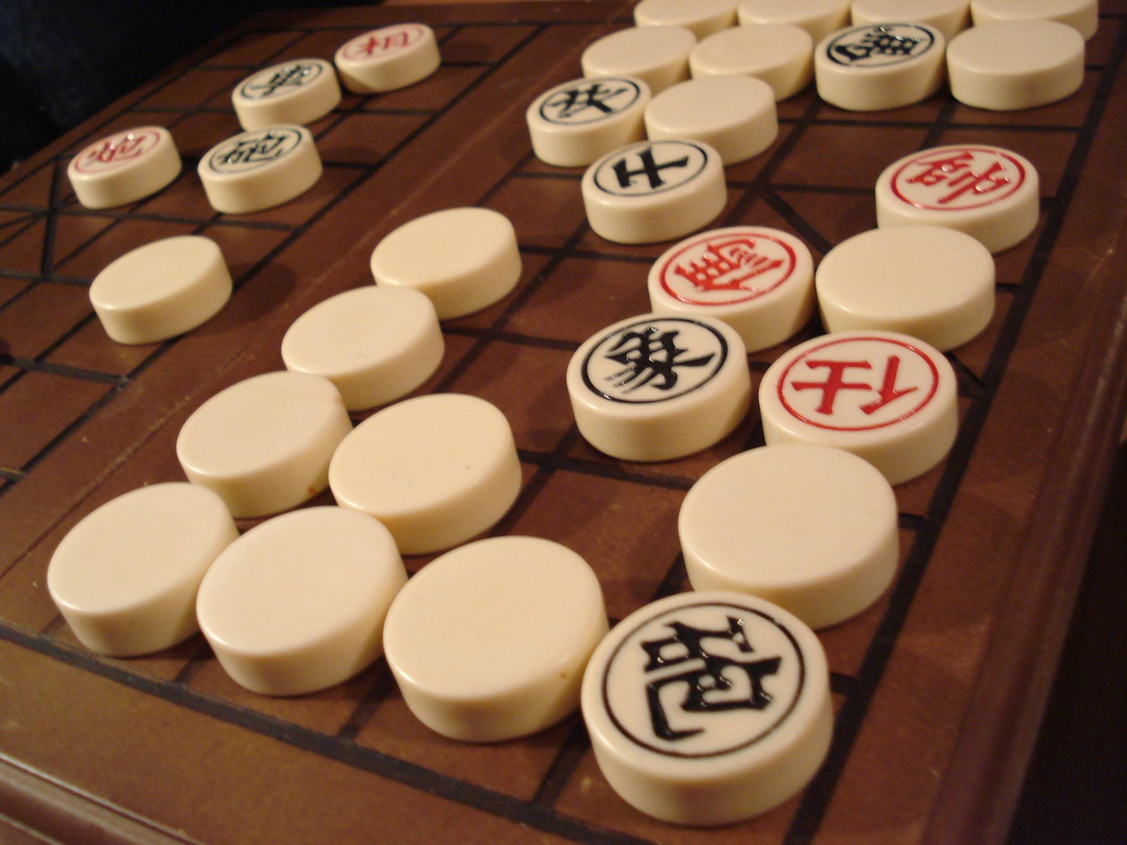
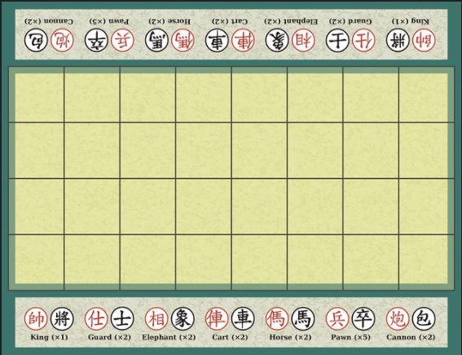
banqi
It is a two player chinese board game played on 4*8 grid(half of the chinese board). It is a social game played for fun rather than competition and lasts upto 10-20 minutes.
Other names:
Half chess, Dark chess, Blind chess.

Slide 4
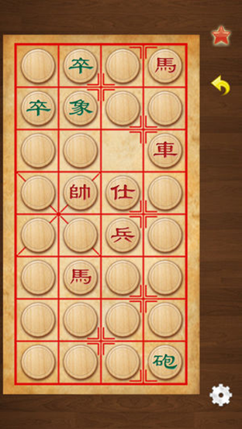
The Game play:
All the pieces are shuffled and randomly allocated face-down to squares on the board.
There are 3 moves:
Turning over a piece.
Moving a piece.
Capturing an opponent’s piece.
Ranking:
General->Chariot->Horse->Cannon,Advisor->Minister->Soldier

Slide 5
Differences in Chess and Banqi:
Chess Banqi
8*8 grid - 4*8 grid
All the pieces are known - All pieces are upside down
King can defeat any piece on board - King defeat any piece on board except pawn
Has black and white piece - Has black and red pieces

Slide 6
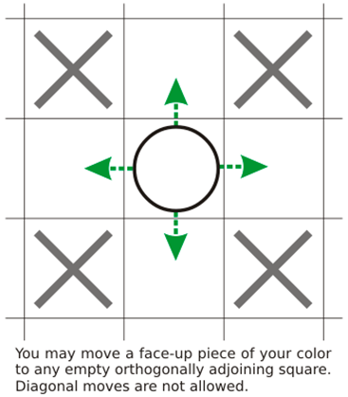
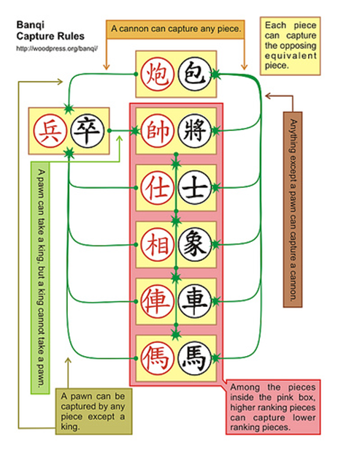
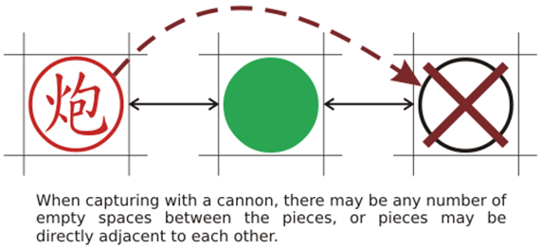
Moves & Captures

Slide 7
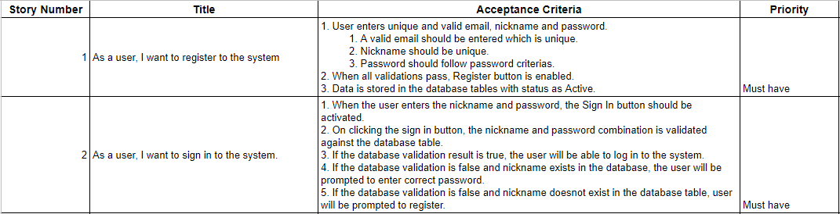
User Stories

Slide 8
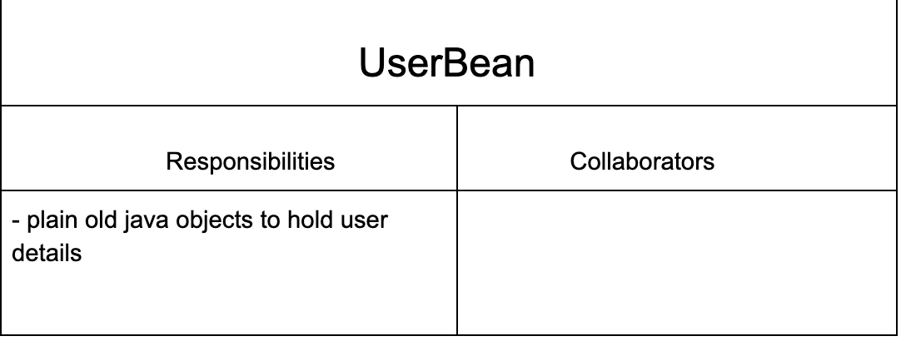
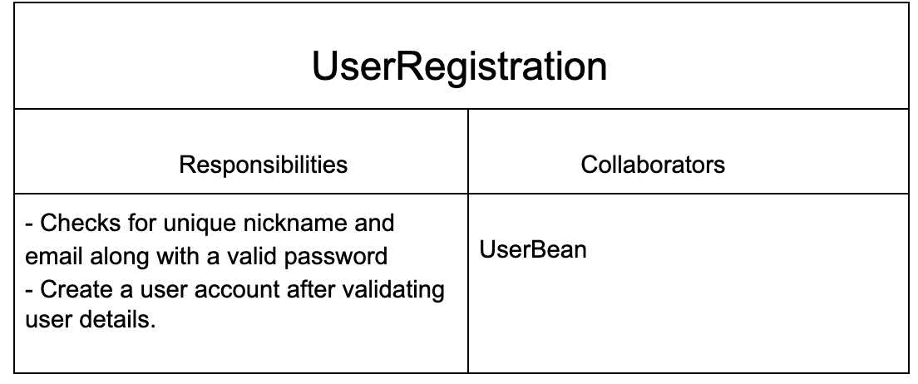
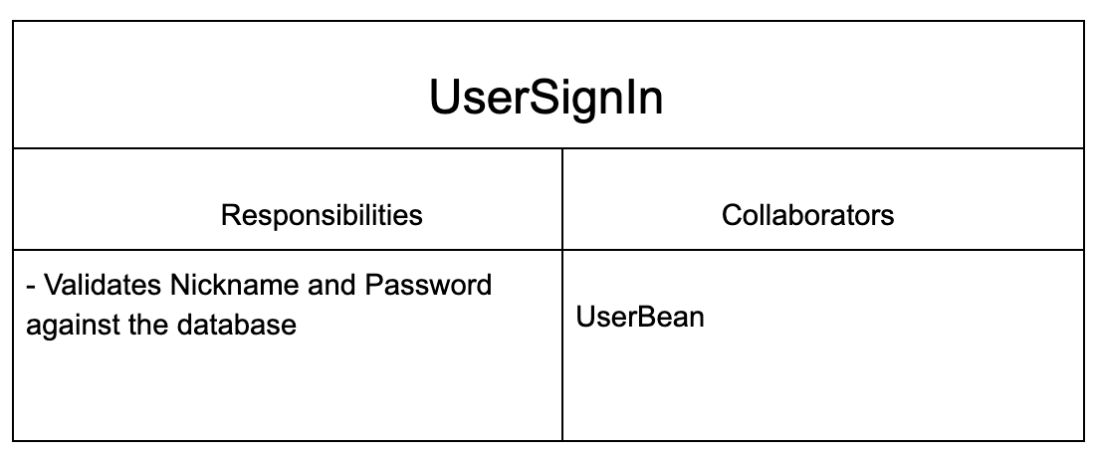
CRC CARDs

Slide 9
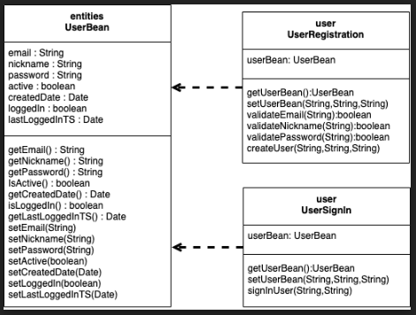
Class Diagram

Slide 10
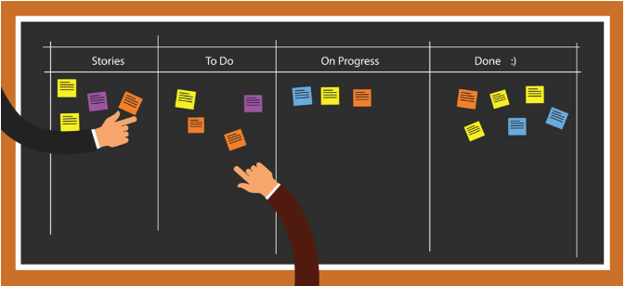
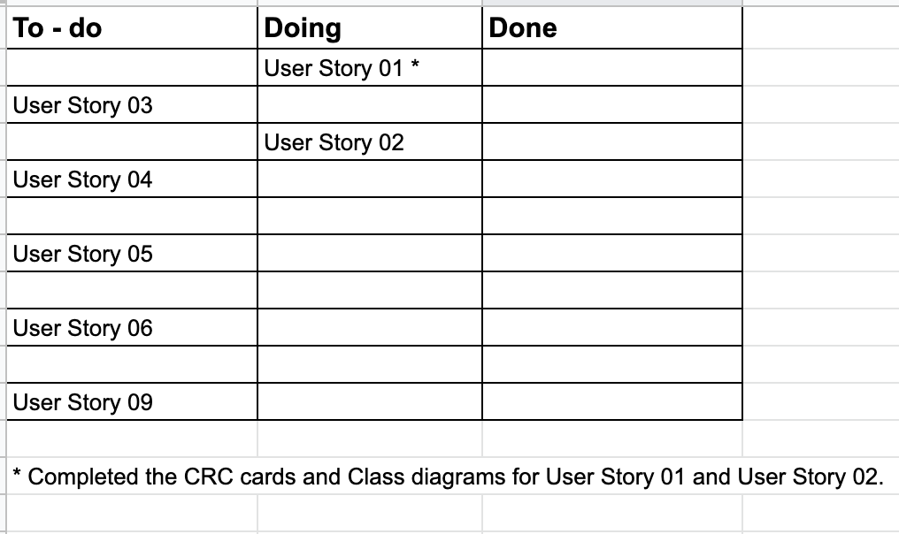
Kanban Board

Slide 11

Sprint meeting:
1. Rachit -Scrum Master, headed scrum meeting
2. Completed requirement gathering and created user stories.
3. Had a Sprint Review with PO - reviewed and added priority to user stories.
4. Reviewed the CRC cards and Class diagrams along with user tasks.
5. Decided technical Aspects
Front-end: jSwing/AngularJs
Database: MySQL

Slide 12
Tools & Technologies:
Back end: JAVA
Database: MySQL
Front end: JSwing/ Angular
IDE: Eclipse, IntelliJ Idea
Repository: Github
Testing: JUnit, Selenium, Jasmine(UI)

Slide 13
