Slide 1

UNSUPERVISED APPROACHES FOR DETECTING AND FORECASTING FRAGILE COUNTRIES
Rachit Dev
Student id: 36268

Slide 2

Index
1. Motivation and Background
2. Research Question
3. Methods
4. Results
5. Conclusion and Discussion
6. Contributions
7. Future Works

Slide 3
Motivation and Background
Fragile State: A fragile state is a country characterized by weak state capacity or weak state legitimacy leaving citizens vulnerable to a range of shocks. Mostly under developed or developing nations falls into this category. The opposite of fragile state is stable state where mostly developed country comes.
It has been seen that once the state is becoming fragile the restlessness of citizens of that country comes into play and protests takes place which turn into riots. Riots is an extreme measure which citizen or government choose to show disparity amongst each others. State sponsored riots are called as pogroms where government is involved against the citizens.
To predict such fragile countries and forecast the fragility of any state where such conditions might occur, this study is conducted.

Slide 4
Research Questions
Can Machine Learning techniques predict the future conflicts that might occur in any country across the world?
How well will an unsupervised learning technique be able to segment the countries on the basis of conflict occurrences?
How Facebook’s Prophet can forecast the fragility of a country fed with time series data?

Slide 5
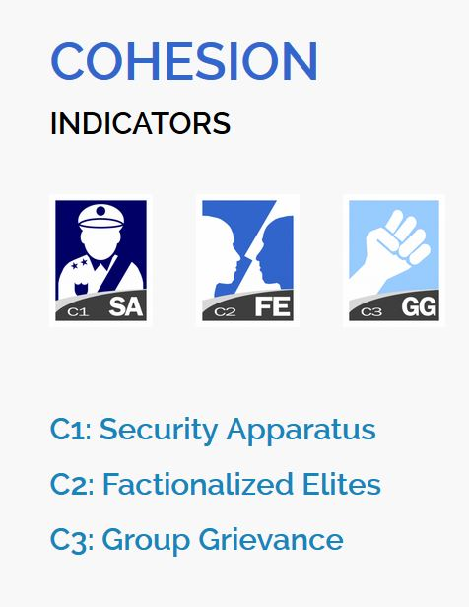
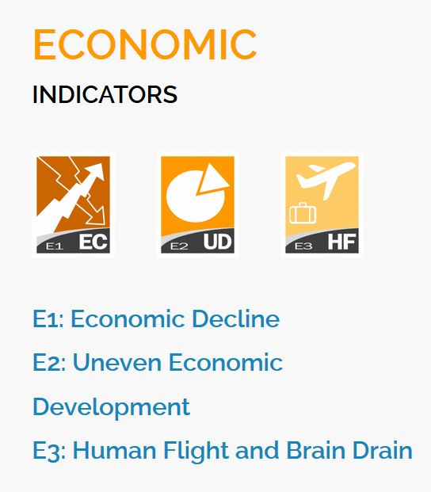
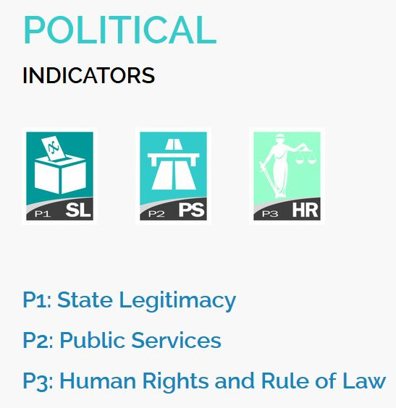
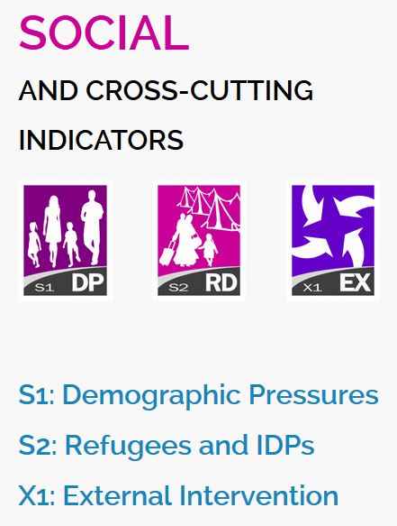
Methods
Data: There is a non profit organization known as Fund for Peace (FFP). They release annual data of all the major countries across the world that is related to the fragility of the state. The data compilation process started from 2006, hence we have used the data from 2006 to 2020. The data contains 12 indicators. For Validation data from “list of riots” is used from Wikipedia, 2020.

Slide 6
Methods (Continued)
Clustering Methods: the fragile and stable countries are clustered using 2 algorithms. K-Means and Hierarchical. Number of clusters were 2 i.e. fragile and stable. These methods are macro in nature i.e. all the countries with respect to year is being fed into the algorithm and then clustered.
Time Series Method: This is more over a micro kind of method where a test country is taken for analysis on all the indicators. The trends show if a country’s situation is deuterating with respect to each and every indicator. The time series which contains all the indicators is fed in the Facebook’s Prophet model to forecast all the indicators for the next 5 years.

Slide 7
Results
Clustering
1. The number of fragile countries are really high in number as compared to the stable countries.
2. Both the algorithms gave similar accuracy of 70%.
3. The Fowlke-Mallows score was almost equal of both the algorithms (76).
Time Series with Facebook’s Prophet
We took the test subject country “India” for analysis on each and every indicator from the year 2006 to 2020. Also the projections were made on all the indicators for the next 5 years.
The fragility of India is going high from the past performances as well as the trend. In other words India is deuterating in almost every indicator.

Slide 8
Conclusion and Discussion
The clustering algorithm gave us 70 percent of accuracy which was one of our research question that how well the segregation of fragile vs stable countries is done by our clustering algorithm.
Facebook’s Prophet model worked well in forecasting each and every indicator of India. The Fragility indicators of India are incrementing and forecasting also proves that they will deuterate more in the near future. This was one of our research question.

Slide 9
Contribution
This research exposes the real numbers of a state which defines its development and is capable to project the numbers for near future.
Using this research citizens of a particular country will know the actual status of development in their own country.
If the fragility of a country is going higher then citizens can decide to change their government or leave the country as per the choices available.
A multi national company can look at the fragility of a state before investing in that country. The MNC can incur heavy losses if the invested country becomes fragile.
This research warns the people about their country as wells as strengthens democracy worldwide.

Slide 10
Future Works
More Data can be incorporated with the FSI data like the press freedom index and democratic index. This will lead to more accurate predictions of fragile countries.
Deep learning (Long Short-Term Memory) models can be created in near future for forecasting the individual indicators of a country.
DEV-OPS and ML-OPS can be used to forecast all the indicators of all the countries and their combined report be automated.

Slide 11
Thank You

