Slide 1
Toward the understanding of the death in children with malaria
Gabriela Czanner
Student number: 12345

Slide 2
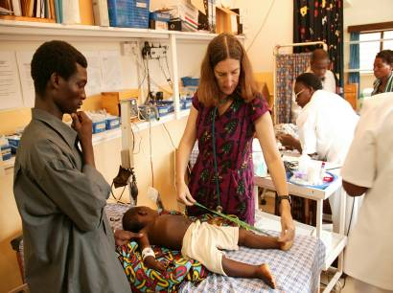
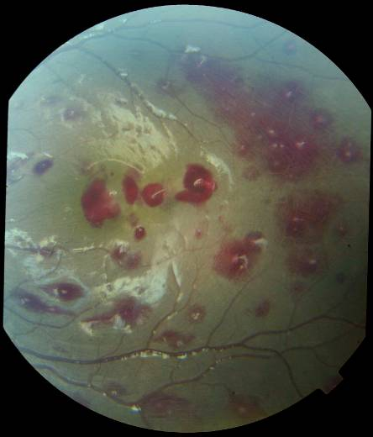
MOTIVATION AND BACKGROUND
Malaria is still a challenging public health problem in the African countries
Malaria kills about 3000 children every day (Unicef, 2019)
Detection of severity of malaria is the key
It is difficult to make diagnosis for best treatment
If we could detect severe cases then we can allocate treatment better
Brain swelling is one of known related factors of the death
It is expensive to measure (Seydel et al., 2015)
Measurement from the retina, the back of the eye, may help
During the malaria hemorrhages occur on retina, identified in case studies (MacCormick et al., 2016)

Slide 3
RESEARCH QUESTION
What clinical variables are associated with the death?
Is retinal haemorrhage associated with death?
Can we use the clinical and haemorrhage variables predict the death?

Slide 4
METHODS
Data
Data come from a cross-sectional observational study in Malawi, in 2008
Main variable: Death and survival of children (binary)
Other variables: Age, Weight, Coma duration, Blood pressure, Retinal haemorrhage variables from images (700 variables)
Missing data
We check the amount of missing data
Check patterns of missingness of the data
Complete data analysis as well as Data Imputation Methods
Principal Component Analysis
For data reduction to construct an index of retinal damage
Logistic regression
I used logistic regression to choose the model: forward, backward, and stepwise model selection criteria
I the used the logistic model to see if I can predict the death/survive

Slide 5
RESULTS
We did not find any patterns of missingness
Concluded we do not have evidence for not missing at random
PCA reduced dimensionality of imaging haemorrhage data
From 700 variables to 1
The constructed PCA index contains 78% of all the damage information
The logistic regression showed that these variables are associated with death
Age (p=0.03)
Weight (p=0.04)
The retinal damage score variables: PCA1 (p=0.02)
Coma duration (p=0.4)
The predictive model
AUROC 68% (95% CI: 52-88%)
55% specificity at 85% sensitivity
Data imputation yield similar results as above

Slide 6
CONCLUSIONS AND DISCUSSION
The age, duration of comma and weight were associated with the increased risk of death
Retinal haemorrhage damage was successfully compressed into 1 variable
The haemorrhages visible in retina are positively associated the increased risk of death
The predictive model is only 68% accurate. This is not accurate enough for death prediction

Slide 7
CONTRIBUTIONS
This study identified that it is possible to reduce the dimensionality of imaging data into one variable
I wrote a code in software R and built the predictive model that gives a probability of death for a new child
This is the first study to combines both the clinical and imaging data

Slide 8
FUTURE WORK
Different variable reduction methods can be used, such as Factor Analysis or Independent Component Analysis
I used logistic regression which requires larger sample sizes. In future, a different method can be used such as linear or quadratic discriminant analysis
The internal validation used is not sufficient. If another external data set was available, then it can be used for an external validation

