Slide 1
CEA Part 2 Estimation and Interpretation

Slide 2
CEA-2 Topics
Average, marginal and Incremental CE ratios
ICERs with two and more than two treatment options
Cost effectiveness threshold
Net Monetary Benefit
League Tables
Presentation of CEA results

Slide 3
Multiple CE Ratios
CE ratios are used to inform decision-makers about the efficiency of a given program and relative to other program alternatives.
ACER and MCER do not involve comparison between programs
ACER MCER ICER

Slide 4
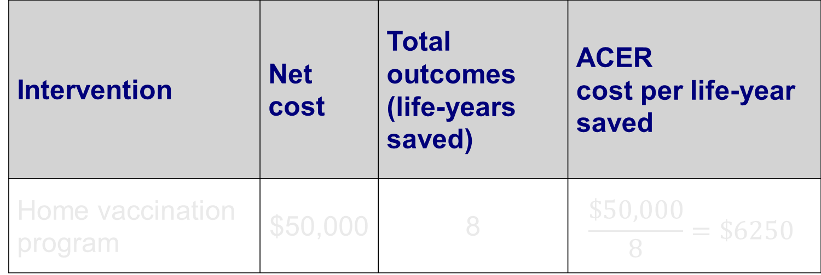
Average Cost-effectiveness Ratio (ACER )
Deals with a single intervention and evaluates that intervention against its baseline option (e.g., no program or current practice).
Is calculated by dividing the net cost of the intervention by the total number of health outcomes achieved by the intervention.
Intervention | Net cost | Total outcomes (life-years saved) | ACER cost per life-year saved
Home vaccination program | $50,000 | 8 | $$\frac{\$50,000}{8}=\$6250$$

Slide 5
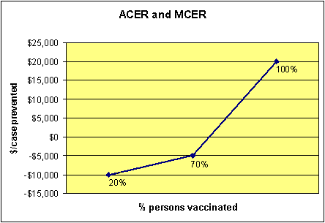
The marginal cost-effectiveness ratio (MCER) assesses the specific changes in cost and effect when a program is expanded or contracted.
ACER and MCER for a vaccination program:
At low vaccination coverage rates (70%), the ACER is negative, indicating a savings in cost. As that percentage grows, however, so does the cost per case prevented because the marginal cost per each additional person vaccinated is much higher than the average cost.
MCER=25,000/.3 = 83,333
MCER=5000/.5 = 10,000
Notes:
The ACER is shown on the vertical axis, $ per case prevented for each level of % vaccinated in the population. It is negative for low levels because it is relatively easy to get some people vaccinated and vaccination saves money by averting morbidity.
Due to diminishing returns in production, it becomes more expensive to get other people vaccinated and therefore the ACER becomes positive as you increase the % of the population vaccinated.
The MCER is determined by the changes between the points in the line graph (rise over run). Thus going from 20% of population vaccinated to 70% vaccinated results in a $5,000 increase in cost (-$5000 – - $10,000) and a .5 increase in effect (.70 - .20), for a MCER of 5000/.5 = 10,000.

Slide 6
Incremental Cost-effectiveness Ratio (ICER)
Compares the differences between the costs and health outcomes of two or more alternative interventions that compete for the same resources, and is described as the additional cost per additional health outcome.
The ICER numerator includes the differences in program costs, averted disease costs, and averted productivity losses if applicable.
The ICER denominator is the difference in health outcomes.

Slide 7
Incremental Cost-effectiveness Ratio (ICER)
We subtract the base case cost and effectiveness from those of the new intervention.
ICER Numerator C₁ – C₀
ICER Denominator E₁ – E₀
ICER = (C₁ – C₀) / (E₁ – E₀)
Where the sub-script 1 denotes the new intervention and 0 denotes the base case or control group.
Positive and negative signs should be examined for the numerator and denominator separately

Slide 8
Incremental Cost-effectiveness Ratio (ICER)
A positive denominator (increase is effectiveness) is desired and a negative denominator is acceptable within bounds (for some stakeholder negative denominator is unacceptable).
No change in the denominator is acceptable if the numerator is negative (a purely cost-saving strategy).
Negative numerator implies the new intervention is cost saving and is a good sign if the denominator is positive or zero.
Positive numerator implies the new intervention costs more and is acceptable within bounds (based on WTP per unit effect.) if the denominator is positive.
No change in the numerator is acceptable if the denominator is positive.

Slide 9
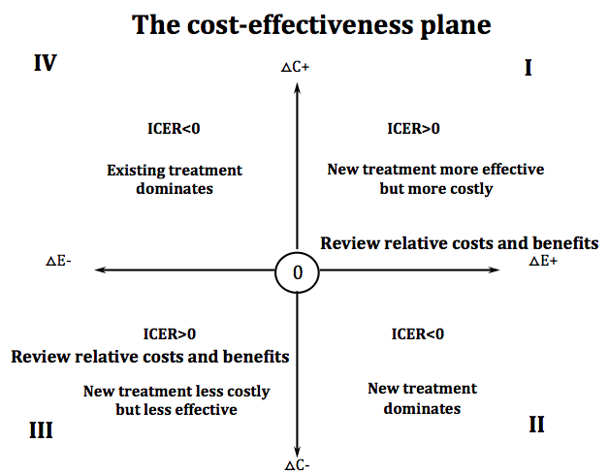
The Cost-Effectiveness Plane
Notes:
We need to consider “acceptability” in quadrant I and III

Slide 10
Cost-Effectiveness Threshold
Notes:
We need to consider “acceptability” in quadrant I and III

Slide 11
Cost-Effectiveness Threshold
When considering quadrant I establishing explicit and evidence based threshold is imperative.
Resources are limited and costs have to fall within budgets. Increase in cost in one area will often involve cutting costs in another area.
NICE uses a threshold of £ 20,000 to £ 30,000. In many studies in the US a threshold of $50,000 has been used.
There are practical and ethical considerations of the threshold.
Threshold often requires valuation of the effectiveness. Should QALY of a 5 year old, 30 year old and 70 year old be valued the same?

Slide 12
Considering multiple alternatives/options
Table 4.5 ICERs and net benefit with multiple alternatives
 | Cost | QALYs | ICERs compared to |  |  | Net benefit
 |  |  | Lowest cost (A) | Next lowest cost | Relevant alternative | $20,000 per QALY | $30,000 per QALY
A | $4,147 | 0.593 | - | - | - | $7,713 | $13,643
B | $8,363 | 0.658 | $64,862 | $64,862 | ED | $4,797 | $11,377
C | $8,907 | 0.787 | $24,536 | $4,217 | $24,536 | $6,833 | $14,703
D | $9,078 | 0.758 | $29,885 | SD | SD | $6,082 | $13,662
Notes:
We need to consider “acceptability” in quadrant I and III

Slide 13
Considering multiple alternatives/options
Multiple pairwise comparisons multiple ICERs
Example options: A, B, C and D
First rule out strongly dominated alternatives before performing ICERs. Rule out D, it is strongly dominated by C
ICER comparison:
Pick a comparison/control option and compare all other options to this control option i.e. compare B, C and D to A. Reason for picking A is often – it is the status quo or it is the least effective and least expensive alternative

Slide 14
Considering multiple alternatives/options
ICER comparison:
Order the alternatives by increasing cost and compare to the previous lowest cost
Order the alternatives by increasing QALY or effectiveness and compare to the previous lowest QALY
Ensure that ICER comparisons are performed with all relevant and acceptable alternatives.

Slide 15
Considering multiple alternatives/options
Moving from A to B is cost-effective at a threshold of $70,000/QALY
So is moving from A to C or B to C
As long as A and C exists B will never be chosen – B is not strongly dominated but dominated due to the existence of the combination A and C – B is extendedly dominated or weakly dominated by the existence of A and C together.
If threshold is $20,000/QALY only option A is viable because C should be compared with A (once B ruled out as extendedly dominated)

Slide 16
Dominance
Occurs when one treatment alternative is both more effective and less costly (or equally as costly) than another treatment alternative.
Also referred to as strong dominance
Quadrant II in slide 11 the new treatment “dominates” the existing
The existing treatment “dominates” the new treatment in quadrant IV of slide 11
Option D in slide 12 is strongly dominated by C
Notes:
Assumptions:
1) treatments are perfectly divisible
2) constant returns to scale; it is possible to deliver alternatives B and D to smaller numbers of patients without any reduction in cost-effectiveness.

Slide 17
Extended Dominance
When an option is not strongly dominated but will never be picked when compared with the options before and after it (when the options are arranged in the order of increasing cost or QALY). Often the linear combination of the options before and after will strongly dominate the extendedly dominated option
Also called weak dominance
Example: Option B in slide 12. If A is provided to 50% of the population and C to the remaining 50% the cost of this combination is $6,527 and effectiveness is 0.69 which strongly dominates B. Any linear combination of A and C dominates B.
Notes:
Assumptions:
1) treatments are perfectly divisible
2) constant returns to scale; it is possible to deliver alternatives B and D to smaller numbers of patients without any reduction in cost-effectiveness.

Slide 18
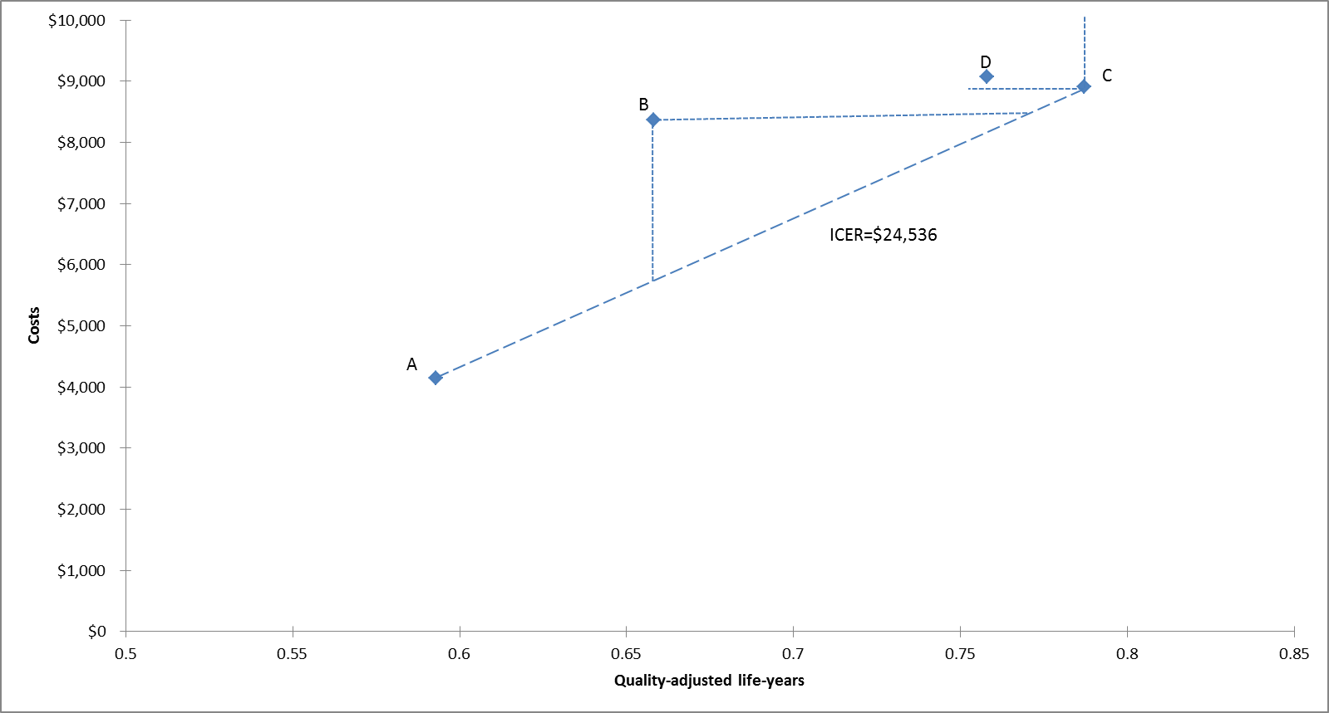
Extended Dominance
Notes:
We need to consider “acceptability” in quadrant I and III

Slide 19
Extended Dominance
For the extended dominance by a linear combination to be realistic certain assumptions have to be met
Treatments are perfectly divisible
When C and A are delivered to a smaller proportion of the population the fixed and variable costs, and effectiveness are such that the cost-effectiveness stays the same
These assumptions are often not true hence B is extendedly dominated (due to the existence of A and C) not strongly dominated

Slide 20
Disadvantages of ICERs
Issues when using ICERs
CE ratios give no indication of size or scale of treatments or programs being assessed
The numerator and denominator needs to be examined separately because the positive or negative sign of the ICER can mean opposite things if the denominator changes sign
Testing for statistical differences between ratios give rise to complications
ICERS can be negative
If the denominator of ICER is zero (no effect) the ratio is infinite
As a ratio statistic, the ICER is not easy to use in a regression analysis and regression analysis can be utilized to control for covariates and for conducting subgroup analysis.

Slide 21
Computing Net Monetary Benefit
The threshold for the ICER or the willingness to pay per unit effectiveness (R_{T}) is used to place a monetary value on the effectiveness
A positive NMB is good and a negative NMB is unacceptable

Slide 22
A program is cost-effective if it has a positive net monetary benefit (NMB):
ΔC / ΔE < R_{T ,} rearranging gives:
R_{T} ΔE – ΔC > 0
R_{T} ΔE – ΔC is the NMB of the program. The change in effectiveness (ΔE), multiplied by the decision-maker willingness to pay per unit of increased effectiveness (R_{T}), less the increase in cost (ΔC).
Example: if R_{T} = $50,000; ΔE = 10; ΔC = $200,000.
NMB = ($50,000 x 10) - $200,000 = $300,000

Slide 23
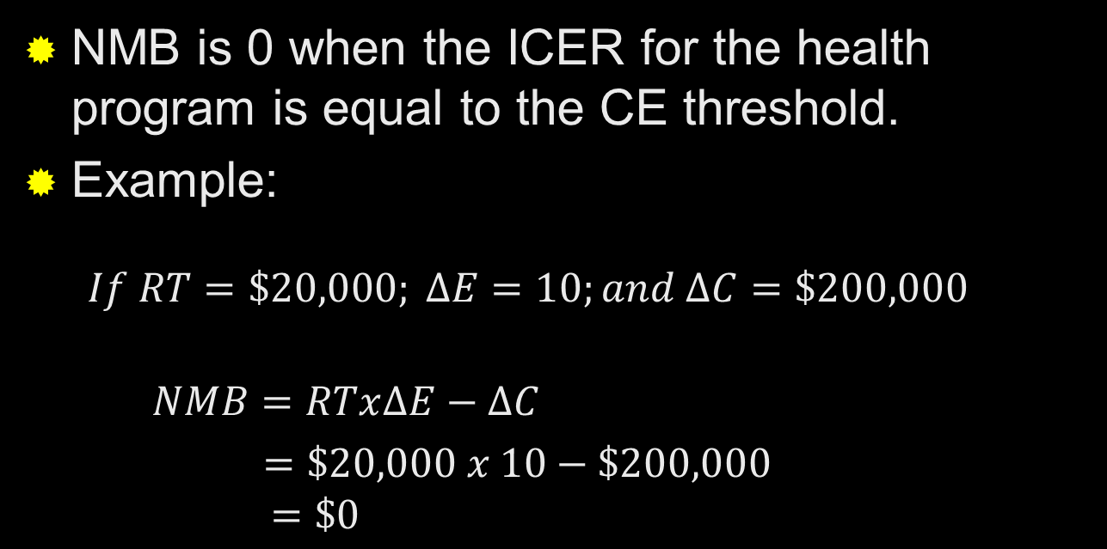
When ICER = Threshold
NMB is 0 when the ICER for the health program is equal to the CE threshold.
Example:
$$If RT=\$20,000; ∆E=10;and ∆C=\$200,000$$
$NMB=RTx∆E−∆C$
$=\$20,000 x 10−\$200,000$ $=\$0$

Slide 24
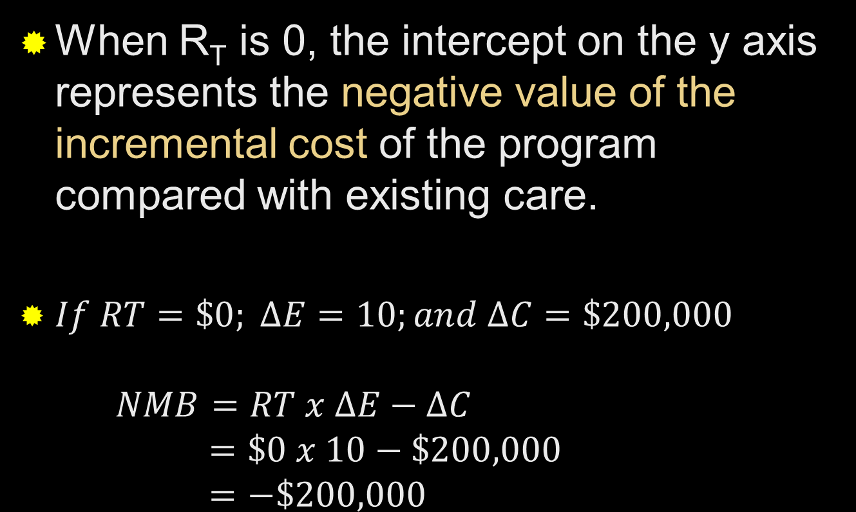
Results of NMB as function of R_{T}
When R_{T} is 0, the intercept on the y axis represents the negative value of the incremental cost of the program compared with existing care.
$If RT=\$0; ∆E=10;and ∆C=\$200,000$ $NMB=RT x ∆E−∆C$ $=\$0 x 10−\$200,000$ $=−\$200,000$

Slide 25
ICER = ΔC / ΔE
NMB= RT * ΔE – ΔC
= – ΔC + ΔE * RT
ICER for program A
Net monetary
benefit
NMB
of program A
versus existing care
ΔE is the slope
o
Value of threshold
Ratio R_{t}
– ΔC
Negative value of the
Incremental costs
Of program A
ΔC/ΔE=R_{t}
Net Monetary Benefit as a function of the threshold cost-effectiveness ratio.

Slide 26
League Tables
Rankings of cost-effectiveness of various health and medical interventions
Listing the cost per QALY of the current study with other interventions
Tufts New England Medical Center Web Site (comprehensive list of cost-utility ratios in health and medicine)
http://healtheconomics.tuftsmedicalcenter.org/cear4/Home.aspx

Slide 27
Presentation of CEA Results
The study question.
A description of the interventions.
Study perspective, time frame, and analytic horizon.
The assumptions used to build the model.
Evidence of the effectiveness of the interventions.
Identification, enumeration, and valuation of all relevant costs.
Inclusion or exclusion of productivity costs.
Discount rate.

Slide 28
Presentation of CEA Results
Results of incremental analysis.
Results of uncertainty analysis (mock-up tables).
Sensitivity analysis
Statistical analysis
Discussion of results that addresses all issues of concern and the implications of assumptions used.

Slide 29
Summary
CEA usually involves the computation of ICER. ACER and MCER are less commonly used.
Before computing the ICER all strongly dominated strategies should be excluded
Examine the numerator and denominator of the ICER to understand what the sign of the ICER implies
NMB analysis can be performed along with the ICER to make the results of the CEA more intuitive and to also use advanced regression methods if need be

