Slide 1
Introduction to Modeling
Suja S. Rajan, PhD
PH 3915

Slide 2
Session Objectives
The TreeAge Lab sessions are designed for students with limited or no previous experience of TreeAge. Students are expected to gain basic knowledge in using the TreeAge software to conduct economic evaluations. Upon completion of the sessions, the student should:
Be familiar with the basic functions in TreeAge.
Be able to construct a simple decision tree.
Learn to use TreeAge to perform cost-effectiveness analyses.
Learn to conduct sensitivity analyses.

Slide 3
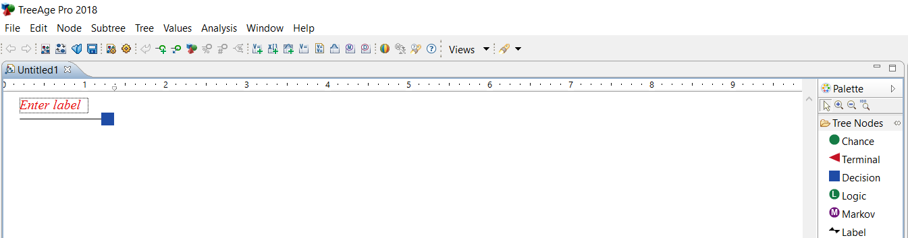
Initiating a tree

Slide 4
Initiating a tree
Treeage will open up a blank page with a decision node (root node)
This is called the Tree diagram editor
You see a blank box where you can enter the label
What is the difference between:
Decision node
Chance node
To add branches to a node (use any of the methods below):
Double click on the node
Use Control + A
Use add braches menu on top (under the “Node” menu)
You can repeat the above three options multiple times to add more branches to a node

Slide 5
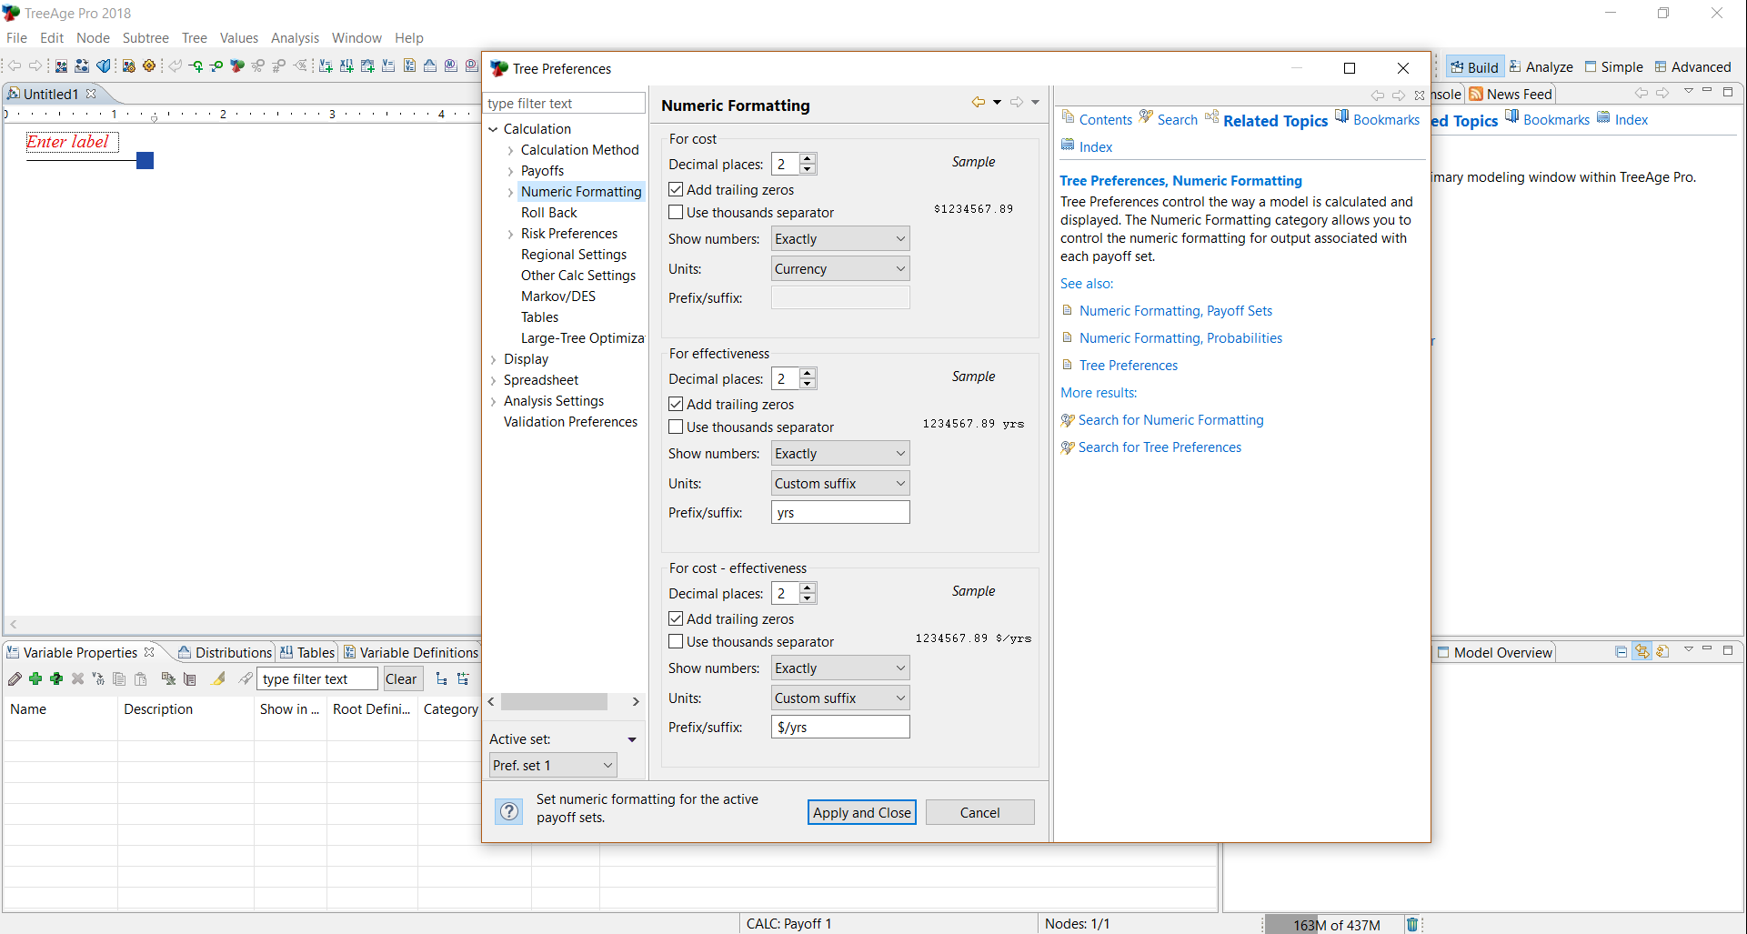
Initiating a tree – Tree preferences (F11 or option under “Edit” or “Tree” menu)

Slide 6
Tree Nodes
Decision Node
The first one is called root node.
Represents choice between several strategies.
Strategies are under control of the stakeholders/interventionists/researchers.
Each branch after a decision node is a mutually exclusive intervention/strategy.
We can have branches that are combinations of two interventions/strategies.
Surgery
Medical Management

Slide 7
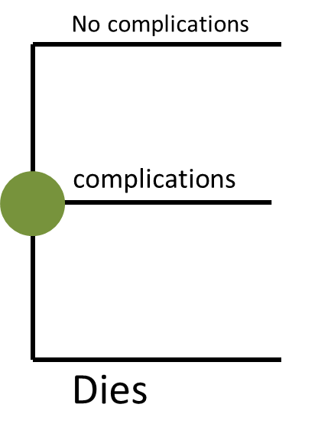
Tree Nodes
Chance Node
Represents various “uncertain” outcomes that can occur after a path has been picked.
Occurrences are not under control of the stakeholders/ interventionists/researchers.
When we create a particular occurrence after a chance node we are required to enter a probability for the occurrence.
Branches/occurrences originating from the same chance node need to have probabilities that add up to one.

Slide 8
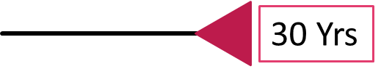
Tree Nodes
Terminal Node
Final node after a path of choices or chances.
This is the node where the final payoffs are computed/analyzed for each pathway.
When terminal node is picked a dialogue box pops up where we can enter costs, QALYs, effectiveness, other payoffs.
We can align all the terminal nodes, if that is visually easier to examine the outcomes – each pathway can be of varying lengths, so the alignment readjusts arm lengths to make the terminal nodes line up.
Notes:
Endnode alignments are under – edit – tree preferences – display – tree/editing layout – pick the box labeled “align endnodes”.

Slide 9


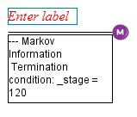
Tree Nodes
Logic Node
Like a chance node but with logical expressions (true/false) instead of probabilities.
Given the options only one of the branches can be “True” after a chain of events, and this can change based on changes in past information.
Label Node
Chance node with probability 100%
Markov Node
Start of a Markov model

Slide 10
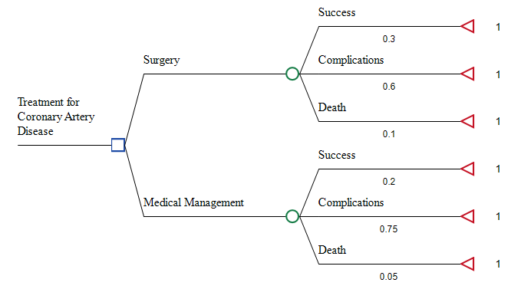
Example Tree
Occurrences with probabilities
Strategies
Payoffs
Probabilities, Costs, QALYs, and Other Payoffs are obtained from the literature, or from ongoing studies.

Slide 11
Right Click Options for a Node (Options also under the “Node” menu)
Defining (Entering) Variables
Edit Payoffs
Entering costs, QALYs, other outcomes/payoffs
Use custom payoff names
Insert Node
Inserting a branch in any direction
Change (Node) Type
Edit Probabilities
Purpose of #

Slide 12
Tree design
Change angles of the branches
“Edit” Menu – Tree Preferences – Display – Tree editing/layout
Branches can be moved up or down using a mouse or touchscreen
Copying sets of branches
Use shift or control to click on all end nodes of branches to be copied; Right click and copy or Control+C; Click on the node from where the set of branches should originate; Right click and paste or Control+P

Slide 13
Analysis (All analyses are listed under the “Analysis” menu/tab)
Roll Back (we can undo the rollback and edit the tree further)
Set Willingness-To-Pay under Tree Preferences
“Edit” (or “Tree”) Menu – Tree Preferences – Calculation – Calculation Method – Cost-Effectiveness – Cost-Eff Params (WTP)
Cost Effectiveness Analysis Graph
Net Monetary Benefit versus Willingness-To-Pay Graph
Sensitivity Analysis

Slide 14
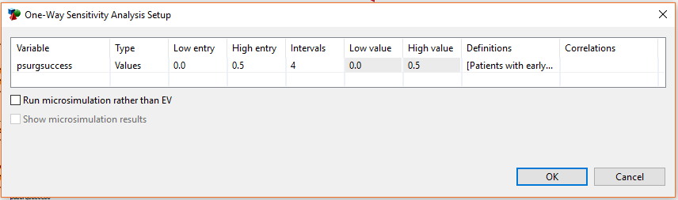
Sensitivity Analysis
One-way Sensitivity Analysis
Two-way and Three-way Sensitivity Analyses
Threshold Analysis

Slide 15
Questions?

