Slide 1

Chapter 2: Supply and Demand: The Basics

Slide 2
Learning Objectives
How the price of a good or service affects the quantity demanded by buyers
How other market conditions affect demand
How the price of a good affects the quantity supplied by sellers
How other market conditions affect supply
How supply and demand interact to determine the market price of a good or service
Why market prices and quantities change in response to changes in market conditions
What the unintended consequences are of price floors and price ceilings

Slide 3
Chapter Outline (Slide 1 of 2)
Demand
The Demand Curve
Shifts in the Demand Curve
Changes in the Price of Another Good
Changes in Consumer Incomes
Changes n Expectations
Changes in Tastes
Supply
The Supply Curve
Shifts in the Supply Curve
Changes in Technology
Changes in Input Prices
Changes in the Prices of Other Goods
Changes in Expectations

Slide 4
Chapter Outline (Slide 2 of 2)
Interaction of Supply and Demand
Market Equilibrium
Shortages
Surpluses
Changes in Market Conditions
Response to a Shift in Demand
Response to a Shift in Supply
A Shift in One Curve or Both?
Price Floors and Ceilings
Price Supports: The Market for Milk
Price Ceilings: The Case of Rent Control
Intended Effects
Unintended Effects
Equilibrium as Spontaneous Order
Some Closing Thoughts

Slide 5
Introduction
Demand: the willingness and ability of buyers to purchase goods
Supply: the willingness and ability of sellers to provide goods for sale in a market

Slide 6
Demand
Law of demand: the principle that an inverse relationship exists between the price of a good and the quantity of that good that buyers demand, other things being equal
Quantity demanded tends to rise as prices fall, and vice versa—happens for two reasons:
If the price of one good falls while the prices of other goods stay the same, substitution of goods for a cheaper good is likely.
When the price of one good falls while incomes stay the same, people feel more wealthy and use their added buying power to purchase more.
Demand combines the willingness and ability to buy.

Slide 7
The Demand Curve
Demand curve: a graphical representation of the relationship between the price of a good and the quantity of that good that buyers demand
Change in quantity demanded: a change in the quantity of a good that buyers are willing and able to purchase that is caused by a change in the price of a good, other things being equal; shown by a movement from one point to another along a demand curve

Slide 8
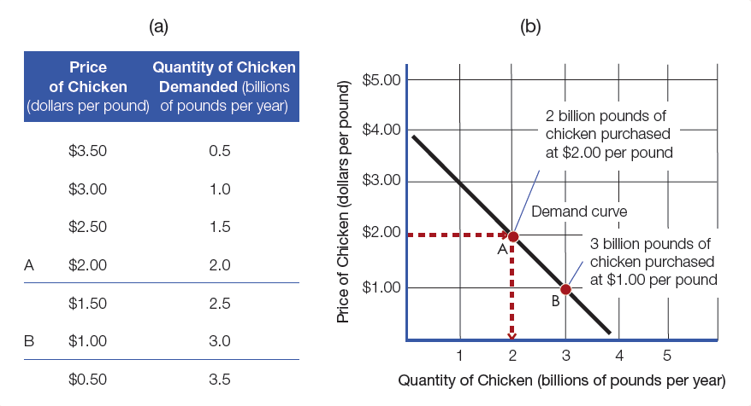
Figure 2-1: A Demand Curve for Chicken

Slide 9
Shifts in the Demand Curve (Slide 1 of 4)
Changes in variables other than price can also affect people’s buying decisions (i.e., the price of competing goods, changes in consumer’s incomes)
Two rules apply to graphically represent this:
“Other things being equal” clause shows the effect of a change in price on quantity demanded in the form of a movement along the demand curve.
The effect of any other good or service creates a shift in the demand curve

Slide 10
Shifts in the Demand Curve (Slide 2 of 4)
Changes in the Price of Another Good
Change in quantity demanded: shown as a movement along the demand curve
Change in demand: a change in the quantity of a good that the buyers are willing and able to purchase that is caused by a change in some condition other than the price of that good; shown as a shift in the demand curve
Substitutes: a pair of goods for which an increase in the price of one causes an increase in demand for the other
Complementary goods: a pair of goods for which an increase in the price of one causes a decrease in demand for the other

Slide 11
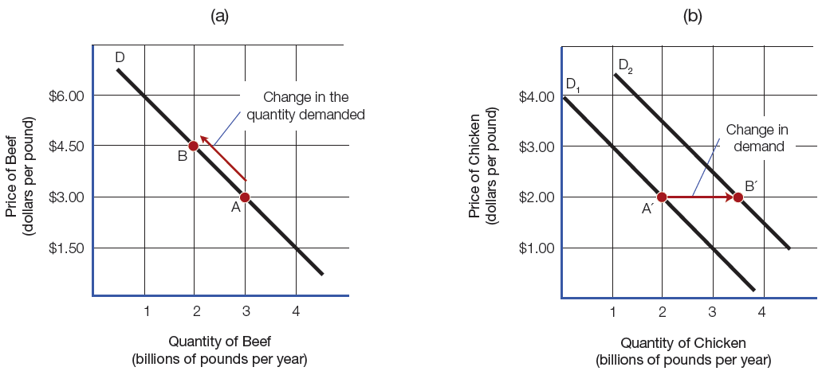
Figure 2-2: Effects of an Increase in the Price of Beef on the Demand for Chicken

Slide 12
Shifts in the Demand Curve (Slide 3 of 4)
Changes in Consumer Incomes—people tend to buy larger quantities of many goods when their incomes rise, assuming that prices do not change.
Normal good: a good for which an increase in consumer income results in the increase in demand
Inferior good: a good for which an increase in consumer incomes results in a decrease in demand

Slide 13
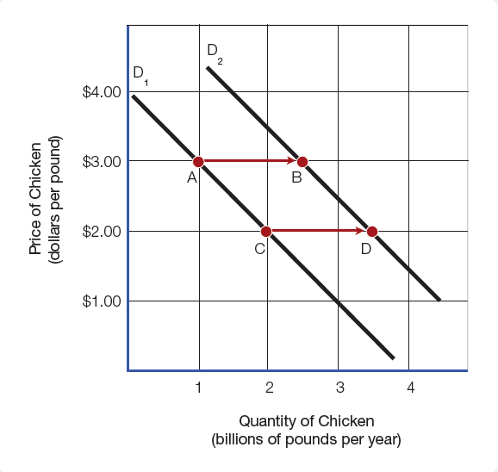
Figure 2-3: Effects of an Increase in Consumer Income on the Demand for Chicken

Slide 14
Shifts in the Demand Curve (Slide 4 of 4)
Changes in buyer’s expectations can also shift demand curves.
Changes in tastes can also cause an increase or decrease in demand.
Such changes can occur rapidly or gradually.

Slide 15
The Supply Curve
Supply curve: a graphical representation of the relationship between the price of a good and the quantity of that good that sellers are willing to supply
Quantity supplied increases as demand goes up, and vice versa.
Positive supply curve slope can be explained by:
Producers’ responses to market incentives
Rising cost of producing additional output facilities of a fixed size
Comparative advantage and opportunity cost

Slide 16
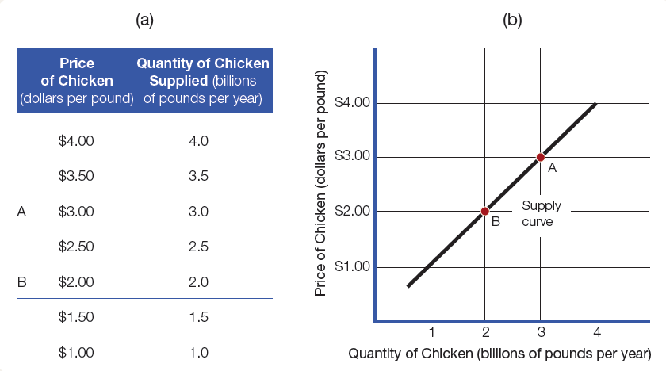
Figure 2-4: A Supply Curve for Chicken

Slide 17
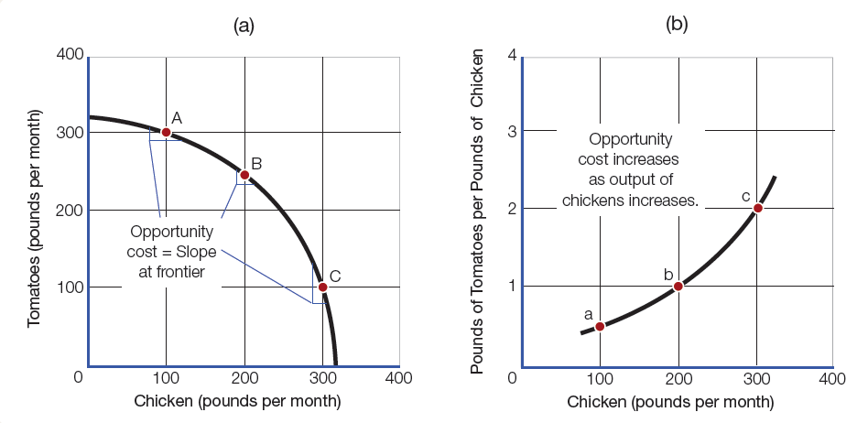
Figure 2-5: The Production Possibility Curve and the Supply Curve

Slide 18
Shifts in the Supply Curve (Slide 1 of 2)
Change in quantity supplied: a change in the quantity of a good that suppliers are willing and able to sell that is caused by a change in the good’s price, other things being equal; shown by a movement along a supply curve
Change in supply: a change in the quantity of a good that suppliers are willing and able to sell that is caused by a change in some condition other than the good’s price; shown by a shift in the supply curve

Slide 19
Shifts in the Supply Curve (Slide 2 of 2)
Factors that can cause a shift in the supply curve:
Changes in Technology
Changes in Input Prices
Changes in the Prices of Other Goods
Changes in Expectations

Slide 20
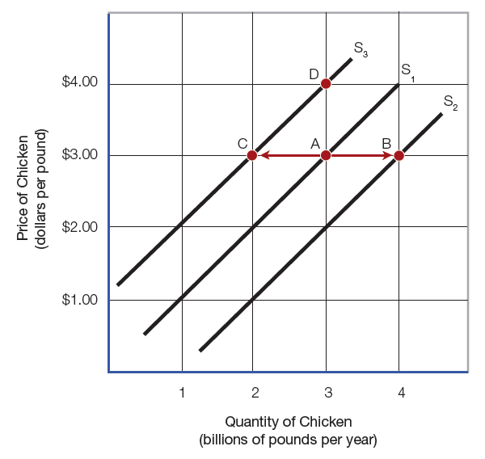
Figure 2-6: Shifts in the Supply Curve for Chicken

Slide 21
Market Equilibrium
Equilibrium: a condition in which buyers’ and sellers’ plans exactly mesh in the marketplace, so that the quantity supplied exactly equal s the quantity demanded at a given price

Slide 22
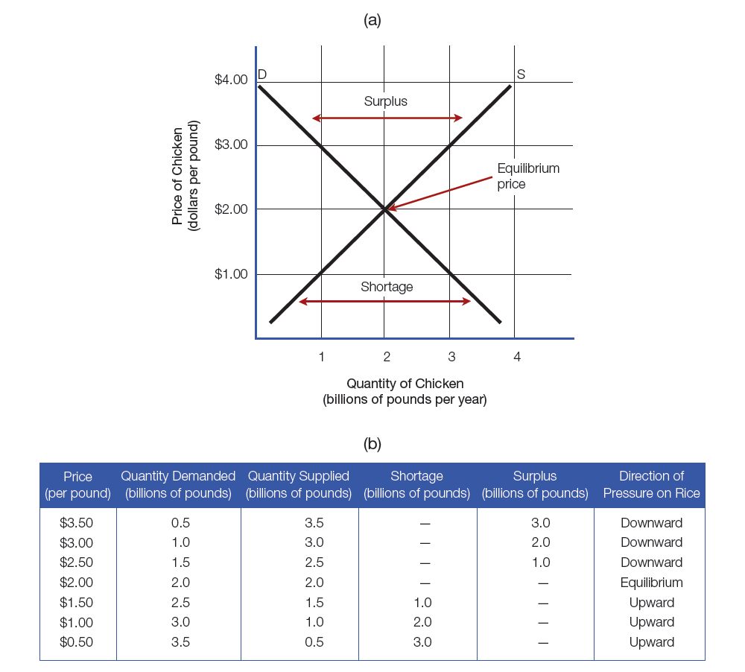
Figure 2-7: Equilibrium in the Chicken Market

Slide 23
Shortages
Excess quantity demanded (shortage): a condition in which the quantity of a good demanded at a given price exceeds the quantity supplied
First sign of a shortage is usually a decrease in inventory—a stock of a good awaiting sale or use.
To rebuild inventory: reduce output, increase price, or a combination of both
As price changes, buyers also adjust, reducing purchases.
Different for markets for services—no inventory—formation of a queue

Slide 24
Surpluses
Excess quantity supplied (surplus): a condition in which the quantity of a good supplied at a given price exceeds the quantity demanded
Inventories will grow
Sellers will cut output, decrease prices, or a combination of both
Buyers will adjust by increasing purchases
Markets with no inventory will react to surpluses by increasing the queue of sellers looking for customers.

Slide 25
Changes in Market Conditions
Response to a Shift in Demand—movement along the supply curve, not a shift in the curve
Response to a Shift in Supply—supply curve would shift and demand curve would remain the same
A Shift in One Curve or Both?
Both curves do not always shift.

Slide 26
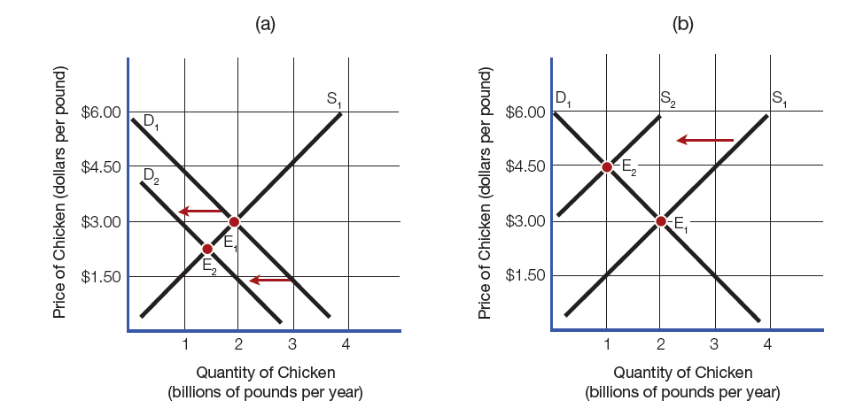
Figure 2-8: Effects of Changing Conditions in the Chicken Market

Slide 27
Price Supports: The Market for Milk
Price floor: lowest price to be charged for a good or service
Example used in the textbook is the milk price support program.
Problems occur with price floors.
Floor can be consistently higher than the equilibrium price causing surplus.

Slide 28
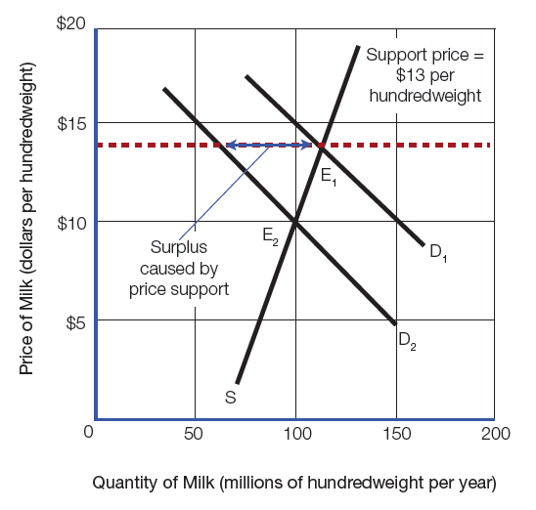
Figure 2-9: Price Supports for Milk

Slide 29
Price Ceilings: The Case of Rent Control
Using price ceilings in the form of rent control to prevent landlords from charging “unreasonably high” rents
Intended Effects
Lower rents
Unintended Effects
Shortage of housing
More housing discrimination

Slide 30
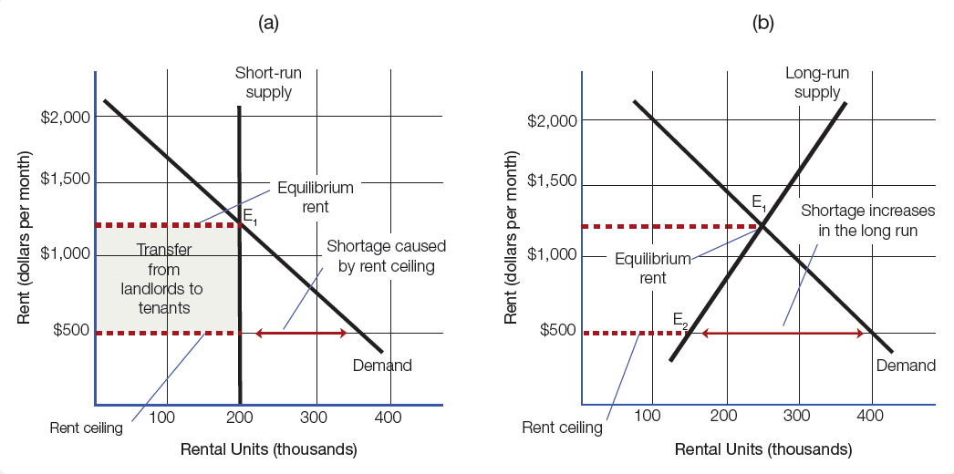
Figure 2-10: Effects of Rent Control

Slide 31
Chapter Summary (Slide 1 of 6)
How does the price of a good or service affect the quantity that buyers demand?
Demand: the willingness and ability of buyers to purchase goods and services
Law of demand: there is a universal relationship between the price of a good and the quantity demanded
Quantity demanded: amount buyers will purchase at a given price
Law of demand can be represented with a negatively sloped demand curve.
Movement upon the demand curve shows a change in quantity demanded

Slide 32
Chapter Summary (Slide 2 of 6)
How do other market conditions affect demand?
Change in demand: a change in any of the variables covered by the “other things being equal” clause causes a shift in the demand curve
For example, changes in prices of goods that are substitutes or compliments, as well as changes in consumers’ incomes

Slide 33
Chapter Summary (Slide 3 of 6)
How does the price of a good affect the quantity supplied by sellers?
Supply: sellers’ willingness and ability to offer products for sale in a market
Increase in the price of a good will increase the quantity of a good supplied, in most markets
Expressed on a positively sloped supply curve

Slide 34
Chapter Summary (Slide 4 of 6)
How do changes in other market conditions affect supply?
Change in any items covered by “other things being equal” clause will shift supply curve
How do supply and demand interact to determine the market price of a good or service?
Equilibrium price: the price at which the quantity of a good that sellers plan to supply will exactly match the quantity that buyers plan to purchase

Slide 35
Chapter Summary (Slide 5 of 6)
Why do market prices and quantities change in response to changes in market conditions?
Change in market condition, shifts the supply or demand curve, changes the equilibrium price and quantity
Demand curve shifts to the right for a normal good if consumer incomes increase.
Causes a shortage
Supply curve shifts to the right if there is a technological advancement, etc.
Causes a surplus

Slide 36
Chapter Summary (Slide 6 of 6)
What are the unintended consequences of price floors and price ceilings?
Price floors lead to persistent surpluses.
Price ceilings lead to persistent shortages, which become more severe over time.

