Slide 1

Chapter 3: Supply, Demand, and Elasticity

Slide 2
Learning Objectives
What economists mean by elasticity
The relationship of demand to revenue
How economists apply the concept of elasticity to changes in market conditions
How elasticity helps in understanding issues of public policy

Slide 3
Chapter Outline (Slide 1 of 2)
Elasticity
Price Elasticity of Demand
Calculating Elasticity of Demand
The Midpoint Formula for Elasticity
Elasticity Numbers and Terminology
Varying- and Constant-Elasticity Demand Curves
Determinants of Elasticity of Demand
Substitute, Complements, and Elasticity
Price versus Opportunity Cost
Time Horizon and Elasticity

Slide 4
Chapter Outline (Slide 2 of 2)
Income Elasticity of Demand
Cross Elasticity of Demand
Price Elasticity of Supply
Applications of Elasticity
Gas Tax or Mileage Standards
Elasticity and Prohibition

Slide 5
Elasticity (Slide 1 of 2)
Elasticity: a measure of the ratio of a change in one variable to a change in another, expressed as a percentage
Price elasticity of demand: the ratio of the percentage change in the quantity of a good demanded to a given percentage change in its price, other things being equal
Effects the way a change in price affects the revenue (price multiplied by quantity sold) that sellers earn from the good in question

Slide 6
Elasticity (Slide 2 of 2)
Elastic demand: a situation in which quantity demanded changes by a larger percentage than price, so that total revenue increases as price decreases
Inelastic demand: a situation in which quantity demanded changes by a smaller percentage than price, so that total revenue decreases as price decreases
Unit elastic demand: a situation in which price and quantity demanded change by the same percentage, so that total revenue remains unchanged as price changes
Perfectly elastic demand: a situation in which the demand curve is a horizontal line

Slide 7
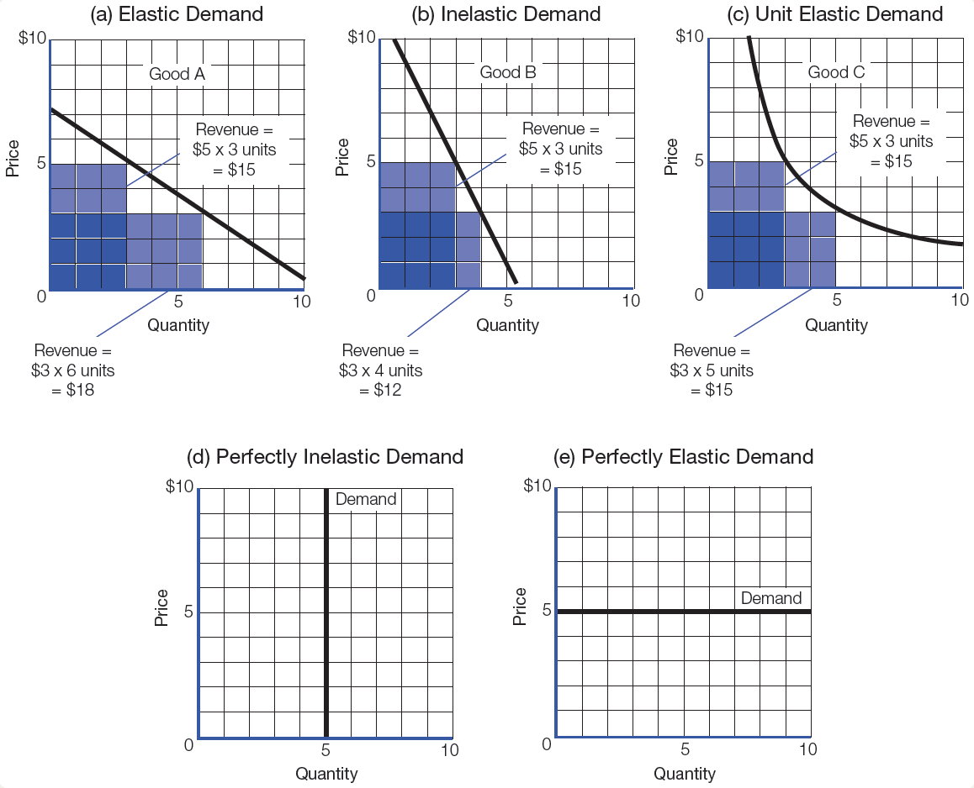
Figure 3-1: Price Elasticity of Demand

Slide 8
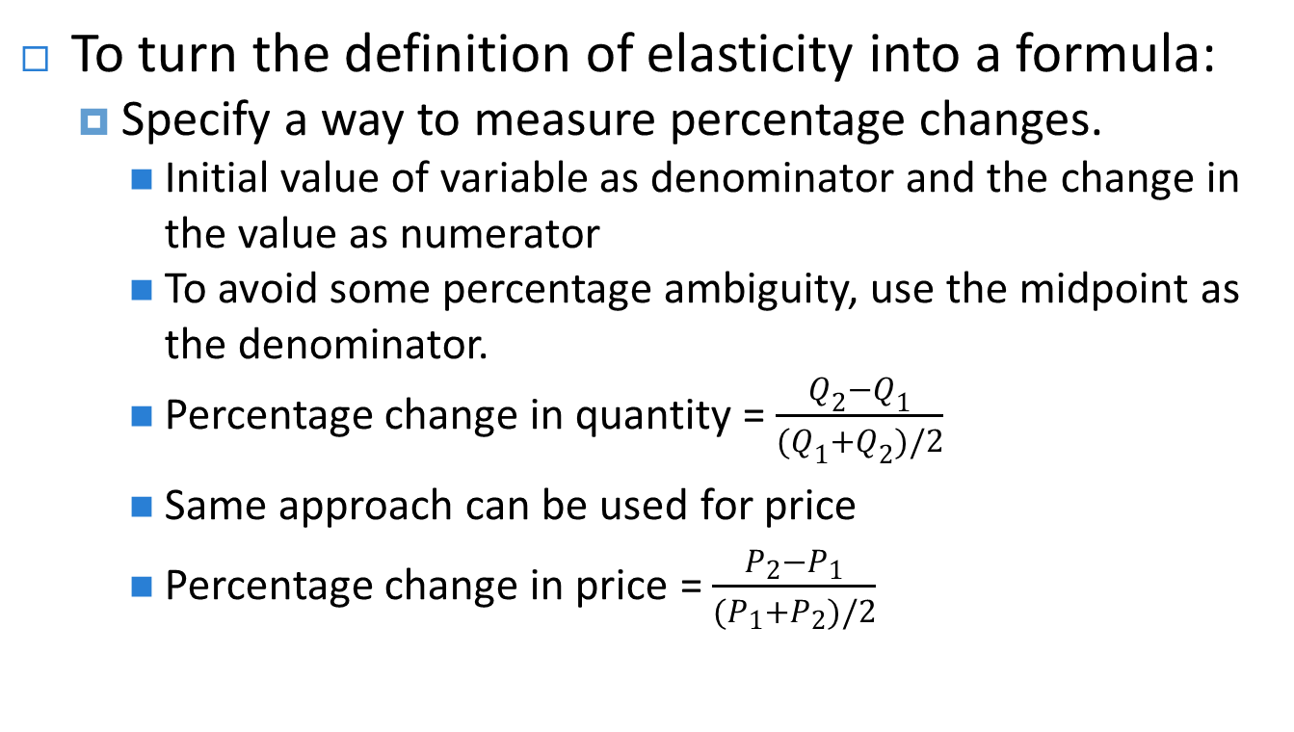
Calculating Elasticity of Demand (Slide 1 of 2)
To turn the definition of elasticity into a formula:
Specify a way to measure percentage changes.
Initial value of variable as denominator and the change in the value as numerator
To avoid some percentage ambiguity, use the midpoint as the denominator.
Percentage change in quantity = $\frac{Q_{2}−Q_{1}}{(Q_{1}+Q_{2})/2}$
Same approach can be used for price
Percentage change in price = $\frac{P_{2}−P_{1}}{(P_{1}+P_{2})/2}$

Slide 9
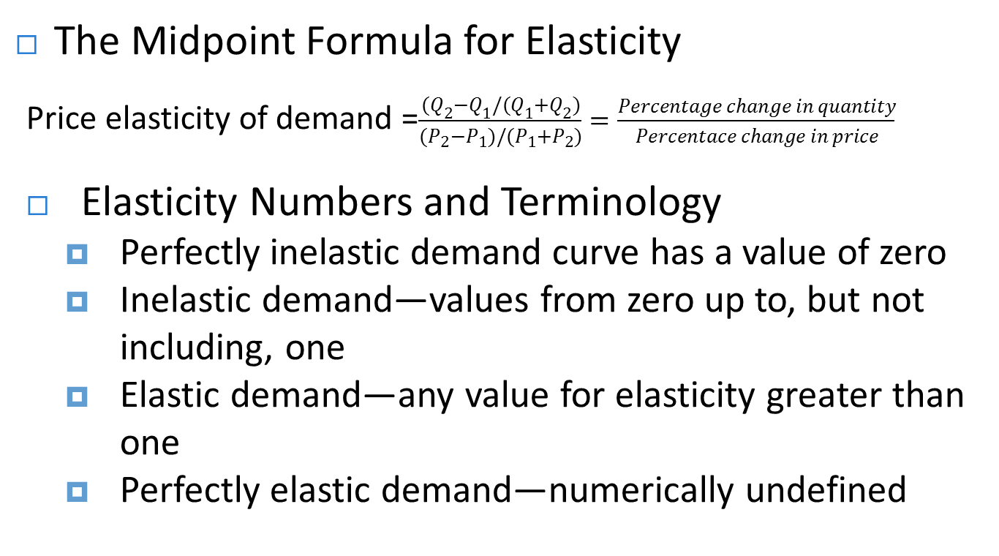
Calculating Elasticity of Demand (Slide 2 of 2)
The Midpoint Formula for Elasticity
Price elasticity of demand =$\frac{(Q_{2}−Q_{1}/(Q_{1}+Q_{2})}{(P_{2}−P_{1})/(P_{1}+P_{2})}=\frac{Percentage change in quantity}{Percentace change in price}$
Elasticity Numbers and Terminology
Perfectly inelastic demand curve has a value of zero
Inelastic demand—values from zero up to, but not including, one
Elastic demand—any value for elasticity greater than one
Perfectly elastic demand—numerically undefined

Slide 10
Varying- and Constant-Elasticity Demand Curves
The elasticity of demand for the same good may be the same or different, depending on the shape of the demand curve.
General rule: Elasticity decreases as one moves down and to the right along a straight-line demand curve.
Demand curves do not always have to be straight lines.

Slide 11
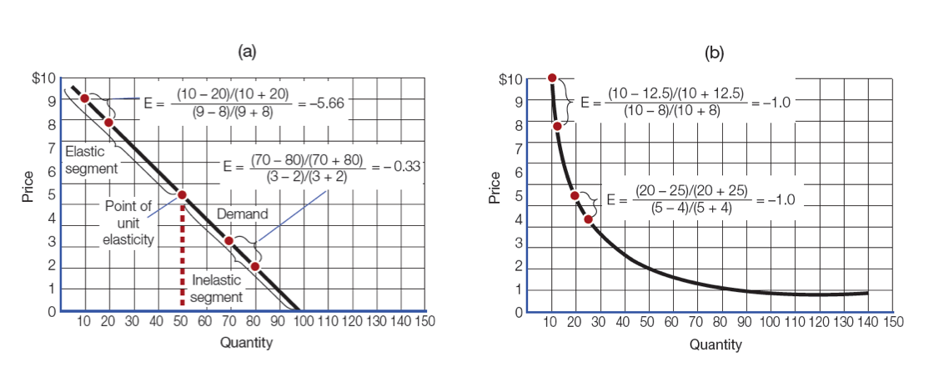
Figure 3-2: Elasticity at Various Points along a Demand Curve

Slide 12
Determinants of Elasticity of Demand (Slide 1 of 2)
Substitutes, Complements, and Elasticity
Demand tends to be more elastic when a good has close substitutes.
Demand for a good tends to be more elastic the narrower the definition of the good.
Substitution offers more elasticity.
Price versus Opportunity Cost
Price is often a good indicator of opportunity cost.
Price can be separated from opportunity cost.

Slide 13
Determinants of Elasticity of Demand (Slide 2 of 2)
Time Horizon and Elasticity
Demand is typically less elastic in the short run.
Elasticity tends to be greater in the long run.
Adjustment to change in price may require change in kind or quantity of goods too.
An increase in the price of a good encourages entrepreneurs to develop substitutes.
Slow adjustment in consumer tastes

Slide 14
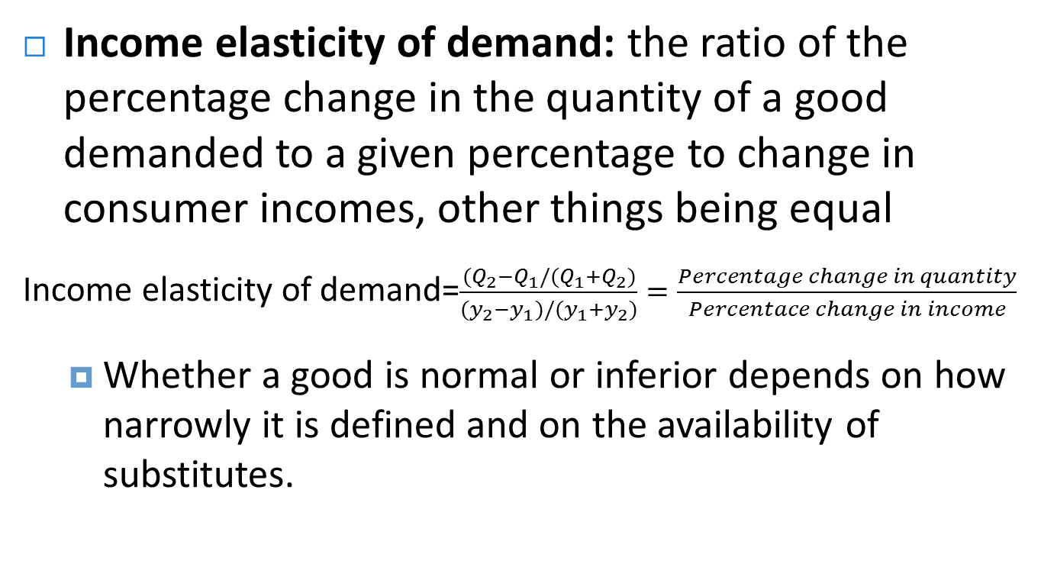
Income Elasticity of Demand
Income elasticity of demand: the ratio of the percentage change in the quantity of a good demanded to a given percentage to change in consumer incomes, other things being equal
Income elasticity of demand=$\frac{(Q_{2}−Q_{1}/(Q_{1}+Q_{2})}{(y_{2}−y_{1})/(y_{1}+y_{2})}=\frac{Percentage change in quantity}{Percentace change in income}$
Whether a good is normal or inferior depends on how narrowly it is defined and on the availability of substitutes.

Slide 15
Cross Elasticity of Demand
Cross elasticity of demand: the ratio of the percentage change in the quantity of a good demanded to a given percentage change in the price of some other good, other things being equal
Provides a new way of measuring the relationships of substitutes and complements

Slide 16
Price Elasticity of Supply
Price elasticity of supply: the ratio of the percentage change in the quantity of a good supplied to a given percentage change in its price, other things being equal
Equation for calculating midpoint is similar to that of determining price elasticity of demand, but the Qs now refer to quantity supplied.
Several conditions can affect elasticity of supply.

Slide 17
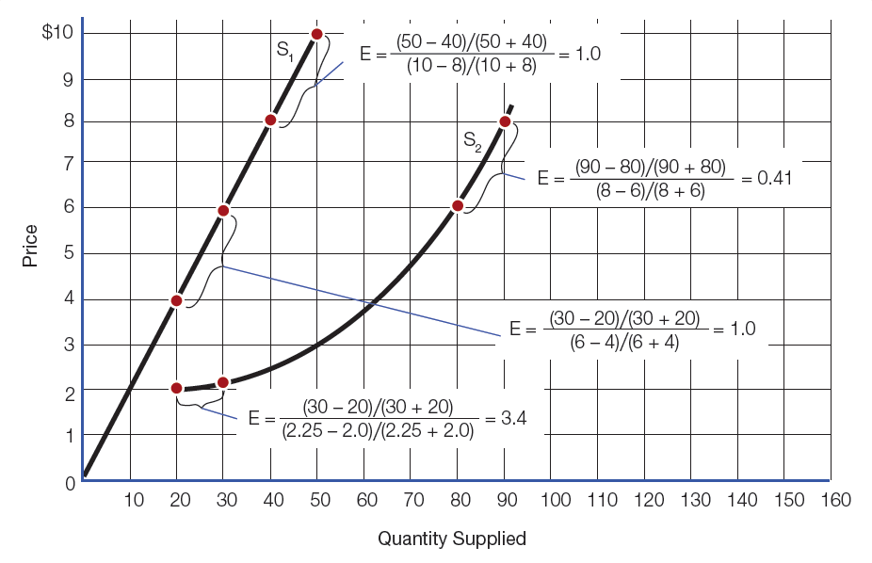
Figure 3-3: Calculating Price Elasticity of Supply

Slide 18
Applications of Elasticity
Gas Tax or Mileage Standards?
Government continues to increase Corporate Average Fuel Economy standard (CAFE standard) for passenger cars
27.5 mpg by 2025
Purchase more fuel-efficient vehicles
Relative merits of CAFE standards versus fuel taxes depend critically on the price elasticity of demand for fuel.

Slide 19
Elasticity and Prohibition (Slide 1 of 2)
Ultimate goal of prohibition is to reduce quantity sold to zero.
Similarities between prohibition and taxation
If price rises enough to supply prohibited good, lawbreakers will supply it—costs are an implicit tax.
Effect of prohibition is to shift a good’s supply curve to the left.
Effects of prohibition depend on the elasticities of demand and supply.

Slide 20
Elasticity and Prohibition (Slide 2 of 2)
Elasticity of demand is important in understanding the intended and unintended consequences of prohibition.
Intended: reduce or eliminate use of product
Where demand is inelastic, intended consequences are smaller and unintended consequences are greater.

Slide 21
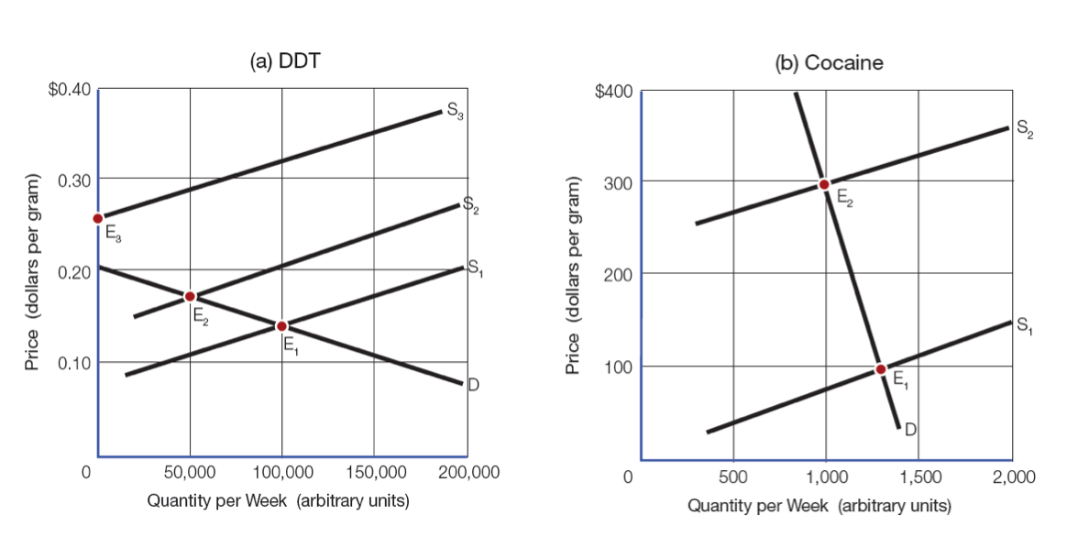
Figure 3-4: Elasticity and the Effects of Prohibition

Slide 22
Chapter Summary (Slide 1 of 4)
What do economists mean by elasticity?
Elasticity: responsiveness of quantity demanded or supplied to changes in the price of a good, measured as a ratio of the percentage change in quantity to the percentage change in price
Price elasticity of demand: the percentage change in quantity demanded divided by the percentage change in the good’s price

Slide 23
Chapter Summary (Slide 2 of 4)
What is the relationship of demand to revenue?
If the demand for a good is elastic, a decrease in its price will increase total revenue.
If it is inelastic, an increase in its price will increase total revenue.
When it is unit elastic, revenue will remain constant as the price varies.

Slide 24
Chapter Summary (Slide 3 of 4)
How do economists apply elasticity to changes in market conditions?
Income elasticity of demand: the ratio of the percentage change in quantity demanded to a given percentage change in income
Cross elasticity of demand: the ratio of the percentage change in the quantity of good A demanded to a given percentage change in the price of good B
Price elasticity of supply: the ratio of the percentage change in the quantity of a good supplied to a given change in its price

Slide 25
Chapter Summary (Slide 4 of 4)
How does elasticity help in understanding changes in public policy?
Many issues of public policy depend on how responsive demand or supply is to changes in price.
Elasticity is important in prohibition.
Prohibition is more likely to have harmful unexpected consequences when demand is inelastic.

