Slide 1
Economic Evaluation: Introductory Lecture
Suja S. Rajan, PhD
Associate Professor - Health Economist

Slide 2
Part 1
Costs in Healthcare and the Importance of Economic Evaluation

Slide 3
Economics in Healthcare
Why should we care?
Government/Policy Makers
Businesses/Employers
Medical Practitioners
Scientists: Economists, Statisticians, Bio-technologists
Health Service Researchers & Public Health Experts
People

Slide 4
Key Facts
U.S. spent $4.3 trillion on health care in 2021, which is 18.3 percent of GDP.^
On average, healthcare costs have grown faster than U.S. GDP by 2.4 percentage points for the past 30 years.*
Health Expenditure is projected to outpace GDP growth by 1.0 percentage point on average annually. †
Almost half of the health care spending is used to treat just 5 percent of the population.*
New technologies and the spread of existing ones account for a large portion of medical spending and its growth.*
Sources: ^CMS. National Health Expenditures 2018. https://www.cms.gov/Research-Statistics-Data-and-Systems/Statistics-Trends-and-Reports/NationalHealthExpendData/NationalHealthAccountsHistorical#:~:text=U.S.%20health%20care%20spending%20grew,spending%20accounted%20for%2017.7%20percent.
*Kaiser Family Foundation. Health Care Costs: A Primer. http://kff.org/health-costs/issue-brief/health-care-costs-a-primer/
† National Expenditure Projections 2012-2022, CMS. http://www.cms.gov/Research-Statistics-Data-and-Systems/Statistics-Trends-and-Reports/NationalHealthExpendData/downloads/proj2012.pdf

Slide 5
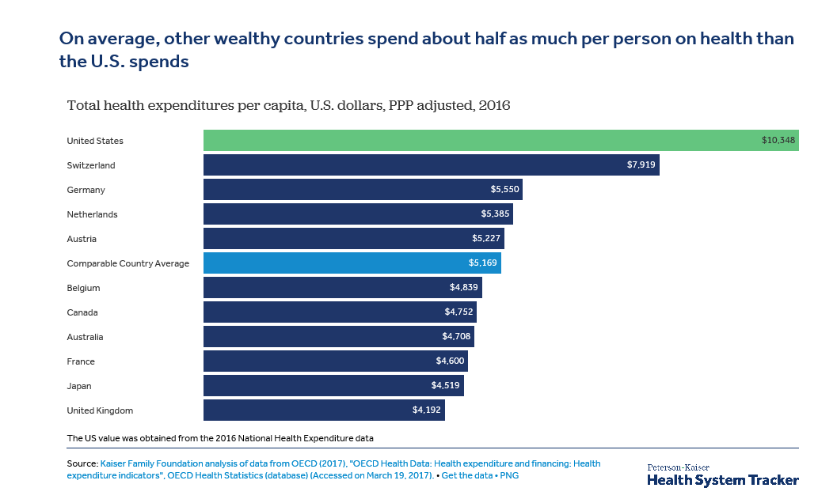
How does the US compare as opposed to other countries?

Slide 6
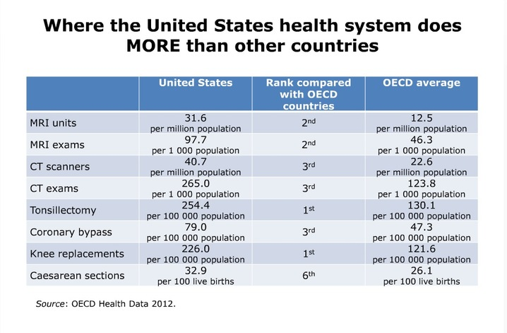
Some procedures we definitely overspend on And not because we are sicker

Slide 7
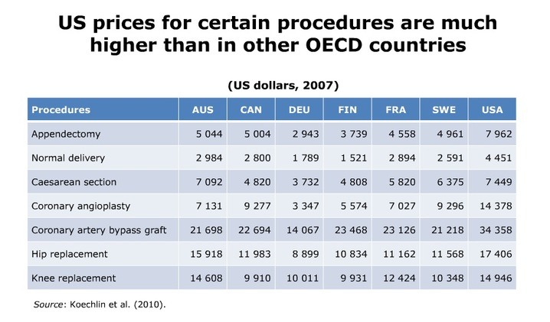
Its not just the quantity, it’s the price tags too Clearly that will reduce the value for every dollar paid

Slide 8
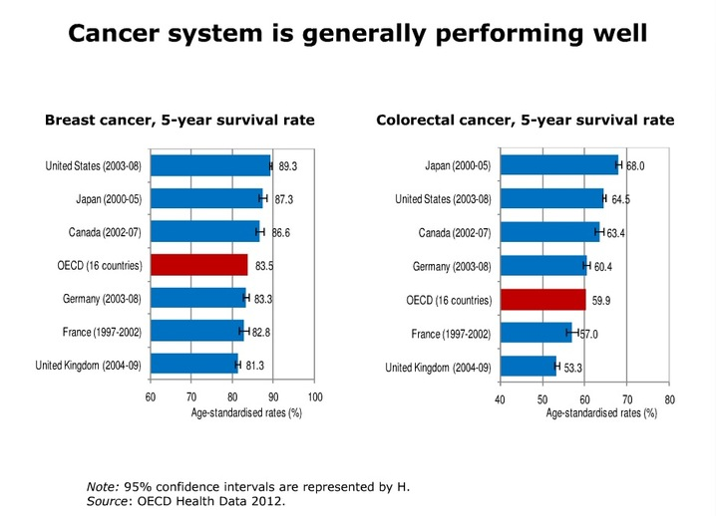
We generally do very well with ailments requiring cutting edge research and technology

Slide 9
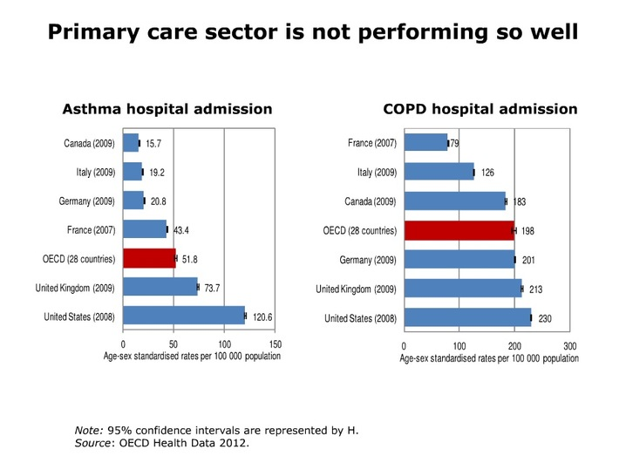
But fall back when it comes to low cost basic care and preventive care

Slide 10
Why be Concerned About High Costs and Efficiency?
Higher spending on health care
Resources are not infinite: Limits spending for other goods and services, e.g. education.
Equity: Makes it increasingly difficult to expand coverage to the uninsured and underinsured.
Affects Income and Wealth: Reduces wages and corporate profits.
Value or “Bang for the Buck”: May not be generating commensurate benefits.

Slide 11
Stages of Health Care Reform
The extension of public funding or health insurance coverage to a high proportion of the (or the entire) population. e.g. ACA
The control of the subsequent surge in health expenditure.
The focusing of reforms on efficiency and remaining inequities/disparities.
Reason why economic evaluation is part of drug approval and medical decision making in most developed countries
Notes:
Senate passing the drug pricing bill in 2022 is a step in this direction.
The Affordable Care Act of 2010 intensified the focus on approaches to reducing health care costs.
Jonathan Gruber, a health care economist, has described the law as the completion of the first round of health reform, which he called the coverage round. We have now entered the second round, or what Gruber calls the cost-reduction round.
Why is cost such an issue for developed countries now a days compared to 70 years back?
Diseases we are battling, acute versus chronic. Technology. Quality and safety policing involves considerable upfront costs for drugs, vaccines, technology. Edward Jenner’s smallpox style vaccine development will not work anymore.
Reform is now a mix of medical care access and affordability, cost containment and quality.
Efficiency can range from logistics management and prevention of drug shortages and expiries in developing/under-developed countries to cost containment in developed countries. US has an infinite capacity to absorb technology in the current setting. Most applications of these methods are in the field of medical care delivery which now makes up 8 percent of GDP among all OECD countries. There is a great need to improve efficiency of production and resource allocation in order to meet the health care and health objectives of both developed and developing countries.
This of course does not preclude the application of these methods for other social objectives such as improvement of the environment which has health and other consequences to well-being of people.

Slide 12
Economic Evaluation
Tools for decision making to:
Understand value of dollar spent
Make investment, purchase and reimbursement decisions
Choose between different technologies – Comparative Effectiveness and Health Technology Assessment
CEA cost-effectiveness
CBA cost-benefit
CUA cost-utility analyses
BIA budget impact analysis
Other economic analysis methods

Slide 13
The CEA Principle
CEA begins with the presumption that the objective of medical technology is to improve health.
CEA is intended to show the relationship between resources used (costs) and the health benefits achieved (effects) for a given technology.
The objective of such analyses is to illustrate how we can maximize the health benefits with a given amount of resources.

Slide 14
Advantages of Economic Evaluation
CEA can play an important role by guiding more sensibly the entry and diffusion of new technology into the population.
Use of the CE criterion will provide an incentive for producers to develop CE products.
Technology is a fundamental “cost driver”

Slide 15
Limitations of Economic Evaluation
A finding that a new technology is cost-effective will not assure its use or reimbursement.
CEA cannot resolve the question of whether society should pay for a new technology (because the comparison is often relative). To do this, we need to
determine how much society is willing to pay for health benefits.
consider other factors such as equity.

Slide 16
Stakeholder Concerns about Using CEA
It will inappropriately limit access to services and facilitate the use of rationing in the delivery of services.
General soundness of cost-effectiveness analysis methodology and lack of trust in the cost-effectiveness data currently being produced.
Use of cost-effectiveness analyses in the coverage decision-making process, particularly by Medicare, may inhibit technical innovation in health care.
Source: American College of Physicians. “Improved Availability of Comparative Effectiveness Information: An Essential Feature for a High-Quality and Efficient United States Health Care System”. 2008.

Slide 17
Summary
Healthcare is expensive, costs are raising, there is high financial burden on consumers/patients, there is a need to contain costs, and need to provide high value healthcare services
Economic evaluation will help assess healthcare technology and services so we can invest in high value products

Slide 18
Part 2
Healthcare Market and Market Failure

Slide 19
Market Failure in Health Care
In the previous class we learnt about “Market” “Demand” “Supply” and how “Markets” help determine the equilibrium price and quantity to be supplied.
However, these simple properties of the market do not hold for the “Healthcare Market”

Slide 20
Market Failure in Health Care
Externalities and Public Goods in Healthcare
Lack of competitive conditions
Who demands the quantity of healthcare? Supplier induced demand
Are we capable of comparing healthcare products/procedures/services? Asymmetric information
Cost of Medical training and technology - No free entry/exit
Price collusion and discount negotiation in groups
Insurance – Price Insensitivity, Moral Hazard and Adverse Selection

Slide 21
Market Failure in Healthcare
Overproduction or underproduction due to externalities. E.g. underproduction of vaccines due to positive externality
Insurance insulates consumers from making price conscious decisions
The primary decisions makers are neither payers nor consumers, but suppliers
Consumers incapable of making informed decisions
In addition to all these there are concerns of inequity
At the end, the price and quantity set in the market are not socially optimal

Slide 22
Externalities
Are the effects of a transaction between parties on outsiders; The uncompensated effects of an action (e.g. Pollution has negative externalities and Vaccines have positive externality)
Consumers are unable to compare the true social cost or benefit of goods in order to purchase the utility maximizing (socially optimal) amount of goods.
Notes:
Externalities, and the market failures they generate, are a major reason for government intervention in private markets. The most familiar and most widely discussed externalities relate to the environment. Pollution raises social cost above private costs, and unregulated, results in the overproduction of products whose production causes the pollution.

Slide 23
Positive Externality Implies MSB>MPB
$
MSC = MPC
A
C
MSB
MPB
q
q’
quantity
Underproduction
Notes:
1. Optimal Production‑ (POINT A) occurs when the social value of the last unit of output is equal to the social cost. 2. Underproduction‑ (POINT C) occurs when the social cost of the last unit of output is less than the social value.

Slide 24
Public Goods
Goods that are consumed or financed collectively (e.g., Clean air, national defense, discovery of vaccine) either because it is impossible to exclude any consumer who does not pay, or because once produced, there is no additional cost for additional consumers.

Slide 25
General Attributes of Public Goods
Nonprovision (or gross underprovision) individuals will not provide the good themselves, even though total benefits outweigh total cost.
Nonrivalry one person's use does not reduce another's consumption, hence it is inefficient to exclude those who do not pay.
Nonexcludability it is impossible or impractical to exclude noncontributors.
Some goods are purely public and some are mixed
Notes:
Nonrivalry in consumption is the key attribute in identifying a public good, although we should keep in mind that publicness is a matter of degree. The important lesson for policy is that by their very nature public goods will not be produced if the task is left to individuals acting in isolation, even when it is to everyone's advantage to have them produced and hence clearly best for the group as a whole. They are, in short, a classic case of market failure.
e.g., a sidewalk from an isolated neighborhood to the village center.

Slide 26
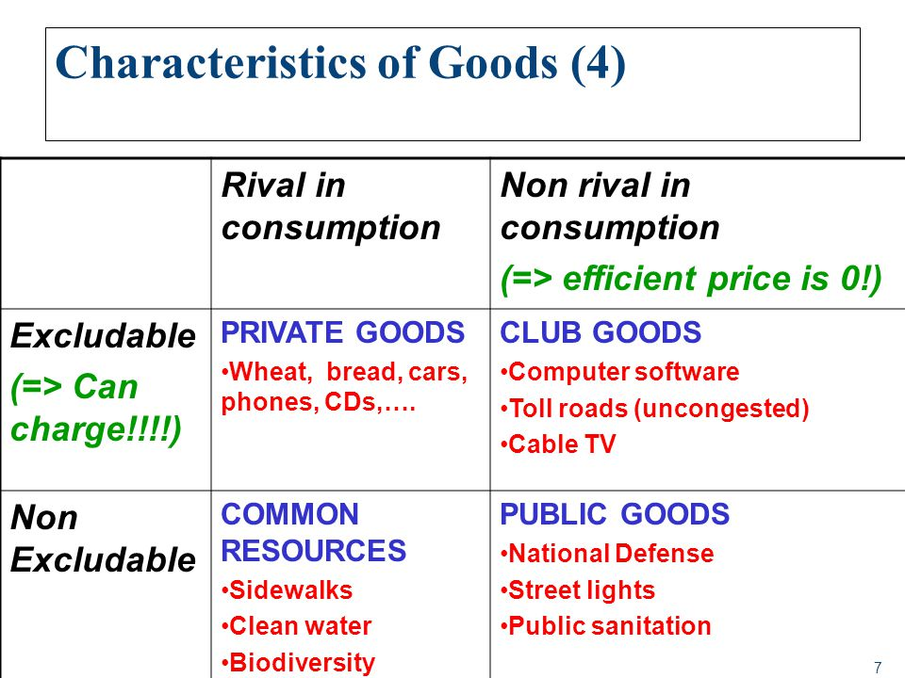
Getzen Text (2004)

Slide 27
Government's Role In The Health Sector
Why is there a need for government involvement in the economic system if private markets have such desirable attributes, i.e. efficiency?
Market failure
Causes of market failure/lack of competitive conditions
Public goods
Externalities
Government responses to market failure

Slide 28
Types of Government Intervention
Improve the functioning of the market by improving the flow of information or enforcement of competition.
Tax citizens and directly provide the good or service.
Regulate prices and quantities to counter externalities and non-competitive markets
Take up the role of insurers/payers for the vulnerable

Slide 29
Types of Government Intervention
Universal insurance to counter Moral Hazard, Adverse Selection, Selective Negotiations, Collusion, Inequity
Ensures equity through subsidies
Subsidize medical training, technology development
Government’s intervention has a moral or social justice dimension, as well as an economic one.

Slide 30
Summary
The simple properties of a market do not apply to healthcare due to the nature of the healthcare product, how’s it demanded/supplied and how its paid for
Also, healthcare products have characteristics of public goods and externalities
Government intervention and healthcare reform becomes imperative

