Slide 1
Agile Lab
Rachit Goel
Prerit Kohli
Shreya Garg

Slide 2
Motivation:
Can friends meet without any plan? Any utility?
NO.
Need?
YES.

Slide 3
Solution needed:
Reduce time and cost to find friends.
Form Groups, retrieve the locations.
Target audience. –Bored? Find friends.
Tag your location.

Slide 4
Capabilities:
Provide Geo-intelligence capabilities.
Locate your friends real time.
Log your travels.

Slide 5



Slide 6
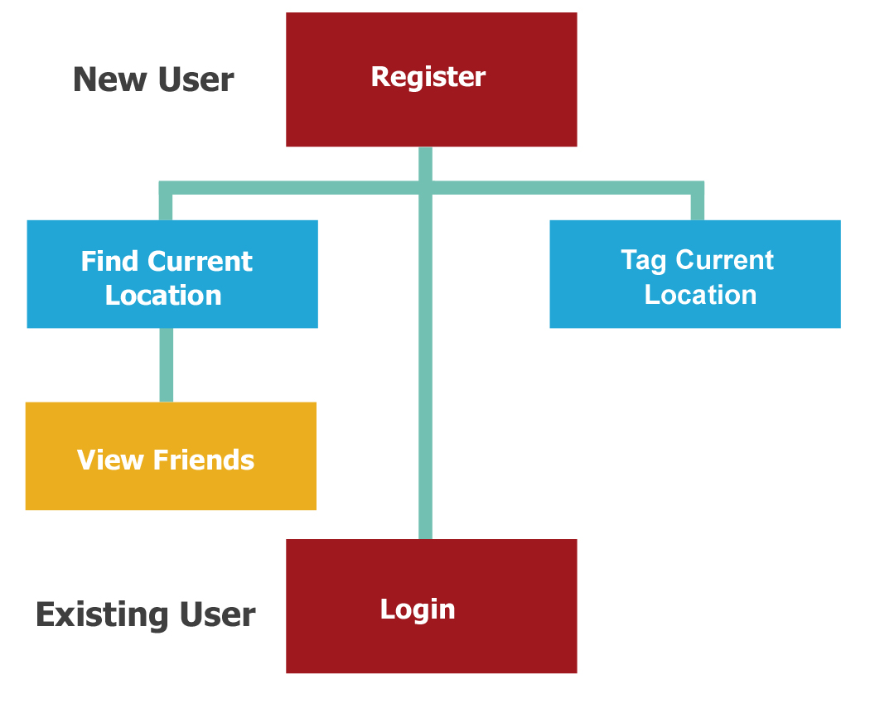

Slide 7
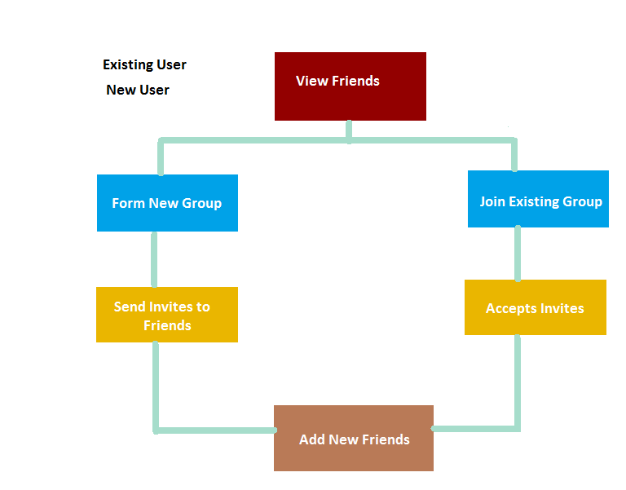

Slide 8
Technology:
Client Side
Java –platform independent
Android Application Development
Server Side
PHP for web services - easy, quick
MySQL
JSON is used for network payload – mobile friendly

Slide 9
Tools:
Client Side
Eclipse IDE.
Android SDK with MySQLite.
Adobe Photoshop CS5

Slide 10
Development Cycle
Cycle 1:
User Interface.
Requirement analysis
Cycle 2:
Current Location
Cycle 3:
Forming groups

Slide 11
Decisions Taken:
Extracting location: GPS vs Network
Why PHP? –easy –quick

Slide 12
Next Steps
Geo-Fencing alerts
SOS Messages
Locating near by stores/restaurant

