Slide 1
Classification Model for Detection of Pigmented Skin Lesions using (HAM) Dermatoscopic Images and Convolution Neural Network (CNN)
Members:
19106055 Mohit Gupta
19106068 Rachit R Jindal
19106076 Rishab Soni
19106101 Vaibhav Saraf
Supervisor: Dr. Karan Jain

Slide 2
Objective
The main objective is to device an efficient and computationally optimum approach by improve the existing classification model in the field of Medical World more precisely Dermatology Department for improved diagnosis followed by a better medical assistance.
Skin diseases are a common problem affecting a lot of people, and lack of proper assistance can led to chronic problems like acne, vascular lesions, Eczema, etc. With evolving computational performance, and algorithms, classification of the disease can be automated and deployed with live stream using a Computer Vision techniques.
Due to lack of diversity all disease can’t be classified, but the common once like Melanocytic nevi, Melanoma, Benign keratosis, etc. can be predicted with high level of accuracy.
This project aims towards the classification of 7-types of common pigmented skin lesions using a Neural Network architecture comprising of CNN, Dropout, MaxPooling and Dense layers and precisely tuned hyper-parameters like Learning Rate, Early stopping, Loss function etc.

Slide 3
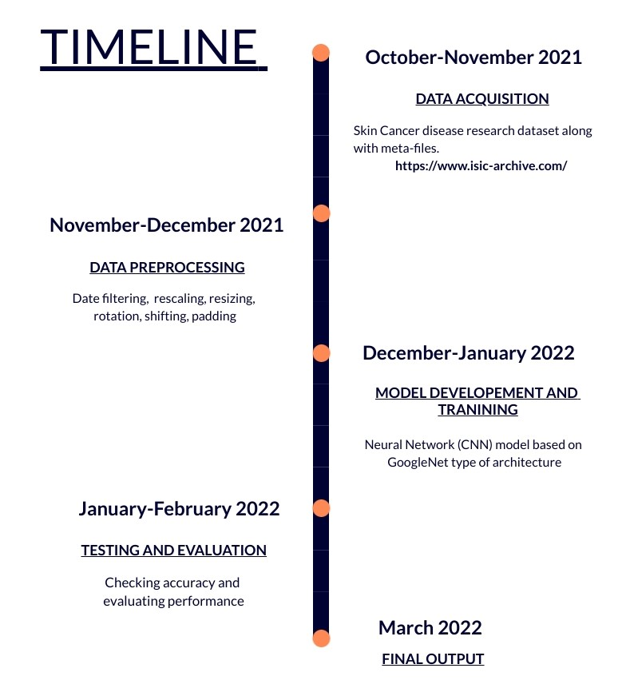


Slide 4
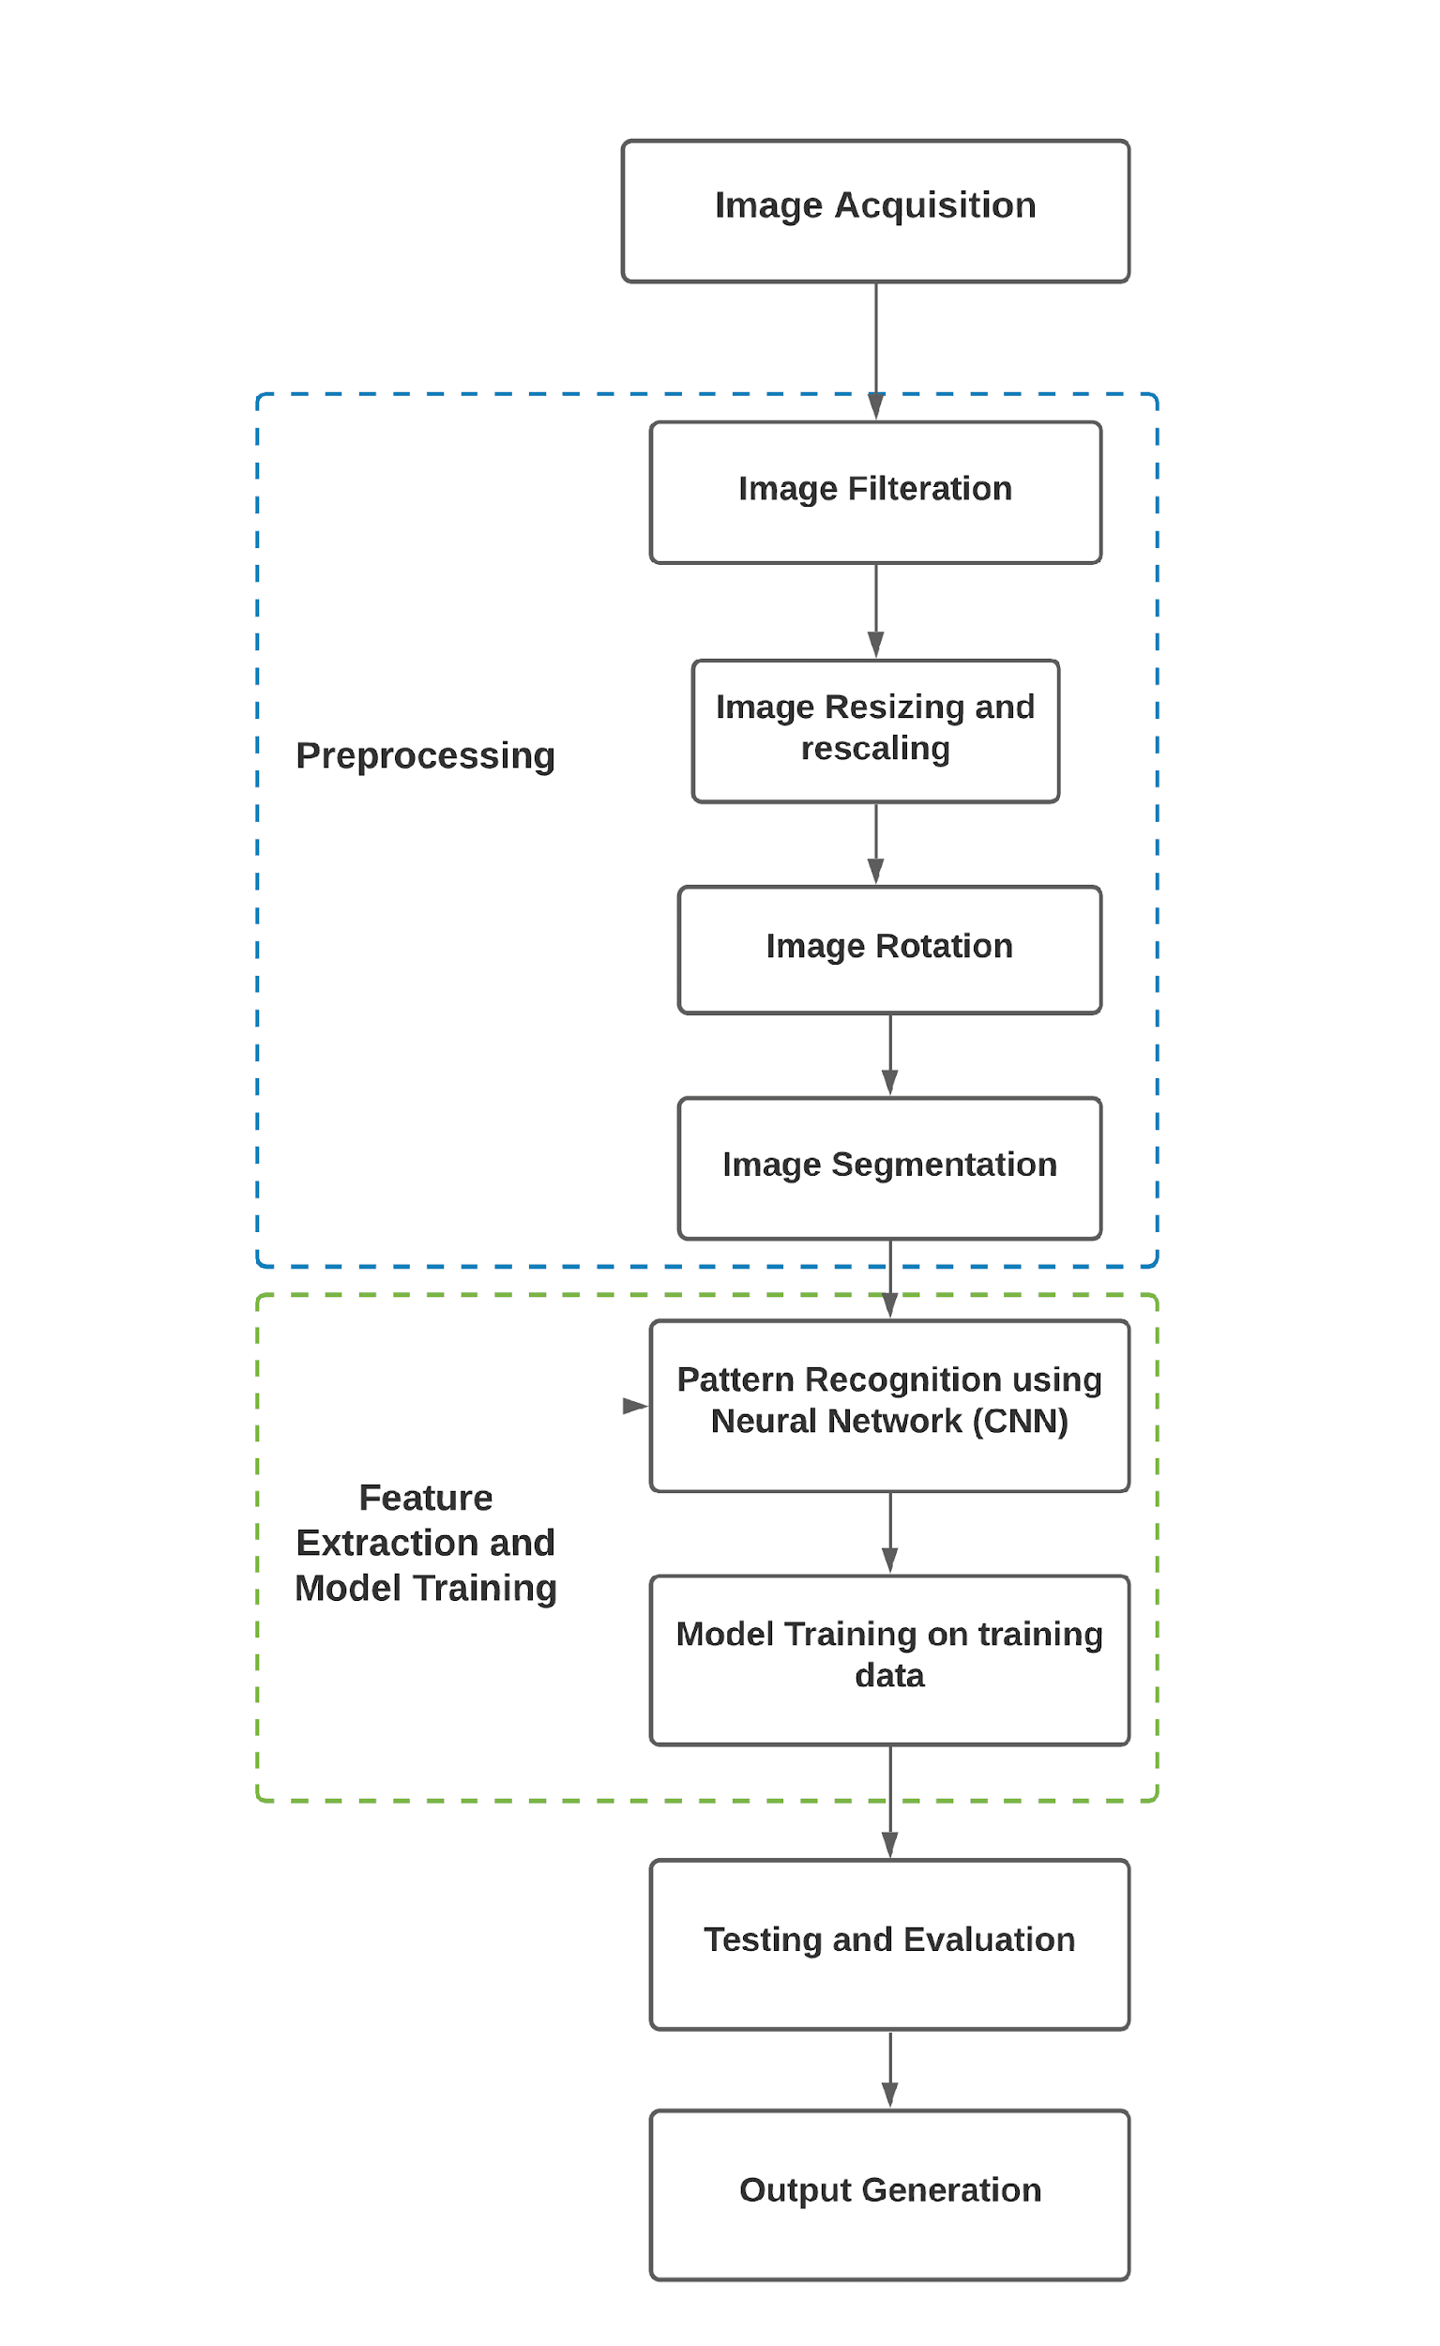
Project Structure
This figure represents the main steps of
proposed methodology to skin disease recognition.
Done using
CNN

Slide 5
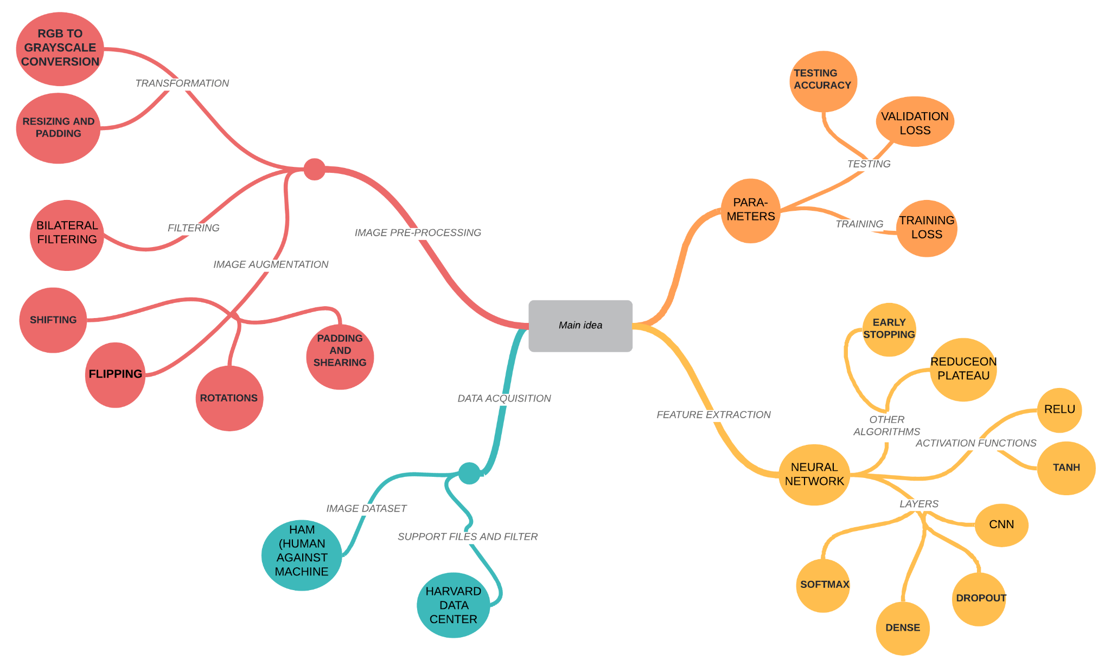

Slide 6
Project Stages
Data Acquisition: Data is acquired from a Harvard Dermatoscopic Research Dataset, i.e., HAM-10000 Dataset (Human Against Machine) comprising of 7 different types of pigmented skin lesions.
Data Pre-Processing: Applying image augmentation techniques like rotation, shifting (vertical and horizontal), shearing and flipping, etc alter the images to produce variations while preserving the feature of the original image.
Model Training and Feature Extraction: This stage is for training and feature extraction (done automatically while training by CNN’s).
Weights and bias matrices of each layer of Neural Network get updated according to specified ‘Cost Function’ and ‘Learning Rate’.
Testing and Evaluation of Final Output: The last stage is to test the model for test data to get the performance of model on real-word unseen data.

Slide 7
Dataset
In our project, we used the HAM10000 ("Human Against Machine with 10000 training images") dataset. It’s a Harvard research dataset acquired from Harvard Dataverse, consisting of 10015 multi-source Dermatoscopic images of common pigmented skin lesions.
Actinic keratosis and intraepithelial carcinoma / Bowen's disease (akiec)
basal cell carcinoma (bcc)
benign keratosis-like lesions (solar lentigines / seborrheic keratosis and lichen-planus like keratosis, bkl)
dermatofibroma (df)
melanoma (mel)
melanocytic nevi (nv)
vascular lesions (angiomas, angiokeratomas, pyogenic granulomas and hemorrhage, vasc).
Reference/Dataset:
https://dataverse.harvard.edu/dataset.xhtml?persistentId=doi:10.7910/DVN/DBW86T

Slide 8
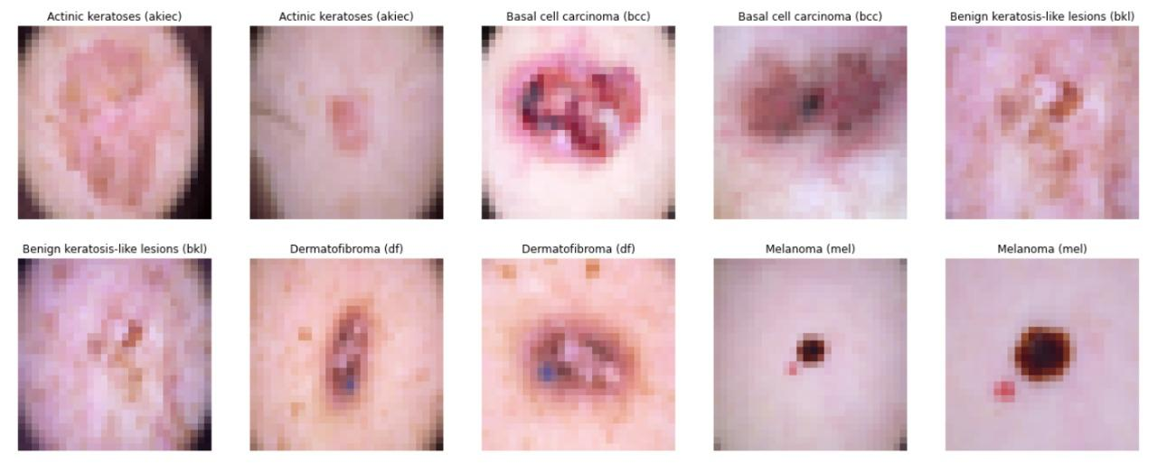
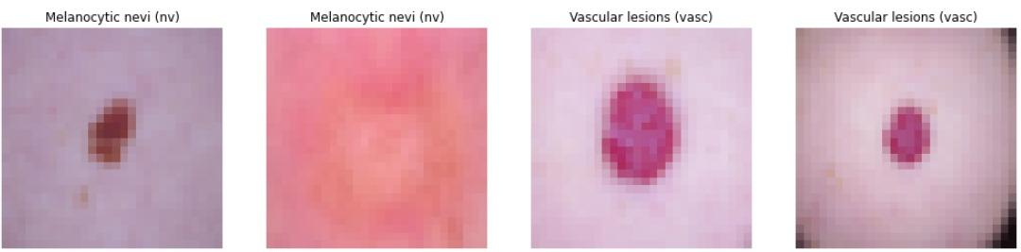
Sample dataset images

Slide 9
Data pre-processing and Augmentation
First Step
This step is used to de-noise and smoothen the Dermatoscopic skin epidermis images using following techniques:
Gray Scaling
Bilateral Filtering and Resizing
Gray Scaling converts the colored image into a grayscale image having 8-bit i.e. 256 (0-255) combinations of colors on grayscale. This is done because the RGB images have 3-different color intensities each having 256 combinations which is a lot of data to store and process.
Bilateral filtering is employed to de-noise impulsive noises while preserving edges in an image. In bilateral filter, a bilateral filter is used to get the intensity of each pixel by taking weighted average of its nearby pixels.
Resizing is used in reduction of the impact of irrelevant background by resizing the image into a focused image while preserving all the features.

Slide 10
Second Step
For Data Augmentation, the images in existing dataset is duplicated so that the variations can be produced in the images. For example, an image of vascular disease is duplicated (x4) and using augmentation, the variations can be flipping, horizontal shifting, vertical shifting and original image, these images provide a better training set with increased diversity.
Data Augmentation techniques like shifting, shearing, padding, rotation, flipping and filling to make variations to the existing dataset so that the model can prevent overfitting and train better.
Following parameters are used in Augmentation technique:
rescale = 1./255 (RGB → Grayscale)
rotation_range = 10 (Rotates image +/- 10)
width_shift_range = 0.2 (Left, Right Shift to +/- 0.2 pixel)
height_shift_range = 0.2 (Up, Downshift to +/- 0.2 pixel)
shear_range = 0.2 (specifies the angle of the slant i.e. 2 degrees)
horizontal_flip = True (reverses the entire rows and columns of an image pixel horizontally)
vertical_flip = True (reverses the entire rows and columns of an image pixel vertically)
fill_mode = 'nearest' (fills empty pixels with nearest neighbouring pixel values)

Slide 11
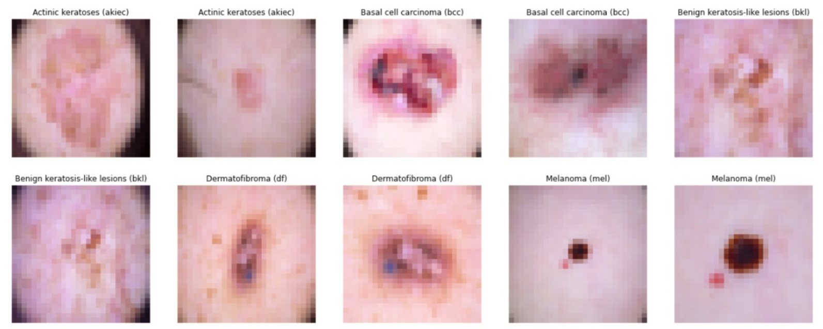
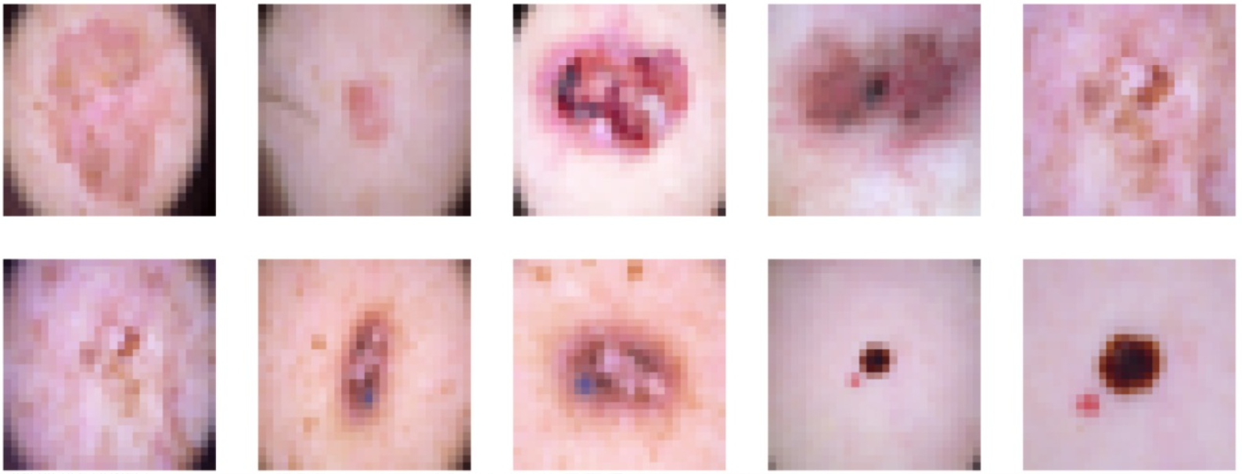
Third Step
This is the last step and essential as well because the output of augmentation tends to overfit the model while training as repeated images of same label only updates specific weights of matrices. To encounter this, shuffling is done which prevents overfitting and increases difficulty while training.
ORIGINAL
AUGMENTED

Slide 12
Method/Technique Used For Classification
After examining the dataset and its allied features, Deep Learning technique of Classification using CNN is employed. This approach is taken because the dataset images have highly sensitive features that have a high possibility to get ignored by any other classification algorithm like KNN, etc.
For this project, a Deep Learning CNN model is used for feature extraction and a fully connected neural network for creation of probabilistic distribution of the image into classes/objects.
This approach is highly accurate and doesn’t sideline even the most basic features in the images.

Slide 13
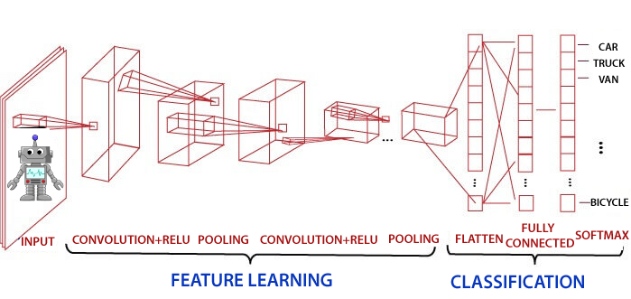
How does CNN model learn and extract features

Slide 14
Learning:
Every CNN layer has filters and kernel associated with it. These kernels are initialized with random values and every filter has its own kernel of different values.
Every filter of the CNN layer generates a feature map, from input image, which is associated with some pattern. For example, if CNN layer has 16 filters, all the filters will produce a feature map. The feature map is then fed into the activation function which perform element-wise operations.
Maxpooling layer selects the maximum values from the activation map based on kernel size. This maximum value is the most dominant feature in the image.
Prediction:
After learning, the output of the CNN layer is flattened and fed into the fully-connected Dense layers (Neural Network layers). The output is the summation of the product of the weights and inputs and then applying the activation function.
The output layer is the Softmax layer that produces the probabilistic distribution of every class of diseases.
For example, if we have 5 output class, Softmax produces array as
[0.05 0.72 0.04 0.01 0.18], thus the class with value 0.72 has the maximum probability.

Slide 15
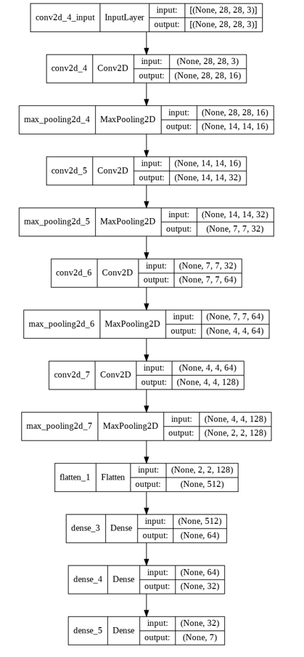
Machine Learning Model Under study
It’s a 13 layer model comprising of Con2d, Maxpooling, Dense, Flatten layers performing convolution filter for dimension reduction.
Conv2d layer creates a feature map using its weight matrix by sliding a kernel over the entire image and adding all the values to generate a pixel value for feature matrix.
It uses ReLU as activation which accepts feature matrix of CNN as input and produces an activation matrix.
Maxpooling layer uses (2x2) kernel and produces a matrix of size of exactly half of the input.
Input size of model -> (28x28x3) as the training image size.

Slide 16
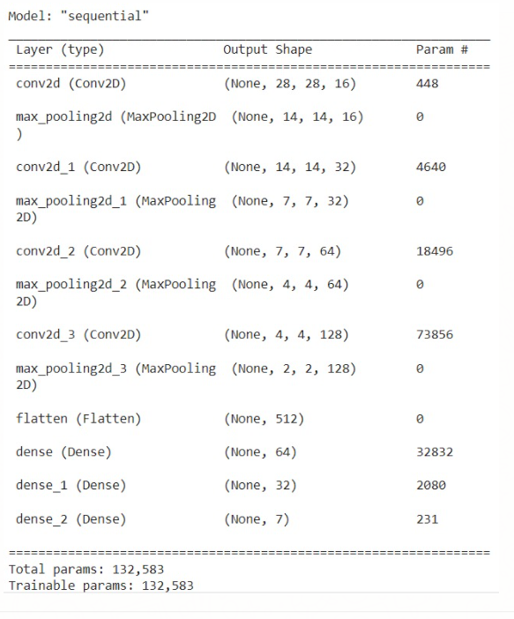
By using the formula for dimension:
output(dim) = (input(dim) – kernel + 2(padding) )/stride+1
All Convolution layers uses kernel size of (3x3) with padding kept as ‘same’ so that the output of layer is always same as input except for filter.
Dimension:
Input Size = (28x28x3)
Conv2d_1 = (28x28x3) -> (28x28x16)
Maxpooling_1 = (28x28x16) -> (14x14x16)
Conv2d_2 = (14x14x16) -> (14x14x32)
Maxpooling_2 = (14x14x32) -> (7x7x32)
Conv2d_3 = (7x7x32) -> (7x7x64)
Maxpooling_3 = (7x7x64) -> (4x4x64)
Conv2d_4 = (4x4x64) -> (4x4x128)
Maxpooling_4 = (4x4x128) -> (2x2x128)
Flatten = (1,512)
Dense_1 = (1,512) -> (1,64)
Dense_2 = (1,64) -> (1,32)
Dense_3 = (1,32) -> (1,7)

Slide 17
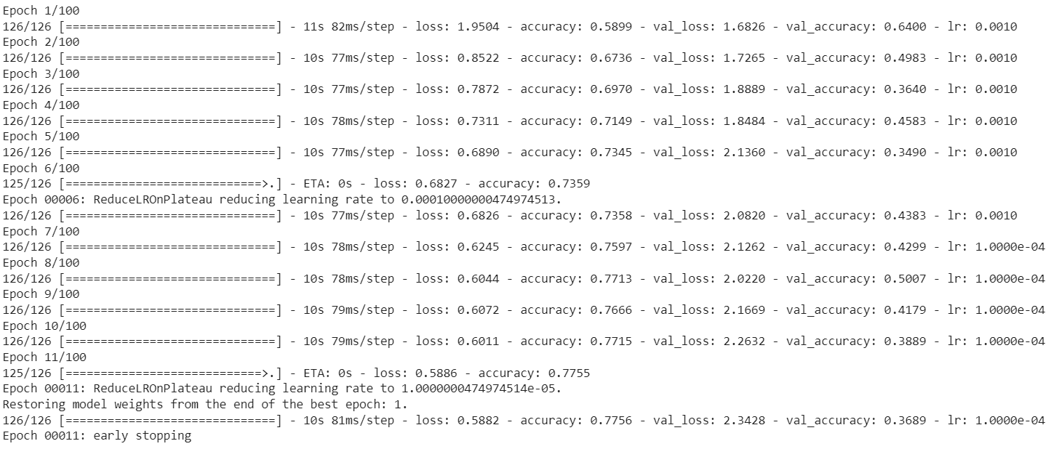
Training on unmodified Model
The training accuracy achieved on the model is 77.56% and the validation accuracy is 36.89%.
Due to the overfitting, and inappropriate model hyper-parameters, training accuracy is low.

Slide 18
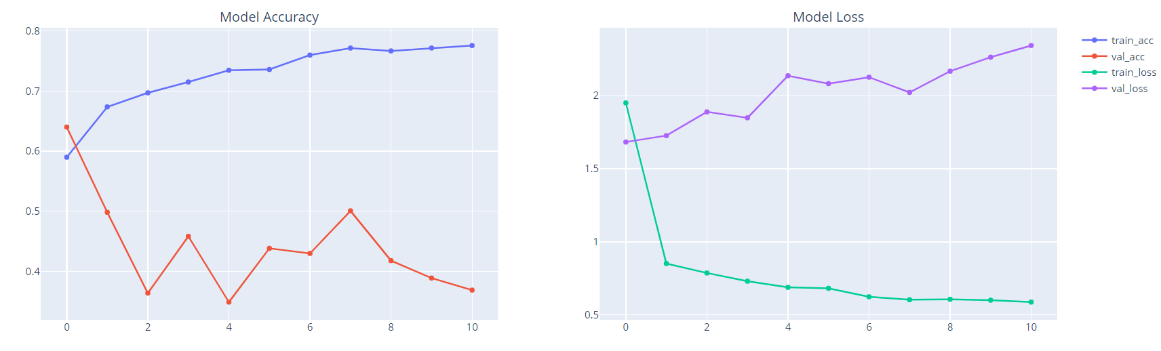
Training Graphs of unmodified Model
The Model accuracy and validation accuracy are fluctuating as seen in the graph showing the instability of the model.
At the same time the Model losses are becoming constant.

Slide 19
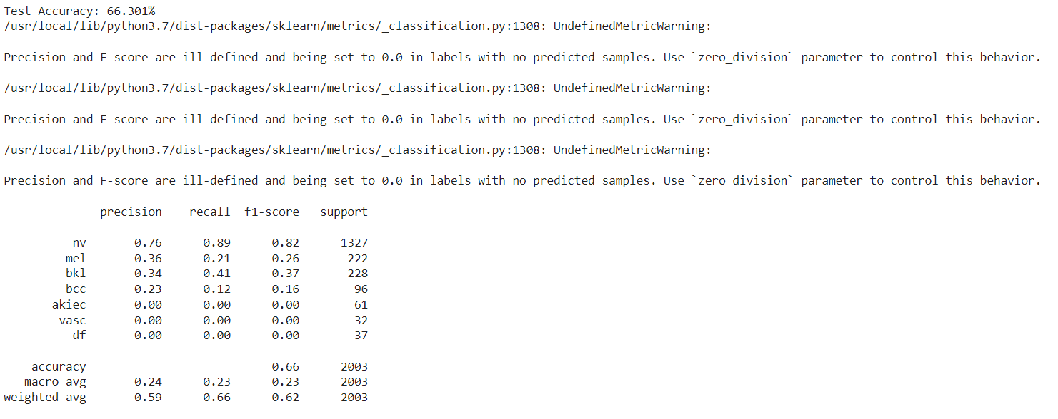
test accuracy on unmodified Model
The test accuracy achieved on the model is 66.301%.
It’s clear that the model is getting overfitted.

Slide 20
Insights from the above model
From the above loss, accuracy and validation graph following point can be stated:
In the Model Loss Graph:
training loss became almost constant in the successive epochs, showing that the model is unable to update its weight and biases to converge the gradient to the optimal value.
the validation loss values are increasing, shows that the model is getting overfitted.
Similarly from the Model Accuracy Graph:
training accuracy is increasing with increasing validation losses, thu the model is getting very well fitted with the training variations treating them as the hypothesis
fluctuating and low values of validation accuracy indicates that model is unable to detect the unseen or test values
Thus from these insights model is getting overfitted, unable to capture all the features. To overcome this, the model is updated with new layers, filters, and optimization function.

Slide 21
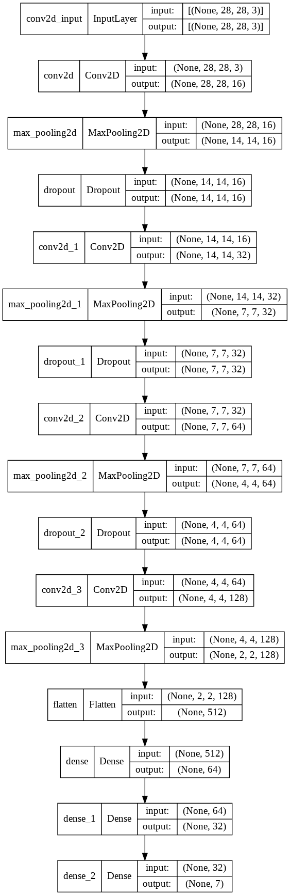
Updated Model Under study
Model comprises 16 layers of Con2d, Maxpooling, Dropout, Dense, Flatten layers performing feature extraction.
Model has the same number of trainable parameters as the original, but even has some of the non-trainable parameters.
It uses ReLU as activation function, it takes feature matrix of CNN as input and produces an activation matrix by performing element-wise operation.
Maxpooling layer uses (2x2) kernel and produces a matrix of size of exactly half of the input.
Input size of model -> (28x28x3) as the training image size.
Notes:
Image Resolution (Readable)

Slide 22
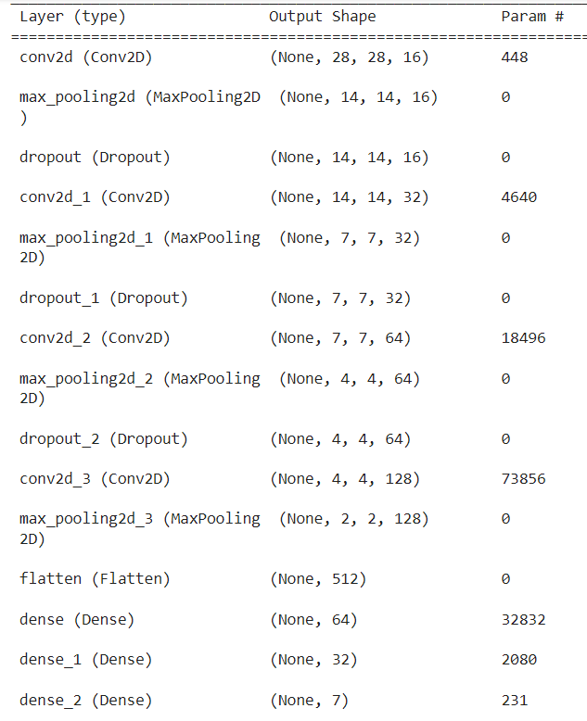
All Convolution layers uses kernel size of (3x3) with padding kept as ‘same’ so that the output of layer is always same as input except for filter.
Dimension:
Input Size = (28x28x3)
Conv2d_1 = (28x28x3) -> (28x28x16)
Maxpooling_1 = (28x28x16) -> (14x14x16)
Dropout = (Randomly sets weights of some neurons to 0 to disable neurons)
Conv2d_2 = (14x14x16) -> (14x14x32)
Maxpooling_2 = (14x14x32) -> (7x7x32)
Dropout = (Randomly sets weights of some neurons to 0 to disable neurons)
Conv2d_3 = (7x7x32) -> (7x7x64)
Maxpooling_3 = (7x7x64) -> (4x4x64)
Dropout = (Randomly sets weights of some neurons to 0 to disable neurons)

Slide 23
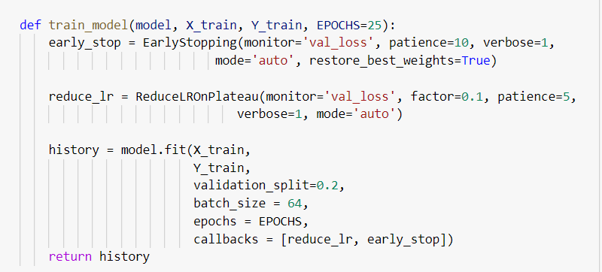
Conv2d_4 = (4x4x64) -> (4x4x128)
Maxpooling_4 = (4x4x128) -> (2x2x128)
Flatten = (1,512)
Dense_1 = (1,512) -> (1,64)
Dense_2 = (1,64) -> (1,32)
Dense_3 = (1,32) -> (1,7)
With Dropout layer, the aim is to prevent overfitting and increase the complexity while training the models weights and biases.
To handle overfitting and improve the accuracy, this model also uses the EarlyStopping and ReduceLROnPlateau callback algorithms. Though, all this increases the complexity of the model but at the same time doesn’t increase the parameters.

Slide 24
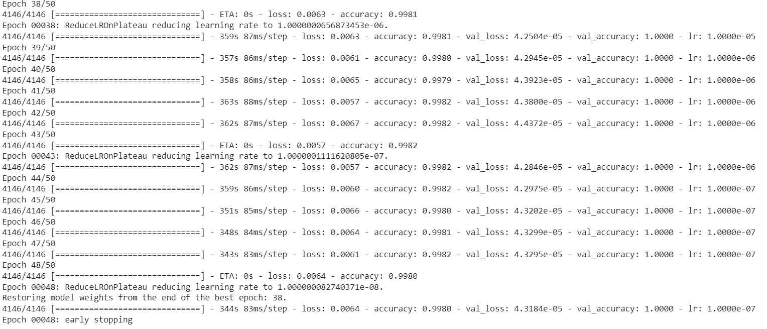
Training on modified Model
The training accuracy achieved on the model is 99.8% and the validation accuracy is 100%.
Thus, the model is showing consistent results on validation and training data without getting overfitted.

Slide 25
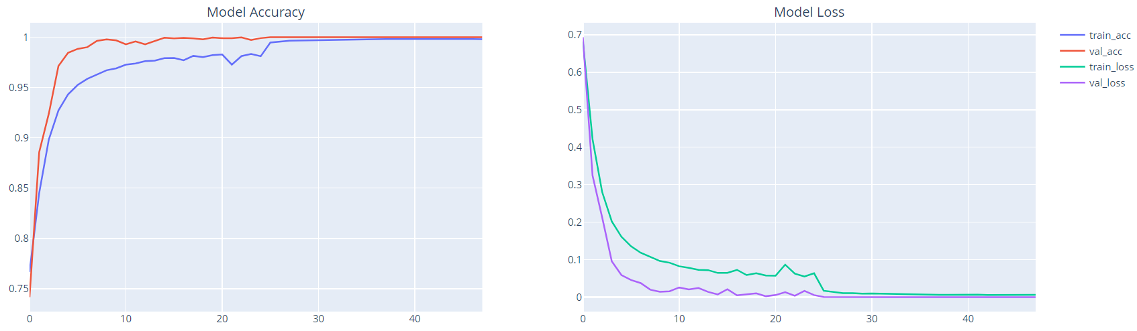
Training Graphs of modified Model
The Model accuracy and validation accuracy are getting saturated as seen in the graph showing the stability of the model.
At the same time the Model losses are also converging to almost 0(zero).

Slide 26
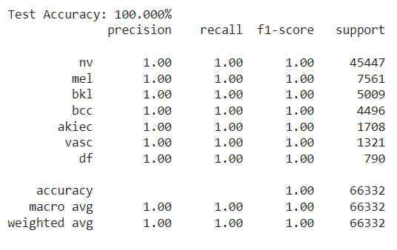
test accuracy on modified Model
The test accuracy achieved on the model is 100%.
0.00677 GFlops

Slide 27
Comparison with different models
Parameters Models | Training Accuracy | Validation Losses | Epochs (Early Stopping)/ Time
Proposed Model | 99.8% | 4.318 x 10^-5 | 50 / 5 hrs 23 min (0.00677 Flops)
XGBoost (eXtreme Gradient Boosting) [6] | 73.2% | 0.842 | 39 / 3 hrs 47 min
DCNN’s [1] | 97.4% | 0.782 | 47 / 7 hrs 39 min (0.85 Flops)
Attentions Based Model (Vgg16 drived) IRV2+GCAM [ | 92% | 3x10^-3 | 123 / 29 hrs (23.6 Flops)
Random Forest [6] | 65.9% | 0.73 | 4 hrs 37 min
Support Vector Classifier [6] | 65.86% | 0.043 | 4 hrs 02 min
Notes:
Change dataset literature in models

Slide 28
conclusion
The skin lesions have been classified using an Image Processing using Neural Network approach with considerable training and testing accuracies with the real-world Dermatoscopic Data from Harvard Research.
The model parameters are estimated using training and validation curves with main focus on the diversification of features in the model. The model has been tested on live real world images sourced from unclassified HAM dataset with high accuracy. Further experimentation with multiple lesions in single image is under way.

Slide 29
References
DaPeng YPeng Yao, et al: Single Model Deep Learning on Imbalanced Small Datasets for Skin Lesion Classification Preprint at https://arxiv.org/abs/2102.01284ao, Shuwei Shen, Mengjuan Xu, Peng Liu, Fan Zhang, Jinyu Xing, Pengfei Shao, Benjamin Kaffenberger, and Ronald X. Xu: Single Model Deep Learning on Imbalanced Small Datasets for Skin Lesion Classification Preprint at https://arxiv.org/abs/2102.01284taset Link
Rosendahl, C., Tschandl, P., Cameron, A. & Kittler, H. Diagnostic accuracy of dermatoscopy for melanocytic and nonmelanocytic pigmented lesions. J Am Acad Dermatol 64, 1068–1073 (2011).
Binder, M. et al. Application of an artificial neural network in epiluminescence microscopy pattern analysis of pigmented skin lesions: a pilot study. Br J Dermatol 130, 460–465 (1994).
Argenziano, G. et al. Interactive Atlas of Dermoscopy (Edra Medical Publishing and New Media: Milan, 2000).
The HAM10000 dataset, a large collection of multi-sources dermatoscopic images of common pigmented skin lesions https://nature.com/articles/sdata2018161
Decision Support System for Detection and Classification of Skin Cancer using CNN Rishu Garg, Saumil Maheshwari and Anupam Shukla2
Harvard Dataverse https://www.dataverse.harvard.edu/dataset
Codella, N. C. F. et al. Skin Lesion Analysis Toward Melanoma Detection: A Challenge at the 2017 International Symposium on Biomedical Imaging (ISBI), Hosted by the International Skin Imaging Collaboration (ISIC). Preprint at https://arxiv.org/abs/1710.05006 (2017).

