Slide 1

AI-First Q2 2026 Hackathon
AI Code Review Bot
Rachit Mathur (VIPL001235)
29/06/2026
Copyright ©VLink Inc. 2025, U.S.| Canada | India | Indonesia
AI HACKATHON

Slide 2
Table of Contents
Problem Statement/ Business Use case
Business Value
Feature List - highlight the innovation using AI
Technology Used
AI agent / RAG / workflow automation explained
AI model / API / framework used
Time Taken to develop the solution
Percentage of AI and Manual Effort
Screenshots (code and output)
GIT HUB URL
Copyright ©VLink Inc. 2025, U.S.| Canada | India | Indonesia
Copyright ©VLink Inc. 2025, U.S.| Canada | India | Indonesia
AI HACKATHON

Slide 3
Problem Statement/ Business Use case
Every engineering team has the same bottleneck: senior engineers are the scarcest resource, and code review is where they spend a disproportionate amount of that time — much of it catching the same class of bugs repeatedly.
If a senior engineer at any product firm spends 30–40% of their time on code reviews, that’s a lot of senior engineering time per person — mostly pattern-matching against known failure modes.
Copyright ©VLink Inc. 2025, U.S.| Canada | India | Indonesia
AI HACKATHON

Slide 4
Business value
1. Cost reduction in engineering time
The bot handles the first-pass review automatically. Senior engineers sengage only when there’s actual design-level thinking required. At a team of 10 engineers, recovering even 2 hours/week per senior = hundreds of hours/year redirected to feature work.
2. Reduced production incidents
The bugs this bot catches are precisely the bugs that cause P0 incidents. A single payment double-charge incident costs far more than the engineering time to build this tool:
∙ Customer remediation
∙ Regulatory scrutiny (especially in payments)
∙ Reputational damage
∙ On-call engineer time at 2am
3. Faster PR cycle time
Review turnaround goes from hours/days (waiting for a senior to be free) to seconds. Junior engineers get immediate, specific feedback without feeling judged. PRs merge faster. Features ship faster. This compounds across every sprint.
4. Consistent enforcement of standards
The bot applies the same standard to every PR, every time. This matters especially in regulated industries (payments, banking) where audit trails and code quality standards are compliance requirements, not just good practice.
5. Junior engineer upskilling
The bot doesn’t just flag issues — it explains the production impact and gives a concrete fix. Training cost goes down over time as the team internalizes patterns.
Copyright ©VLink Inc. 2025, U.S.| Canada | India | Indonesia
AI HACKATHON

Slide 5
Feature List - highlight the innovation using AI
∙ HMAC-SHA256 webhook signature validation with constant-time comparison
∙ Async processing via CompletableFuture — responds 202 before AI call starts
∙ Smart diff parsing — filters noise, classifies backend vs frontend files
∙ GPT-4o powered review catching N+1 queries, missing idempotency, no timeouts, race conditions and PII logging
∙ Agent mode — two-pass reasoning for cross-file interaction bugs
∙ Posts structured inline GitHub comments with issue, impact & fix
∙ REST API (/api/reviews, /api/stats) ready for dashboard integration
∙ Fails open — bot errors never block a PR
∙ Fully configurable via YAML — model, thresholds, skip rules, agent toggle
∙ Frontend review built-in — activate by removing extensions from skip list​​​​​​​​​​​​​​​​
Copyright ©VLink Inc. 2025, U.S.| Canada | India | Indonesia
AI HACKATHON

Slide 6
Technology Used
∙ Java 17 — Core language
∙ Spring Boot 3.2 — Web framework, dependency injection, actuator
∙ OpenAI GPT-4o — AI code review engine
∙ GitHub Webhooks API — PR event ingestion
∙ kohsuke/github-api — GitHub client library
∙ HMAC-SHA256 — Webhook signature validation
∙ CompletableFuture — Async processing
∙ ConcurrentLinkedDeque — Thread-safe in-memory store
∙ RestTemplate — OpenAI HTTP client
∙ Maven — Build & dependency management
∙ YAML — Externalized configuration
∙ ngrok — Local tunnel for webhook testing
∙ JUnit 5 + Mockito — Unit testing​​​​​​​​​​​​​​​​
Copyright ©VLink Inc. 2025, U.S.| Canada | India | Indonesia
AI HACKATHON

Slide 7
AI agent / RAG / workflow automation explanation
GitHub PR Event
│
▼
WebhookController ← validates HMAC-SHA256 signature, returns 202 immediately
│ async
▼
PullRequestHandler ← orchestrates the pipeline
│
├ ► DiffParser ← filters noise, classifies files (backend/frontend)
│
├► ReviewStrategyFactory
│ ├ STANDARD → single OpenAI call (default)
│ └─ AGENT → two-pass reasoning (bot.review.agent-mode-enabled=true)
│
├► OpenAiClient ← calls GPT-4o with domain-specific system prompt
│
├► ReviewCommenter ← posts review + individual issue comments to GitHub
│
└─► ReviewStore ← ConcurrentLinkedDeque in-memory audit log
│
└─► GET /api/reviews ← consumed by React dashboard (future)
Copyright ©VLink Inc. 2025, U.S.| Canada | India | Indonesia
AI HACKATHON

Slide 8
AI model / API / framework used
∙ OpenAI GPT-4o — code review model
∙ OpenAI Chat Completions API (/v1/chat/completions)
∙ JSON mode enforced for structured output (response_format: json_object)
∙ Spring Boot 3.2 — application framework
∙ Spring Web MVC — REST endpoints and webhook receiver
∙ Spring Actuator — health and metrics
∙ kohsuke GitHub API — GitHub client
∙ JUnit 5 + Mockito — testing framework
∙ Maven — build and dependency management​​​​​​​​​​​​​​​​
Copyright ©VLink Inc. 2025, U.S.| Canada | India | Indonesia
AI HACKATHON

Slide 9
Time Taken to develop the solution
| Hours| Phase | Work Done |
| 0-1 | Setup | Project scaffold, Maven, YAML, ngrok, GitHub webhook |
| 1-2 | Security | HMAC-SHA256 signature validator, webhook controller |
| 2-3 | GitHub | GitHub API client, diff parser, file classification |
| 3-5 | AI Engine | OpenAI client, system prompts, JSON response parsing |
| 5-6 | Review Posting | GitHub commenter, summary + inline issue comments |
| 6-7 | Orchestration | PR handler pipeline, strategy factory, agent mode |
| 7-8 | Error Handling | Rate limit, timeout, malformed JSON, fail-open logic |
| 8-9 | Storage + API | In-memory review store, REST endpoints for dashboard |
| 9-10 | Testing | Unit tests - validator, parser, OpenAI client, handler |
| 10-11 | Config | YAML config, prompt refinement, end-to-end testing |
| 11-12 | Demo Prep | Test PRs, bug fixes, documentation, presentation |
Copyright ©VLink Inc. 2025, U.S.| Canada | India | Indonesia
AI HACKATHON

Slide 10
Percentage of AI and Manual Effort
65% Manual — 35% AI-Assisted
∙ Core security logic written and reasoned manually
∙ Distributed systems design decisions made manually
∙ AI used as a coding assistant, not an architect
∙ All AI output reviewed, tested, and validated by the developer​​​​​​​​​​​​​​​​
Copyright ©VLink Inc. 2025, U.S.| Canada | India | Indonesia
AI HACKATHON

Slide 11
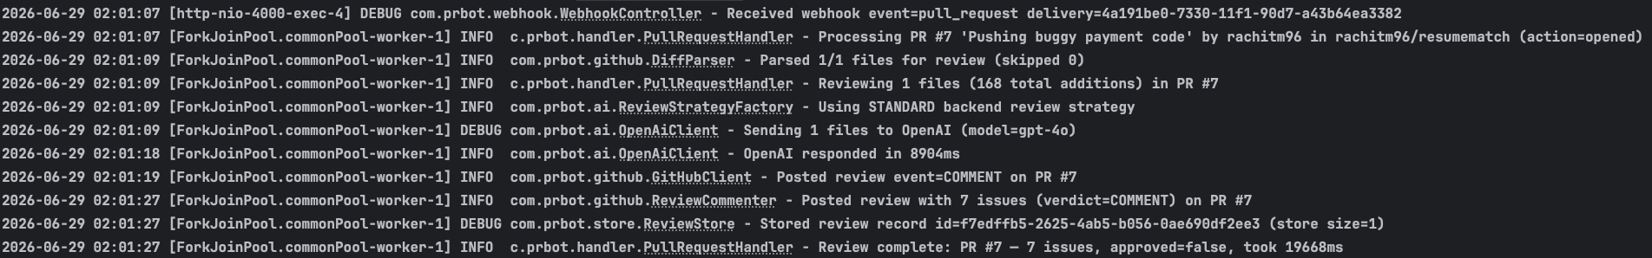
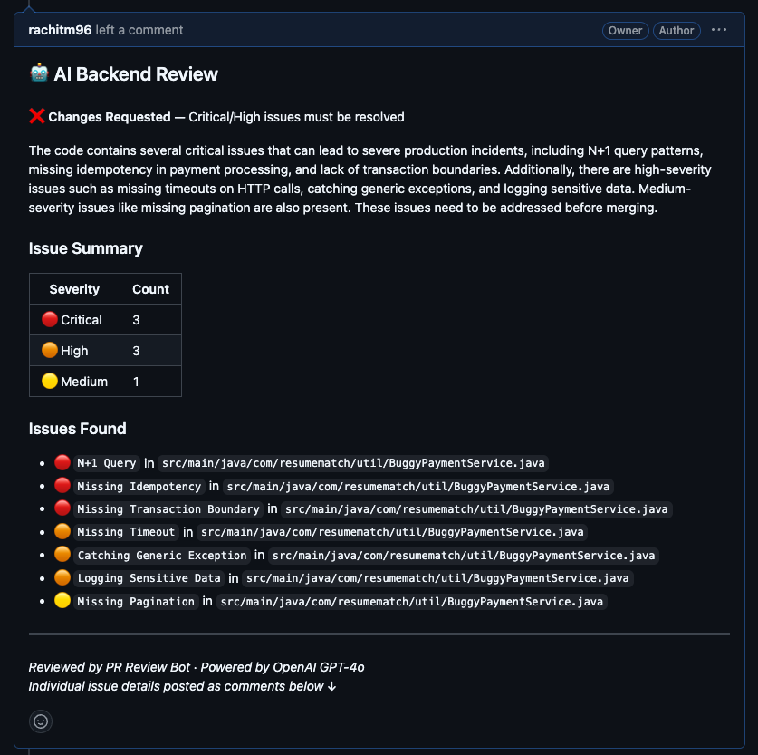
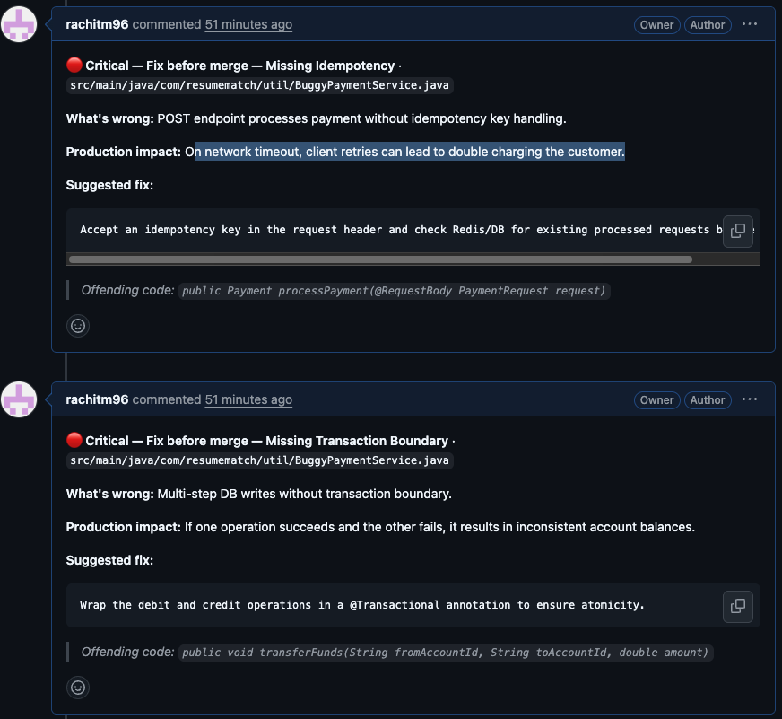
Screenshots (code and output)
Copyright ©VLink Inc. 2025, U.S.| Canada | India | Indonesia
AI HACKATHON

Slide 12
GIT HUB URL
https://github.com/rachitm96/pr-review-bot
Copyright ©VLink Inc. 2025, U.S.| Canada | India | Indonesia
AI HACKATHON

Slide 13
THANK YOU
This document/material contains confidential and proprietary information intended solely for the participants of this AI Hackathon. The content, ideas, data, code, and discussions shared as part of this event should not be disclosed, distributed, or used outside the scope of the hackathon without prior authorization.
Please ensure that any sensitive information, internal data, or intellectual property shared during the hackathon is handled responsibly.
Copyright ©VLink Inc. 2025, U.S.| Canada | India | Indonesia
AI HACKATHON

