Slide 1

Houston Ship Channel HubCo
October 2001

Slide 2
Overview
ENA will re-establish a physical presence in the Texas gas market – without Houston Pipe Line:
  Retain a strong presence in gas and power trading.
  Continue purchasing gas from producers and marketing gas to end users.
  Develop a transport/storage network to meet the needs of customers rather than the other way around.
  Increase Enron’s ability to transact by increasing price transparency and market liquidity.
ENA’s will employ an “asset light” strategy to more closely align our interest with our customers:
  We are not trying to maximize the profitability of our assets at the expense of our customers
  We can tailor our products/services to our customers needs:
    Bundled Services: Gas purchases/sales, asset management, logistics, producer services
    Unbundled Services: Commodity risk management, marketing, transportation, processing, back-office, measurement, EOL, asset development.

Slide 3
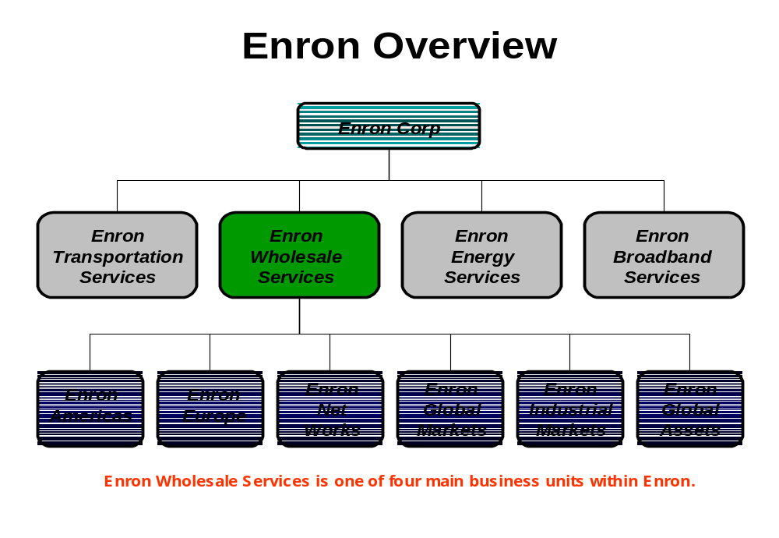

Slide 4
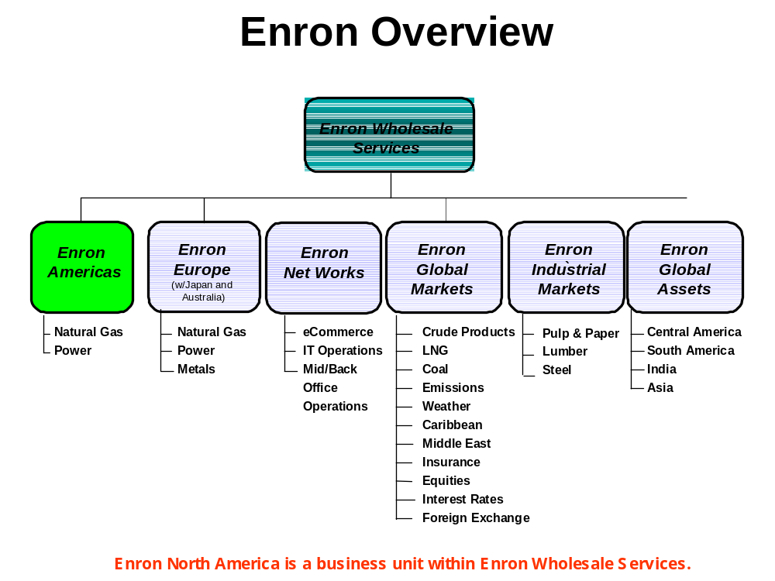

Slide 5
Market View
What products and services would you consider “outsourcing” to third parties?
  Back Office / Logistics
  Nominations and Scheduling
  Measurement
  Trading / Mid-Marketing / Asset Optimization
  Origination / Producer Services
What is your view on the need for additional products and market liquidity:
  Intrastate transportation products (hourly, commodity based tariffs, storage)
  Direct access to downstream customers
  Bundled vs. unbundled services
Suggestions for Enron?

Slide 6
Current Strategy
Develop a flexible network of commodity, transport, and storage positions:
  Create supply and market hubs to increase price transparency and liquidity
  Acquire access to pipeline capacity to link supply and demand.
  Acquire access to storage capacity to serve swing markets – IPPs and others
  Establish direct access to both suppliers and end-use customers
Provide products that enable customers to increase optionality and extract value from the market:
  Leverage Enron’s market making capability to create liquidity and optionality for customers
  Leverage Enron’s processes, systems and information flow to increase the efficiency of our customer businesses.
  Differentiate ourselves by offering both bundled and unbundling products.
  Position EOL as a tool to increase liquidity and price transparency
Integrate EOL into Texas intrastate market to increase transportation and commodity liquidity; Key points of presence:
  Trading Hubs – Houston Ship Channel, Waha, King Ranch, Katy, Carthage, Agua Dulce/Banquette, Thompsonville, Beaumont
  Create a Market to Trade Intrastate Transportation Under a Standard Contract – HPL, Midcon/KN, Tejas, El Paso, Oasis

Slide 7
Trading Hubs
Create “HubCo’s” at various trading points to allow physical intermediation between market players:
  Form intrastate header systems to serve as a contracting intermediaries between gas users, interstate pipelines, intrastate pipelines, producers, and trading entities
  Use EOL to trade physical and financial products at these HubCo trading points.
  Use the physical basis at these trading points to develop a synthetic transport product between “trading hubs” within Texas.
Make a market around dedicated HubCo assets or 3rd party assets:
  Using dedicate assets will required capital investment or firm demand charges but will provide more control over interconnects and flows..
  Using third party assets will must have enough optionality and liquidity to establish competition between counter parties
HubCo Objectives/Benefits:
  Increase ability of suppliers, shippers, and offtakers to transact
  Increase access to physical transport from major supply points
  Increase price transparency and physical product definition
  Maximize physical flow across HubCo

Slide 8
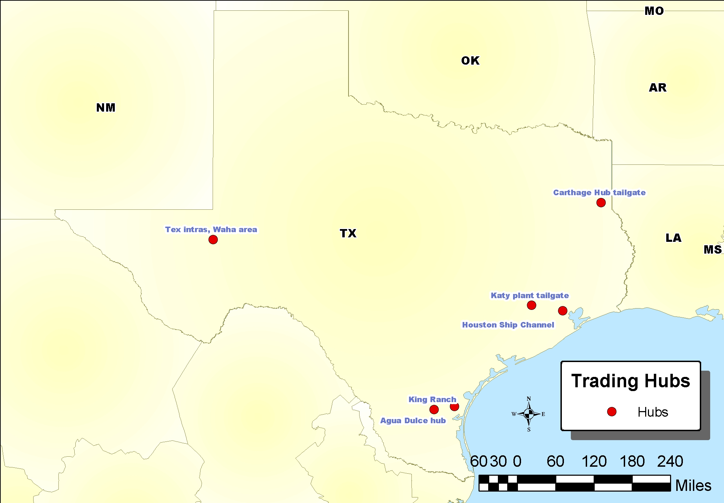

Slide 9
HubCo Deal Structure
Offtaker or Supplier
Pipeline
ENA
Capital and/or Assets
Capital and/or Assets
Capital and/or Assets
% Equity Interest
% Equity Interest
% Equity Interest
Partnership Agmts.
GTS
Operator
HubCo
Access to markets at HAS
Access to intrastate and interstate pipelines
Access to storage
EOL trading point
Nomination, scheduling & hub mgmt services
O&M Agmts.
Hub Serv. Agmts.
ENA (EOL)
Storage/Bal Agmts.
Hub Transp. Agmt.
Interconnect Agmt.
Pipelines
Shippers
Pipelines

Slide 10
Ship Channel HubCo: Structure 1
Dedicated HubCo assets linking supply pipelines and customers:
Structure charge as a hub access fee for physical gas delivery
HubCo runs at intrastate pipeline pressure – additional compression charge is separate if required
HubCo handles nominations, scheduling and balancing
HubCo can sell firm transport across hub and provide scheduling and nominations for firm shippers.
IndustCo 1
IndustCo 2
PipeCo 3
IndustCo 3
Localized Connectivity
PipeCo 2
HubCo
PipeCo 4
PipeCo 1
PipeCo 5

Slide 11
Ship Channel HubCo: Structure 2
Use existing customer assets to create HSC pool:
Structure charge as a hub access fee for each physical gas delivery – must meet pressure / flow requirements of HubCo
Enron creates a forward market for “into IndustCo” products.
Enron uses competing pipelines to effect physical delivery to IndustCo
HubCo handles nominations, scheduling and balancing
HubCo can sell firm transport across hub and provide scheduling and nominations for firm shippers.
Meter
Meter
Meter
Meter
IndustCo 1
IndustCo 3
Meter
Meter
Meter
Meter
Meter
Meter
Meter
Meter
IndustCo 2

Slide 12
Industrial Customer
Industrial Customer Benefits:
  Increase ability to source gas from multiple pipelines, markets, suppliers
  Increase ability to secure favorable transport rates
  Increased price transparency and market liquidity.
  Physical HSC price curve provides basis for more physical/financial products.
  Physical gas hub forms the basis for a physical power trading point in ERCOT
Industrial Customer Role/Activity:
  Transact to buy/sell gas through Enron OnLine across the hub.
  Potential for HubCo to use customer meters or install HubCo meters to measure flow to customer sites.
  Potential for HubCo to use customer pipelines to increase physical connectivity between pipelines.
Industrial Customer Actions:
  Continue discussions with Enron with respect to establishing and using HubCo.
  Discussions with ENA with respect to using customer assets to support HubCo activities.

Slide 13
Shipper/Marketer
Shipper/Marketer Benefits:
  Increase ability to deliver gas to end user in the ship channel market
  Increase ability to secure favorable transport rates
  Increased price transparency and market liquidity.
  Physical HSC price curve provides basis for more physical/financial products.
  Physical gas hub forms the basis for a physical power trading point in ERCOT
Shipper/Marketer Role/Activity:
  Transact to buy/sell gas through Enron OnLine across the hub.
  Potential for HubCo to use customer meters or install HubCo meters to measure flow to customer sites.
  Potential for HubCo to use customer pipelines to increase physical connectivity between pipelines.
Shipper/Marketer Actions:
  Continue discussions with Enron with respect to establishing and using HubCo.
  Discussions with ENA with respect to using customer assets to support HubCo activities.

Slide 14
Implementation
Define the asset base for HubCo and form a new intrastate pipeline (JV or other) to allow physical connectivity between market participants:
    Pipelines or industrial customers contribute capital and/or assets
    Enron contributes capital and/or assets
    HubCo services provided under outsourcing contracts
Establish the roles/responsibilities of parties and enter into service agreements with GTS, ENA and others for commercial services:
    Nominations/scheduling/confirmations
    Billing/reporting/cash management
    Auditing
Enter into service agreements with Sid Richardson, Unocal, GTS and others for operational services:
    Operations/gas control
    Physical balancing/measurement
Enter into interconnect and transport agreements with 3rd parties:
    Hub services provided for a fee
    Transport agreement terms are standardized

Slide 15
Summary
Define and develop products – based on customer needs not asset position:
    Transport and storage products – unbundled from delivered gas.
    Commodity risk management products – bundled or unbundled.
    Outsourcing and asset management products
    Service products
Develop a track record
    Establish and demonstrate the ability to link serve suppliers and end users in Texas without ownership of physical assets
    Show benefits of being an “asset-neutral” service provider
    Leverage internal knowledge of Texas market and structured products
Build customer relationships on market expertise:
    Demonstrate how Enron can “create and share” value with customers
    Distinguish Enron from other marketers, traders, transporters in Texas
    Develop a “non-HPL” track record

