Slide 1
UNIFY Performance -
Problems, Solutions And Plans
June 21, 2000

Slide 2
Agenda
Concepts
  Unify strengths / weaknesses
  Conceptual solutions
  Summary Recommendations
Sybase 12.0 / Performance Tuning Team
MS SQL Server Performance Test
Unify Middle Tier Test
Unify Strategic Technical Migration Planning
Issues, Questions, Next Steps

Slide 3
UNIFY - Strengths
The Unify system delivers robust functionality
This system is far ahead of the competition (e.g. - Dynegy)
We have critical skills we can leverage through a small core of IT / Business experts
This system supports rapid time to market (EOL, Power, Bridgeline)

Slide 4
UNIFY - Weaknesses
The Unify architecture does not support the current business from a technical perspective -- performance is abysmal
The IT and Business teams are currently too stretched
The IT team is overly reliant on contractors

Slide 5
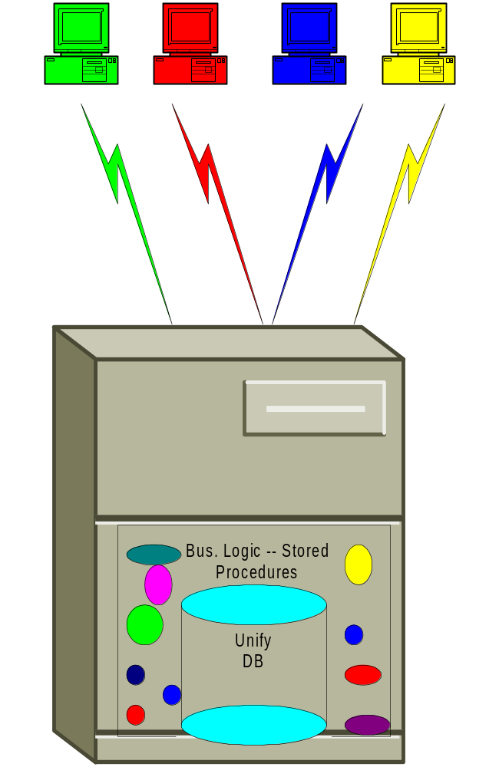
UNIFY
Architecture Issues
Application / Technical Architecture
  Sybase Database
    Page level locking on system tables
    No more than 4 table joins without temp tables
    Optimizer flakiness
    Shared read locking
    Long running transaction logging
  2-tier doesn’t scale well
  Functional process can improve

Slide 6
UNIFY - Fix The Database
Upgrade the Sybase database
  Immediately move to Sybase 12 to get fast performance improvements
‘Port’ to MS SQL Server OR…….
Re-write to Oracle as our database

Slide 7
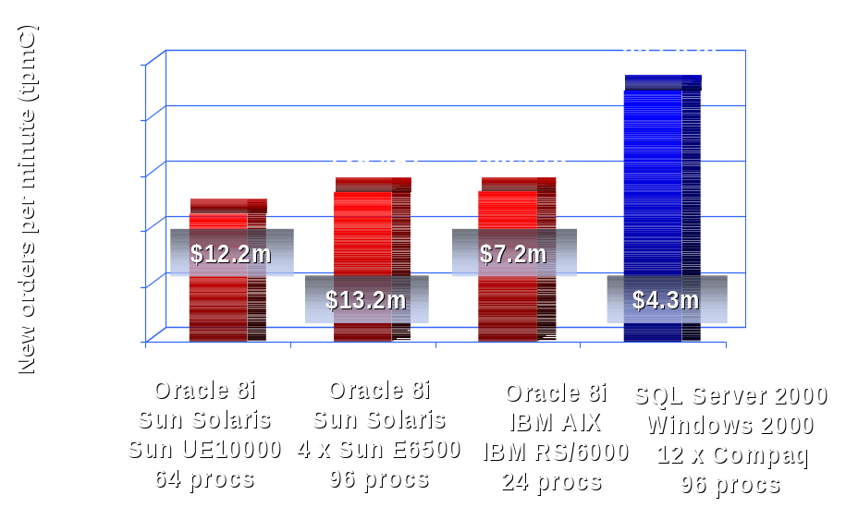
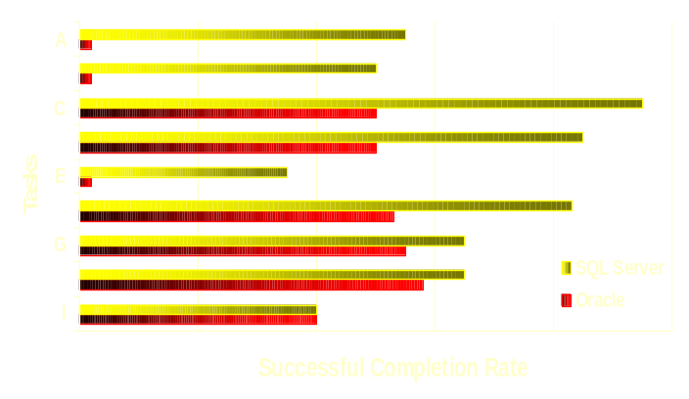
MS SQL Server - Potential Benefits
Impressive benchmarks in several areas
  Latest measures show that in some instances it is a challenger to Oracle
    World record TPC-C, SAP and PeopleSoft benchmarks
  Excellent Price to Performance ratio
  Fastest database to deploy
20%
40%
60%
80%
100%

Slide 8
MS SQL Server
Weaknesses
  Not proven for large, high volume apps
  Uncertain whether SQL Server will address existing DB limitations
  SQL Server introduces lots of new ‘moving parts’
    Intel platform (vs. Sun)
    Windows 2000 (vs. Unix)
    Beta SQL Server functions
Strengths
  Moving to SQL Server can be done in a matter of months
  3-tier architecture improvements can be made incrementally after the move to SQL Server
  Far lower cost and application delivery risk
  Microsoft will provide strong support as an ‘early adopter’

Slide 9
Oracle
Weaknesses
  Requires a re-write in a ‘big bang’ fashion
    Phase 1 - Power / Global Product Settlements
    Phase 2 - Gas Logistics / Settlements
  Could take up to 2 years to move all components
  Requires support for 2 systems during transition
  Far more expensive
  Higher delivery risk
Strengths
  Oracle is the industry leading choice for enterprise applications
  Oracle has a strong performance record over the last 5 years for large, high volume applications
  This leverages our current, proven HW and UNIX operating system architecture

Slide 10
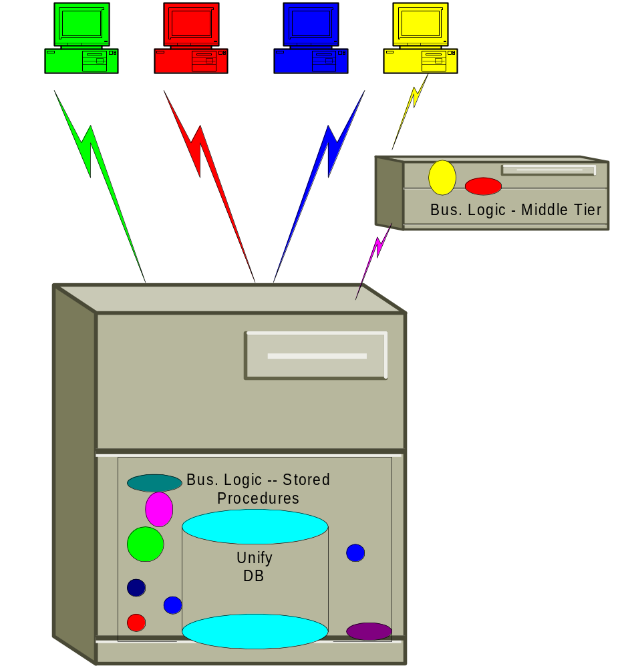
Middle Tier
Migration
If SQL Server
  We can write the middle tier on an incremental basis
If Oracle
  A separate team will continue to incrementally add a middle tier to the existing system while the new system is built

Slide 11
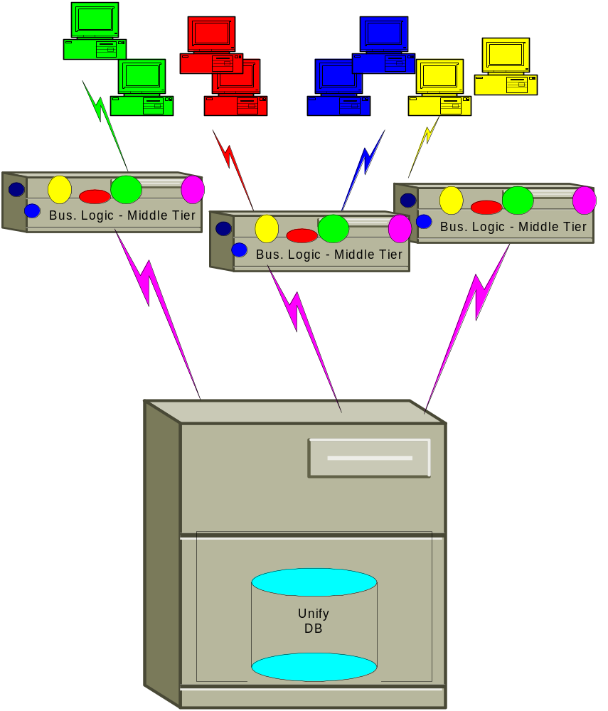
Final
Architecture
Benefits of N-tier
  Hardware scaleability
  Modularity
    Technology changes are implemented more incrementally
    E.G. - Web enable without too much effort
    DB connection pooling

Slide 12
UNIFY - Summary Recommendations
Kick off 4 new project teams
  Sybase upgrade with a new team to provide full-time performance monitoring and tuning
  SQL Server go/no-go performance test
  Legacy Unify middle tier migration
  Strategic Unify architecture migration planning
Hire and train new ENRON IT resources. Build up the leadership team within IT
Reduce reliance on contractors
Leverage consultants but only when :
  Enron manages the teams
  Enron participates full-time at all levels on the team

Slide 13
UNIFY - Summary Recommendations
Develop more business analysis and project management skills within the group
IT/Business must work together to prioritize new Unify requirements on an ongoing basis
The business must hire and train ‘super user’ staff within the business teams

Slide 14
UNIFY - Summary Recommendations
IT/Business must focus on system training more.
Maintain a strong ongoing Business / IT partnership for planning and delivery of these projects
Caveat - Current timelines and cost estimates are very preliminary

Slide 15
Upgrade Sybase And Create A Performance Tuning Team

Slide 16
Sybase 12.0 / Performance Tuning Team - Scope
6/12-6/16 - Ensure that the whole system ports. Test all processes.
6/19-6/23 - Quickly conduct a performance test
  Current tests this week are very positive
July - If test proves positive, prepare for rollout -- Probably mid-July.
July - Form a full-time Performance Tuning / Monitoring Team
  Proactive, full-time responsibility for monitoring and tuning the HW, Application DB and Operating System
  Cross-functional team composed of Unify application, DBA and UNIX talent
  Single point of contact for all UNIFY performance issues
  Accountability with a full-time focus on our number 1 issue

Slide 17
Assumptions
The ability to use extra memory with Sybase 12.0 will extend the life of the Sybase DB
Sybase is not a long-term solution for UNIFY’s performance issues
Code will be ported, not rewritten

Slide 18
Performance Team Staffing
Unify Performance Monitoring Team
    Enron Owner - Dave Nommensen - Part time application leadership
    Enron Owner - John Pyle - Part time DBA leadership
    Technical Manager - Matt Pena (anticipated new hire)
    Full time, experienced UNIFY technical developer - TBD
    Full time, developer trainee - TBD
    Full time, experienced DBA - TBD
    Full time, DBA trainee - TBD
    Part time UNIX support - TBD
    Sybase Consultant - TBD

Slide 19
High Level Cost Estimate - 1 Year
Internal Resources - $400K
Consulting Resources - $100K

Slide 20
Microsoft SQL Server

Slide 21
MS SQL Server - Scope
Analyze pros/cons of MS SQL Server architecture
Gather data from leading companies using SQL Server for enterprise high-volume applications
  Utilize Gartner & Meta Group to gather technical market data
Define a go/no-go performance test
  Setup a test environment
  Test how much of the code ‘ports’
  Stress test and measure in the following scenarios
    2-tier (apples to apples comparison with current architecture)

Slide 22
MS SQL Server - Assumptions
ENRON will quickly build a performance test environment
UNIFY will eventually require support for up to 750 users on a 300 Gigabyte Database
MS SQL Server 2000 (beta) will be used
Note: Early data is not very hopeful that SQL Server will be a viable option

Slide 23
MS SQL Server - Staffing
Enron Resources
    Enron Owner - Regan Smith (Part-time)
    DBA - Jim Ogg (Part-time)
    Developer resources as required - TBD (Part-time)
    Business resources for testing support - TBD (Part-time)

Slide 24
MS SQL Server - Staffing
Consulting Resources
    Consulting Mgr - LaRay Odum (Part time)
    SQL Server DBA/Developer - Curt Rice (Full-time)
    SQL Server tuning expert - Microsoft Consultant (Full-time)

Slide 25
MS SQL Server - Dependencies
Short term resource limitations
SQL Server 2000 is still in beta 2 release. ENRON requires a full release before moving to production
Significant code changes will be required in key processes:
  Inner & Outer joins, Cursor Logic & Case Statements
  Some of the major processes (DRAFT) requires re-coding
Hardware/software acquisition
  COMPAQ hardware will require extensive testing
Unix processes will have to be converted
SQL Server must support replication (e.g.- Global Systems) for a “go” decision to be reached

Slide 26
MS SQL Server - Timeline
Re-write ‘Slice’ Of Code
7/15
Performance
Test Set Up
7/15
Performance
Test
7/31
Go/No-Go For Interim / Strategic Move

Slide 27
MS SQL Server - Cost
Costs to get to a go/no-go decision
  Internal Resources - $50K
  External Resources - $100K
  Hardware Costs - $150K ?
    We will try to obtain leased or ‘free’ machines from COMPAQ

Slide 28
Middle Tier Architecture

Slide 29

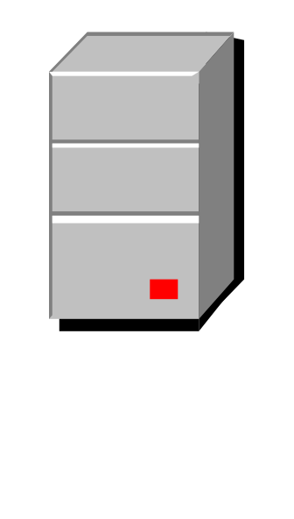
Middle Tier - Scope
Identify major Unify processes which tax the overall system
Continue this as an ongoing incremental project as long as we stay on Sybase
Use findings from this effort to determine the best long-term target architecture
High priority processes for a re-write :
  Settlements Draft (Sales, Supply, Service, and Service Invoice)
  Nominations
  Tracking & Balancing
  Others ?
Unify Client
Settlements
SYBASE DB Server
Nominations
Tracking + Balancing

Slide 30
Middle Tier - Scope
Remove business logic code running in Sybase stored procedures to support these processes and move to a middle tier for increased scalability
Settlements
Unify Client
Nominations
SYBASE DB Server
Tracking + Balancing
Settlements
Nominations
Tracking + Balancing
Settlements
Nominations
Tracking + Balancing
Application Server

Slide 31
Middle Tier - Scope
Determine the appropriate architecture on the middle tier
  Incremental legacy system improvements
  Strategic technical architecture
Determine the performance/scalability from the middle tier with a comprehensive test
Establish the technical framework that facilitates both tactical and strategic goals

Slide 32
Middle Tier - Potential Benefits
Reduce UNIFY performance problems by pulling processing off the DB server
Hardware scaleability to support future growth on multiple Application Servers
Frees client machines for other tasks during long-running processes
Makes it easier to adapt to business and technical change

Slide 33
Middle Tier - Assumptions
Focus initially on the Settlements Draft process
Initially test a Java-based middle tier architecture
Microsoft technologies (COM/SQL Server) may also be considered if SQL Server proves to be a viable RDBMS

Slide 34
Middle Tier - Staffing
Enron Resources
  Enron Owner - Dave Nommensen
  Enron Architect - Paul Poellinger - Application Support
  Developer - Russell Whitton - Settlements (Full-time)
  2-3 Other Enron Java developers - TBD (Full-time)
  Business analyst - TBD (Part-time)
  Business resources for design and testing - TBD (Part-time)

Slide 35
Middle Tier - Staffing
Consulting Resources
  Consulting Mgr - LaRay Odum (Part-time)
  Tech Arch - Nadeem Abbasi (Part-time)
  Senior Java Architect / Developer - TBD
  BEA WebLogic Expert - TBD

Slide 36
Middle Tier - Timeline
Acquire Hardware
App Server, JDBC Drivers
6/23
Install/Configure Hardware
App Server, JDBC Drivers
6/30
Wrap Draft Invoice Java Classes
into EJBs in App Server
7/7
Begin Performance Testing
7/14

Slide 37
Middle Tier - Timeline
Review Results
Go/No Go Recommendation
7/21
I F G O . . .
Design PowerBuilder Integration
8/15
Establish overall framework
8/31
Code + Test
NOMS, Tracking/Balancing
???

Slide 38
Middle Tier - Cost
Costs to get to a go/no-go decision
  Internal Resources - $50K
  External Resources - $100K
  Hardware Costs - $200K-$250K

Slide 39
UNIFY Strategic Migration Planning

Slide 40
UNIFY Strategic Migration Planning - Scope
Define the strategic target architecture with data from the tactical projects
Work with London / West Desk to assess leverage and partnership opportunities
Define the functional scope and phasing including Global Product requirements
Create a top-down code-object based estimating model for the Settlements re-write
Develop Request For Proposal document to solicit consulting bids for assistance

Slide 41
UNIFY Strategic Migration Planning - Assumptions
Business resources will be available as SMEs as needed during the course of this project to define:
  Growth expectations
  New requirements (global products, ….)
  Staff planning
Team will work closely with the new architecture group in defining the target architecture

Slide 42
UNIFY Strategic Migration Planning - Potential Benefits
Plan to architect the system for:
  Very high scaleability and performance
  Modularity for ongoing adaptation to business and technology change
  Global product requirements
  Web delivery and/or application service provider functions
If MS SQL Server proves to be viable, we can incrementally improve the system

Slide 43
UNIFY Strategic Migration - Staffing
Enron Resources
  Enron Owner: Ramesh Rao / Ken Harmon
  Tech Arch: John Simmons (Part-time)
  Tech Arch: Paul Poellinger (Part-time)
  Settlements Functional Architect: Ken Harmon (Part-time)
  Gas Logistics Functional Architect: Dave Nommensen (Part-time)
  Accounting Functional Architect: Regan Smith (Part-time)
  DBA - Jim Ogg
  Business Analyst: Dorothy Picketts (Part-time)

Slide 44
UNIFY Strategic Migration - Staffing
Consulting Resources
  Consulting Mgr - LaRay Odum (Part time, primary focus)
  Technical Architect - Nadeem Abbasi (Part time)
  Analyst - Juan Salazar

Slide 45
UNIFY Strategic Migration - Timeline
Identify Scope
6/22
Inventory Objects
6/30
Develop high level reqts / scope
8/31
Design Future Tech Arch
8/31
Estimating Model / RFP
9/15

Slide 46
UNIFY Strategic Migration - Planning Cost
Internal Resources - $50K
External Resources - $250K

Slide 47
Questions / Next Steps
UNIFY / DCAF hiring update
Suggestions, Questions, Concerns ?
Next Steps to discuss
  UNIFY monthly steering committee for cross-organization guidance on:
    Status -- progress and issues
    Unify needs and new priorities
    Allocation of scarce resources
  Business hiring plans for ‘super users’

