Slide 1






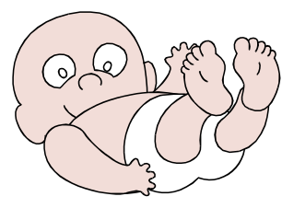
It’s A Contest!!!
Melissa Graves is going to have a baby! The two people who submit the closest date & time of baby Graves’ birth, will win a $50.00 gift certificate to the Fisherman’s Wharf Seafood Grill in Galveston, Texas.
Please submit your entries by e-mail to: Katherine Benedict

