Slide 1
Central Desk
Hunter Shively

Slide 2
Overview
Regional Characteristics
PGL&C Transaction
Chicago Office (Midwest Hub)
Generation Impact

Slide 3
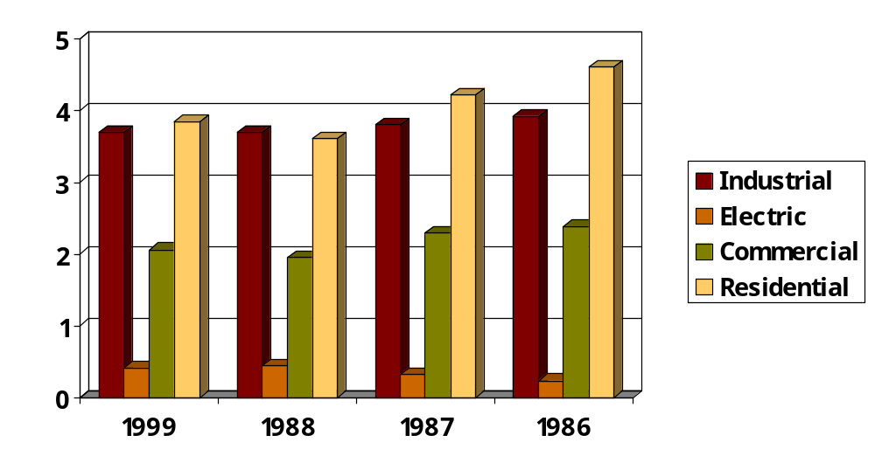
Daily Midwest Consumption
Illinois, Indiana, Iowa, Michigan, Minnesota, Missouri, Nebraska, and Wisconsin
The combined total for each year is an average of 10.4 BCF/Day

Slide 4
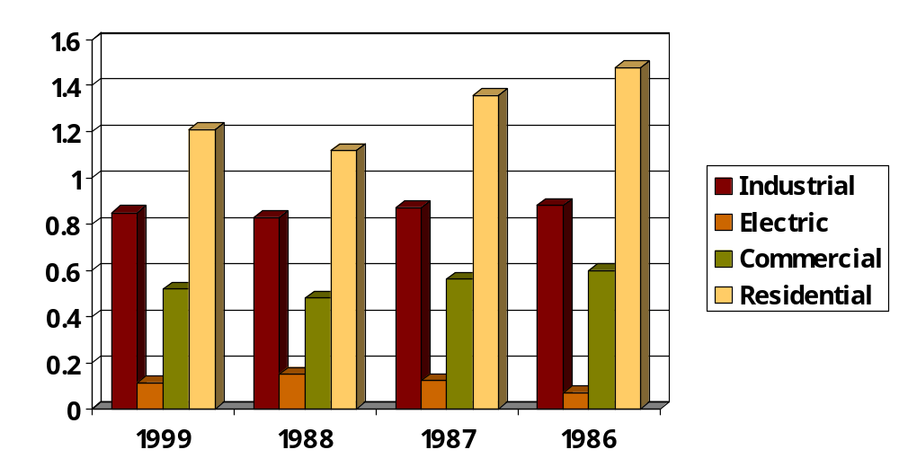
Daily Illinois Consumption
The combined total for each year is an average of 2.8 BCF/Day

Slide 5
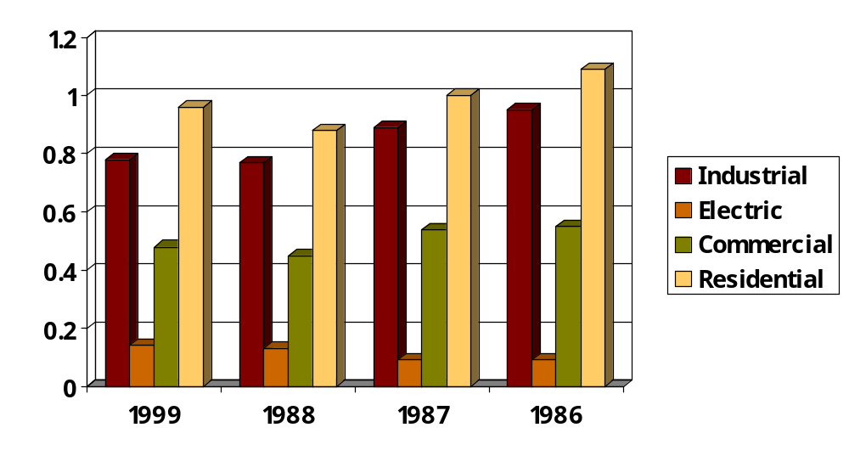
Daily Michigan Consumption
The combined total for each year is an average of 2.5 BCF/Day

Slide 6
Large LDC profiles
Nicor 1.3 bcf/day
Consumers 1.0 bcf/day
Michcon .8 bcf/day
NIPSCO .7 bcf/day
Peoples Energy .7 bcf/day

Slide 7
Nicor Gas Company
3rd largest LDC throughput in the United States
Average daily winter load of 2.2 Bcf/day
Record load of 4.6 Bcf on January 18, 1994

Slide 8
Nicor Assets
1.6 Bcf/day of transportation
144 Bcf of company owned storage
39 Bcf of leased storage
Company owned storage has a daily peak delivery of 2.8 Bcf

Slide 9
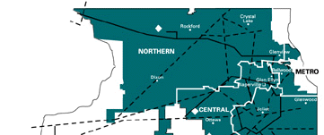
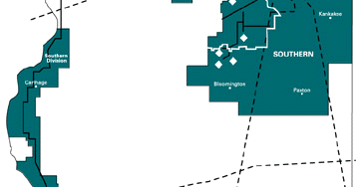
Nicor Gas Service Territory

Slide 10
Consumers and Michcon
Company owned storage
Michcon 155 Bcf
Consumers 150 Bcf
Consumers and Michcon combine for 1.9 Bcf of Michigan’s 2.5 Bcf of daily load

Slide 11
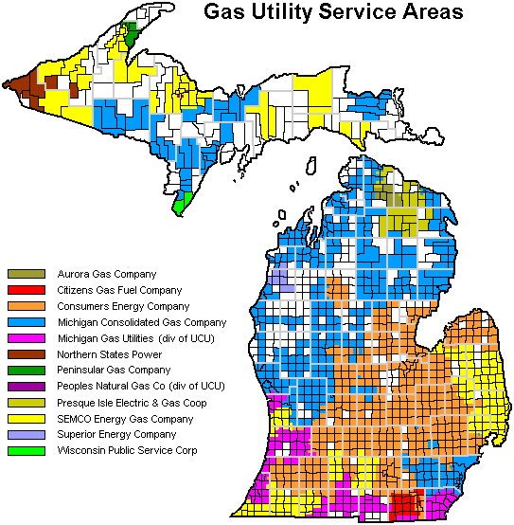

Slide 12
Peoples Energy
Service territory is the city of Chicago
peak design day is 2.9 BCF/day

Slide 13
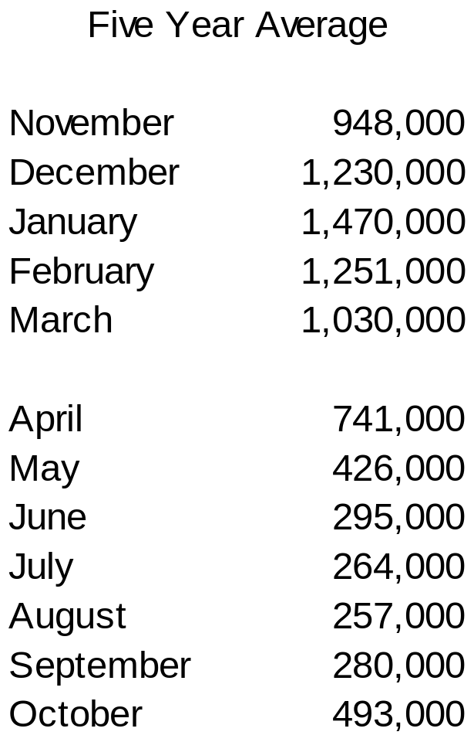
Average Daily Load by Month

Slide 14
Manlove Storage Complex
120 miles south of Chicago
34 BCF water aquifer facility
LNG facility that stores 2 BCF
Normal withdrawals begin in December
Physical nature of the field requires that when the field starts withdrawals, 5BCF must be withdrawn in 17 days
Peak deliverability of 1 BCF/day

Slide 15
Other Assets
Propane peaking facility
Leased storage
NGPL 29 BCF
ANR 10 BCF
PEPL 2.5 BCF

Slide 16
Peoples Transaction
Five Year Deal that started in October 1999
Monthly Baseload Volume sold and priced at the Chicago City Gate
Peoples’ transportation contracts are released to ENA
Peoples sold April-November physical Straddles
Peoples sold December-March financial calls

Slide 17
Peoples Daily Swing Rights
Gas Daily Priced
Peoples can call daily priced gas up to the amount of transportation contracts released to ENA
Peoples can put 200,000/day

Slide 18
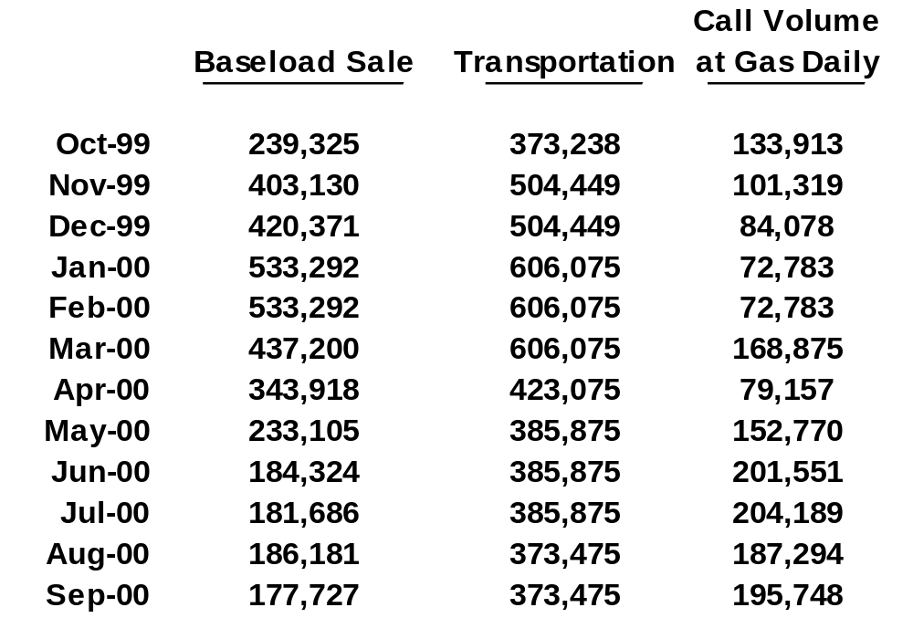
Monthly Volume, Transportation, and Call Rights

Slide 19
Key benefits of the deal
Large presence in Chicago
Transportation wheeling
Information
Daily Burn
ENA helps Peoples make decisions
Other Utilities share info with Peoples
Hub Partnership

Slide 20
Enron / Peoples Joint Venture
Office is across the street from Peoples
Comprised of Enron and Peoples employees
Most of the Peoples employees have job responsibilities with the Hub and Utility
The JV’s primary purpose is to optimize the excess assets of the utility

Slide 21
Assets held by HUB
16.5 BCF of NGPL Field area storage
7.5 BCF of Manlove storage
1 BCF of Propane (230,000/day deliverability)
Hub can optimize all utility owned assets

Slide 22
Benefits of JV to Trading Group
Information
ENA can originate transactions with other utilities
ENA can use assets that it does not own or lease

Slide 23
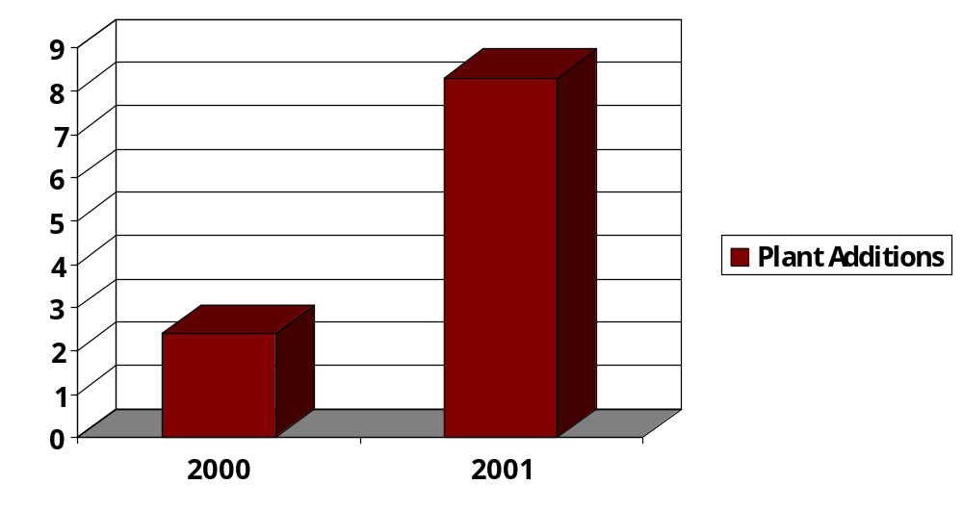
2000 and 2001 MAIN Additions

Slide 24
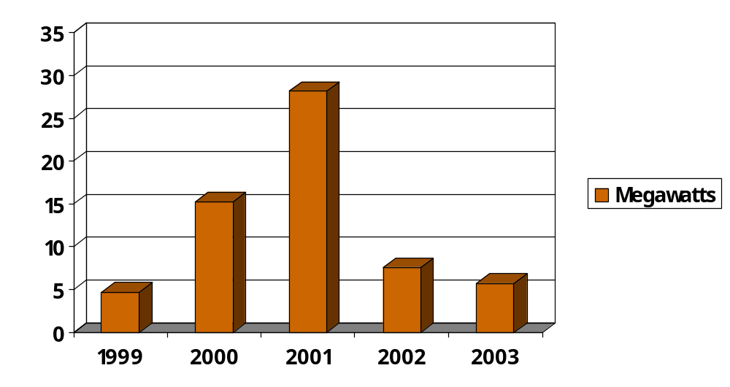
EIA Proposed Power Additions

