Slide 1
Central Origination
Implementation Plan
January 7, 2001

Slide 2
Implementation
Customer Targets
  Tier I – Significant Counterparties
      Transactional
      Regional
  Tier II – 2001 Transactional Counterparties
  Tier III – TBD/Potential Regional Clients
Central Origination Organization
Implementation Schedule

Slide 3
Customer Targets – Tier I
Central Region Focus
  Cilco
  Cinergy
  CMS Marketing
  Conoco, Inc.
  Constellation Power
  Consumers Energy
  Cook Inlet
  IDACORP Energy LP
  Interstate Energy
  MichCon
  MidAmerican Energy
  Nicor Enerchange
  Nicor Gas Company
  NiSource
  OG&E Energy
  Oneok
  Peoples Gas & Light Co.
  Tenaska Marketing
  Union Gas
  Utilicorp United

Slide 4
Customer Targets – Tier II
  Alleghney Energy
  Ameren Services
  Archer Daniels Midland
  Clinton Energy
  CMS Field Services
  CoEnergy
  DTE Energy
  Empire District Electric
  Enbridge
  Entergy Arkansas
  Entergy Louisiana
  Excelon Energy
  Ft. James Paper
  Georgia Pacific
  Great River Energy
  Heartland Energy
  Kaxtex Energy
  MCV Limited
  Memphis Light & Gas
  Metropolitan Utilities District
  Nexen Marketing
  NRG
  PCS Nitrogen Fertilizer
  ProLiance Energy
  Seminole Energy
  Terra Industries
  Twister
  Wisconsin Gas Company
  Wisconsin Power & Light
  Wisconsin Public Service
  WPS Energy
  XTO Energy (CrossTimbers)

Slide 5
Transportation Targets
Interstate Pipelines
  Alliance
  ANR
  NGPL
  NNG
  Northern Border
  Trunkline
  Vector
Intrastate Pipes/Hubs/Gates
  OG&E
  ONG
  Reliant
  Union/Dawn
  Nicor
  Peoples Gas & Light
  Nipsco

Slide 6
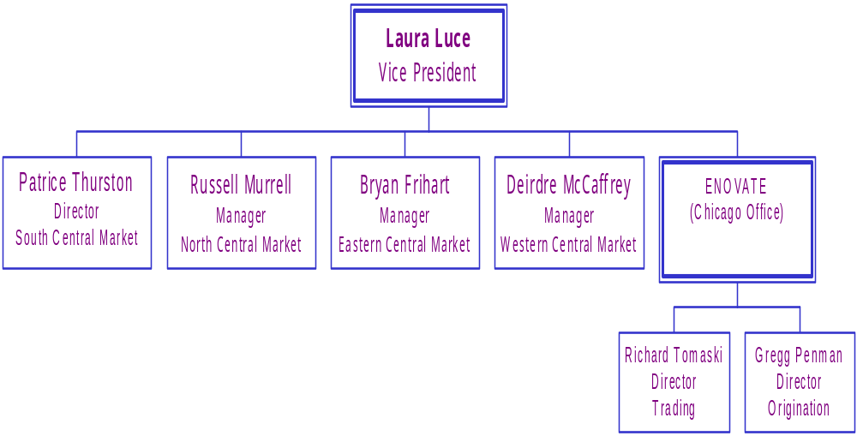
Central Origination

Slide 7
Implementation Schedule
Week 1
Week 2
Week 3
Week 4
Week 5
Tier I & 2
Contract Mailing
Tier I
Customer Visits
Tier 1
Customer Visits
Tier 2
Follow-up & Visits
Tier 1 & 2
Follow-up & Visits

