Slide 1
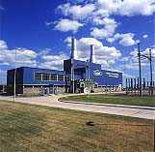
Project Starburst
Overview of Acquisition of 70 MW Combined Cycle Power Plant
Argentina
December 7th, 2000

Slide 2
Agenda
Opportunity & Structure
Power Plant Profile
Strategic Rationale
Financial Performance & Statistical Summary
History of the Transaction
Amendments to the Original Dash Executed
Financial Value Drivers
Valuation Assumptions & Results

Slide 3

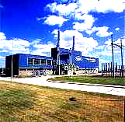
Opportunity
is a family-controlled food giant. Vertically integrated, the company wants to divest of non-core assets. Included in this strategy is a 70 MW Combined Cycle Power Plant located in Rio Cuarto Córdoba, Central Argentina.
Asset Purchase - US$ 12 MM plus VAT
100% Equity Transaction
Arcor Will Transfer Plant employees to Enron.
Closing Expected by December 15th
Structure

Slide 4
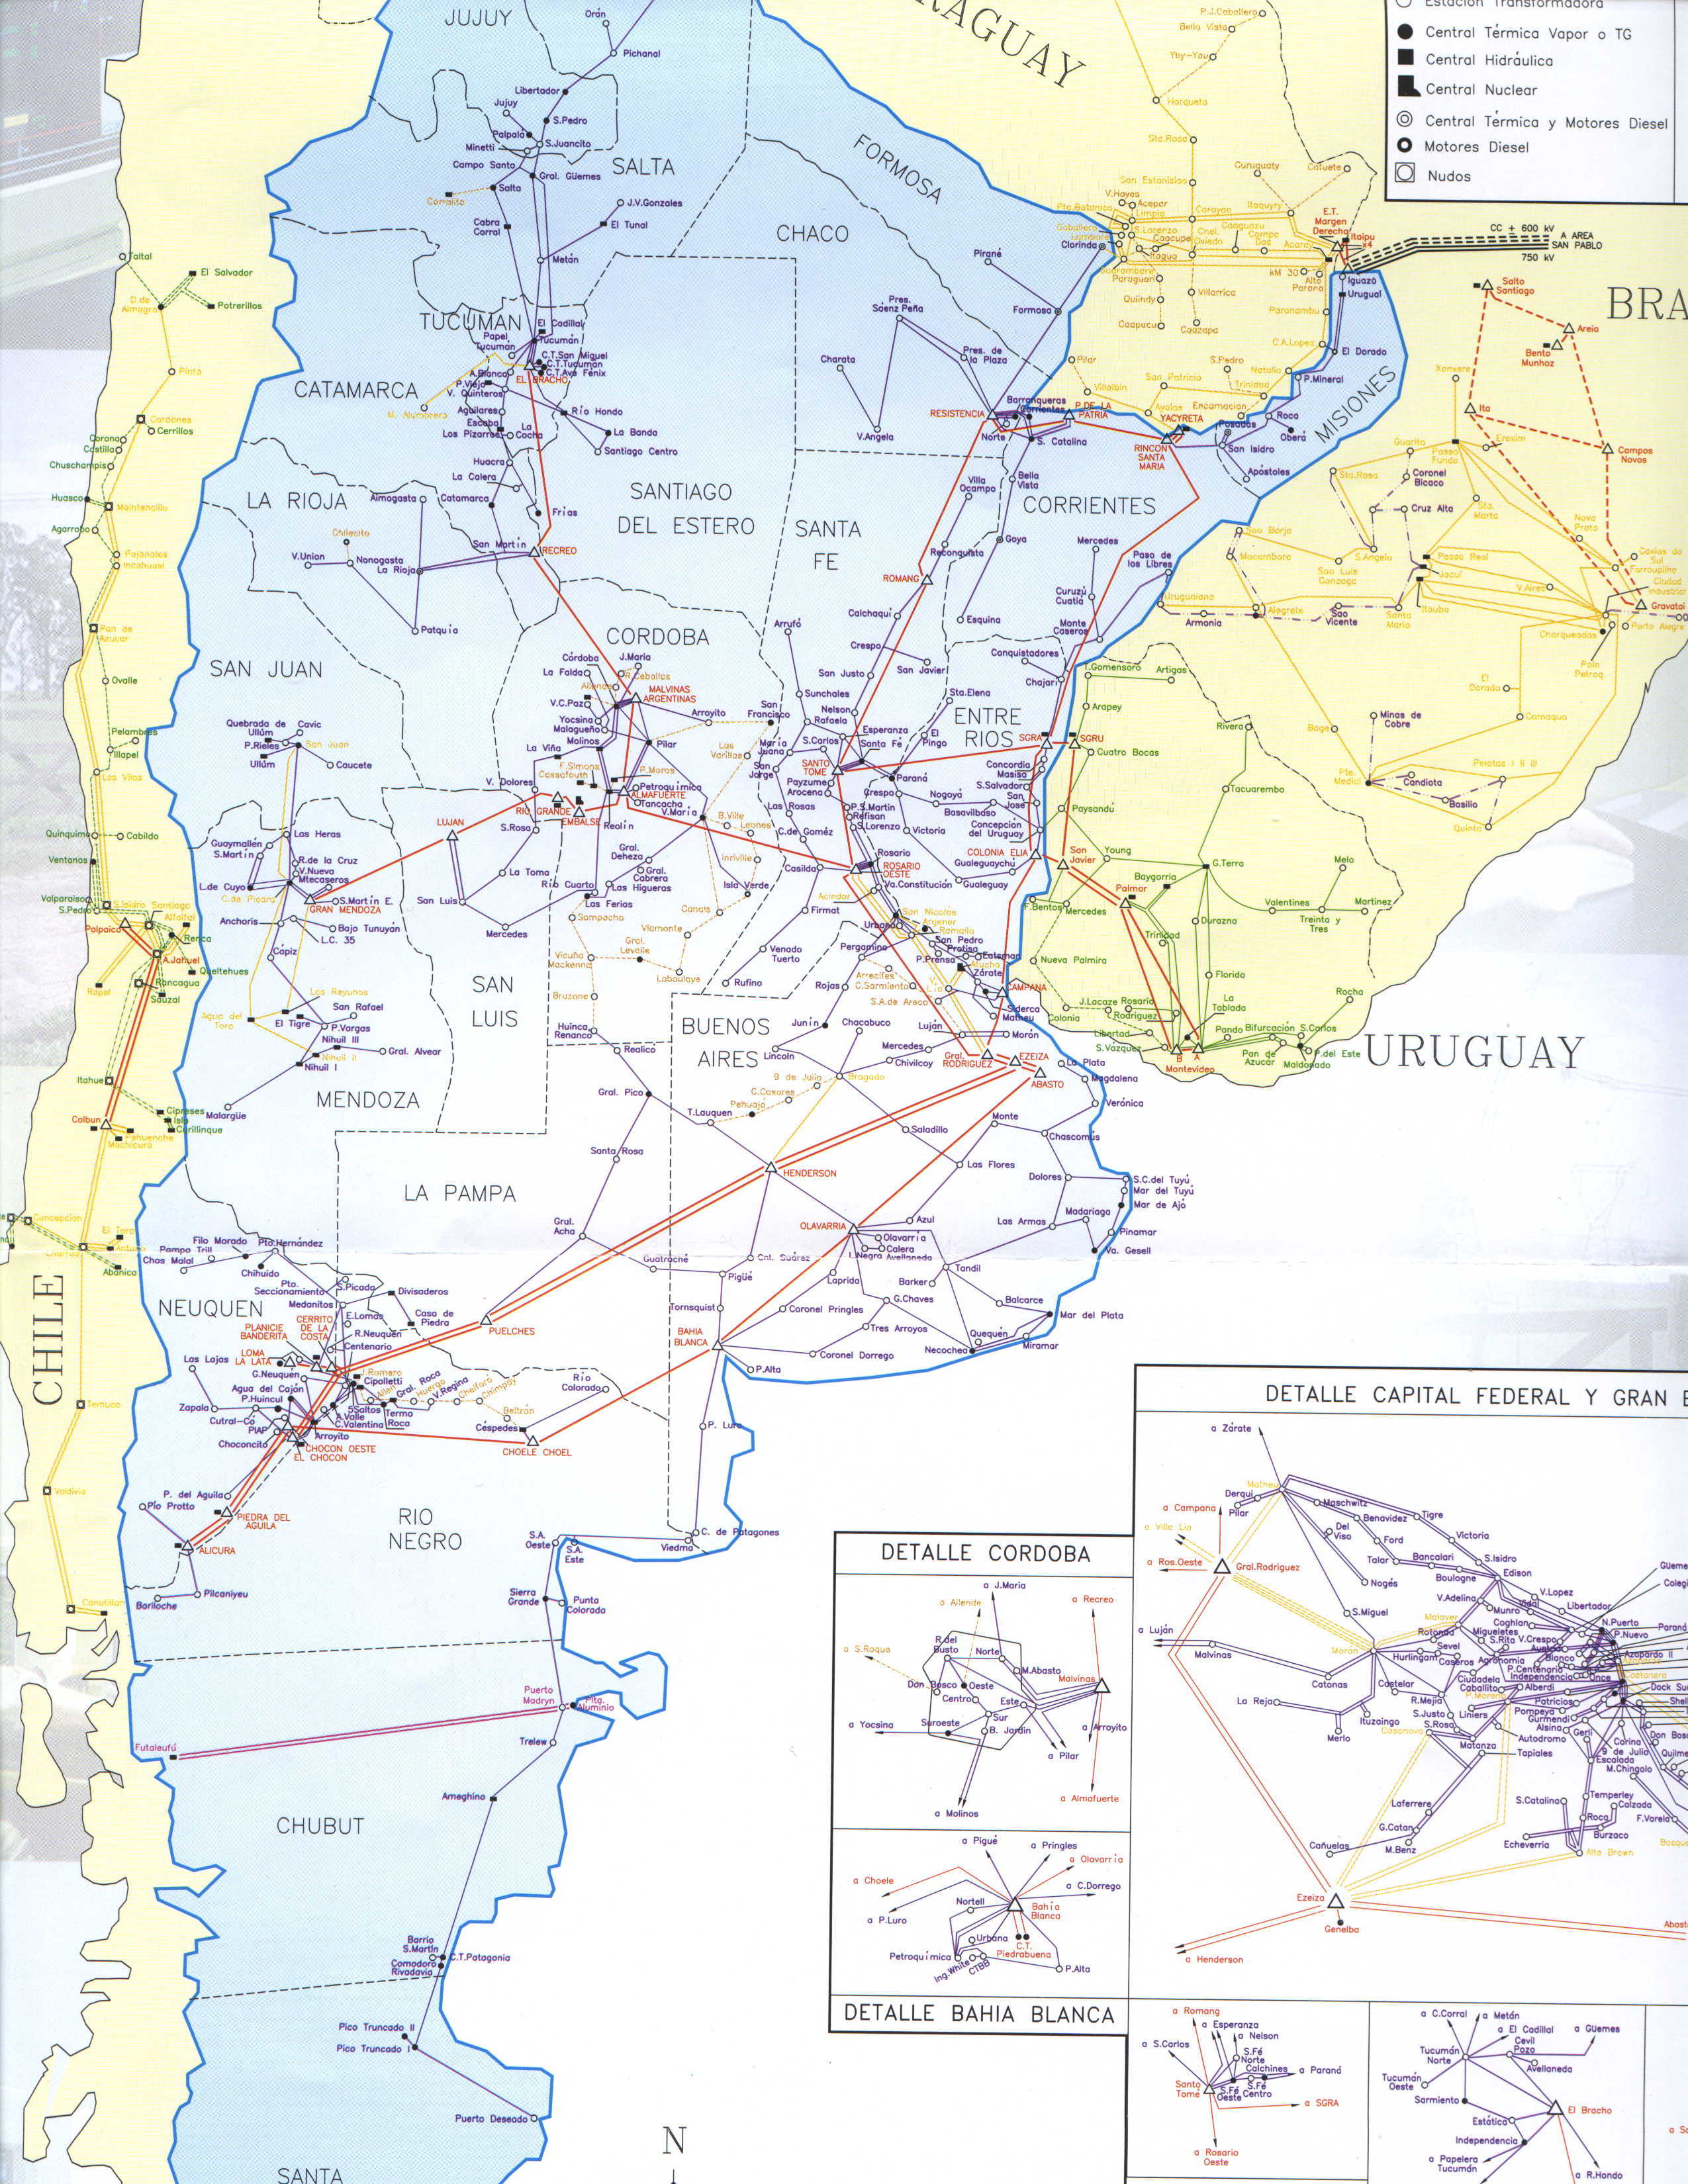
Power Plant Profile
MODESTO MARANZANA PLANT
70 MW Installed Capacity
Operating in Argentina since March 1995
Average Load Factor last three years: 87%
Avg. Marginal Cost of Production: $14.50/MWh.
Heat Rate: 2,200 Kcal/KWh
17 direct employees

Slide 5
Strategic Rationale
Purchase the Power Plant as a “Power Trading Position”
  Physical Hedge Against Upward Price Changes (Natural Cap).
  Take Advantage of Upward Price Volatility - Option Value.
  Ability To Swing Plant Between Natural Gas/Diesel Consumption and As a Vehicle for Fuel/Electron Arbitrage.
  Access to Market Information via participation on Generator’s Association.
  Space, Facilities and Scale Economies to Expand Generating Capacity
“Where’s Your Steel?”
  Duke Energy (Our Closest Merchant Services Competitor) has Recently Purchased 950 MW (Dominion Assets).
  Cement Physical Generating Presence - Commitment to the Market.
  Assist New Market Penetration and Access to Deal Flow.
  Address Local Industry Concerns/Demands.
Natural Gas Demand Position
  Gas Marketing Opportunities (Plant Max Consumption 440,000m3/d).
  Ability to Penetrate TGN Territory With Firm Capacity.

Slide 6
Strategic Rationale
It’s Cheap
Enron is paying $180 per kW versus recent Argentine Power Plant Acquisitions on Average $250 per kW
Strategic Long Position
This Acquisition Can Solve Two Current Constraints in EA’s Role as a Power Marketer in Argentina:
  Constant Market Evolution: Tight Liquidity and Recent Increase in Winter Volatility Make Getting Long a Challenge
  Still Some Cultural Bias Against “Marketers” (Fear of Lack of Physical Backup/”Where´s Your Steel?”)
Torn Sleeve
Q12001 - Monetization of Merchant MWs - Years 1-5
Machine Value
Plant Has a Physical Break-up Value of at Least $ 8.0 Million

Slide 7
Financial Performance and Statistical Summary
(US$ million) 2000 ⁽¹⁾ 1999 1998 1997
Gross Revenues 14.8 ⁽²⁾ 16.2 16.4 16.0
EBITDA 4.6 4.7 4.8 4.8
Estimated Book value of the assets 13.7 15.5 17.2 17.2
2000 ⁽¹⁾ 1999 1998 1997
Generation (MWh-yr) 474,203 455,684 498,056 469,568
Average Spot Monomic price ($/MWh) 23.5 23.3 21.3 21.7
Average EPEC PPA price ($/MWh) 37.9 37.9 37.9 37.9
Variable Cost of Production ($/MWh) ⁽³⁾ 18.4 18.2 19.5 18.6
⁽¹⁾ Based upon December Estimations
⁽²⁾ Epec PPA Contract Volume Reduction May’00
⁽³⁾ Inclusive of All Demand Charges

Slide 8
History of the Transaction
May 31st – Original Dash Executed
June 6th – Asset Purchase Agreement Executed
  Main Condition Precedents
    Antitrust Commission Approval
    EPEC PPA Transfer
    Gas Supply Contract Transfer
    Municipality Tax Exemption Transfer
    Extra Due Diligence
    Water Well Test
September 30th - Original Closing Date (all condition precedents met except EPEC PPA & the Municipality Tax Exemption)
November 30th - 1st Extension
December 15th - 2nd Extension
(*) EPEC is the LDC

Slide 9
Amendments to the Original Dash Executed
Terms & Conditions | Old | New
1- EPEC PPA
1.1- Volume [MW]: | 6.5 | 25
1.2- Price [$/MWh]: | 37 | 34
1.3- Term [Months]: | 52 | 12
1.4- PV PPA Impact [MM$]: | 0 | (.3)
2- True Up Value Impact [MM$]: | 0 | 1.5
3- Forward Curve Impact [MM$]: | 0 | 3.7

Slide 10
Financial Value Drivers
($ Million) - IRR 26.84%
20
16
Tax & Transaction Costs
True Up Value
12
Arcor PPA
6.5MW (3 years Term)
$1.1
$11.6
Total Upfront Payment
$1.5
8
$0.7
$2.3
EPEC PPA
25 MW (12 month term)
$6.0
4
Merchant Activities
Power/Gas/Ops Savings/Taxes
0

Slide 11
Valuation Assumptions & Results
Assumptions:
Discount Rate: 15%
Term: 15 years
Level of Debt: $0
Results:
Merchant Activities: $ 14,606 k
PPA’ s: $ 2,334 k
Terminal Value: $ 1,688 k
Total Value: $ 18,628 k
CF Drivers:
Power Curve: Mid Curve
Dispatch: 89% (15 year average)
Tax Recovery: Yes
Gas Prices: Mid Curve

Slide 12
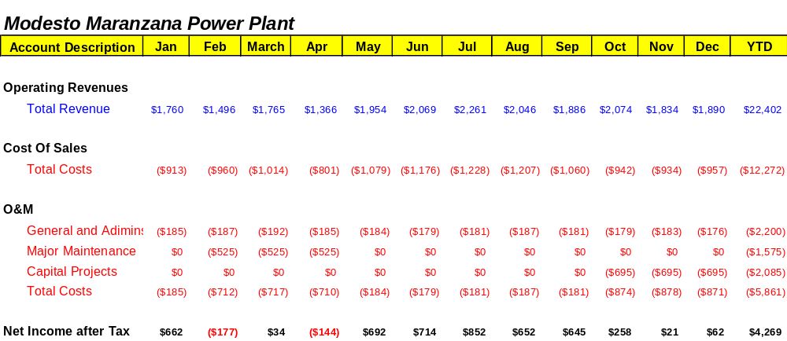
Valuation Results - Monthly Cashflow - 2001

Slide 13
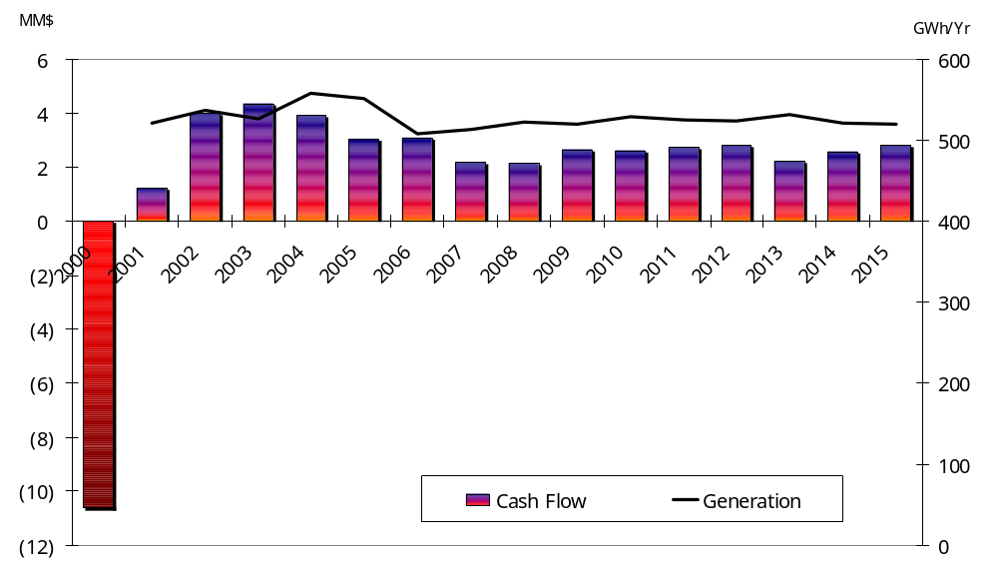
Valuation Results – Cash Flow & Generation - Yearly
(1)
(1) Without Salvage Value in year 15 = 13,732

Slide 14
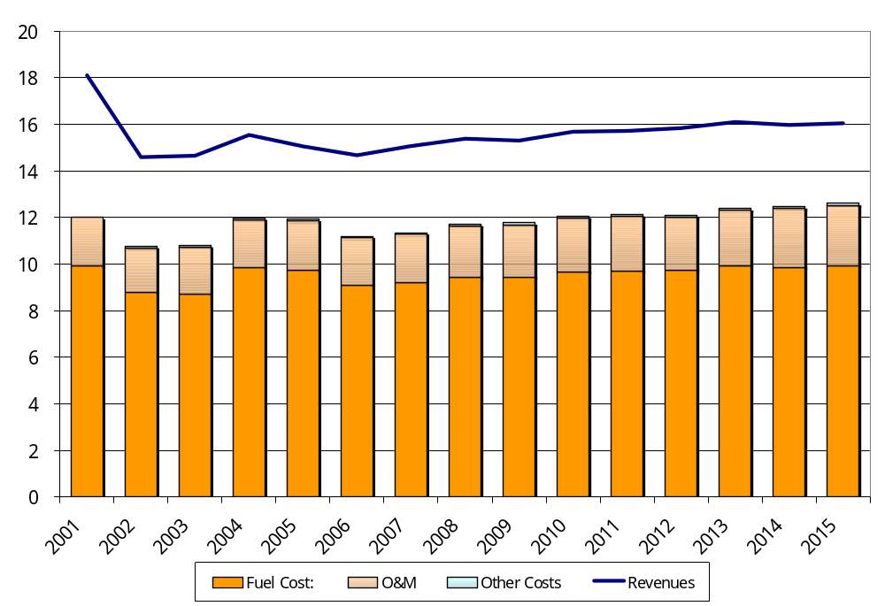
Valuation Results – Revenues & Expenses
($ Million)

Slide 15
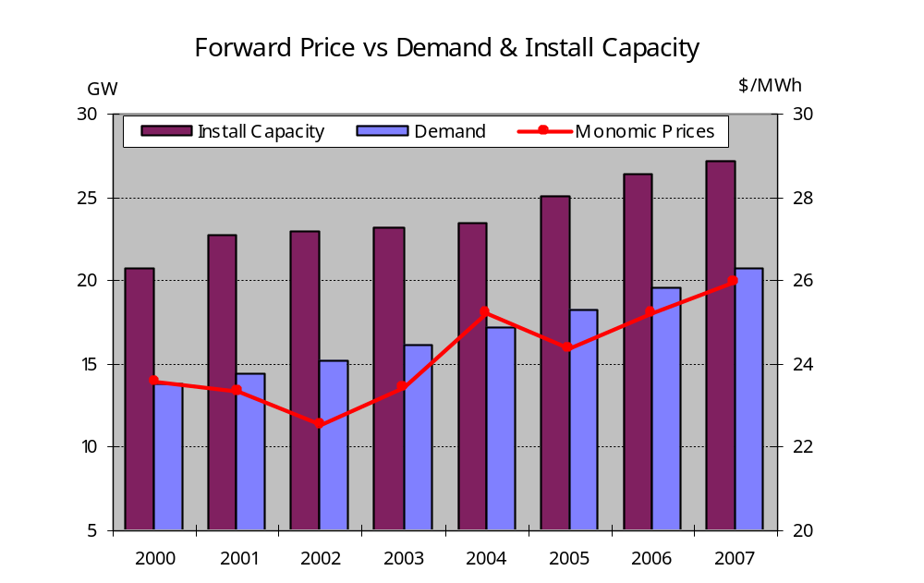
Valuation Assumptions - Forward Power Curve
(1) Monthly Averages - Monomic prices

Slide 16
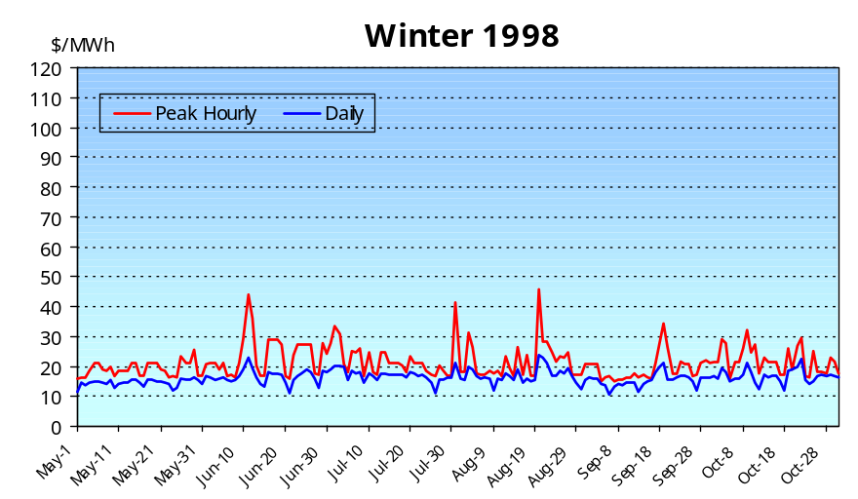
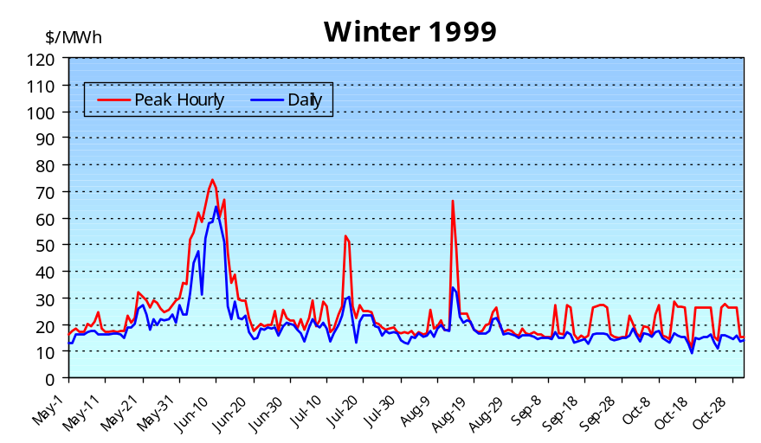
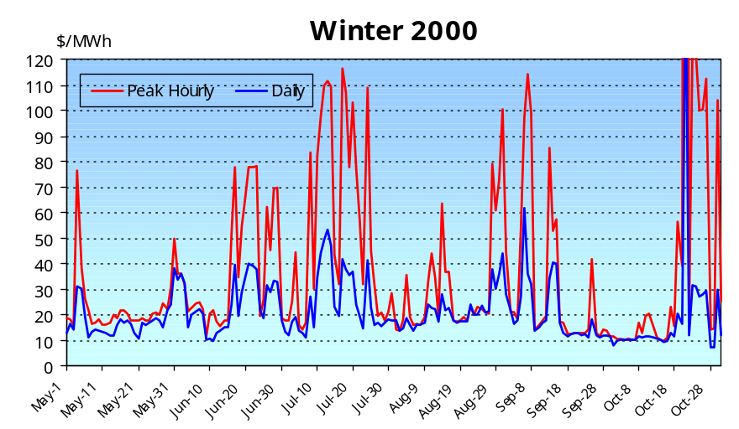
Volatility - Increase of Winter Daily Prices (1)
Low reservoir levels, low stock of Fuel Oil, thermal & nuclear unavailability
Mild Winter, low WTI prices, El Niño
Increase Volatility Drivers:
Significant Spread Increase between NG & Oil
Exports => 10% Load Increase (Brazil + Uruguay)
Frequent Gas Curtailments due to Pipeline Saturation
Low Reliability of CC in Switching to Gas Oil
Lack of Grid Expansion (Basis Differential)
System Vulnerability to Large CC (800MW Units)
Oct-00 $1500 per MWh - Comahue Line Outage
(1) Daily Averages - Energy Prices

