Slide 1
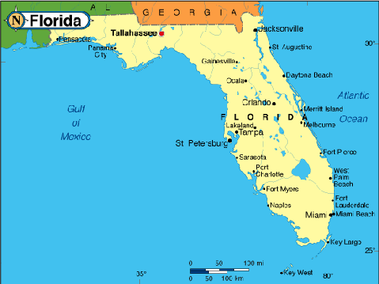

Enron North America
Florida Merchant Power Plant
July 5, 2000

Slide 2
Project Development Overview Florida Power Plant
Project Description
  Installation of an approximate 279 MW (91ºF and 65º humidity, natural gas operations) simple cycle peaker at one of three potential locations in SE Florida.
  Estimated project development budget of $3 million.
  Multiple site development to hedge development risk and create generation/origination optionality.
  Targeted commercial operations is June 1, 2001.
  First market mover advantage - no prior merchant IPPs constructed in Florida to date.
  Take advantage of short generation supply and recent market volatility in Florida market through summer 2003.
  Optionality of transmission along entire Eastern U.S.
  Option to expand into combined cycle and increase capacity by roughly 75 MW with installation of STG.
  Exit Strategy: sale to GENCO or 3rd party developer.
  Locations in order of priority: Broward, Medley-Dunn, and Midway. Land option term will allow for continued development optionality through 2002.
  Two additional sites under control for development by summer 2002.
  Sites in other states (i.e. LA and MO) being pursued in part as hedges for Florida development risk.
Strategy

Slide 3
Project Development Critical Path Issues Florida Power Plant
FPL is not likely to cooperate on electrical interconnection and has been historically successful in blocking merchant IPPs in Florida.
Rezoning and land use approvals will take at least 4-6 months at each site. Public comment is likely.
Best case construction schedule as a result of the above is 4-5 months assuming a June 1 start.

Slide 4
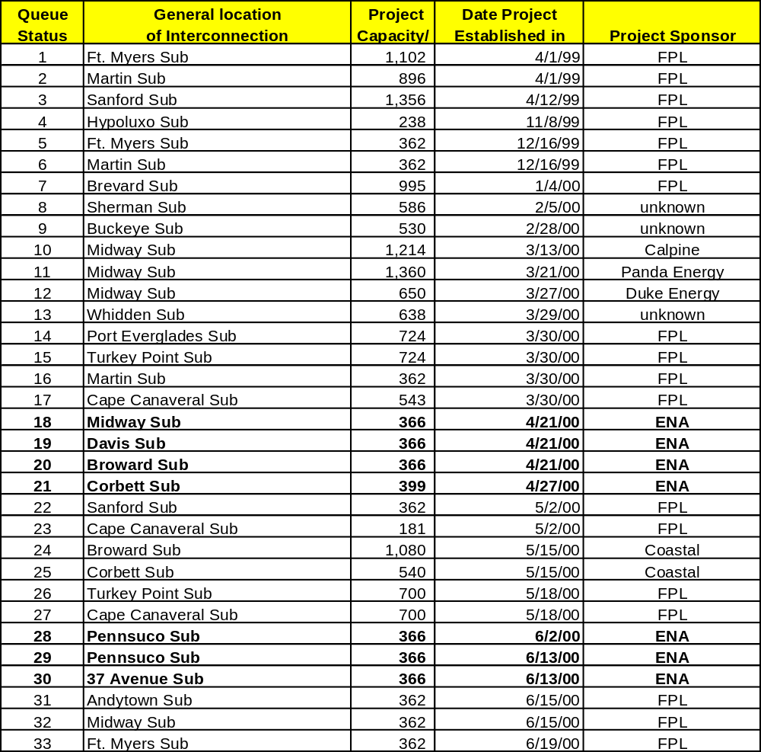
FP&L Interconnect Request Queue Florida Power Plant
Based on the best available information at time of publication.

Slide 5
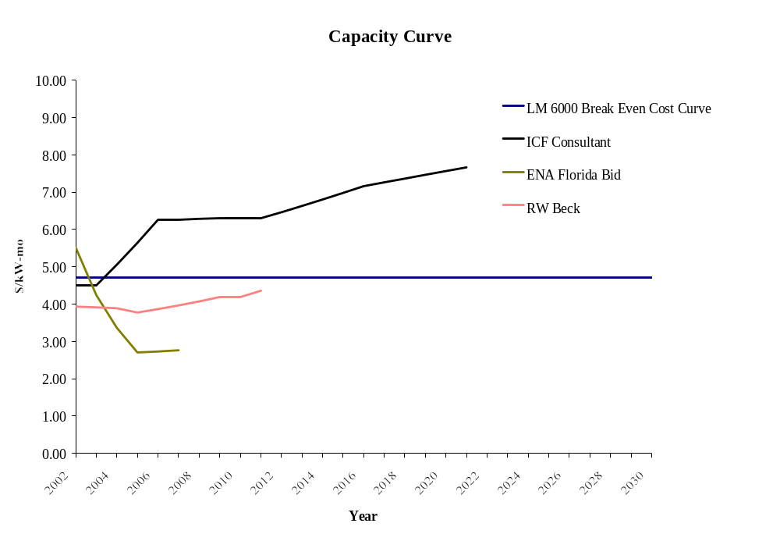
Florida Curve Scenarios
Florida Power Plant
* Capex of $161 MM amortized over 30 years with 10% residual value and 7% interest.

Slide 6
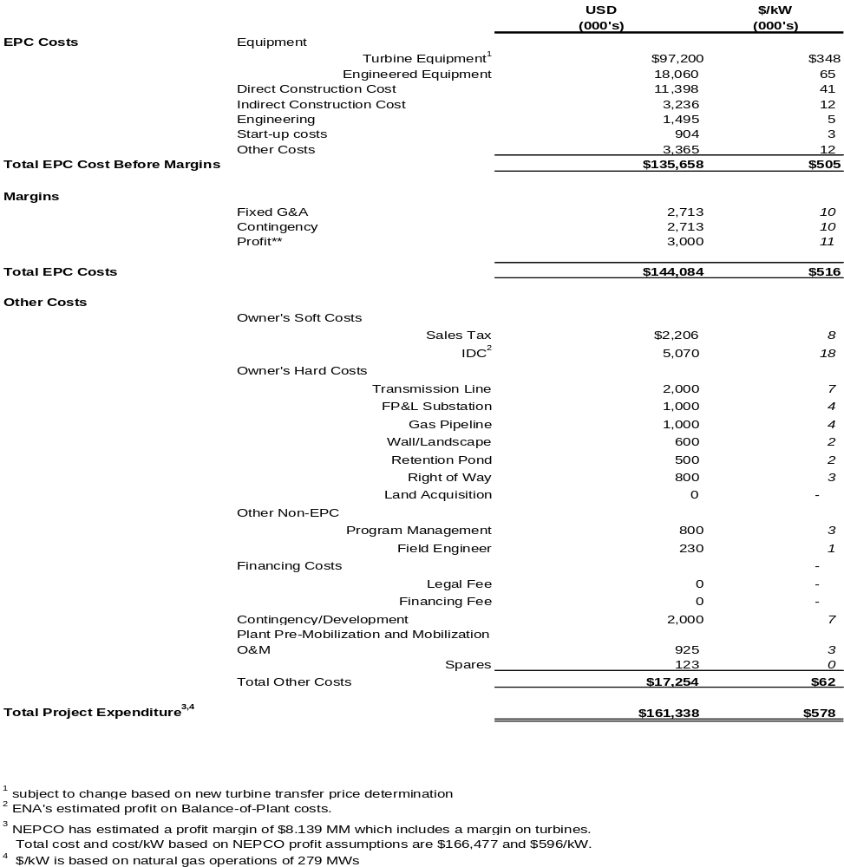
Estimated Construction Budget Florida Power Plant

Slide 7
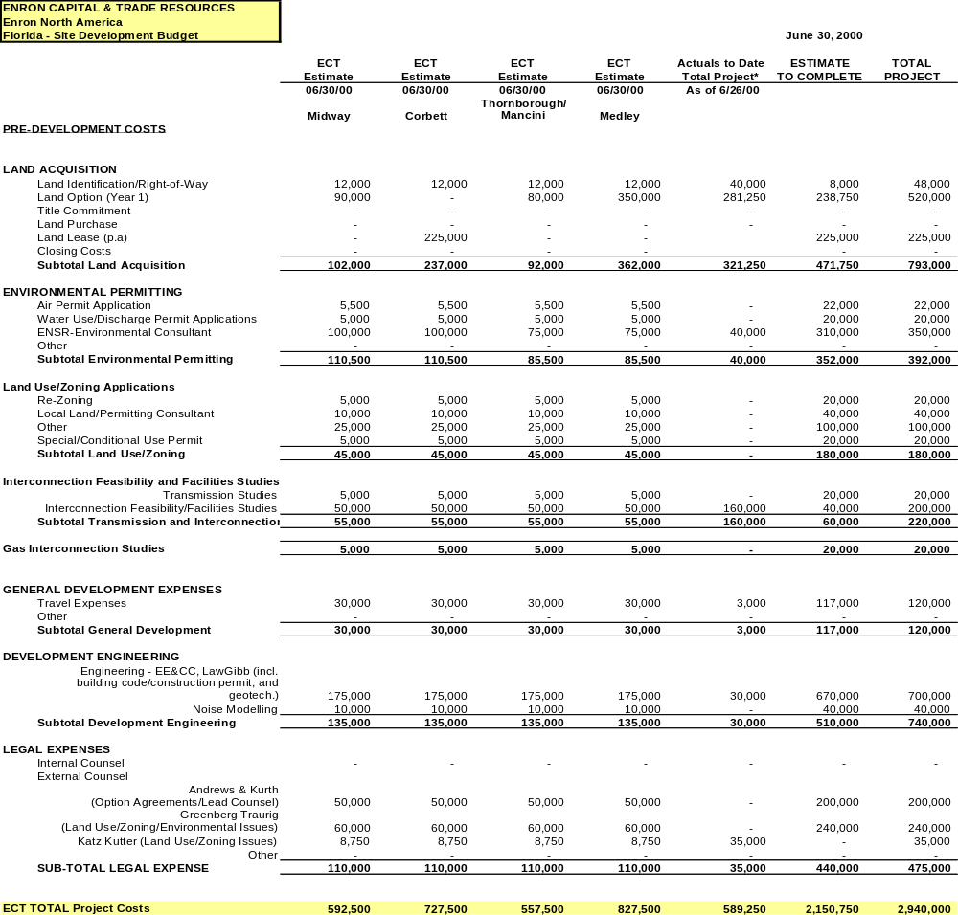
Florida Development Budget Florida Power Plant

Slide 8
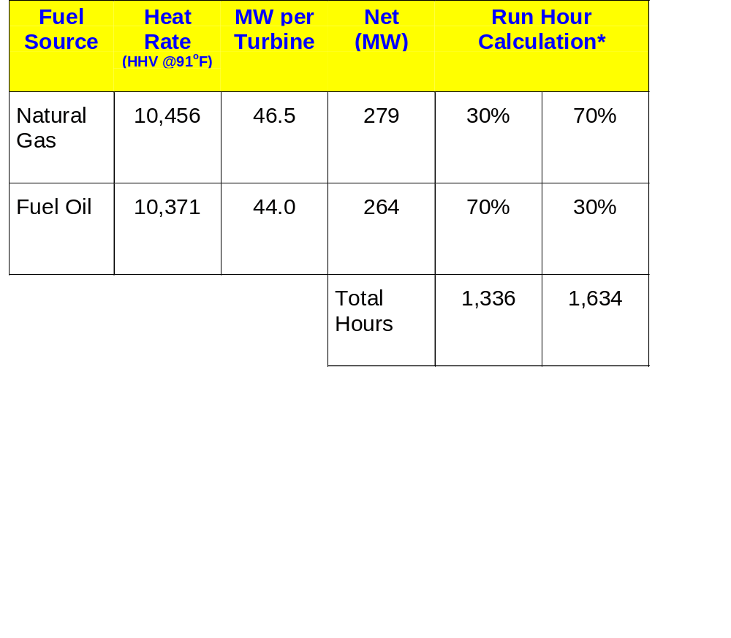
Equipment: 6 GE LM6000 turbines with enhanced SPRINT
* Run hours are based on non-PSD emission limits of 250 tons/year which applies to simple cycle plants.

Slide 9
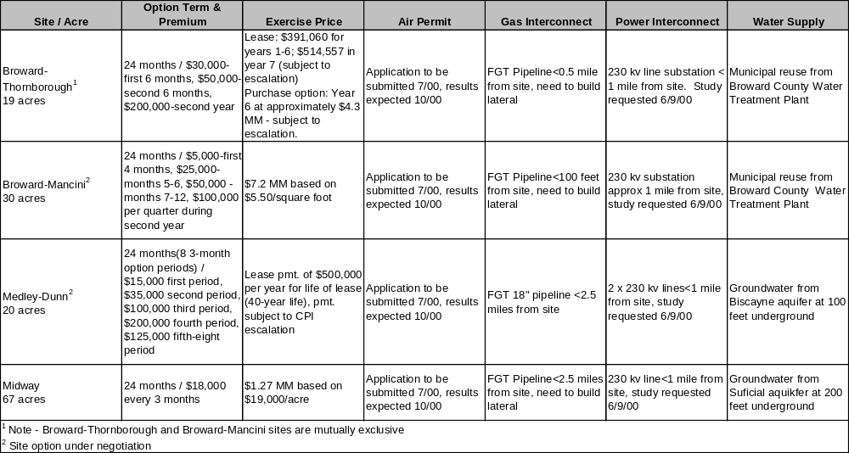
Project Details - June 2001 Target Sites Florida Power Plant

Slide 10
Project Details - June 2002 Target Sites Florida Power Plant
Site / Acre
Option Term & Premium
Exercise Price
Air Permit
Gas Interconnect
Power Interconnect
Water Supply
$2.5 - 3.0 MM based on $125,000/acre in yr 1 and $150,000 in yr. 2
1-year lease with option to
Application to
Proposed 12-mile NUI
Goundwater from
Corbett
extend lease through year
be submitted
pipeline<.5 miles from
230 kV line<1000 feet
Surficial aquifer at
2/$56,250 every 3 months
7/00, results
site, expected
from site, study requested
200 feet
during year 1
expected 10/00
completion in late 2001
6/9/00
underground
$1.1 - 1.2 MM based on $30,000/acre in yr. 1 and $33,000/acre in yr. 2.
3-twelve month option periods.
Homestead
Option premium: $40K/year for
Application to
Groundwater from
each of the first two 12 month
be submitted
FGT's 18'' pipeline is
230 kV line<1 mile from
Floridian aquifer.
periods, $50K for the last 12
7/00, results
within 2 miles of the
site, study requested
Capex will be in
month period
expected 10/00
site
6/9/00
excess of .5 MM.

Slide 11
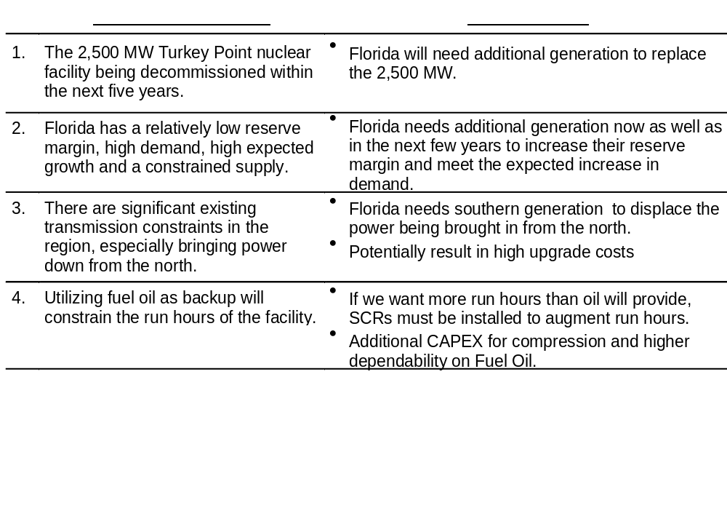
Florida Supply/Demand Issues Florida Power Plant

