Slide 1
The DeMotivational Series
“When you don’t care any more”

Slide 2


Slide 3


Slide 4


Slide 5


Slide 6


Slide 7
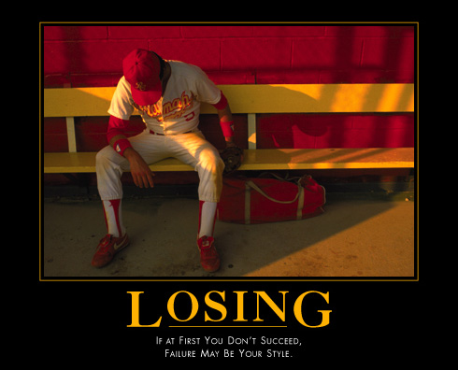

Slide 8


Slide 9


Slide 10


Slide 11


Slide 12


Slide 13


Slide 14


Slide 15


Slide 16


Slide 17


Slide 18
The DeMotivational Series
“When you don’t care any more”
Now go be productive!

