Slide 1

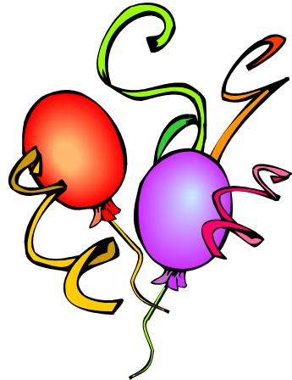
You are invited to Elena's Birthday Dinner at “Russian Bear”
Where: 1801 Diary Ashford
When: Saturday (Nov. 3rd) at 8 PM
P.S. Call me if you have any questions at 713.302.2619

