Slide 1

Group 1 – Project 1 – Healthcare
Rachel J, Aleksandra C, Cristian L, Shawn L

Slide 2
Research Questions
Does health expenditure impact life expectancy?
Does residency location impact life expectancy?
Does gender impact life expectancy?

Slide 3
Research Question 1 – Health Expenditure
Approach
Defining the question/variable:
Looked at Health Expenditure as a % of GDP
% of GDP: money spent on health goods and services by all levels of government as well as non-government entities such as individuals and private health insurers.
Spending on health goods and services could include: medical services (e.g., Medicare and private health), hospital services (public and private), pharmaceutical benefits, research.
Looked at Developing vs. Developed countries (as grouped by WHO), to help understand the comparison and relationship between Life Expectancy and Health Expenditure.

Slide 4
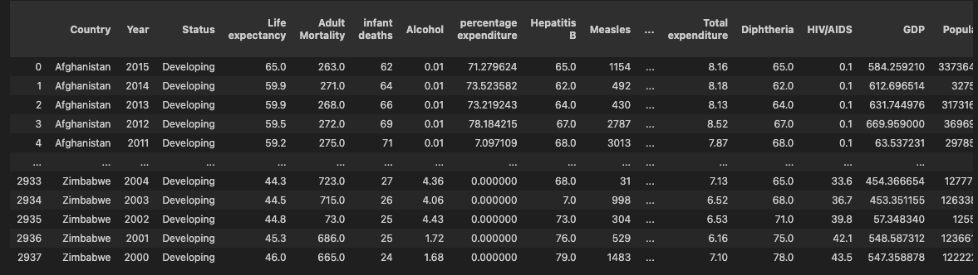
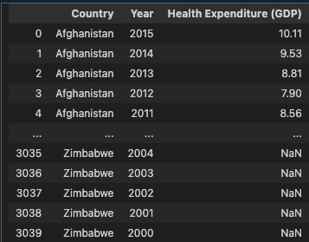
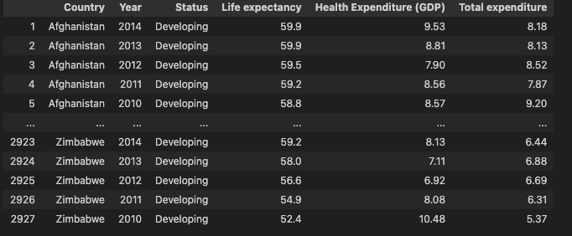
Research Question 1 – Health Expenditure
Dataset
Imported csv from Kaggle:
Merged with csv on health expenditure (% of GDP) from WHO:
Variables of interest:

Slide 5
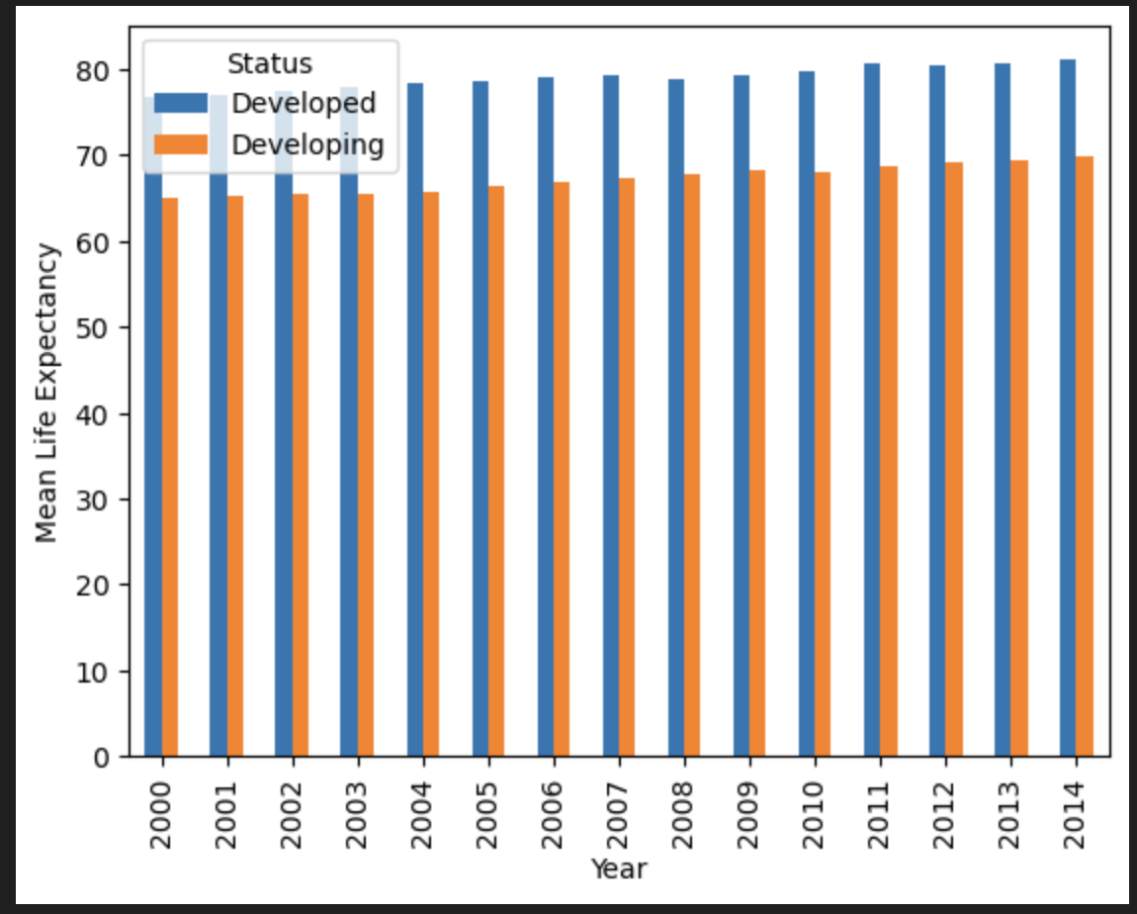
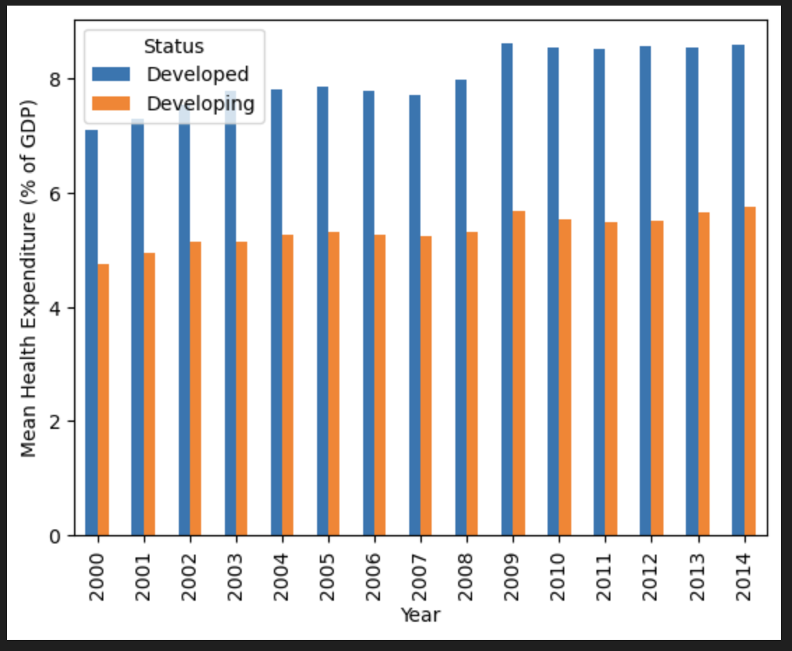
Research Question 1 – Health Expenditure
Findings and Analysis
Developed countries on average have a higher life expectancy than Developing countries.
Developed countries significantly spend more on health than Developing countries.
Between 2009-2014, both Developing and Developed countries overall increased their spending on health compared to prior years of 2000-2008.
Around 2010 onwards, there is a slight increase in the life expectancy for Developed countries, which does reflect the increase in health expenditure around the same time.
For Developing countries, the life expectancy increases slightly in 2009 (which is also when health expenditure had a significant increase), before dropping slightly in 2010 and then increased from 2010 onwards.

Slide 6
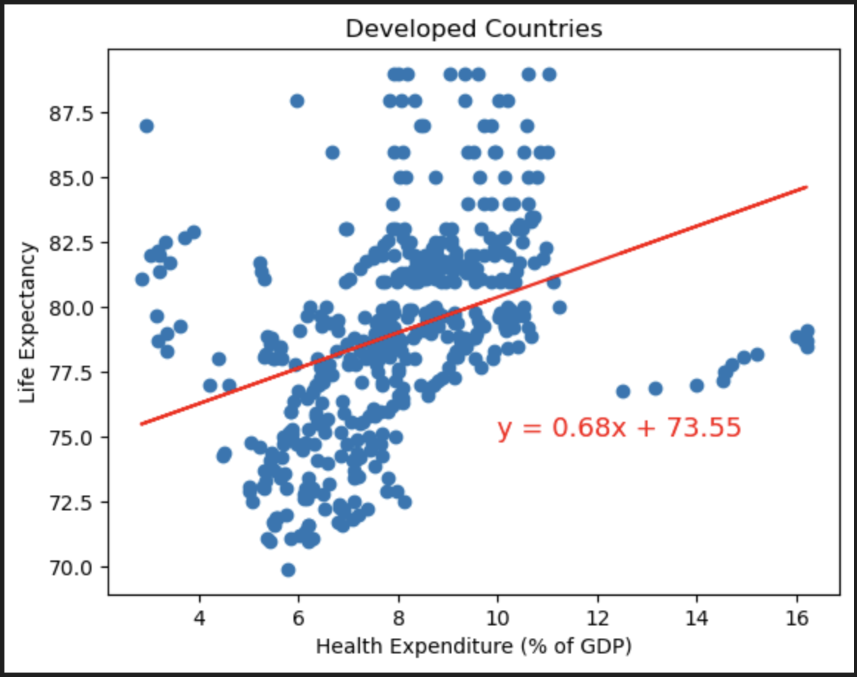
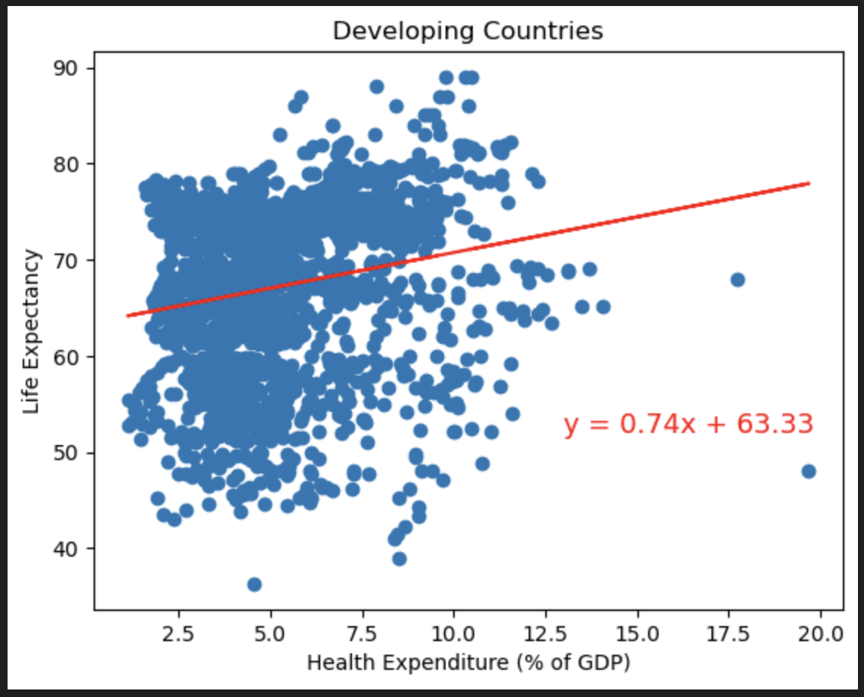
Research Question 1 – Health Expenditure
Findings and Analysis
The correlation for Developed Countries is 0.37.
The correlation for Developing Countries is 0.19.

Slide 7
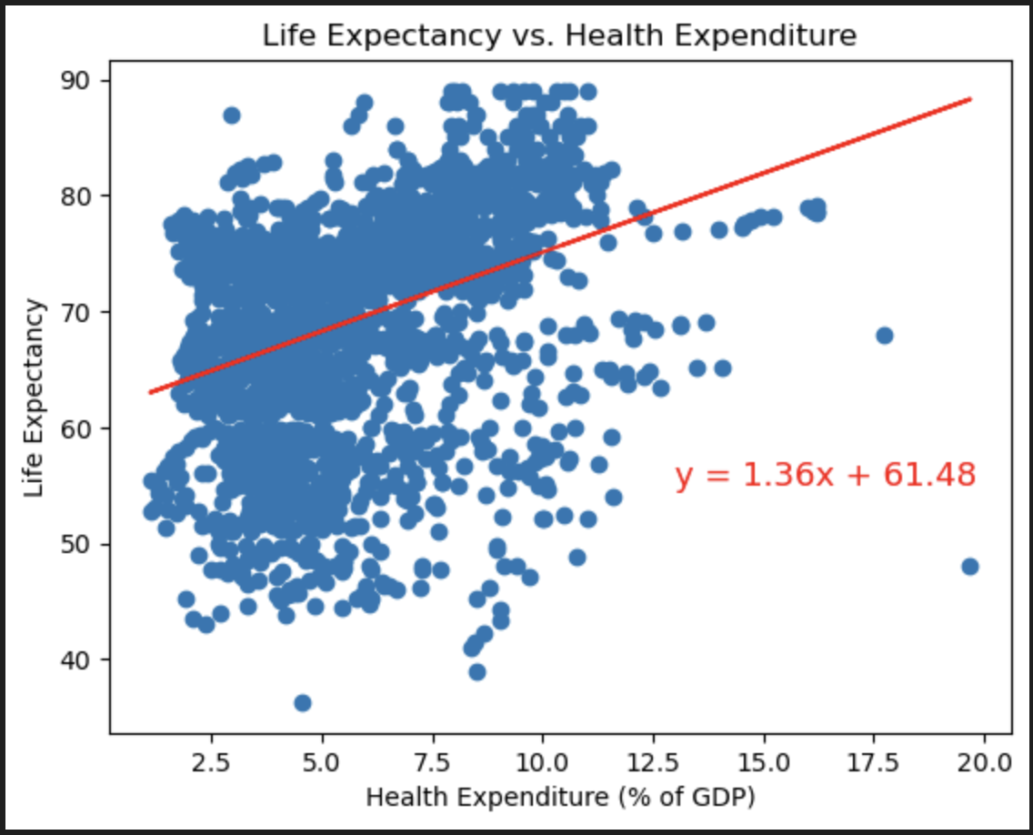
Research Question 1 – Health Expenditure
Findings and Analysis
For Developing countries, there is a weak, positive relationship between health expenditure and life expectancy.
For Developed countries, there is a medium positive relationship between health expenditure and life expectancy.
Overall across all countries, there is also a medium positive relationship between health expenditure and life expectancy. Meaning as health expenditure increases, life expectancy slightly increases as well.
Conclusion: Health Expenditure has a slight impact on Life Expectancy. Although it is not a strong relationship, in conjunction with other factors, health expenditure has a positive impact on life expectancy.
The correlation for all countries is 0.36.

Slide 8
Research Question 2 – Residency Location
Approach
Defining the question/variable:
Is life expectancy relevant to Residency Locations?
How to define Residency Location?
How to determine if the life expectancy is relevant to the Residency Location?

Slide 9
Research Question 2 – Residency Location
Dataset
Life Expectancy Data – published by World Health Organization
Life expectancy at birth, males – published by Australian Bureau of Statistics
Life expectancy at birth, females – published by Australian Bureau of Statistics
Australian Population by States – published by Australian Bureau of Statistics

Slide 10
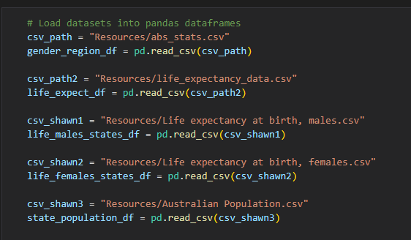
Research Question 2 – Residency Location
Dataset

Slide 11
Research Question 2 – Residency Location
Findings and Analysis
The first approach: Country Status classified by WHO
Developed countries vs Developing countries
Null Hypothesis: Life expectancy is not relevant to developing status
First step:
Collect raw life expectancy and GDP per capita data for both developed and developing countries, from 2000 – 2015. For T testing.
Calculate the mean of raw life expectancy data and mean of raw GDP data to make a table, and also for plotting

Slide 12
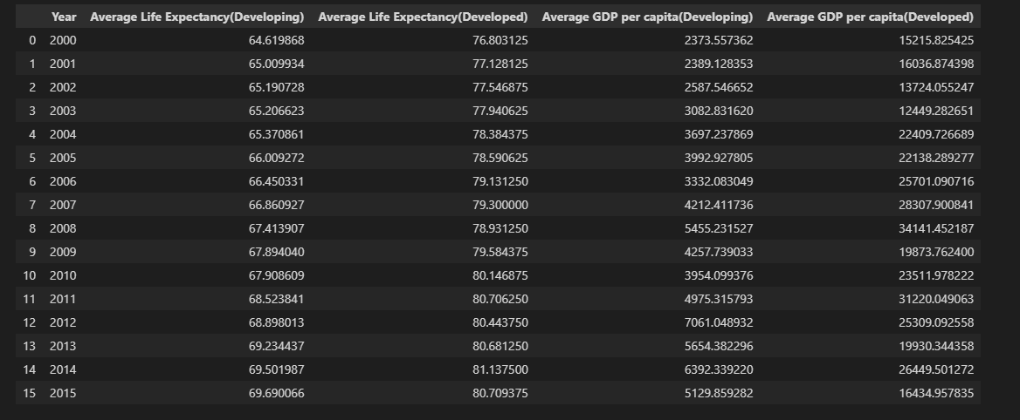
Research Question 2 – Residency Location
Findings and Analysis

Slide 13
Research Question 2 – Residency Location
Findings and Analysis
Findings:
A very small p value - Life expectancy is statistically significant to country status.
Null hypothesis is rejected.
Life expectancy in developed countries is higher than developing countries.

Slide 14
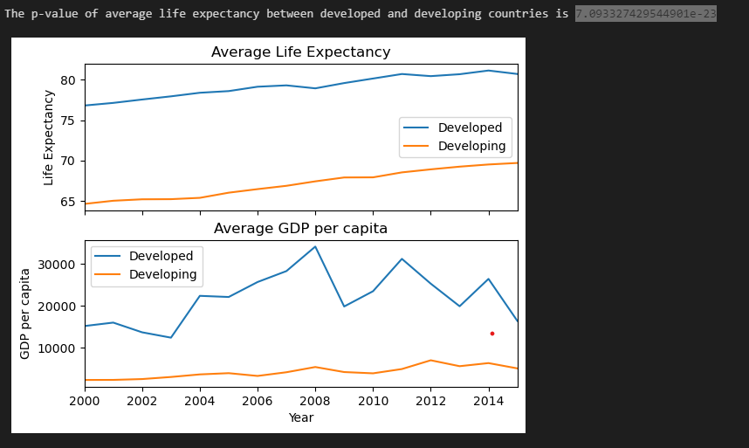
Research Question 2 – Residency Location
Findings and Analysis

Slide 15
Research Question 2 – Residency Location
Findings and Analysis
Second approach:
Mannually pick developed countries and developing countries from each continent.
Totally 9 country groups
Restrictions:
Only 3 developed countries in Asia.
No developed country in Africa and South America.
Developing countries in Oceania have too small population.
Canada is a developing country by WHO

Slide 16
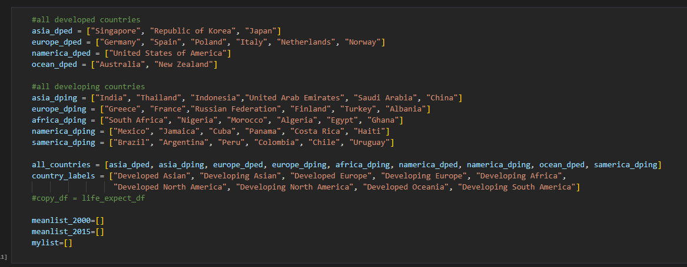
Research Question 2 – Residency Location
Findings and Analysis

Slide 17
Research Question 2 – Residency Location
Findings and Analysis
Calculate average life expectancy for each country group in year 2000, and in year 2015
The average life expectancy increases over time, and developed countries still have higher life expectancy
Will time be a factor to life expectancy?
Collect all the years (2000-2015) data for all the groups, and draw a boxplot base on it.
Discard Developing North America group because of its way too many outliers
Their data seem get affected by unnatural behaviors

Slide 18
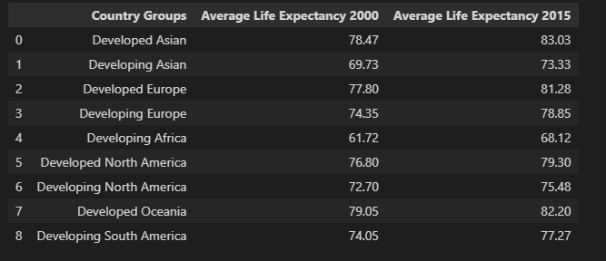
Research Question 2 – Residency Location
Findings and Analysis

Slide 19
Research Question 2 – Residency Location
Findings and Analysis
ANOVA test on all developed country groups (0.05 > p value > 0.01)
After removing NA Developing group, ANOVA test on all developing country groups.
Removing Developed NA group (US) since it has the lowest average life expectancy.
ANOVA test on developed Aisa, Oceania, and Europe. P value = 0.172
T Test between developing countries in a tournament style.
Developing countries in Europe have the higheset average life expectancy

Slide 20
Research Question 2 – Residency Location
Findings and Analysis
Findings:
Life expectancy is relevant to the residency country/continent.
In developing world, life expectancy increases significantly from continent to continent.(e.g. average 64.5 in Africa, 76.83 in Europe)
In developed world, U.S or NA is dragging everyone down. If U.S. is excluded, life expectancy would become irrelevant to residency locations.

Slide 21

Research Question 2 – Residency Location
Findings and Analysis

Slide 22
Research Question 2 – Residency Location
Findings and Analysis
Third approach:
Research Life expectancy from each state in Australia
Using Geoapify to get the latitude and longitude data
Hvplot the data on an interactive map

Slide 23
Research Question 2 – Residency Location
Findings and Analysis
Merging of male and female data sets downloaded from ABS
Adding new columns to collect data from the API call
The latitude and longitude data collected are used for mapping
Person Life Expectancy column is redundant.
Merge another data set that have population size info to the dataframe
Population size will be the relative size of the drawing circle on the map

Slide 24
Research Question 2 – Residency Location
Findings and Analysis
Findings:
Excluding Northen Territory, life expectancy is basically the same for everywhere in Australia
Life expectancy is much lower in NT, which might need further analysis

Slide 25
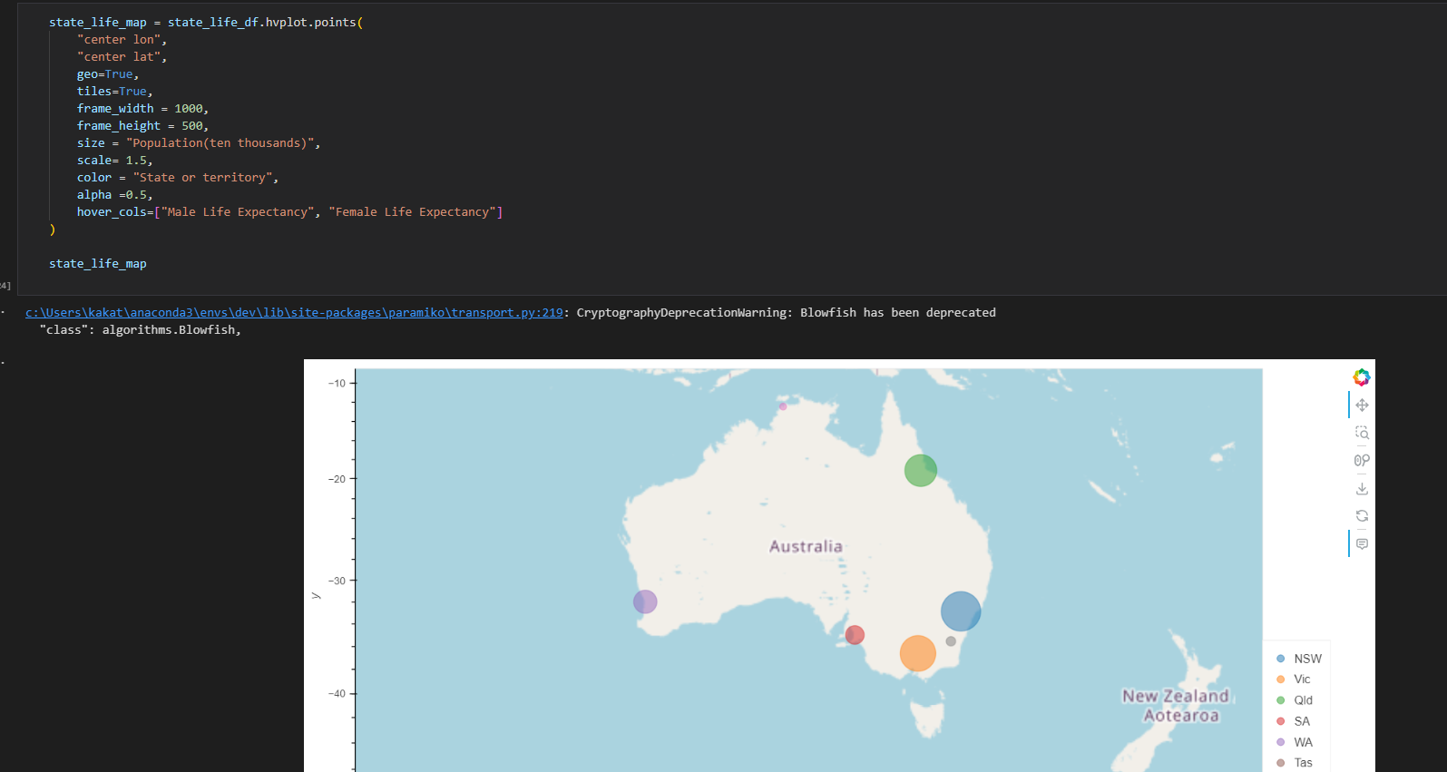
Research Question 2 – Residency Location
Findings and Analysis

Slide 26
Research Question 2 – Residency Location
Findings and Analysis
Summary:
Life expectancy is strongly relevant to country status, developed countries have much higher life expectancy than developing countries.
In developed worlds, Europe, Asia, and Ocean have similar life expectancy and they are all higher than United States.
In developing world, developing European countries have the highest life expectancy, following by South America as a close second
In Australia, life expectancy is similar every state, except Northern Territory.

Slide 27
Research Question 3 – Gender
Approach
Defining the question/variable:
Analysis of Gender vs. Life Expectancy is designed to provide a comprehensive understanding of the dataset impact on demographic disparities.
Our aim was to uncover differences between male and female life expectancies, exploring outliers and potential limitations within the dataset. Ultimately, our goal was to answer the question: Who lives longer? Males or females?
To achieve that we manipulated the dataset and visualized it in different ways in order to gain valuable insights.

Slide 28

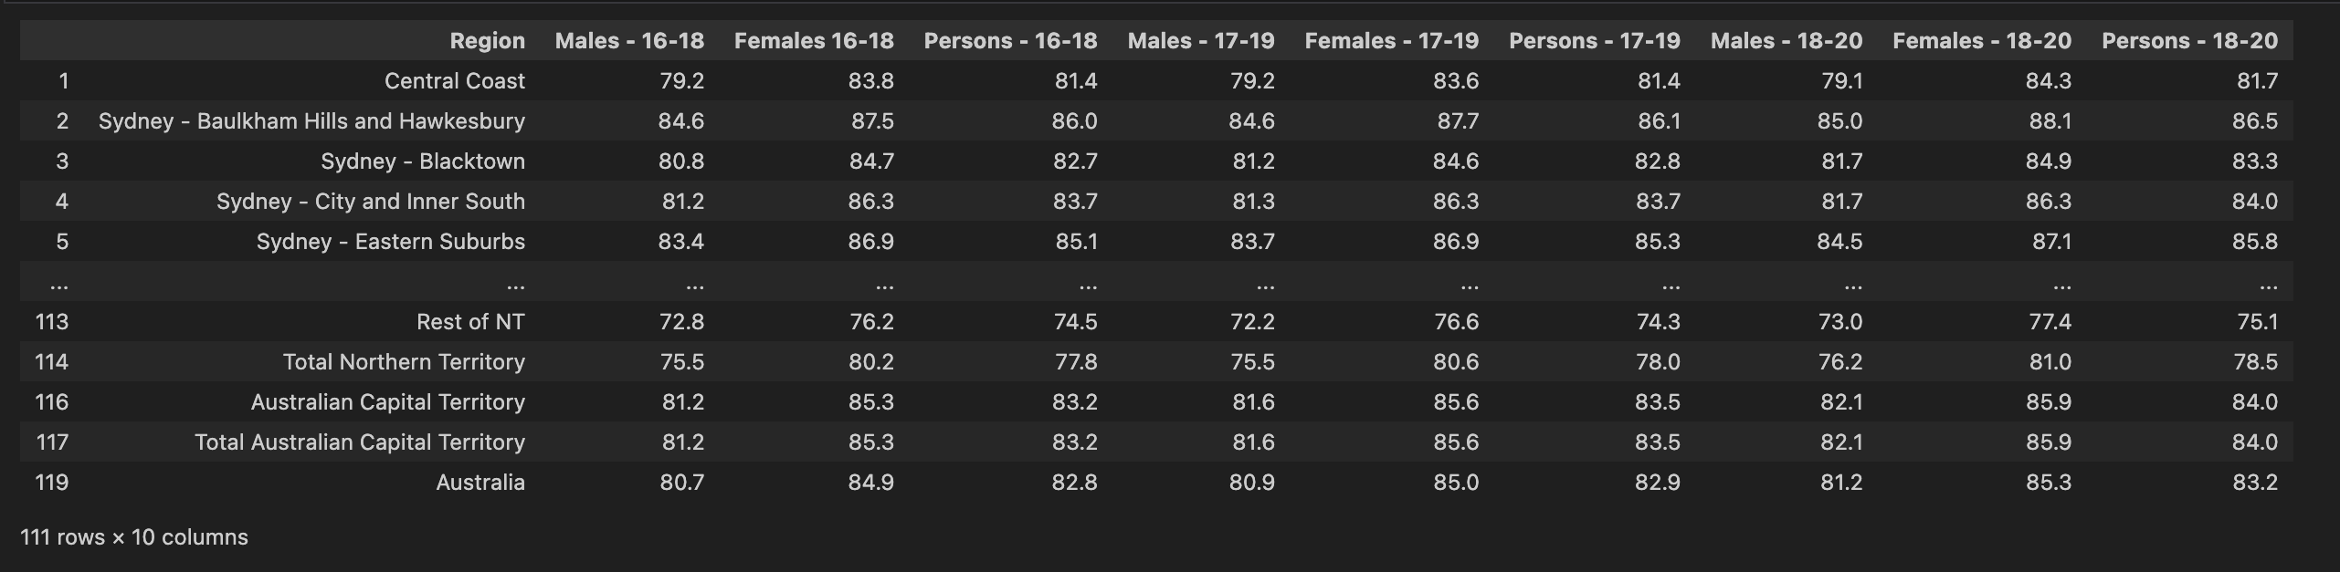
Research Question 3 – Gender
Dataset
Imported the Excel spreadsheet from Australian Bureau of Statistics.
Converted ABS spreadsheet into csv file.
Cleaned the dataset of NaN values, sorted out column names and picked variables of interest.
Converted results into a DataFrame for further analysis.

Slide 29
Research Question 3 – Gender
Findings and Analysis
Our comprehensive analysis included summary statistics detailing the count, mean, standard deviation, minimum and maximum values and quartiles. We employed visualizations such as bar graphs, to illustrate key trends, conducted t-test and p-value calculations for statistical evaluation, utilized scatter plots to explore relationships and leveraged box plots to identify distribution patterns within the data. This multifaced approach provided a thorough understanding on the gender-based differences in life expectancies and allowed us to gain some valuable insights.

Slide 30

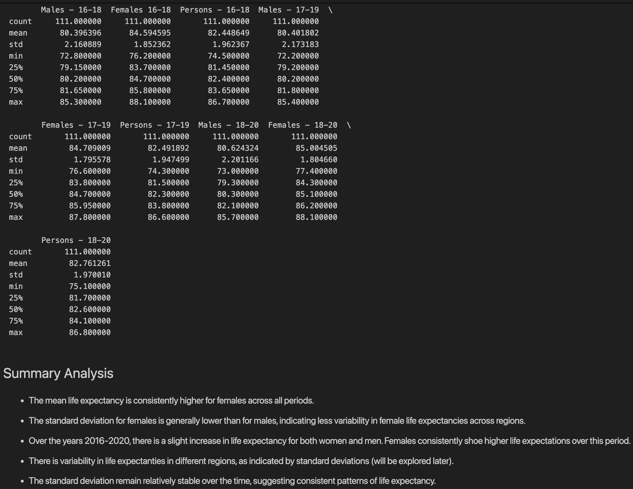
Statistical Analysis
Mean Life Expectancy: Females consistently have higher mean life expectancies across all periods.
Standard Deviation Comparison: Females generally exhibit lower standard deviations than males, indicating less variability in female life expectancies across regions.
Temporal Trends (2016-2020): A slight overall increase in life expectancy is observed for both genders during this period, with females consistently showing higher expectations.
Regional Variability: Life expectancies vary across regions, as indicated by standard deviations (further exploration planned).
Stability of Standard Deviation: The standard deviation remains relatively stable over time, suggesting consistent patterns in life expectancy.

Slide 31
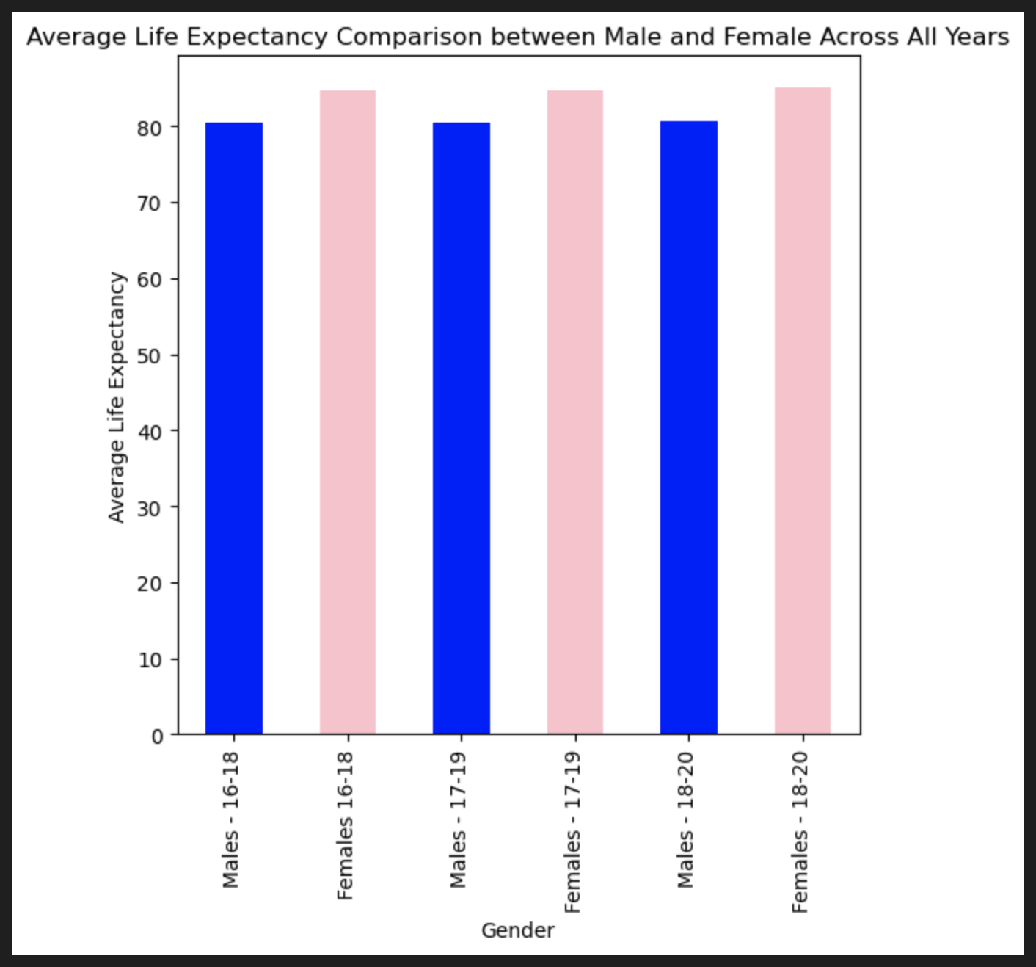
Bar Graph Across All Years
The bar graphs provided compare life expectancy of males and females across years 2016 - 2020; graphs reveal a consistent trend. Over this time periods, the life expectancy of females consistently surpasses that of males. The analysis of the bar charts clearly indicate that, on average, women tend to life longer than men in the given regions.
This insight is valuable for understanding demographic trends. Further investigation into the factors contributing to this gender disparity could provide valuable information for targeted interventions and policies to improve overall life expectancy and address potential health inequalities.

Slide 32
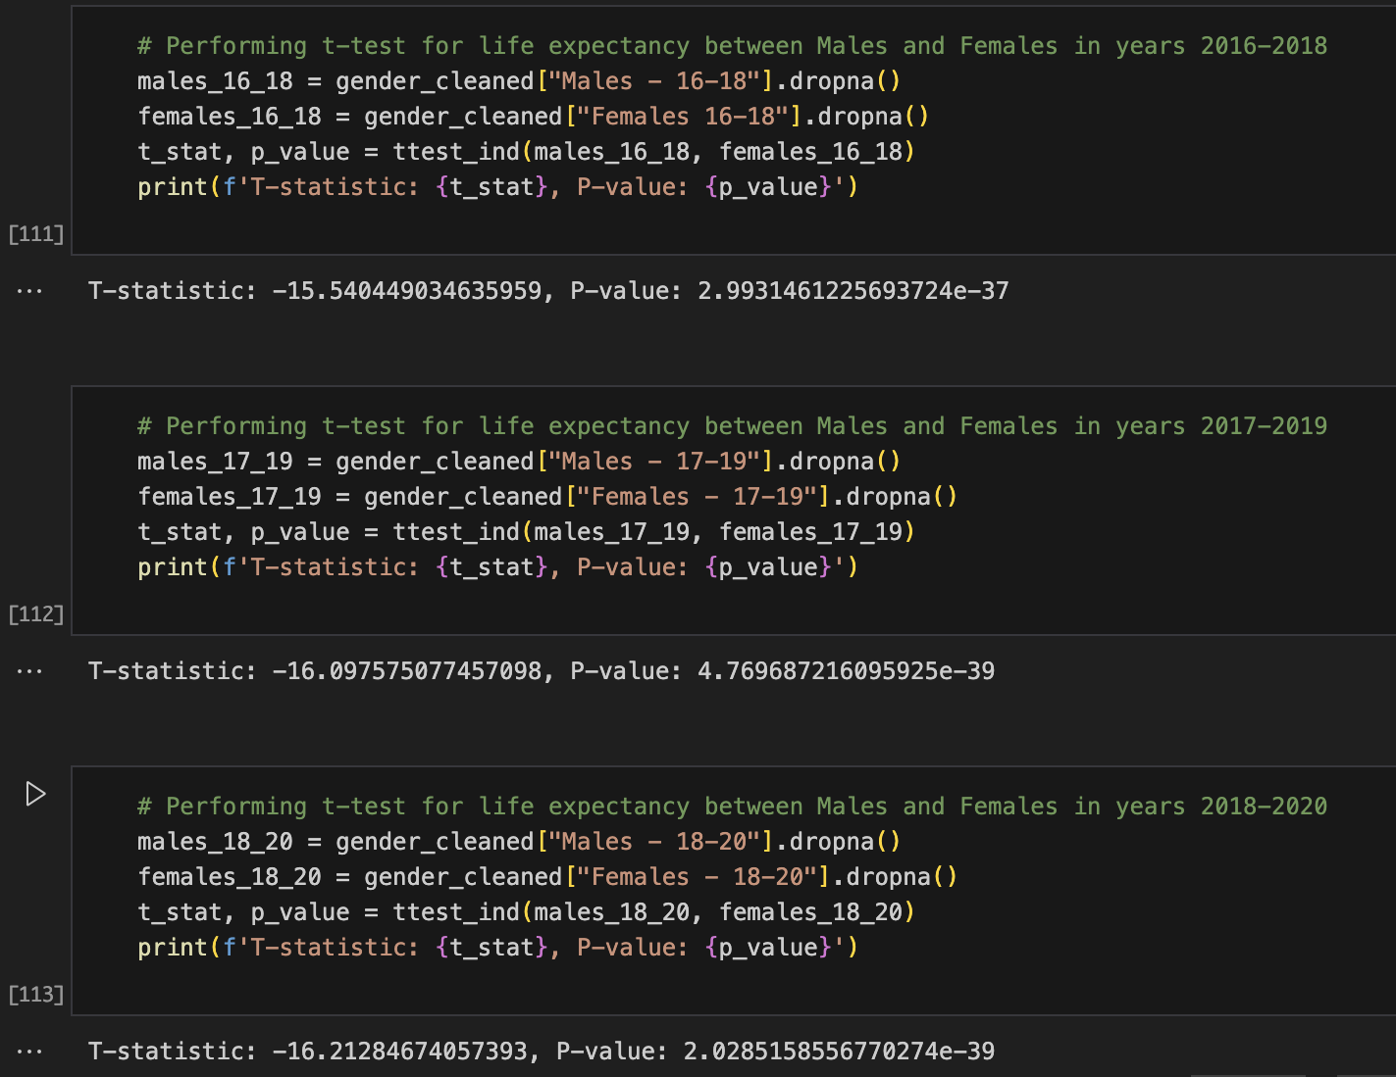
T-statistic and P-value
T-statistic
The t-statistic measures how much the means of the two groups across years 2016-2018, 2017-2019 and 2018-2020 differ relative to the variation within the groups.
We can observe that across three different times the t-statistic is highly negative being -15.54 for years 2016-2018, -16.09 for years 2017-2019 and -16.21 for years 2018-2020, indicating that the mean life expectancy for males during those years is significantly lower than for females.
P-value
P- value across given years is extremely small (close to zero - being respectively: 2.99, 4.76, 2.02). This indicates that the observed difference in life expectancy between males and females is highly unlikely to be due to random chance alone. A small p-value suggests strong evidence against null hypothesis, which, in this case, would be that there is no difference in life expectancy between males and females during specific years. In summary, the t-test results suggest that there is a statistically significant difference in life expectancy between males and females.

Slide 33
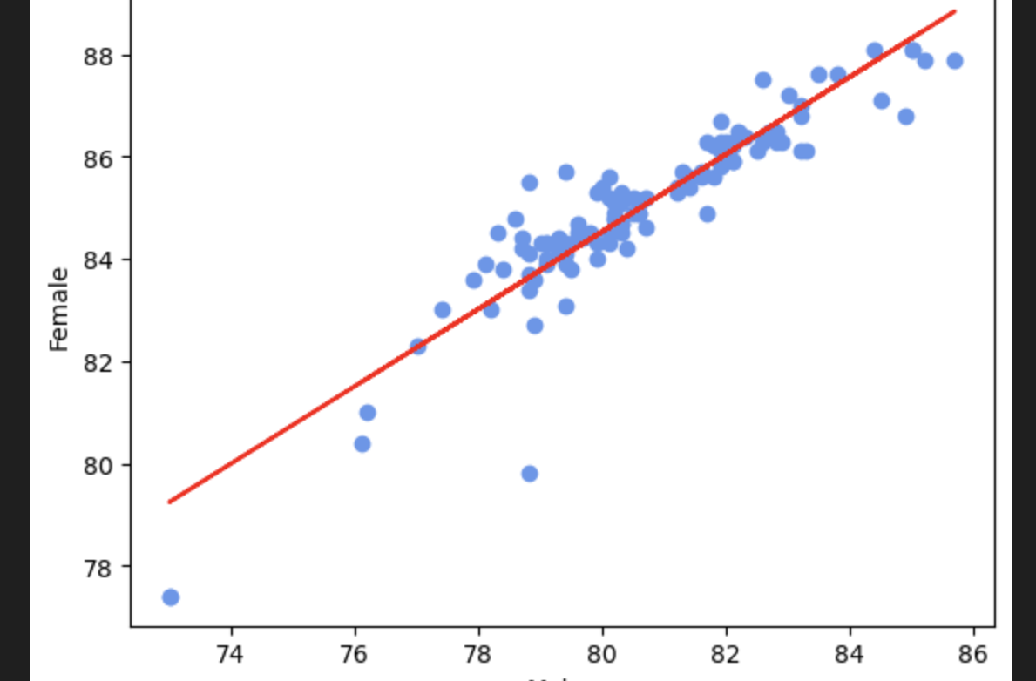
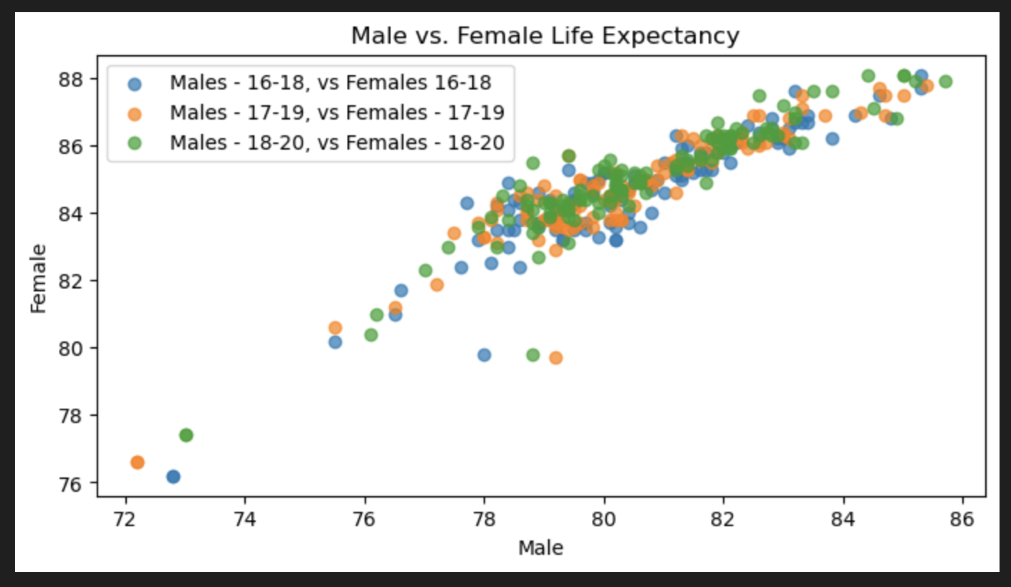
Scatter Plot and Correlation
The correlation coefficient of 0.92 between male and female life expectancies suggest a strong positive linear relationship. This indicates that as one gender's life expectancy increases, the other gender's life expectancy tends to increase proportionally. The high correlation suggest a consistent pattern in life expectancy between women and men, reflecting a strong positive association.

Slide 34
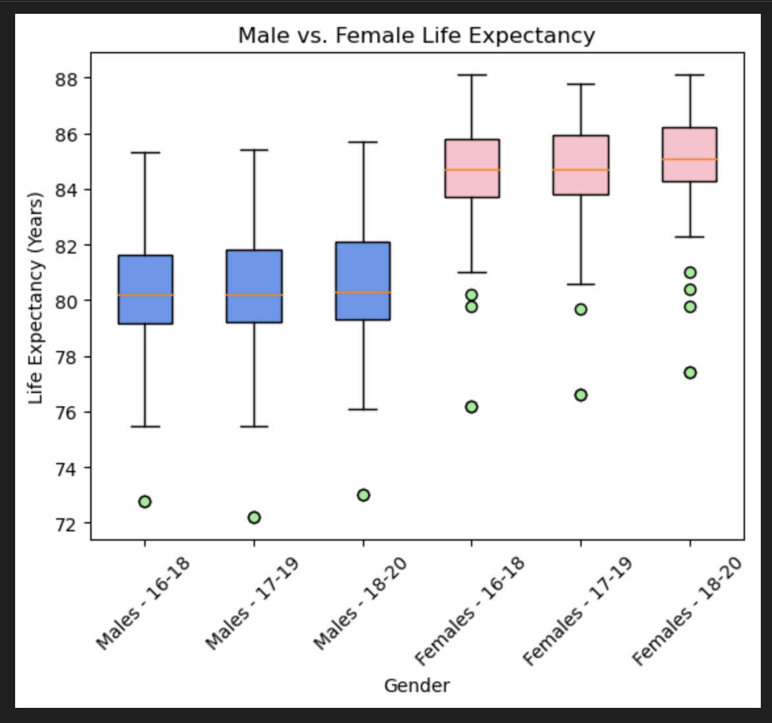
Box Plot and outliers
Once again it is evident, that female life expectancies consistently surpass those of males, with medians ranging from 84 to 86 years compared to males' 80 to 82 years.
Despite the presence of outliers suggesting some variability, those deviations have minimal impact on the overarching trend. This robust pattern underscores the enduring observation that, on average, women enjoy longer life expectancies than males, contributing valuable insights to demographic disparities.

Slide 35






Key Findings:
After throughout analysis it is evident that females live longer than males;
As life expectancy of males increases, female life expectancy also increases;
T-statistics and P-value tests suggest that this outcome is not due to a random chance alone.

Slide 36
Conclusions
Does health expenditure impact life expectancy?
From the comparison between Developed and Developing countries, as the spending on health increases, life expectancy slightly increases as well.
Does residency location impact life expectancy?
Does gender impact life expectancy? Gender significantly influences life expectancy, as females consistently show higher median values (84-86 years) compared to males (80-82 years).

