Slide 1
Group 1 – Project 1 – Healthcare
Rachel J, Aleksandra C, Cristian L, Shawn L

Slide 2
Research Questions
Does health expenditure impact life expectancy?
Does financial wellness impact life expectancy?
Does residency location impact life expectancy?
Does gender impact life expectancy?

Slide 3
Research Question 1 – Health Expenditure
Approach
Defining the question/variable:
Looked at health expenditure as a % of GDP and as a % of total government spending
% of GDP: money spent on health goods and services by all levels of government as well as non-government entities such as individuals and private health insurers.
% of total government spending: money spent on health goods and services by the government.
Spending on health goods and services could include: medical services (e.g., Medicare and private health), hospital services (public and private), pharmaceutical benefits, research.

Slide 4
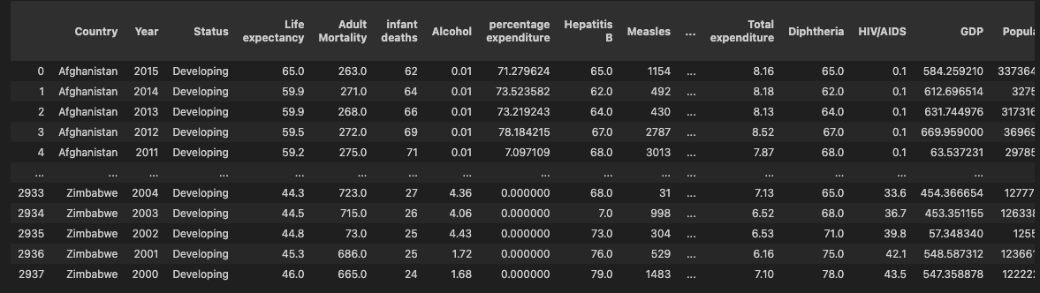
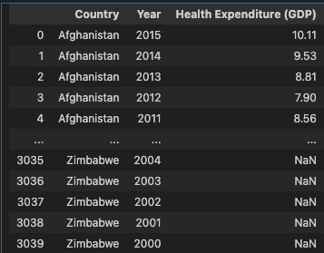
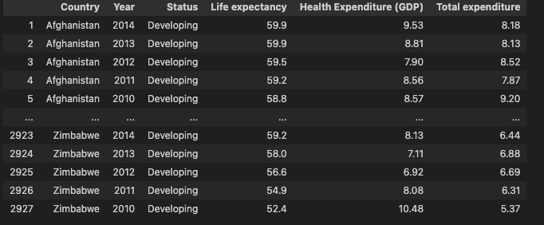
Research Question 1 – Health Expenditure
Dataset
Imported csv from Kaggle:
Merged with csv on health expenditure (% of GDP) from WHO:
Variables of interest:

Slide 5
Research Question 1 – Health Expenditure
Findings and Analysis

Slide 6
Research Question 2 – Financial Wellness
Approach
Defining the question/variable:

Slide 7
Research Question 2 – Financial Wellness
Dataset

Slide 8
Research Question 2 – Financial Wellness
Findings and Analysis

Slide 9
Research Question 3 – Residency Location
Approach
Defining the question/variable:

Slide 10
Research Question 3 – Residency Location
Dataset

Slide 11
Research Question 3 – Residency Location
Findings and Analysis

Slide 12
Research Question 4 – Gender
Approach
Defining the question/variable:
Analysis of Gender vs. Life Expectancy is designed to provide a comprehensive understanding of the dataset impact on demographic disparities.
Our aim was to uncover differences between male and female life expectancies, exploring outliers and potential limitations within the dataset. Ultimately, our goal was to answer the question: Who lives longer? Males or females?
To achieve that we manipulated the dataset and visualized it in different ways in order to gain valuable insights.

Slide 13
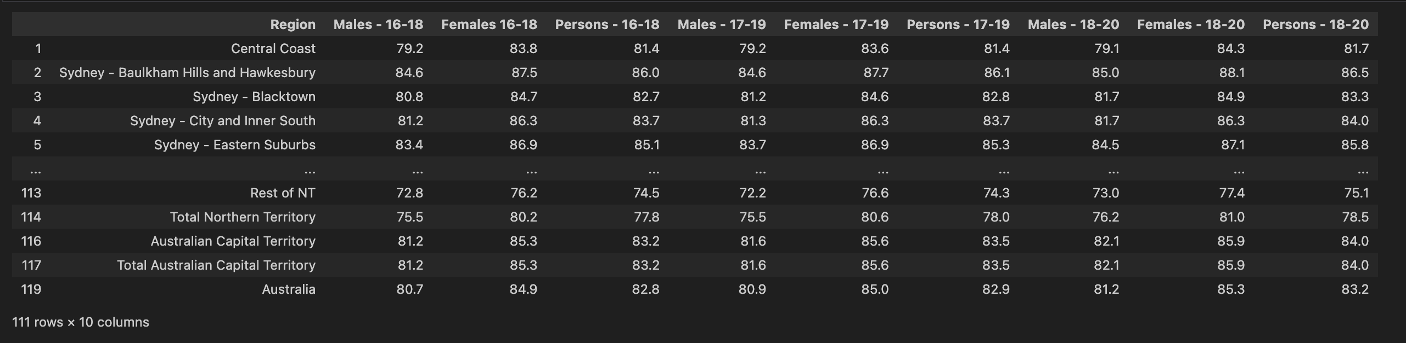
Research Question 4 – Gender
Dataset
Imported the Excel spreadsheet from Australian Bureau of Statistics.
Converted ABS spreadsheet into csv file.
Cleaned the dataset of NaN values, sorted out column names and picked variables of interest.
Converted results into a DataFrame for further analysis.

Slide 14
Research Question 4 – Gender
Findings and Analysis
Our comprehensive analysis included summary statistics detailing the count, mean, standard deviation, minimum and maximum values and quartiles. We employed visualizations such as bar graphs, to illustrate key trends, conducted t-test and p-value calculations for statistical evaluation, utilized scatter plots to explore relationships and leveraged box plots to identify distribution patterns within the data. This multifaced approach provided a thorough understanding on the gender-based differences in life expectancies and allowed us to gain some valuable insights.
Key findings:
After throughout analysis it is evident that females live longer than males;
As life expectancy of males increases, female life expectancy also increases;
T-statistics and P-value tests suggest that this outcome is not due to a random chance alone.

Slide 15
Conclusions
Does health expenditure impact life expectancy?
Does financial wellness impact life expectancy?
Does residency location impact life expectancy?
Does gender impact life expectancy? Gender significantly influences life expectancy, as females consistently show higher median values (84-86 years) compared to males (80-82 years).

