Slide 1
Predicting Your Risk of
Heart Disease
Group 8

Slide 2
Heart disease is the leading cause of death in Australia.
1 in 4 Australians die from CVD each year.
1 Australian dies from CVD every 12 minutes.

Slide 3
Data Model Implementation

Slide 4
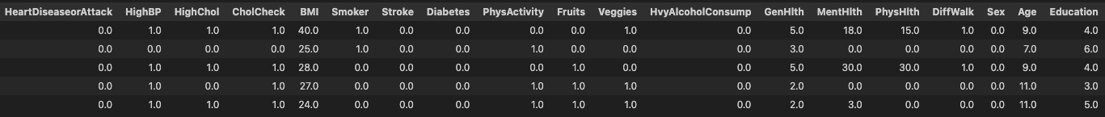
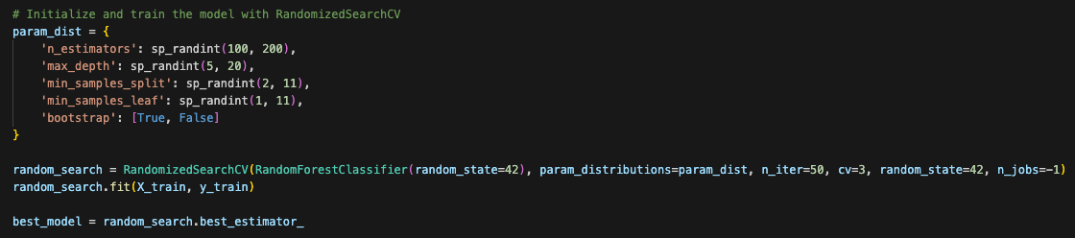
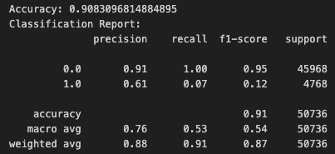
Training the Model
1
2
3
Dropped irrelevant columns, normalised & standardised data, and split into training and testing sets
Preprocessing
Parameters were initialised and Random Forest Classifier was used to train the model
Training the Model
Classification Report generated to determine accuracy scores
Evaluating the Model

Slide 5
Data Model Optimisation

Slide 6
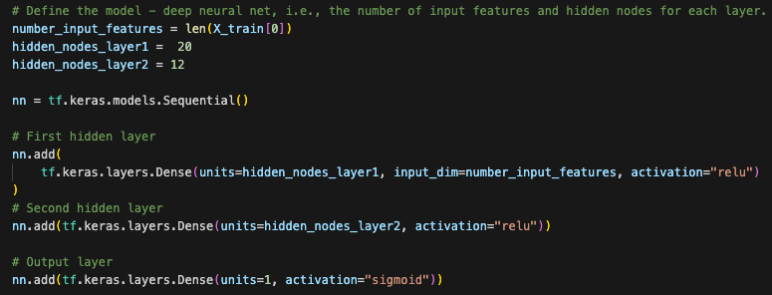

Using Different Model: Tensorflow

Slide 7
Classification Report
Accuracy: 0.25
-- | Precision | Recall | f1-score | Support
0.0 | 0.92 | 1.00 | 0.32 | 57493
1.0 | 0.10 | 0.83 | 0.17 | 5927
accuracy |  |  | 0.25 | 63420
macro avg | 0.51 | 0.51 | 0.25 | 63420
weighted avg | 0.84 | 0.25 | 0.31 | 63420

Slide 8
Hyperparameter Optimisation using Optuna

Slide 9
Why use Optuna?
Pros
Cons
Automated Hyperparameter Tuning
Efficiency
Easy to Use
Pruning Mechanism
Visualization
Resource Intensive
Randomness
Overfitting Risk
Lack of Deterministic Results

Slide 10
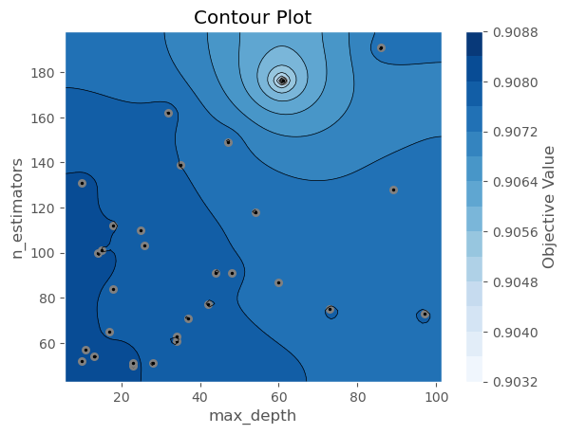
Relationship between n_estimators and max_depth

Slide 11
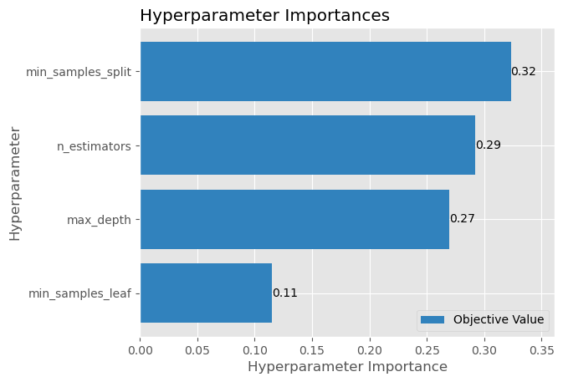
min_samples_split as most important parameter

Slide 12
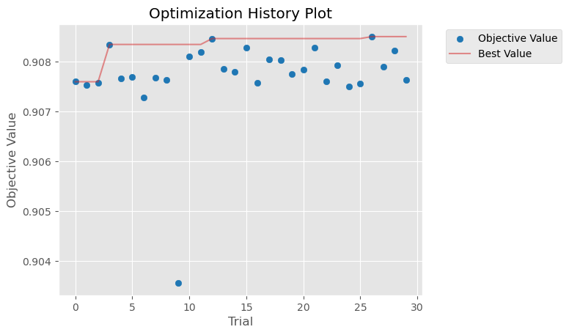
Improvement of accuracy over time

Slide 13
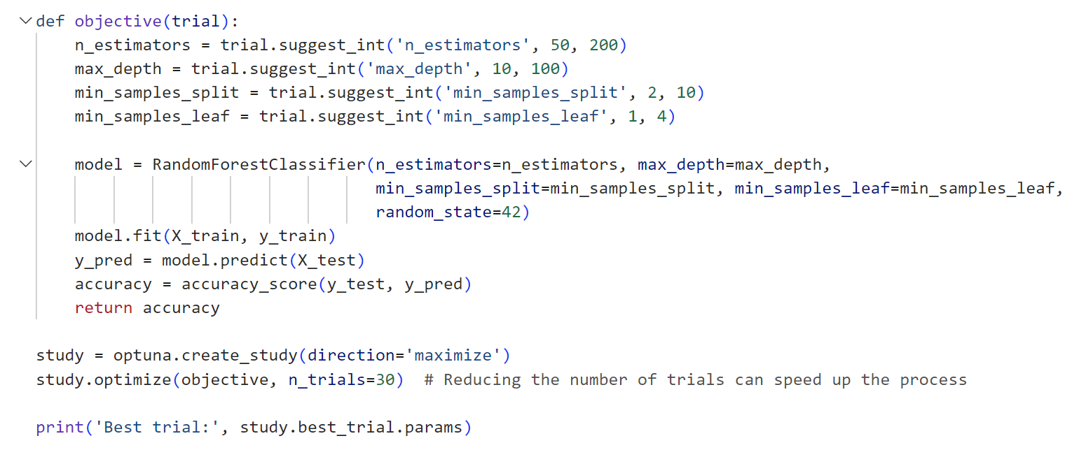
Define objective function for Optuna

Slide 14
Classification Report
Accuracy: 0.9083096814884895
-- | Precision | Recall | f1-score | Support
0.0 | 0.91 | 1.00 | 0.95 | 45968
1.0 | 0.62 | 0.07 | 0.12 | 4768
accuracy |  |  | 0.91 | 50736
macro avg | 0.77 | 0.53 | 0.54 | 50736
weighted avg | 0.88 | 0.91 | 0.87 | 50736

Slide 15

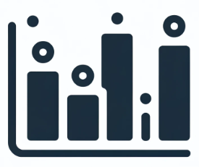

USER-FRIENDLY WEB APPLICATION
PREV
NEXT
APP.PY
FEATURE IMPORTANCE
Handles server-side logic
Processes user inputs
Makes predictions
Highlights significant factors
INDEX.HTML
Provides user interface
Displays results

Slide 16
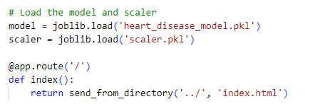
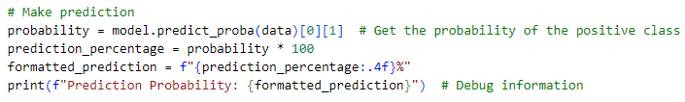
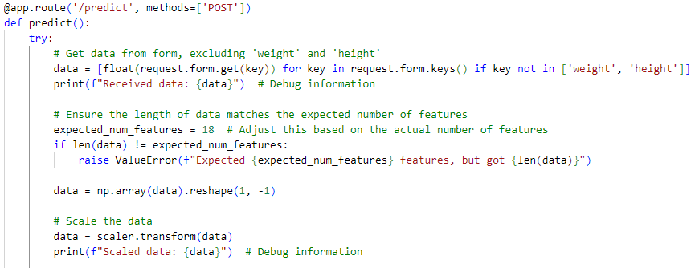
THE APP.PY SCRIPT
Rendering the main HTML page
Making predictions
Handling user input

Slide 17
THE INDEX.HTML FILE
1
2
3
PREV
NEXT
Provides user interface
Includes BMI calculator for ease of use
Displays results

Slide 18
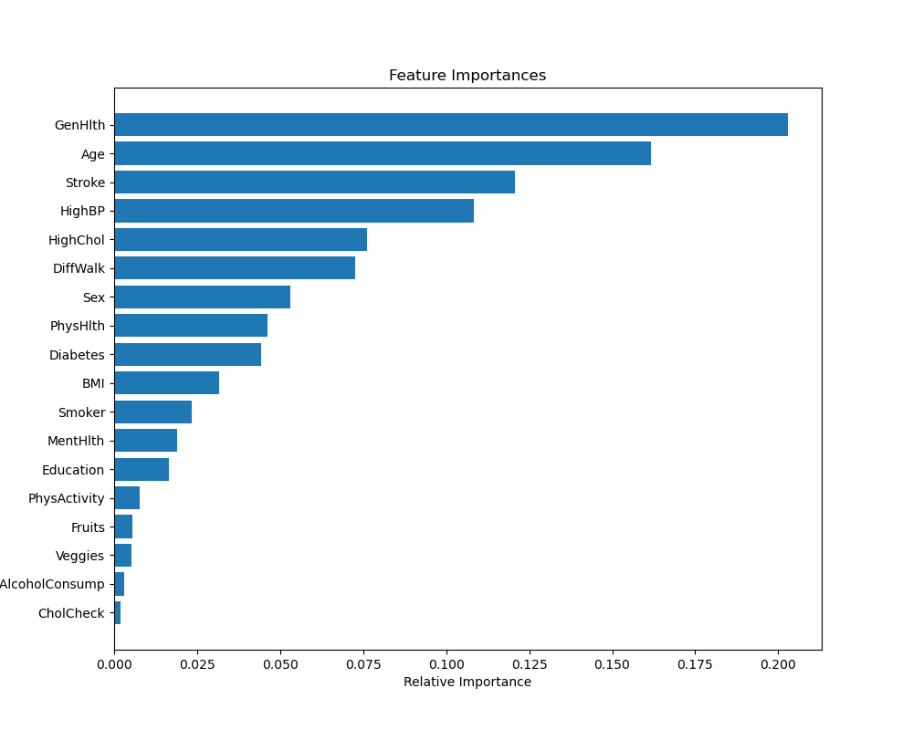
FEATURE IMPORTANCE GRAPH
PREV
NEXT
Highlights significant factors

Slide 19
Conclusion
PREV
NEXT
Overall high accuracy…
But precision and recall scores for those who do have heart disease is low.
Good at making predictions if you don’t have heart disease.
Can be improved by using a better data set.

Slide 20
THANK
YOU!
REV

