Slide 1
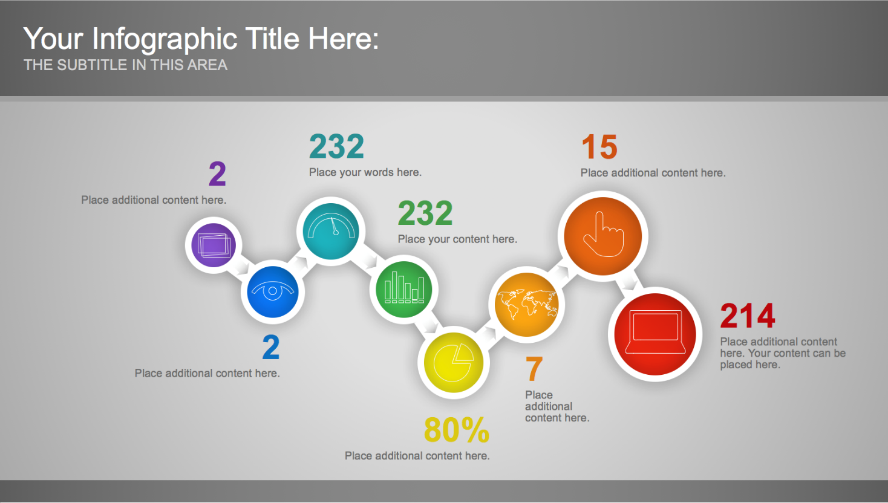

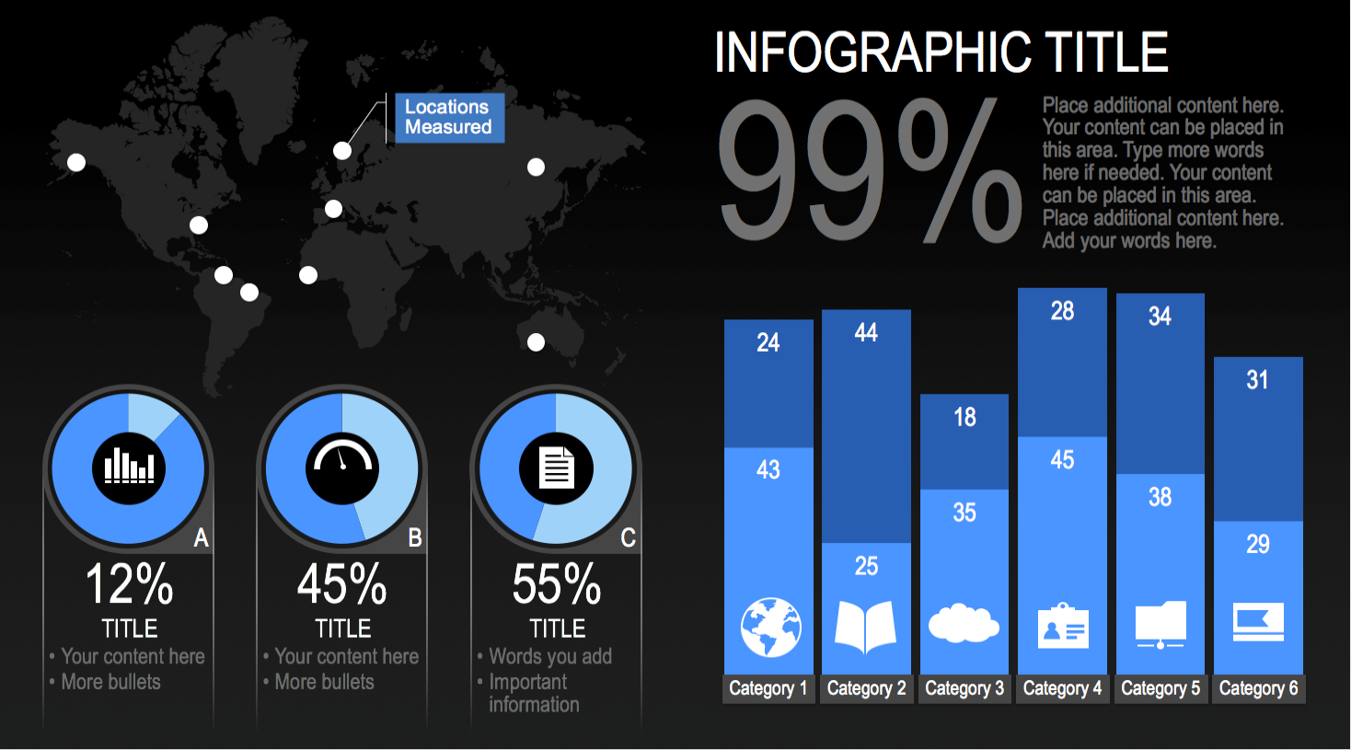
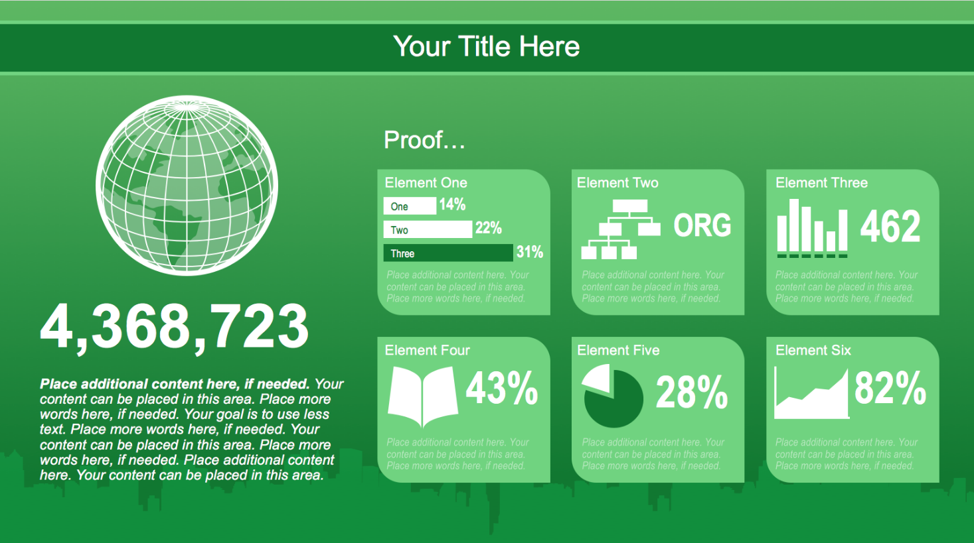
PowerPoint Infographics Sampler
Sales &
Revenue
Analysis
Capstone II

Slide 2

PROJECT PROGRESS-Phases involved
Capstone data analytics
Introduction to dataset.
Data Cleaning and Transformation: Efficiently clean and transforming the data to ensure consistency and accuracy, laying the groundwork for insightful analysis.
Gathering and Loading Data: we will be importing and loading data into Tableau, ensuring our Dashboard is based on accurate and relevant data.
Building the Data Model: Design a robust Data Model by establishing relationships between different data elements, facilitating seamless interactions within the Dashboard.
Designing Report Visuals: Bringing our Dashboard to life with visually stunning Report Visuals, including charts, graphs, and tables that present data in a captivating manner.

Slide 3

Introduction Of Dataset
Our dataset is from an Indian Amazon sales. This set contains seven files. Since "Amazon Sale Report.csv" includes the most data and matches the context the best, it will be considered the main file. This file may be related to two other files, "International Sale Report.csv" and "Sale Report.csv," using the column SKU. It is presumed that the "International sale Report.csv" represents sales to clients outside of India. For the SKUs listed in the first two pages, extra product information is included in "Sale Report.csv". Next, it appears that the files "May-2022.csv" and "P L March 2021.csv" have pricing data for different e-commerce platforms.
Ultimately, it's challenging to clean data and make it useful.

Slide 4

Research Questions
Calculate Total Sales: Calculate and display the total sales value for the selected period, allowing users to understand the overall revenue generated.
Analyze Orders: Analyze the number of orders placed during the selected period, helping to identify sales patterns and order trends.
Compare Sales by Product with Previous Year: Compare sales performance for each product between the selected period and the previous year, highlighting growth or decline in sales.
Display Top 5 Cities: Present a visualization showcasing the top 5 cities based on sales, allowing users to quickly identify the most lucrative locations.
Analyze Sales by Customer and Compare with Previous Year: Analyze sales data by customer, highlighting the performance of individual customers and comparing it to the previous year.
Create Slicers for customer, Category, Gender, Date and service level: Enable users to interact with the data by providing slicers for selecting specific dates, cities, products, and channels, allowing for dynamic filtering and personalized analysis

Slide 5

Tips and Tricks (PC and Mac)
Data Fetching & Cleaning(Python)
Importing Lib
import pandas as pd
import numpy as np
import matplotlib.pyplot as plt
Importing Data set
df_customer
df_geolocation
df_order_items
df_order_payment
df_review
df_orders
df_product
sales

Slide 6
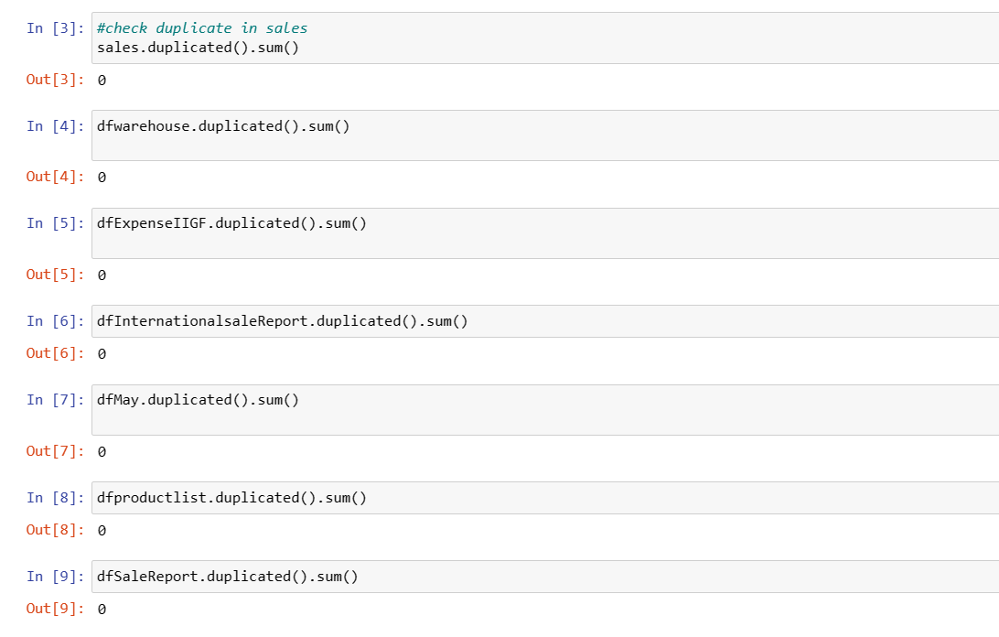

Slide 7
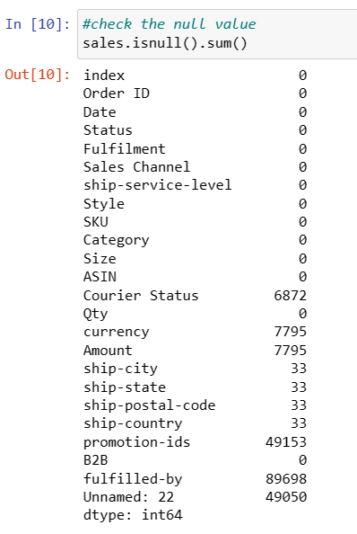
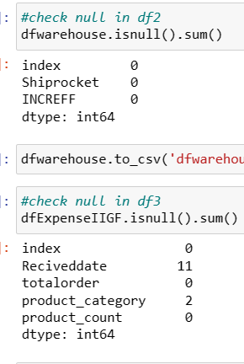
Checking & Dealing with null

Slide 8
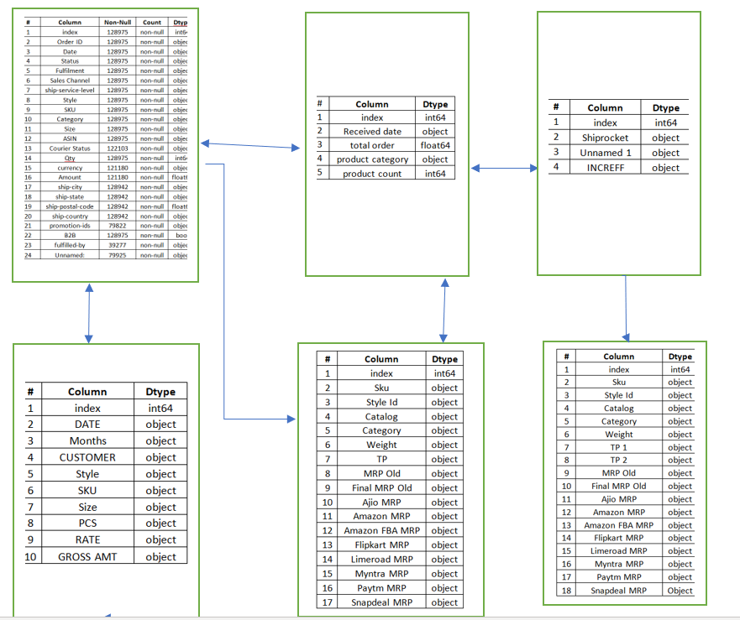
Data Schema

Slide 9
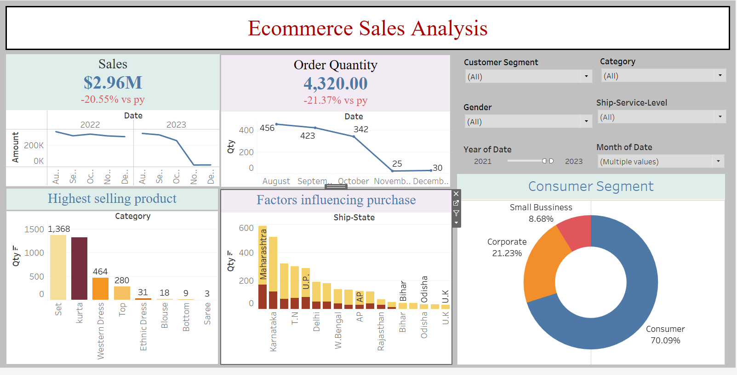
Sample 2
Dashboard
Tableau

Slide 10
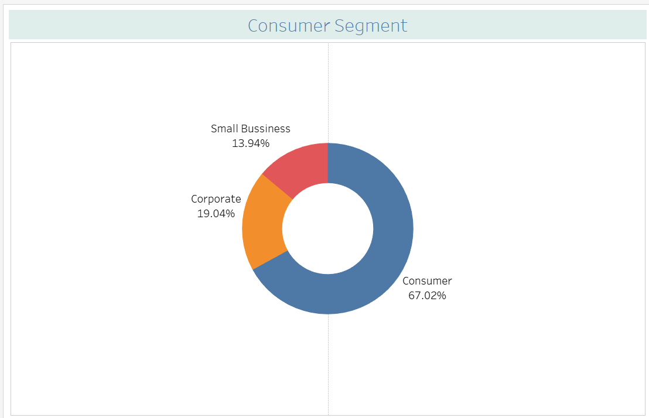
Customer Segment
Oh!.... Consumer covers large space

Slide 11
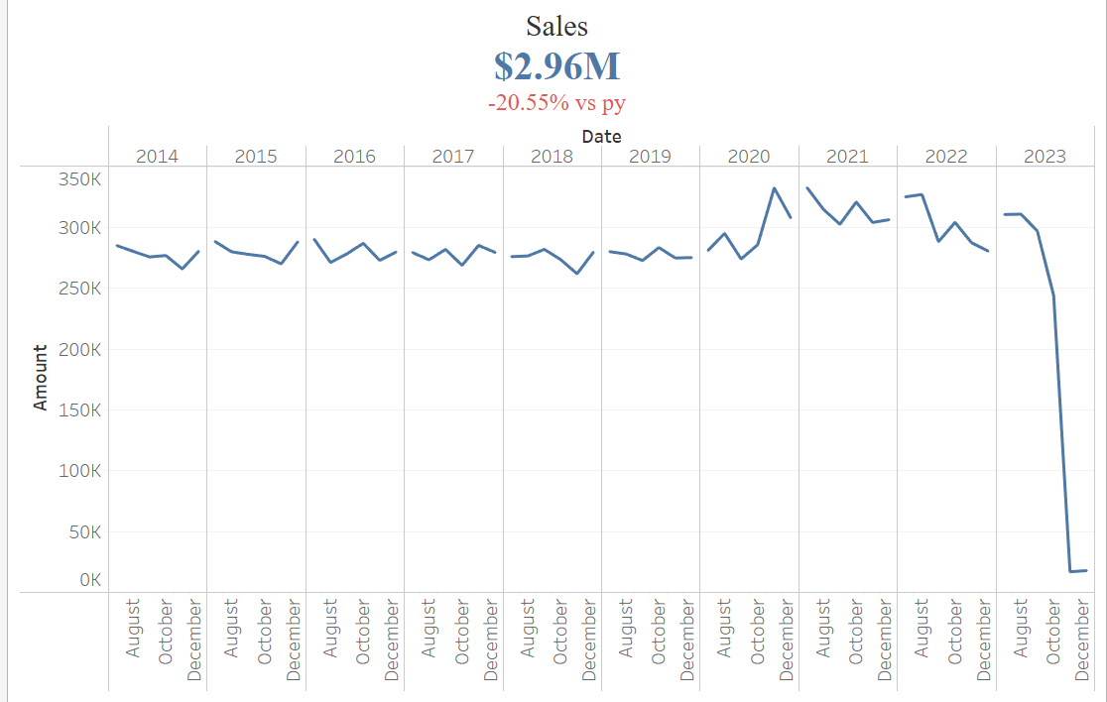
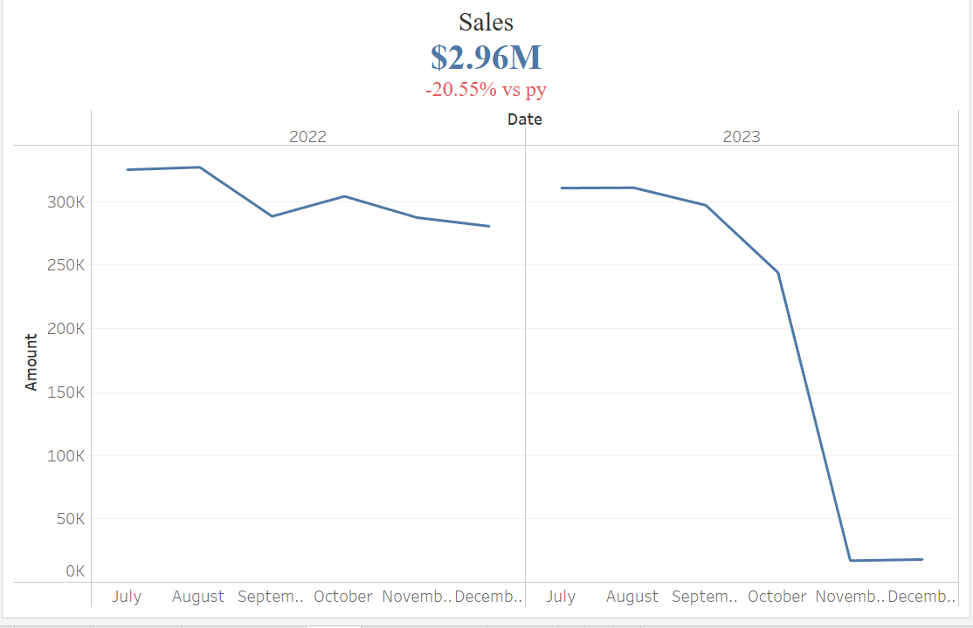
Sales

Slide 12
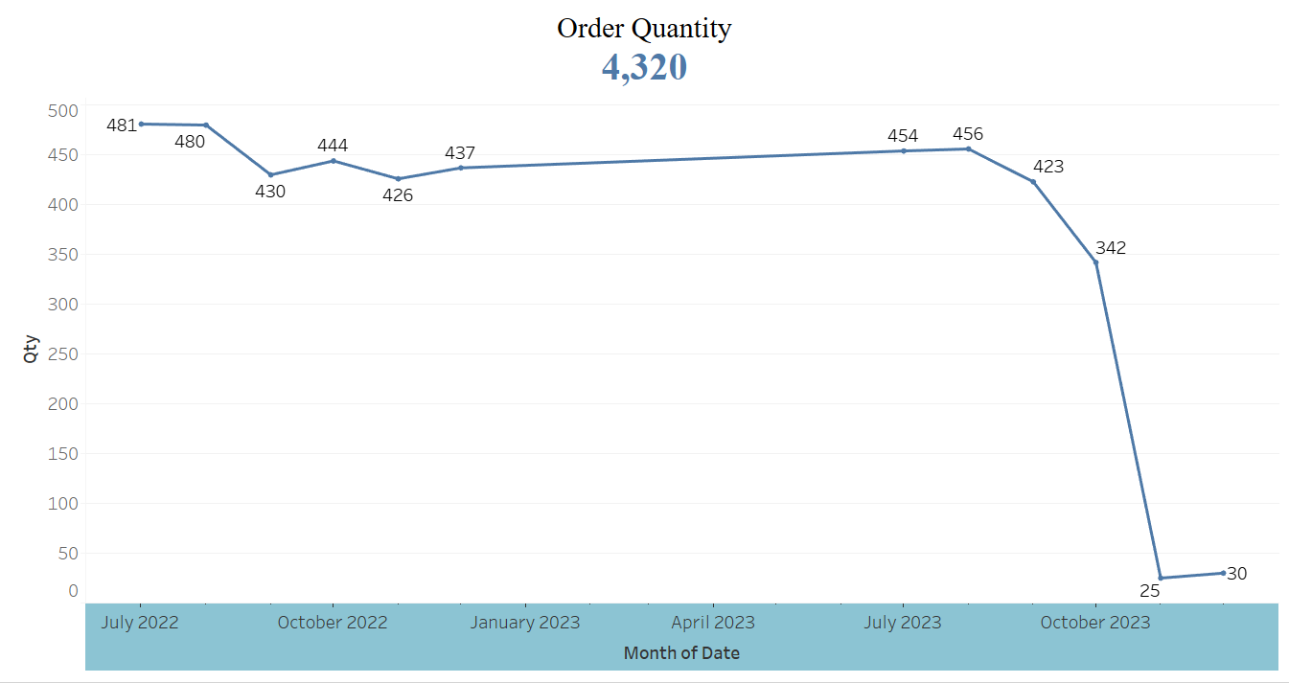
Quantity sold

Slide 13
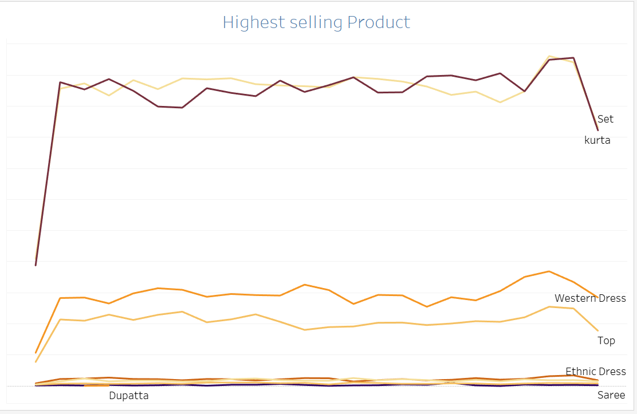
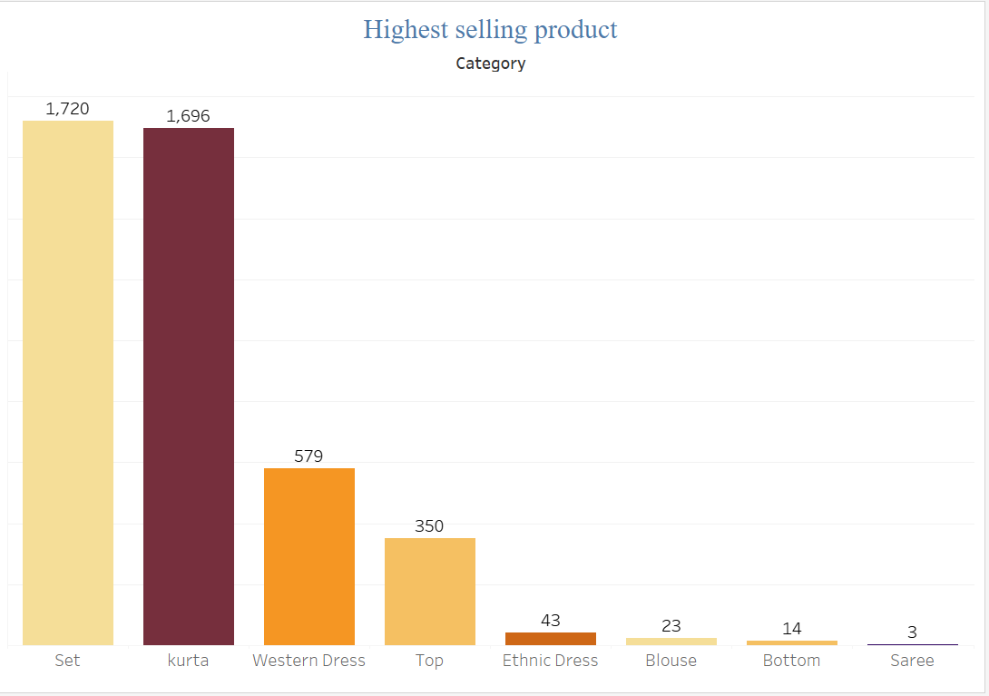
Highest Selling Product

Slide 14
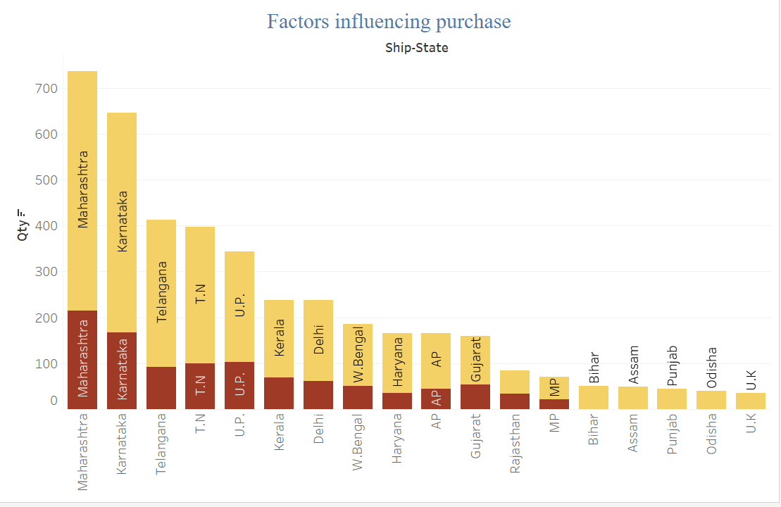
Sales Vs. Service Level & Quantity Sold
Five top-performing states are Maharashtra, Karnataka, Tamil Nadu, Uttar Pradesh & Delhi. To increase sale and revenue in particular areas we should promote the new designs ,tailoring and try to improve the service levels .

Slide 15
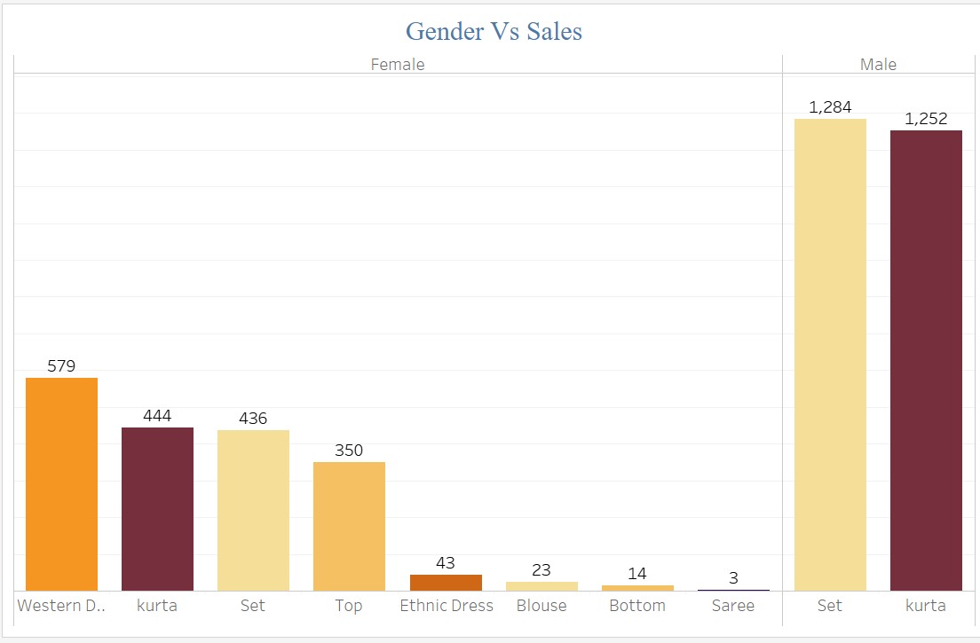
Influence Of Gender On Sales

Slide 16
Conclusion for the year 2023
Sales decreased by more than 10%
01
There is a drop in sales of all the top 7 Products
02
4 Customers are leading to a drop in sales
03
The profit margin in the Export channel is higher

Slide 17

Conclusion
The sales trends indicate a seasonal or promotion-driven peak in April, highlighting the impact of marketing or external factors on B2B sales performance. The following decline points to the potential end of these effects or a temporary market saturation. This suggests that while promotional activities can significantly boost sales, strategies should be developed to maintain a more consistent sales performance throughout the year.
Promotional strategies seem to be effective, as indicated by the higher average order value of transactions with applied promotions. This effectiveness may be due to incentivizing larger purchases or enhancing the perceived value. The insight suggests that promotions could be strategically used to lift sales, especially during periods of expected decline.
The concentration of sales in India might reflect the dataset's origin (amazon.in) and underscores the importance of local market understanding and tailoring strategies to regional specifics.
The similar average order values across volume segments imply that customers spend consistent amounts per order, irrespective of the quantity. This may reflect effective pricing strategies that cater to various purchasing scales.

Slide 18

Conclusion(Cont.)
The comparable average order quantities in high versus low-value segments suggest that the order value is influenced more by the item types or prices rather than the quantity, pointing towards a product mix that is well balanced between high-value and low-value items.
In conclusion, the analysis underscores the need for dynamic sales and marketing strategies that are responsive to the identified patterns and trends. Efforts should be concentrated on maintaining sales momentum post-promotion peaks, leveraging promotions to boost higher- value transactions, and developing a balanced approach that caters to both high-frequency lower-value purchases and less frequent, high-value transactions. Additionally, the insights call for a region-specific focus to capitalize on the predominant market, with an eye towards expanding or diversifying as dictated by the sales data trends.

Slide 19

Group 4
Rachna Dhico(0814805)
Jatinder Bath(0812522)
Vishavjeet Singh(0814828)

