Slide 1
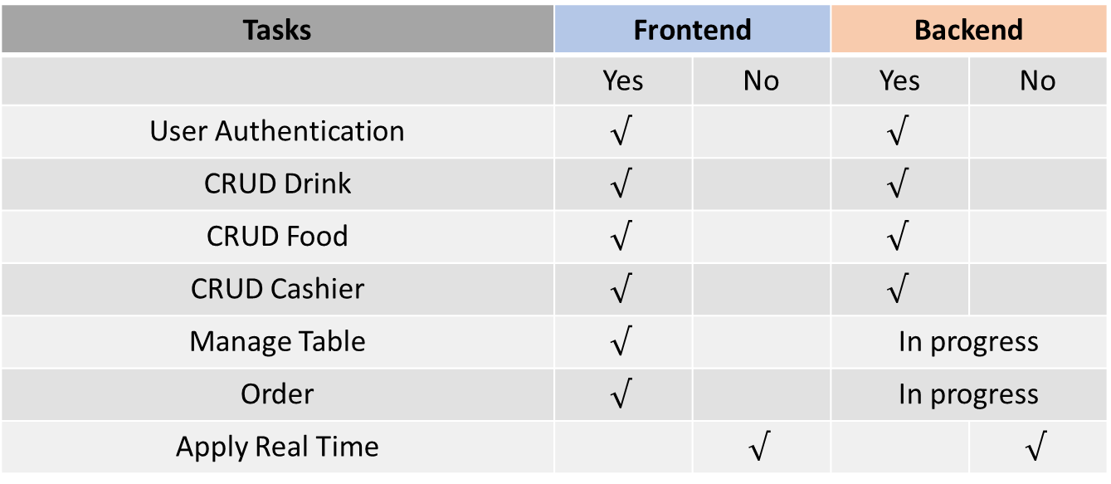
Completed & uncompleted Tasks
Tasks | Frontend |  | Backend
 | Yes | No | Yes | No
User Authentication | $$√$$ |  | $$√$$
CRUD Drink | $$√$$ |  | $$√$$
CRUD Food | $$√$$ |  | $$√$$
CRUD Cashier | $$√$$ |  | $$√$$
Manage Table | $$√$$ |  | In progress
Order | $$√$$ |  | In progress
Apply Real Time |  | $$√$$ |  | $$√$$

Slide 2
Planning
ACTIVITIES | WEEKS
 | 1 | 2 | 3 | 4 | 5 | 6 | 7
Learn new Technologies
Analyze Requirement
Database Design
Implementation
Testing

Slide 3


