Slide 1
Indexing for Interactive Exploration of Big Data Series

Slide 2
what is the problem
Large data series – produced by numerous applications with the need to query them as soon as the data is available
The current indexing mechanism lend to large data to query time
building index involves building the FULL tree upfront – at indexing time

Slide 3
why is it important
Data continues to grow waiting for a long time to query not acceptable for many business
Sequential scan only benefit single long data series and queries for small subsequences
Efficient indexing is required to support data exploration effectively.

Slide 4
Main Idea
Interactively and adaptively build parts of the index – driven by workload/query.
Initialization cost is kept at very low levels
creating only a partial tree structure deep enough to not penalize the first query.
Algorithms focus on how to incrementally sort columns in main memory.

Slide 5
Main Idea (contd)
3 new approaches presented
ADS Index (Adaptive Data Series )
delaying indexing until they are absolutely necessary
ADS+ Index
Filling index on demand
As more queries are performed - column reaches closer to sorted state
PADS+ Index
adapting leaf sizes on-the-fly
varying leaf sizes across the index

Slide 6
Background Data Series Representations and the iSAX Index
SAX ( Symbolic Aggregate approximation) technique :
the value space is partitioned into segments that follow the normal distribution.
Each value can then be represented by a character/smaller number of bits – that corresponds to the segment that it falls in.
This leads to a representation with a very small memory footprint – imp requirement for very large data series

Slide 7
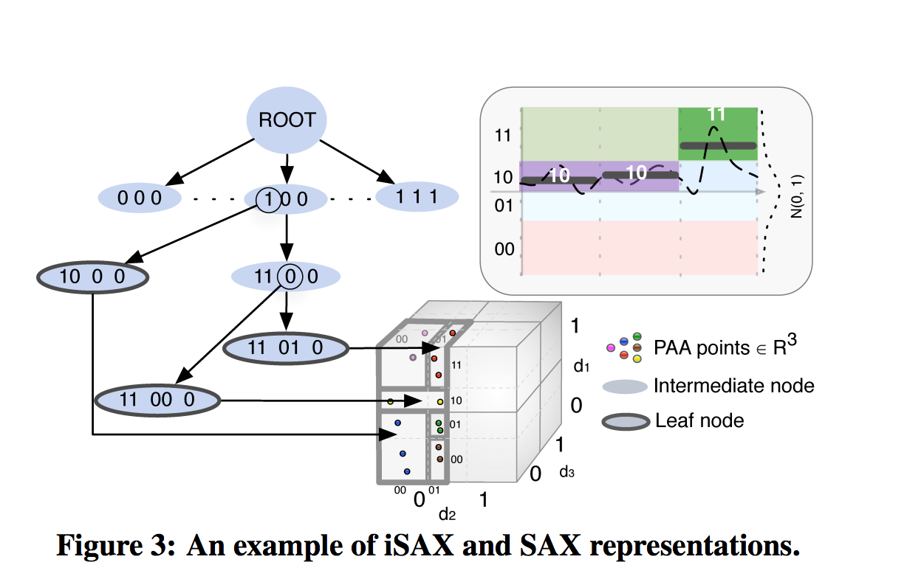
Background(contd)
In this figure – data series divided in 4 segments – 00, 01, 10, 11
SAX word for this segmentation of size 3 will be 10,10,11

Slide 8
Technique Details ADS
ADS Index Creation
scans the file
record the position
Read a size n of data series
convert it to iSax representation,
add the iSAX and the position info to the buffers
when the buffer is full – move the data to the appropriate leaf buffer - split as when needed
Sequentially flush each leaf buffers in the index to the disk
Leaf nodes kept in the disk

Slide 9
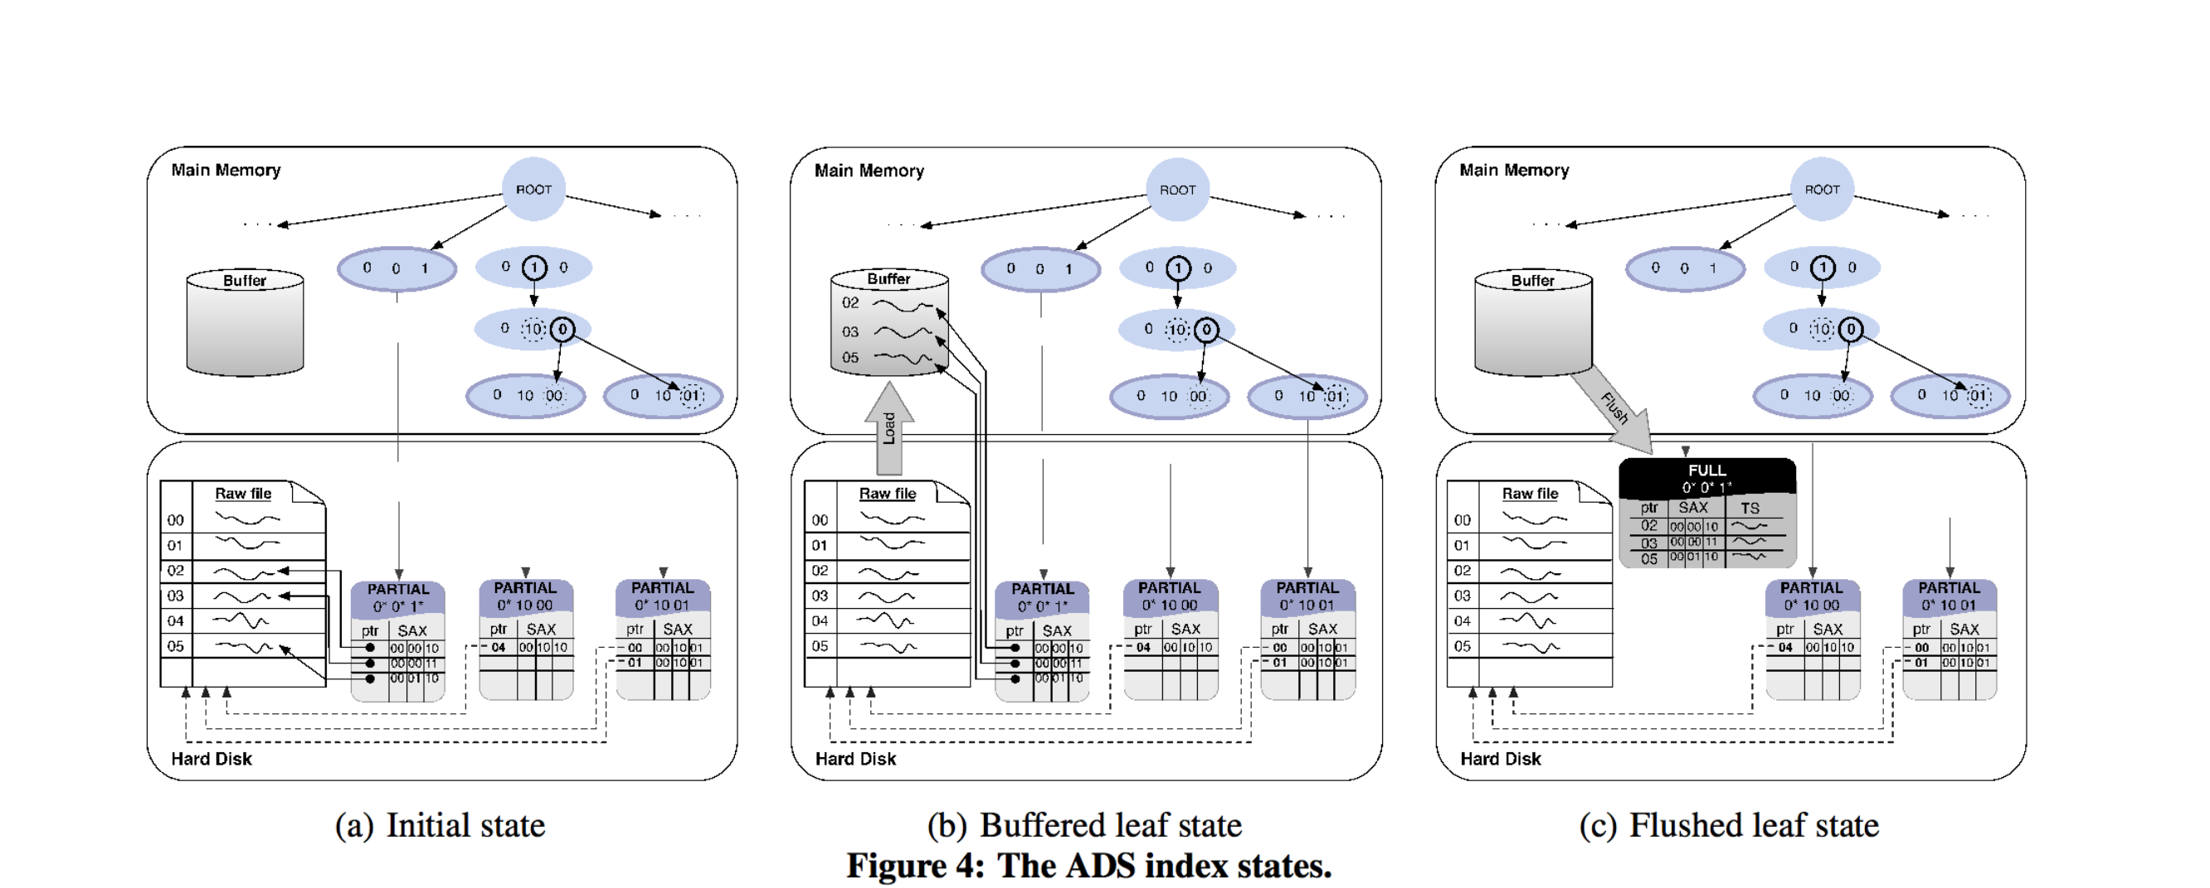
ADS

Slide 10
ADS (contd)
I/O and Memory Profile
Does only one scan of the data series
Does not move raw series through the tree
Leaf is light weight – data series remain in the raw file. – helps with I/O and memory
Buffering
Buffers at 2 levels :
FBL – First Buffer level - set of buffers corresponding to the children of the root
LBL – Leaf Buffer Level – second layer corresponding to the leaf of the index – on the disk

Slide 11
ADS (contd)
Querying and Refining ADS
Refines the index during query processing time
Querying process
Converting the query to iSAX representation
Search the index nodes for a matching iSAX
If the search ends in a leaf node marked –“Partial”
Fetch the partial leaf from the disk into memory
Reads all positions in this leaf
Sort these positions to ensure sequential access of raw file( which is good for performance – reduces cache misses)
Fetch the raw data series
Assigned to this leaf node and kept in the LBL ( Leaf buffer level )
The leaf node contains pointers to this buffered data
LBL will get flushed to the disk when the main memory is full.
When leaf node is flushed it is marked as “FULL’
Any future queries will need to fetch the leaf node from the disk ( if flushed ) or read it from LBL

Slide 12
ADS+ Index
Adaptive Leaf size
Splits are expensive as I/O involved in the data movements to/from disk
Split directly effected by leaf size : tree with big leaf size – leads to faster index, slower query
Delays leaf materialization even further

Slide 13
ADS+ Index
Main Idea
Two different leaf sizes
Large leaf size – optimize initialization cost. This will reduce split cost.
Small leaf size – optimize query cost
Rely on the query to appropriately split the leaf , reduce leaf size in the hot areas
Future queries benefit from every split operation – as relevant data can be found by traversing the tree instead of scanning large leaves.
Initial tree built with a constant ( large ) leaf size
Querying – ADS+ refine the index leaf on-the-fly by recursively splitting it till leaf size <= query leaf size
While leaves are created due to split – not all of them are needed for query
These additional leafs are left as it – with a size < initial lef size and > query leaf size.
When workload arrive that need these additional leaf- they will be split to reach the query leaf size.

Slide 14
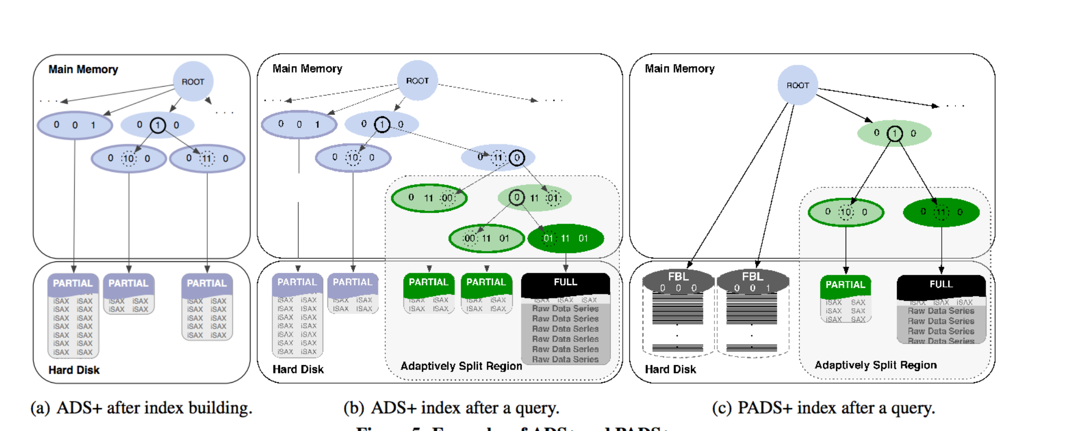
PADS+ ( Partial ADS+)
Variation of ADS+ for skewed workloads.

Slide 16
PADS+
Improvises on the initialization phase – making it even more transparent.
Tailored for case where users have a few targeted queries or for skewed workloads.
Skewed workload – query only needs a part of the data or focuses on subsets

Slide 17
PADS+
Main Idea
Build parts of index tree and for small subsets of data – depending on query
Initialization Phase
Scans the file
Only creates a root node and the iSAX representation
Only maintains buffers in FBL.
Ready for handling query

Slide 18
PADS+
Querying phase
Similar to ADS+
Continuously and incrementally refined
Query directs the nodes that are split till they are small enough to contain data.
Query converted to iSAX representation – and finds the FBL for this representation
It pulls this FBL from the disk – and adaptively splits it – till its size <= query leaf size.
To optimize reading from disk for each query
Initialize leaf size is set to infinite – thus split can be performed on large leaf BUFFERS

