Slide 1
Coloring

Slide 2
Flight Gates
flights need gates, but
times overlap.
how many gates needed?

Slide 3
Airline Schedule
time
122
145
67
257
306
99
Flights

Slide 4
Conflicts Among 3 Flights
Needs gate at same time
145
306
99

Slide 5
Model all Conflicts with a Graph
257
122
145
67
306
99

Slide 6
Color the vertices
Color vertices so that adjacent
vertices have different colors.
min # distinct colors needed =
min # gates needed

Slide 7
Coloring the Vertices
257
122
145
assign
gates:
67
306
257, 67
122,145
99
306
4 colors
4 gates
99

Slide 8
Better coloring
257
122
145
67
306
3 colors
3 gates
99

Slide 9
Final Exams
Courses conflict if student
takes both, so need different time slots.
How short an exam period?

Slide 10
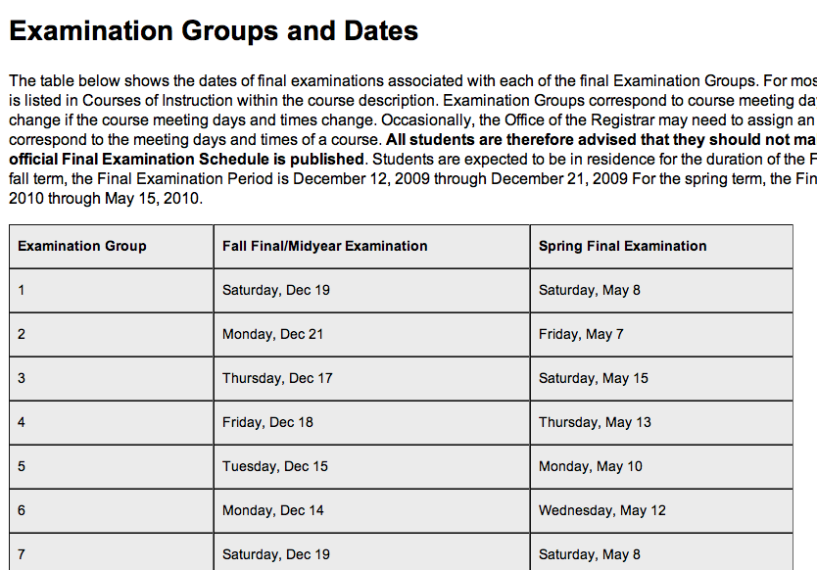
Harvard’s Solution
Different “exam group” for every teaching hour. Exams for different groups at different times.

Slide 11
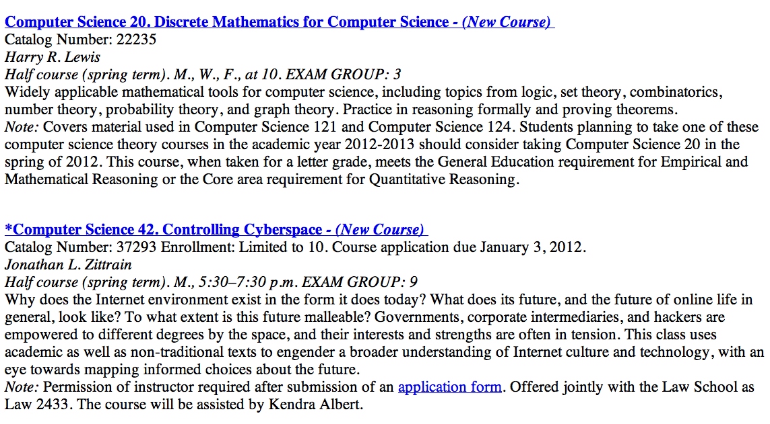

Slide 12
But This May be Suboptimal
Suppose course A and course B meet at different times
If no student in course A is also in course B, then their exams could be simultaneous
Maybe exam period can be compressed!
(Assuming no simultaneous enrollment)

Slide 13
Model as a Graph
A
B
Means A and B have at least one student in common
AM 21b
CS 20
Celtic 101
M 9am
M 2pm
T 9am
T 2pm
Music 127r
4 time slots
(best possible)
Psych 1201

Slide 14
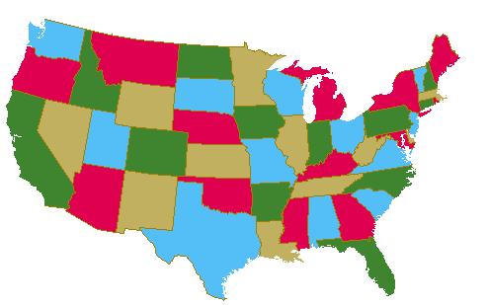
Map Coloring

Slide 15
Planar Four Coloring
any planar map is 4-colorable.
1850’s: false proof published
(was correct for 5 colors).
1970’s: proof with computer
1990’s: much improved

Slide 16
Chromatic Number
min #colors for G is
chromatic number, χ(G)
lemma:
χ(tree) = 2

Slide 17
Trees are 2-colorable
root
Pick any vertex as “root.”
if (unique) path from root is
even length:
odd length:

Slide 18
Simple Cycles
χ(C_{even}) = 2
χ(C_{odd}) = 3

Slide 19
Bounded Degree
all degrees ≤ k, implies
χ(G) ≤ k+1
very simple algorithm…

Slide 20
“Greedy” Coloring
…color vertices in any order. next vertex gets a color different from its neighbors.
≤ k neighbors, so
k+1 colors always work

Slide 21
coloring arbitrary graphs
2-colorable? --easy to check
3-colorable? --hard to check
(even if planar)
find χ(G)? --theoretically
no harder than 3-color, but
harder in practice

Slide 22
Finis

