Slide 1
Connectivity

Slide 2
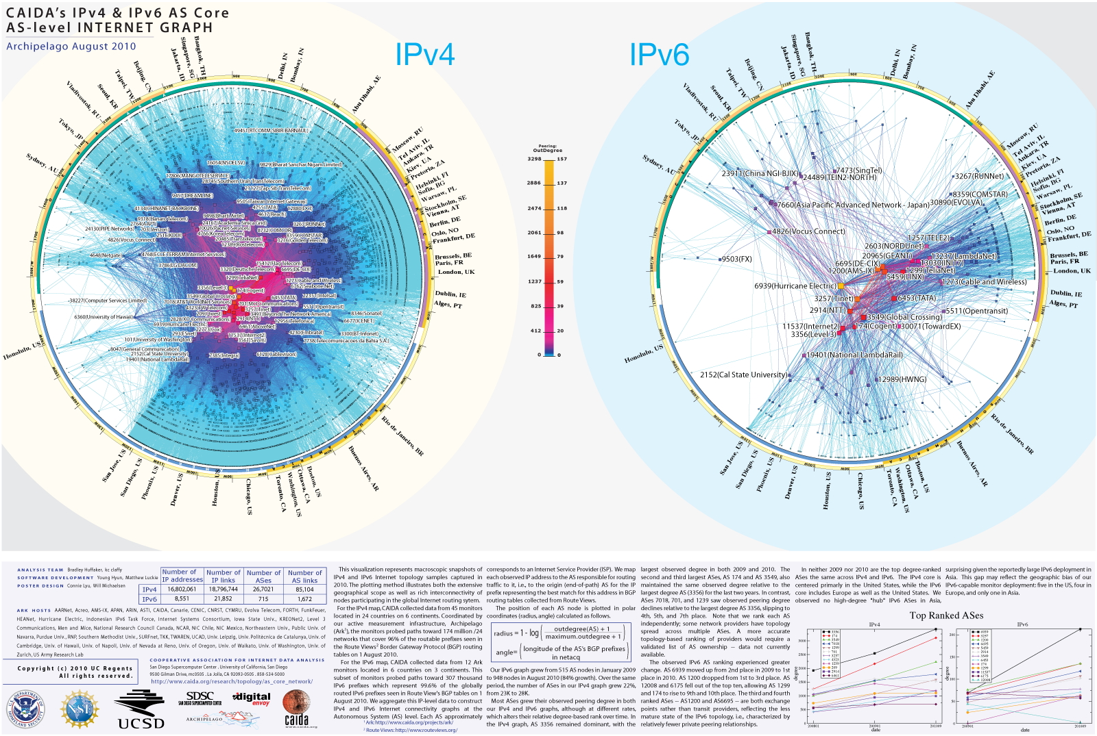
Graphs of the Internet

Slide 3
Connectivity
Connectivity measures fault
tolerance of a network:
how many connections can
fail without cutting off
communication?

Slide 4
Connectivity Between Vertices
Two vertices are connected in a graph G if there is a path between them
u and v are connected in G, u and w are not
“Being connected in G” is an equivalence relation on vertices
w
u
G =
v

Slide 5
Connected Components
Every graph consists of
separate connected
pieces (subgraphs) called
connected components

Slide 6
One Graph with 2 Connected Components

Slide 7
Connected Components
A graph is connected
iff it has only
1 connected component

Slide 8
Edge Connectivity
Def: The edge connectivity of a graph G is the smallest number of edges that must be removed to disconnect G

Slide 9
Edge connectivity = 1
delete
The edge is called a bridge

Slide 10
Edge Connectivity = 2

Slide 11
Vertex Connectivity
Def: The vertex connectivity of a graph G is the smallest number of vertices that must be removed to disconnect G

Slide 12
A graph with vertex connectivity 1
delete
The vertex is called an articulation point

Slide 13
delete

Slide 14
Vertex Cut = set of nodes whose removal disconnects the graph
Vertex cut of size 2
“Biconnected” means vertex connectivity at least 2, i.e. connected but no articulation point

Slide 15
Finis

