Slide 1
Recurrences

Slide 2
What is a Recurrence Relation?
A system of equations giving the value of a function from numbers to numbers in terms of the value of the same function for smaller arguments
Eg Fibonacci:
F₀ = 0, F₁ = 1, and for n>1,
F_{n} = F_{n-1}+F_{n-2}

Slide 3
A note on Fibonacci
Incredibly, the Fibonacci numbers can be expressed as
The second term is o(1) so the Fibonacci numbers grow exponentially

Slide 4
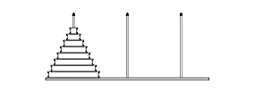
Towers of Hanoi
1 2 3
Move all disks from peg 1 to peg 3
Move one disk at a time
Never put a larger disk on a smaller disk

Slide 5
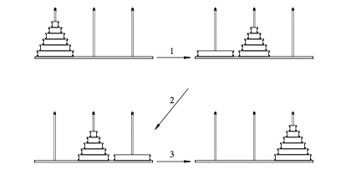
Recursive Solution
How many moves H_{n} to transfer all n disks?
n = 1 => H₁ = 1
H_{n+1} = 2H_{n}+1

Slide 6
Conjecture and Prove
H₁ = 1
H₂ = 2H₁+1 = 3
H₃ = 2H₂+1 = 7
H₄ = 2H₃+1 = 15
Conjecture: H_{n} = 2^{n}-1
Works for n=1, 2, 3, 4
H_{n+1} = 2H_{n}+1 = 2∙(2^{n}-1) + 1 = 2^{n+1}-1
(by recurrence equation; by induction hypothesis; by simplifying algebraically)

Slide 7
Divide and conquer
Determine whether an item x is in a sorted list L by binary search
For convenience assume list L has 2^{n} elements for some n
Algorithm:
If L is of length 1, check to see if the unique element is x and return T or F accordingly.
If L is of length 2^{n+1} where n ≥ 0, compare x to L[2^{n}].
If x≤L[2^{n}] then search for x in L[1..2^{n}].
If x>L[2^{n}] then search for x in L[2^{n}+1..2^{n+1}].

Slide 8
Analysis
Let D_{n} = # of comparison steps to find an element in a list of length n (which is a power of 2)
D₁ = 1
D_{2n} = 1+D_{n}
D₂ = 2
D₄ = 3
D₈ = 4

Slide 9
Analysis
Proof: n=1 (k=0) ✓
Assume D_{n} = 1 + lg n
D_{2n} = 1 + D_{n} = 2 + lg n = 1 + lg(2n) ✓

Slide 10
Merge Sort
Sort a list L of length n = 2^{k} as follows:
If n = 1 the list is sorted
If n = 2^{k+1} and k≥0 then
Split the list into L[1..2^{k}] and L[2^{k}+1..2^{k+1}]
Sort each sublist by the same algorithm
Merge the sorted lists together
T(1) = 1
T(2n) = 2T(n) + cn

Slide 11
Merge Sort Analysis
T(1) = 1
T(2n) = 2T(n) + cn
T(2) = 2+c
T(4) = 2(2+c) + 2c = 4 + 4c
T(8) = 2(4+4c) + 4c = 8 + 12c
T(16) = 2(8+12c) + 8c = 16 + 32c
T(32) = 2(16+32c) + 16c = 32 + 80c
? T(n) = n + c(n/2)lg n

Slide 12
Prove the Conjecture
? T(n) = n + c(n/2)lg n
T(1) = 1 = 1 + c(1/2)lg 1 = 1 + 0 = 1 ✓
T(2n) = 2T(n) + cn
= 2(n+c(n/2)lg n) + cn
= 2n + cnlg n + cn
= 2n + cn(lg n + 1)
= 2n + c(2n/2) lg (2n)✓

Slide 13
FINIS

