Slide 1
Series
Geometric Series
Binomial Coefficients
Harmonic Series

Slide 2
Sum of a Geometric Series
What is
Method 1: Prove by induction that for every n≥0,
And then make some argument about the limit as n →∞ to conclude that the sum is 2.

Slide 3
Sum of a Geometric Series
Alternatively, use the fact that
Why? Let F(x) = 1 + x + x² + x³ + …
Then xF(x) = x + x² + x³ + …
= F(x) – 1
Since xF(x) = F(x) - 1, F(x) = 1/(1-x)
???!
Now plug in x = ½: !
These “formal power series” have many uses.

Slide 4
Another example
What is
Since ,

Slide 5
Another Example
What is
Generalize. Note that S=F(1/3) where

Slide 6
Manipulating Power Series

Slide 7
Another Approach
But then

Slide 8
Identities involving “Choose”
What is
“Set Theory” derivation
Let S be a set of size n
This is the sum of the number of 0 element subsets, plus the number of 1-element subsets, plus …, plus the number of n-element subsets
Total 2^{n}

Slide 9
Binomial Theorem
because if you multiply out
(x+y)(x+y)(x+y)…(x+y)
the coefficient of x^{i}y^{n-i} is the number of different ways of choosing x from i factors and y from n-i factors

Slide 10
Using the Binomial Theorem
Since
substituting x = y = 1 yields

Slide 11
Using the Binomial Theorem
What is
Try to make this look like the binomial thm

Slide 12
Stacking books
Can you stack identical books so the top one is completely off the table?

Slide 13
Stacking books
Can you stack identical books so the top one is completely off the table?
One book: balance at middle
1
1

Slide 14
Stacking books
Two books: balance top one at the middle, the second over the table edge at the center of gravity of the pair
1
1
1
½

Slide 15
Stacking books
Three books: balance top one at the middle, the second over the third at ½, and the trio over the table edge at the center of gravity
1
½

Slide 16
Stacking books
Three books: balance top one at the middle, the second over the third at ½, and the trio over the table edge at the center of gravity = (1+2+2½)/3 = 1⅚ from right end
1⅚
1
½

Slide 17
Stacking books
Three books: balance top one at the middle, the second over the third at ½, and the trio over the table edge at the center of gravity = (1+2+2½)/3 = 1⅚ from right end
1⅚
1
½
⅓
See a pattern?

Slide 18
The Harmonic Series Diverges
Let . Then for any n,
Doubling the number of terms adds at least ½ to the sum
Corollary. The series diverges, that is,

Slide 19
Proof by Induction that the Harmonic Series Diverges

Slide 20
The Harmonic Series Diverges

Slide 21
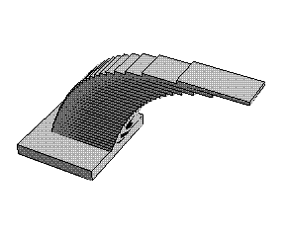
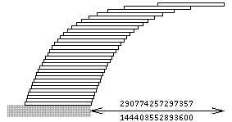
So with a stack of 31 books you get 2 book lengths off the table!
And there is no limit to how far the stack can extend!
http://mathforum.org/advanced/robertd/harmonic.html

Slide 22
FINIS

