Slide 1
Strong Induction

Slide 2
Induction Rule

Slide 3
Strong Induction Rule

Slide 4
You May Need Multiple Base Cases
For example,
R(0)&R(1)&…&R(k-1) (k base cases)
and (∀n≥k-1)(R(0)&R(1)&…R(n) => R(n+1))
Together imply (∀m) R(m)
And the base cases may start with some j>0
In which case the conclusion is (∀m≥j) R(m)

Slide 5
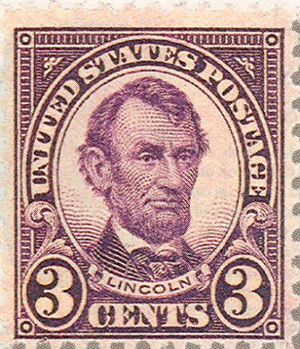
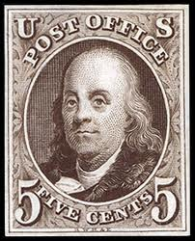
Making Postage
Theorem: Every amount of postage ≥ 8 cents can be made up of 3 and 5 cent stamps.
Or in math: For any n≥8, n = 3p+5q for some p≥0 and q≥0.
Say that a number is postal if it can be expressed as a sum of 3’s and 5’s. Then we want to prove
The Postal Theorem: Every number ≥8 is postal.

Slide 6
Proof of Postal Theorem
Base cases:
8 is postal:
9 is postal:
10 is postal:

Slide 7
Proof of Postal Theorem
Induction step
Let n≥10 and assume all numbers ≥ 8 and ≤ n are postal
Then n+1≥11.
Then (n+1)-3≥8 and is postal by the induction hypothesis
Then n+1 = plus the stamps for (n+1)-3
So n+1 is postal too.

Slide 8
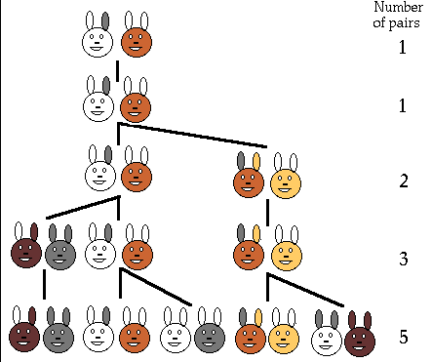
Fibonacci Numbers
Start with a pair of rabbits
After 2 months a new pair is born
Once fertile, a pair produces a new pair every month
Rabbits always come in breeding pairs, and never die
http://morrischia.com/david/portfolio/boozy/research/fibonacci's_20rabbits.html

Slide 9
Fibonacci Numbers
0, 1,
0+1=1,
1+1=2,
1+2=3,
2+3=5,
3+5=8, …
F_{n+1}=F_{n}+F_{n-1} (n≥1)
F₀=0
F₁=1

Slide 10
How Many Binary Strings of length n with No Consecutive 1s?
n
0 | <>
1 | 0 | 1
2 | 00 | 01 | 10 | 11
3 | 000 | 001 | 010 | 011 | 100 | 101 | 110 | 111

Slide 11
How Many Binary Strings of length n with No Consecutive 1s?
n
0 | <>
1 | 0 | 1
2 | 00 | 01 | 10 | 11
3 | 000 | 001 | 010 | 011 | 100 | 101 | 110 | 111

Slide 12
How Many Binary Strings of length n with No Consecutive 1s?
n
0 | <>
1 | 0 | 1
2 | 00 | 01 | 10 | 11
3 | 000 | 001 | 010 | 011 | 100 | 101 | 110 | 111

Slide 13
How Many Binary Strings of length n with No Consecutive 1s?
n
0 | <>
1 | 0 | 1
2 | 00 | 01 | 10 | 11
3 | 000 | 001 | 010 | 011 | 100 | 101 | 110 | 111

Slide 14
How Many Binary Strings of length n with No Consecutive 1s?
n
0 | <>
1 | 0 | 1
2 | 00 | 01 | 10 | 11
3 | 000 | 001 | 010 | 011 | 100 | 101 | 110 | 111
1, 2, 3, 5, … ? Are these the Fibonacci numbers??
0000 | 0001 | 0010 | 0011
0100 | 0101 | 0110 | 0111
1000 | 1001 | 1010 | 1011
1100 | 1101 | 1110 | 1111

Slide 15
C_{n} = #Binary Strings of length n with No Consecutive 1s
n | 0 | 1 | 2 | 3 | 4
C_{n} | 1 | 2 | 3 | 5 | 8
n | 0 | 1 | 2 | 3 | 4 | 5 | 6
F_{n} | 0 | 1 | 1 | 2 | 3 | 5 | 8
C_{n} = F_{n+2}??
Why would that be?
Say that a string is “good” if it has no consecutive 1s
Why would a “good” string of length n+1 have something to do with good strings of shorter length?

Slide 16
Getting Good Strings of Length n+1
A good string of length n+1 ends in either 0 or 1. Call this good string x.
[Try breaking the problem down into cases]
If x ends in 0, the first n digits could be any good string of length n since adding a 0 to the end can’t turn a good string bad
There are C_{n} strings like that
x
 |  |  |  |  |  |  | 0
Good string of length n

Slide 17
Getting Good Strings of Length n+1
If x ends in 1, the next to last digit must be 0 (otherwise x would end in 11 and be bad)
But the previous n-1 digits could be any good string of length n-1. There are C_{n-1} strings like that
Total = C_{n+1} = C_{n}+C_{n-1}
 |  |  |  |  |  | 0 | 1
x
Good string of length n-1

Slide 18
Proof by Induction that C_{n}=F_{n+2}
(Base cases)
C₀ = 1 = F₀₊₂
C₁ = 2 = F₁₊₂
(Induction hypothesis)
Assume n≥1 and C_{m}=F_{m+2} for all m≤n.
Need to show that C_{n+1} = F_{n+3}
Then C_{n+1} = C_{n}+C_{n-1} (by previous slide)
= F_{n+2}+F_{n+1} (by the induction hypothesis)
= F_{n+3} by defn of Fibonacci numbers

Slide 19
Finis

