Slide 1

Computer Science 20
All the Math you need for your Computer Science courses
that you won’t learn in your Math Courses
Discrete Mathematics for Computer Science
Harvard CS20/CSCI E-20, with thanks to Albert R. Meyer

Slide 2

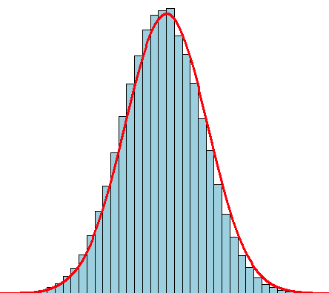
Some Topics
Formal logic (p∨q) ∧¬(p∧q)
Graphs and digraphs
Probability
Counting
Number theory p ≡ q^{r} (mod m)
… see the “placement test” on the web site
a
b
c
d
f

Slide 3
Skills!!!
How to do proofs
By contradiction
By induction
…
How to read and write mathematics
And typeset!
How to collaborate
How to present clearly and persuasively

Slide 4
3 Principles of Course Philosophy
Learning, not competing
Absolute grading standards – no “curve”
Class will post solutions to exam questions!
Learn by doing, not by listening
Consume the course material in many small bites

Slide 5
Typical Class Day
Before each class:
Reading and check-in problems (30-60 mins)
Watch mini-lecture (~20 minutes)
In class
Executive Summary (10 minutes)
Sample problem (5 minutes)
Collaborative problem solving in groups of 4 (35 mins)
Weekly
Homework (3-5 hours)
Write up and post one problem solution
So class week =
3 hours class time
~8 hours out-of-class time
Most readings from MIT course notes

Slide 6
Requirements
Attendance is mandatory!
See “Course policies” for details
Official/emergency absences ⇒ email cs20@seas.harvard.edu
Class begins at 10:10 sharp
Homework boxes removed at 10:30, no late submissions
50-minute midterm exam (21 Feb)
3-hour final during exam period

Slide 7
Grading Mix
Homework 40%
Midterm 15%
Final exam 30%
Check-in questions 10%
Write up in-class problems 5%
(Poor attendance: Exclusion or failure)

Slide 8
And now – the course in action!

