Slide 1

Proofs
1/25/12

Slide 2
Why Do Proofs?
Because we want to be SURE something is true ALWAYS, not just true in the situations we can imagine or have tested
Because we often learn something from the proof BEYOND the truth of the proposition. We may learn WHY something is true.
Because we sometimes can convert a proof into an ALGORITHM. For example, we may not only prove that something EXISTS but learn how to FIND it.
1/25/12

Slide 3
Example: 2-color map theorem
Theorem: Any map drawn using infinite straight lines can be 2-colored.
WHY???
RED
BLACK
RED
RED
BLACK
BLACK
RED
1/25/12

Slide 4
Example: 2-color map theorem
Theorem: Any map drawn using infinite straight lines can be 2-colored.
Give the lines a direction
For each region, count
how many
vectors it lies
to the right of
Color black if even
Red if odd
Crossing one line changes parity of count
3
2
2
1
1
0
1
1/25/12

Slide 5
In a proof every step must follow logically from previous steps
Bogus “Proof” that 2 = 4
Let x := 2, y := 4, z := 3
Then x+y = 2z
Rearranging, x-2z = -y
and x = -y+2z
Multiply: x²-2xz = y²-2yz
Add z²: x²-2xz+z² = y²-2yz+z²
Factor: (x-z)² = (y-z)²
Take square roots: x-z = y-z
So x=y, or in other words, 2 = 4. ???
1/25/12

Slide 6
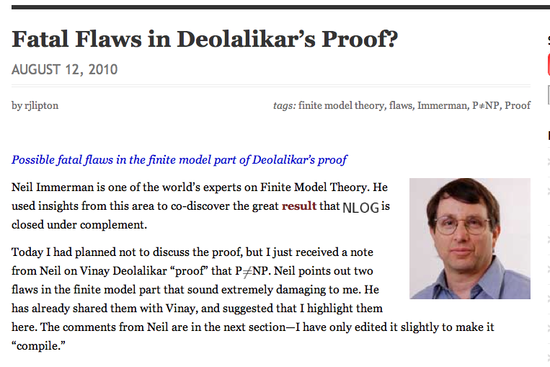
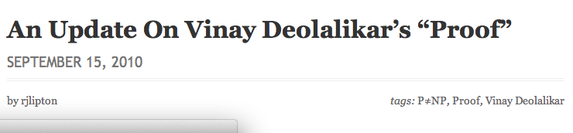
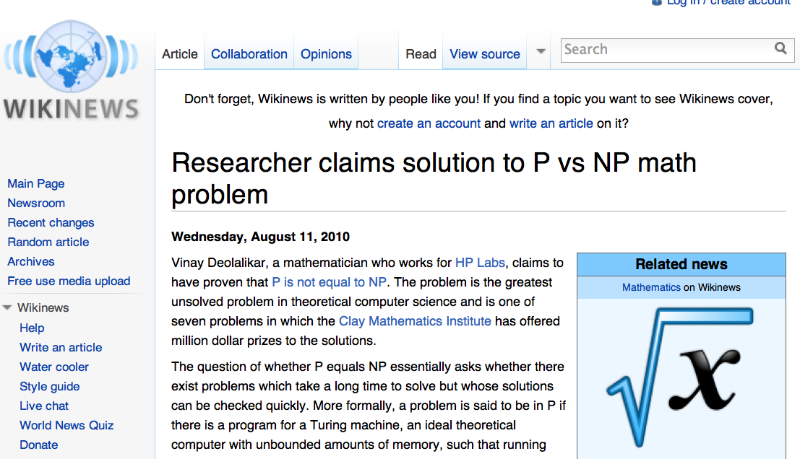
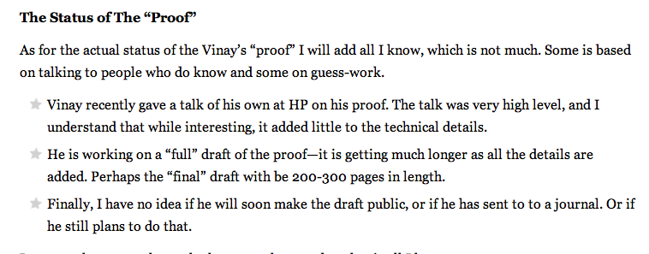
1/25/12

Slide 7
A Proof
Theorem: The square of an integer is odd if and only if the integer is odd
Proof: Let n be an integer. Then n is either odd or even.
[Case analysis]
1/25/12

Slide 8
More slowly …
Thm. For any integer n, n² is odd if and only if n is odd.
To prove a statement of the form “P iff Q,” two separate proofs are needed:
  If P then Q (or “P ⇒ Q”)
  If Q then P (or “Q ⇒ P”)
“If P then Q” says exactly the same thing as “P only if Q”
So the 2 assertions together are abbreviated “P iff Q” or “P⇔Q” or “P ≡Q”
1/25/12

Slide 9
More slowly …
Thm. For any integer n, n² is odd if and only if n is odd.
(<=) If n is odd then n=2k+1 for some integer k …
  then n²=4k²+4k+1, which is odd
(=>) “If n² is odd then n is odd” is equivalent to “if n is not odd then n² is not odd” (“contrapositive”)
which is the same as “if n is even then n² is even” (since n is an integer) …
  then n=2k for some k and n²=4k², which is even
1/25/12

Slide 10
Contrapositive and converse
The contrapositive of “If P then Q” is “If (not Q) then (not P)”
The contrapositive of an implication is logically equivalent to the original implication
The converse of “If P then Q ” is “if Q then P ” – which in general says something quite different!
1/25/12

Slide 11
Proof by contradiction
To prove P, assume (not P) and show that a false statement logically follows.
Then the assumption (not P) must have been incorrect.
1/25/12

Slide 12
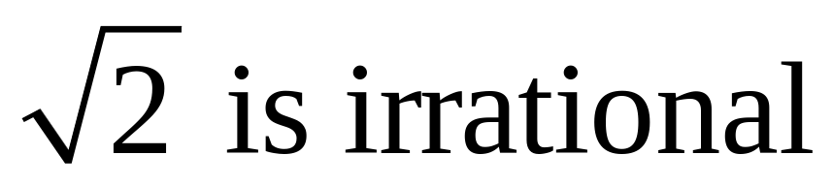
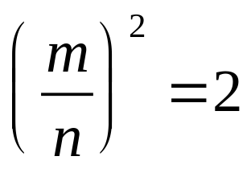
That is, there are no integers m and n such that
Suppose there were and derive a contradiction.
1/25/12

Slide 13
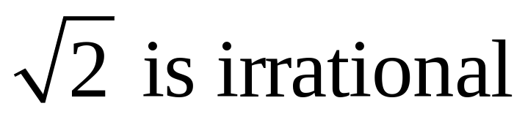
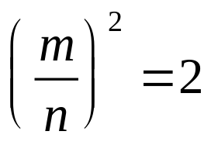
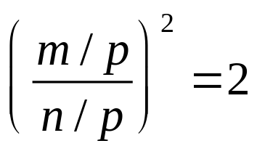
Suppose
Without loss of generality assume m and n have no common factors.
  Because if both m and n were divisible by p, we could instead use
  and eventually find a fraction in lowest terms whose square is 2.
1/25/12

Slide 14
Suppose (m/n)² = 2 and m/n is in lowest terms.
Then m² = 2n².
Then m is even, say m = 2q. (Why?)
Then 4q² =2n², and 2q² = n².
Then n is even. (Why?)
Thus both m and n are divisible by 2. Contradiction. (Why?)
1/25/12

Slide 15
TEAM PROBLEMS!
1/25/12

