Slide 1

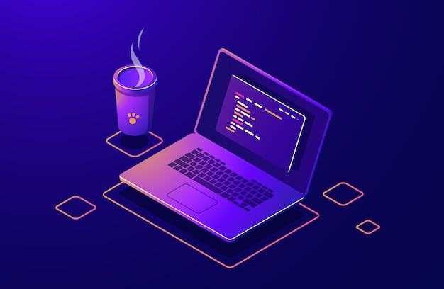


Slide 2
What is Github?
At a high level, GitHub is a website and cloud-based service that helps developers store and manage their code, as well as track and control changes to their code. To understand exactly what GitHub is, you need to know two connected principles:
Version control
Git

Slide 3
What Is Git?
Git is a specific open-source version control system created by Linus Torvalds in 2005.
Specifically, Git is a distributed version control system, which means that the entire codebase and history is available on every developer’s computer, which allows for easy branching and merging.
According to a Stack Overflow developer survey, over 87% of developers use Git.

Slide 4
How To Get Started With GitHub
Sign up for a free GitHub account
Create a repo
Upload the files from desktop
To Make Website visible
Go to settings
Go to code and automation section
Go to Pages
Change the branch to master
Done

Slide 5
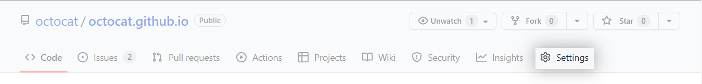
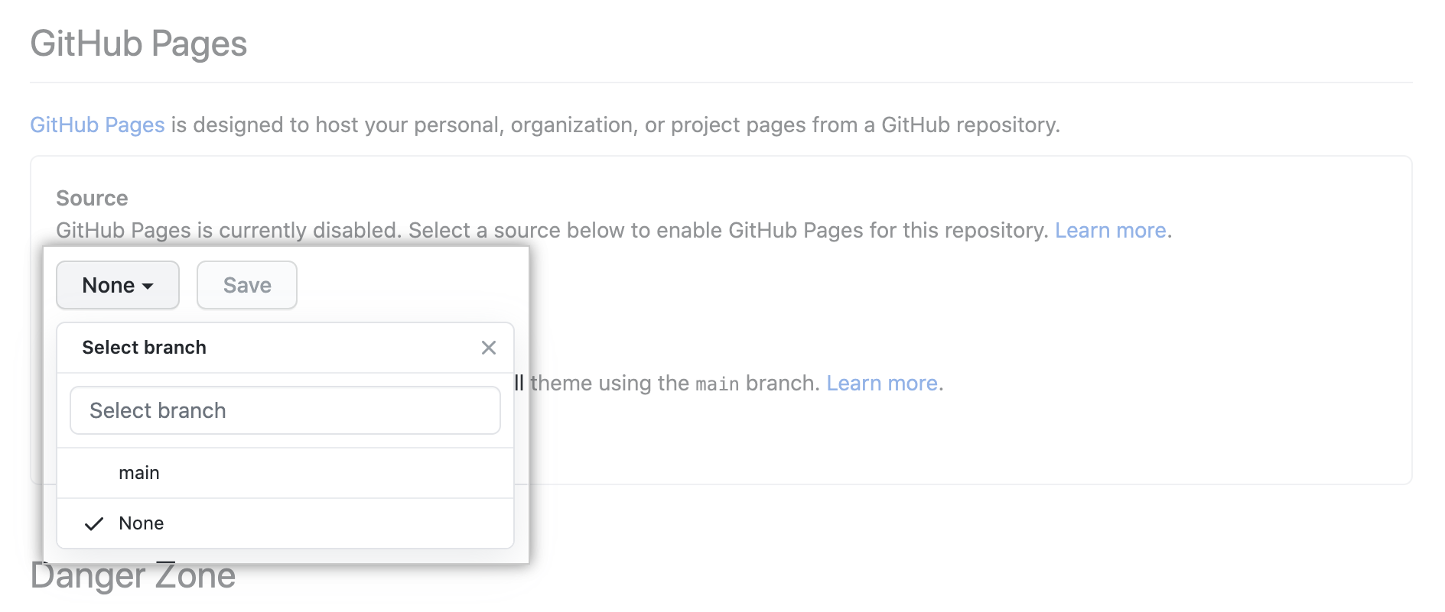
Publishing from a branch
Make sure the branch you want to use as your publishing source already exists in your repository.
On GitHub, navigate to your site's repository.
Under your repository name, click Settings.
4.In the "Code and automation" section of the sidebar, click Pages.
5. Under "Build and deployment", under "Source", select Deploy from a branch.
6. Under "Build and deployment", under "Branch", use the None or Branch drop-down menu and select a publishing source.

Slide 6
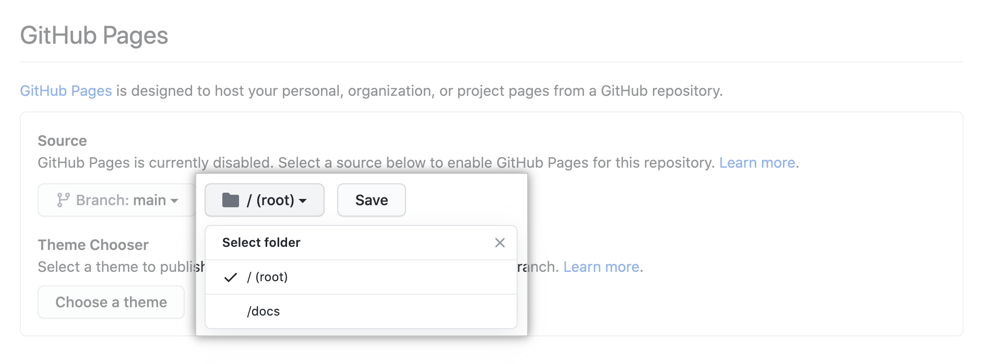
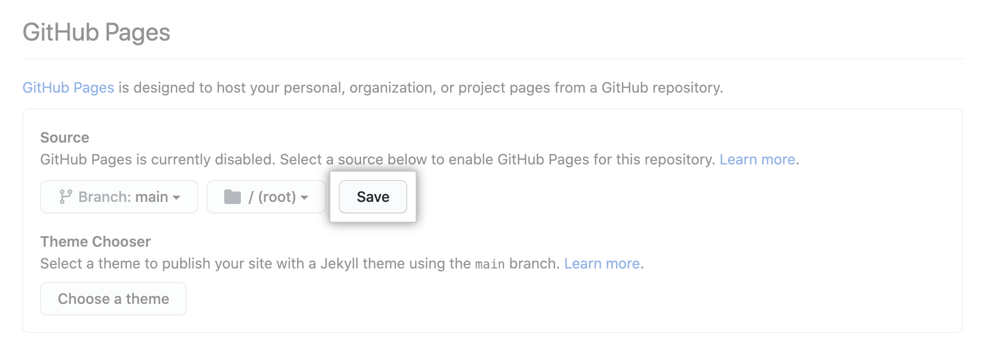
8. Optionally, use the drop-down menu to select a folder for your publishing source.
Click Save.

Slide 7
So what are the main benefits of using GitHub?
It makes it easy to contribute to your open source projects
Documentation
Showcase your work
Markdown
GitHub is a repository
Track changes in your code across versions
Integration options

Slide 8
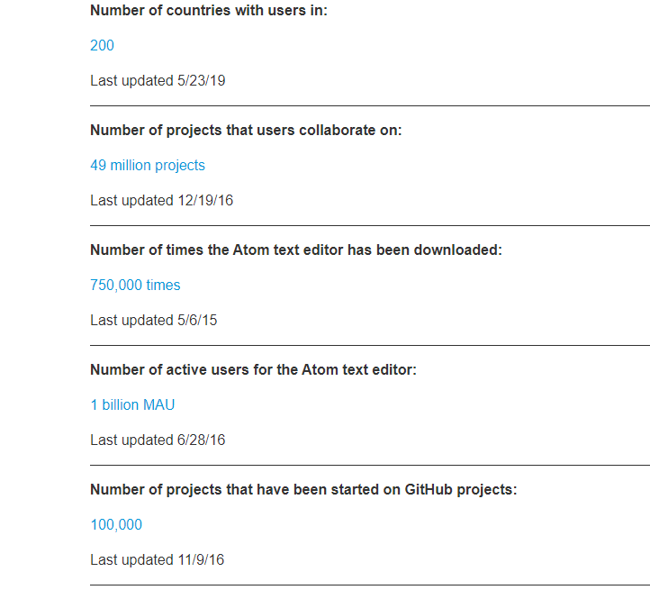
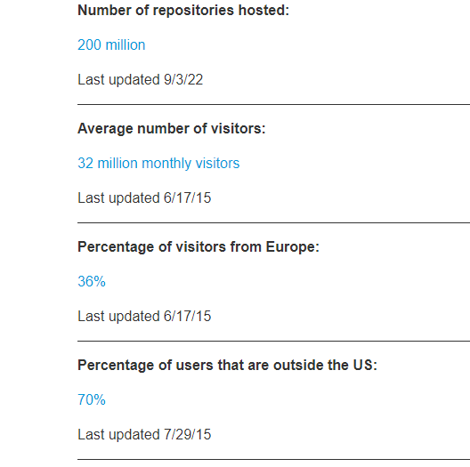

Slide 9
1. git clone
Tell Git who you are
git config --global user.name “Rachna Pant"
git config --global user.email email@gmail.com
Create a new local repository
git init
Check out a repository
git clone /path/to/repository
Add files
git add <filename>
git add *
Commit
git commit -m "Commit message"

Slide 10
Push
git push origin master
Status
git status
Checkout git checkout -- .
Used to undo the changes on the local files
Revert git revert revert id
How to check revert id “log”
Reset git reset

