Slide 1
Oculus Go Development
In Unity3D
Wendy Cai (wc586r)
York Delloyd (yd837d)

Slide 2
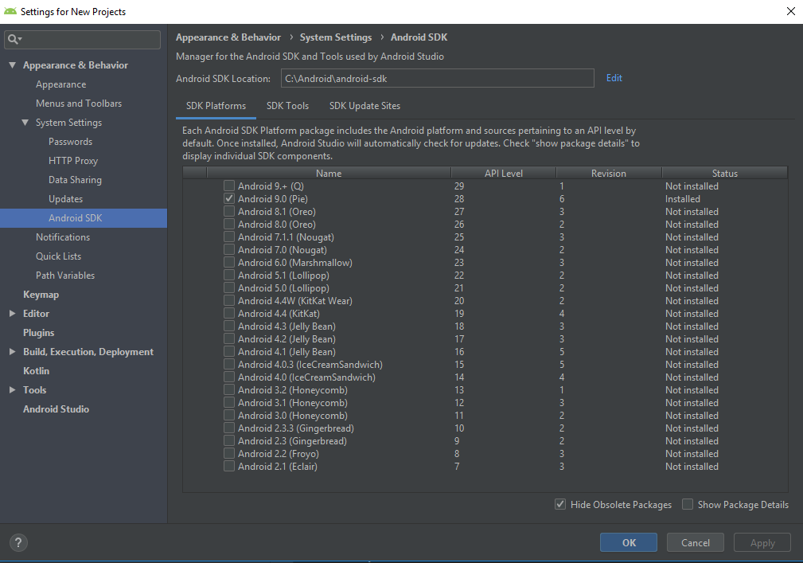
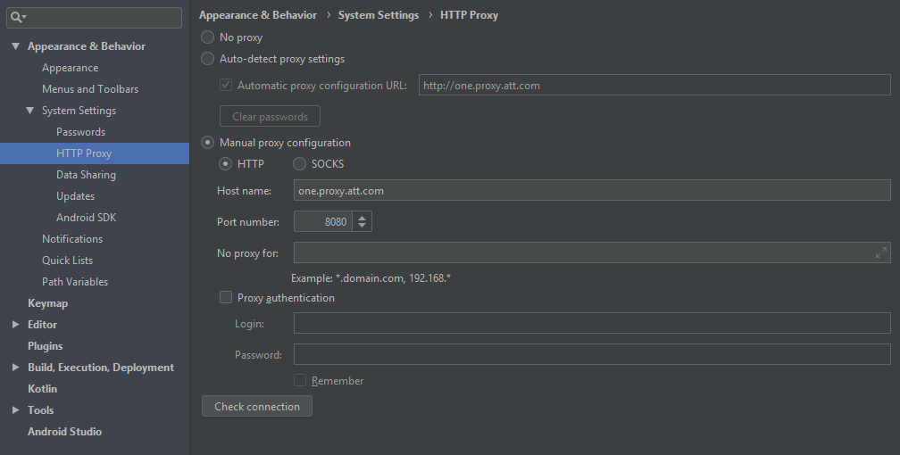
Install the Android SDK
Off !!ATTCORP!! – Very important
Download and install Android Studio
https://developer.android.com/studio
Make sure an android sdk is installed
If not, add http proxy
Try to install on ATTCORP.

Slide 3
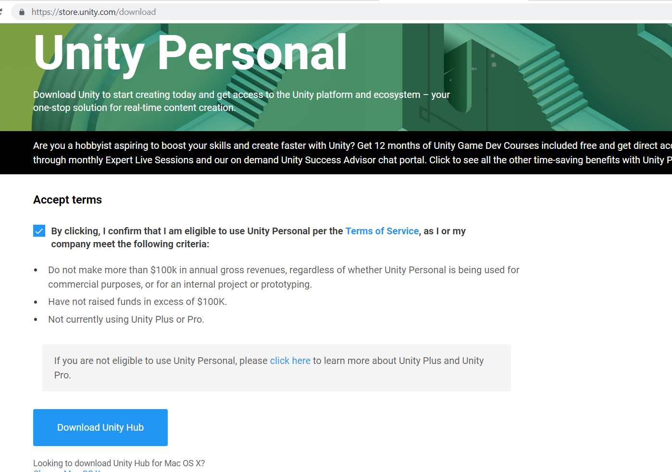
Download Unity
https://store.unity.com/download
May need to go off company wifi
Attcorp -> Attwifi
!!To Use ATTWIFI you need to select the network and go into your browser to login!!

Slide 4
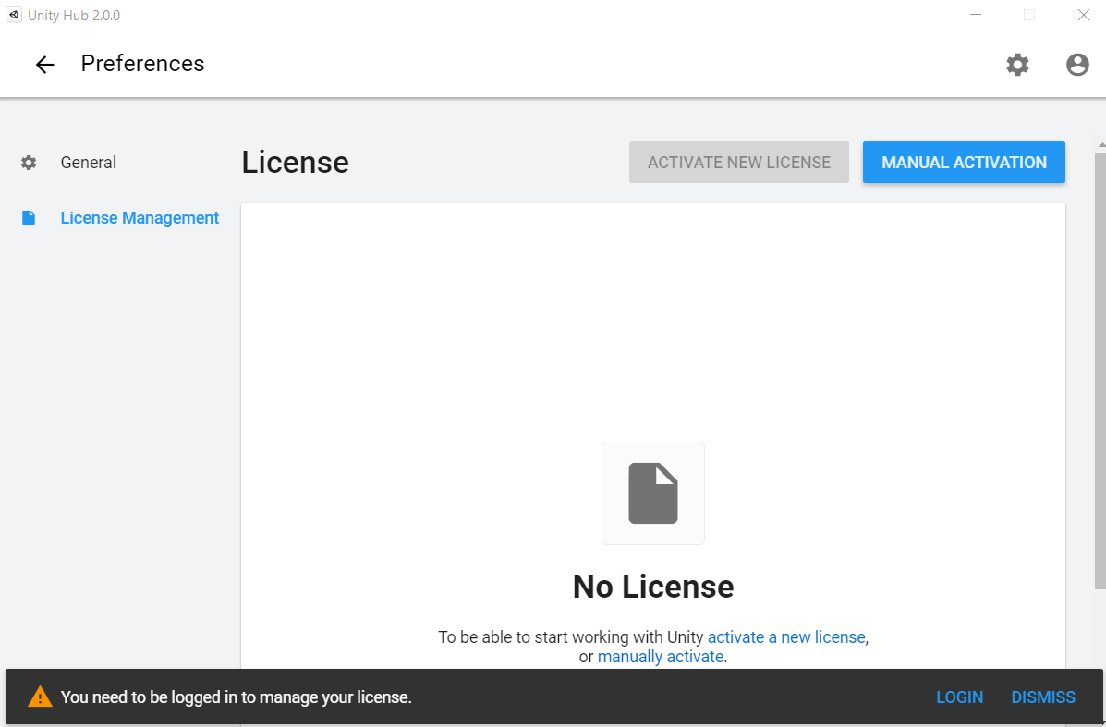
Activate Unity
Go ahead and press login.
I recommend using your university email to create the account as there may be benefits

Slide 5
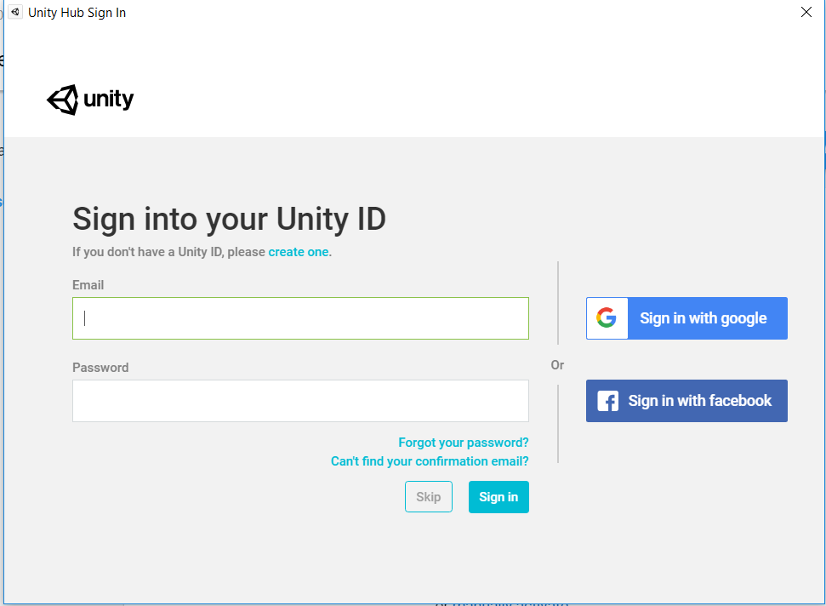
Activate Unity
If you don’t have an account:
Create One
If you do have an account:
Sign In

Slide 6
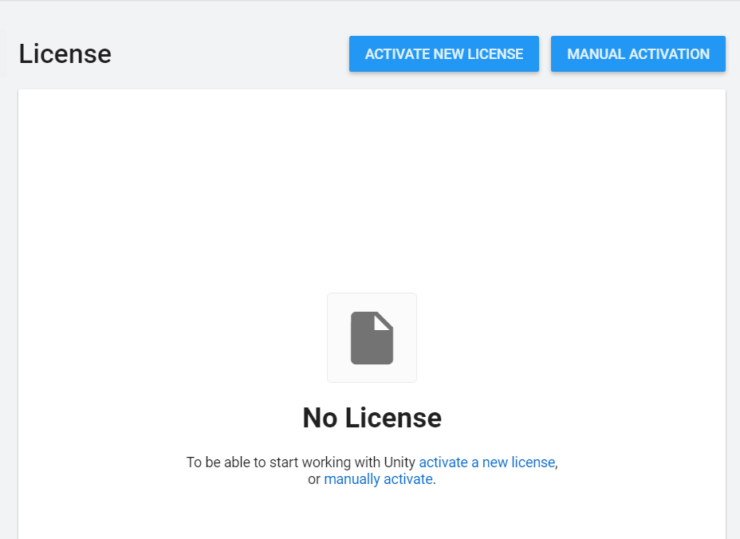
Activate Unity
Once logged in, activate new license

Slide 7
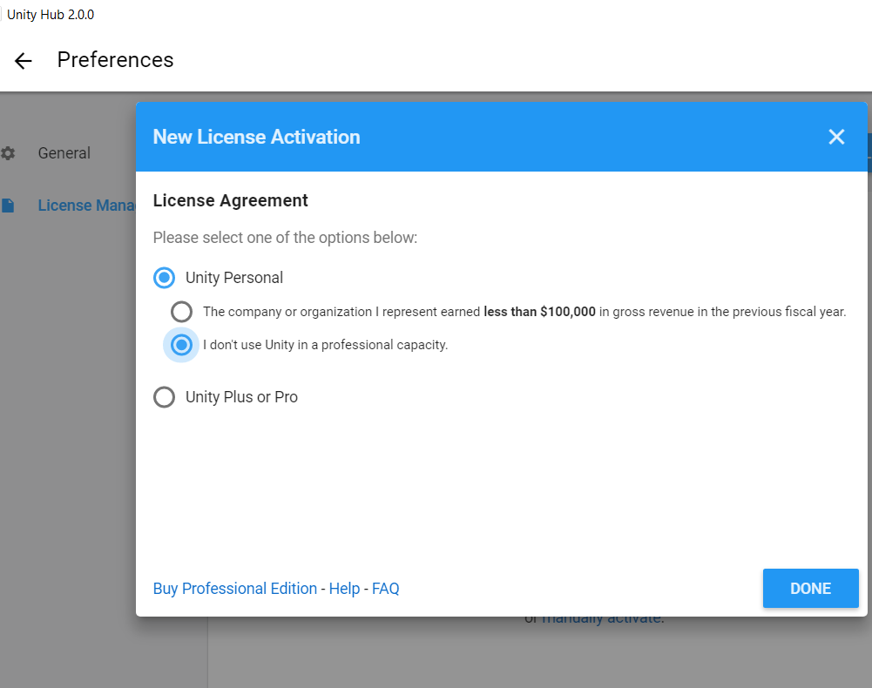
Activate Unity
Select
Unity Personal
I don’t use Unity in a professional capacity
Unless you’re making money more than $100,000 making unity programs… if you are please come see me. I’d like a cut of it.
Then press the back arrow to return to the hub screen

Slide 8
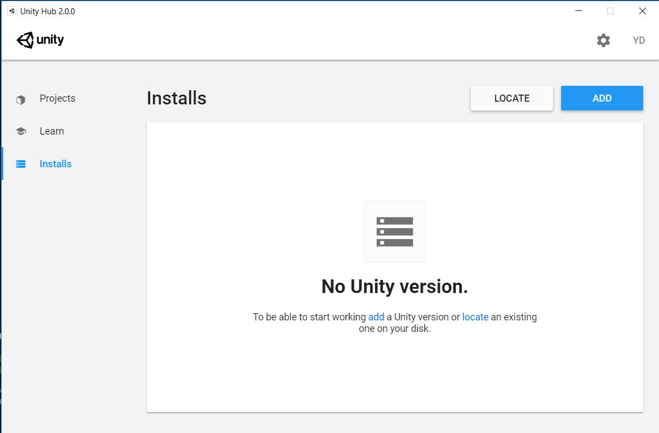
Installing Unity
Under Installs
Click Add

Slide 9
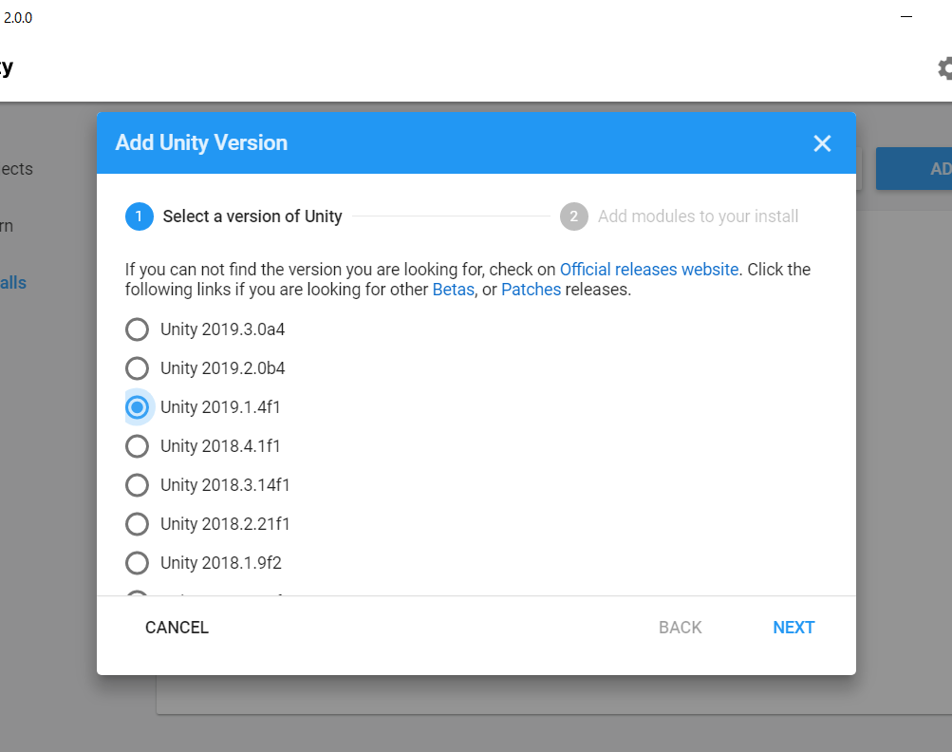
Installing Unity
Select the latest stable version.
Denoted by an ‘f’ appended for to the end.
Then click next

Slide 10
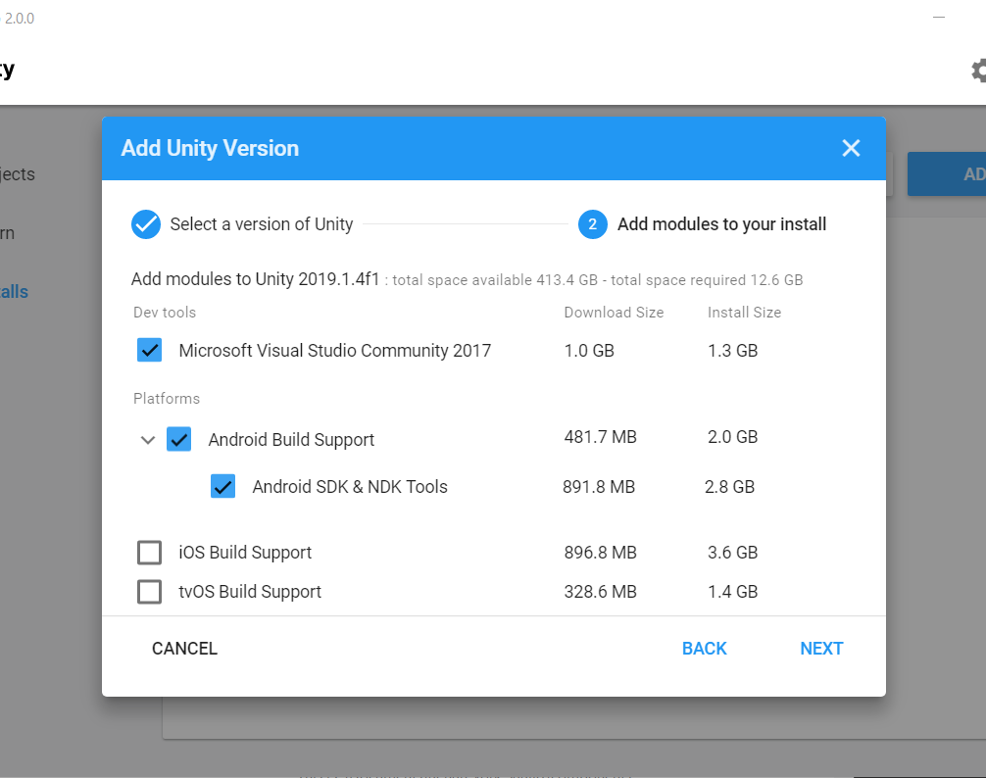
Installing Unity
If you don’t already have a IDE then you can allow Visual Studio Community 2017
Open up the drop down and select Android Build Support and Android SDK & NDK Tools
Click next
It is a large file and will take time.
This will need to be done off company wifi.

Slide 11
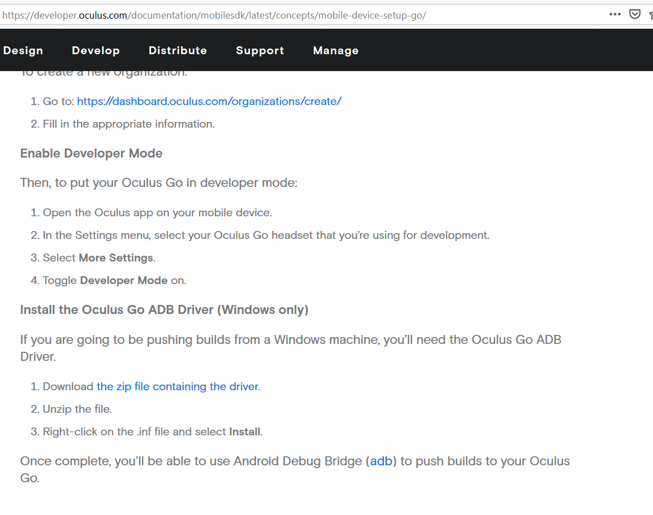
Oculus Go ADB Driver
https://developer.oculus.com/documentation/mobilesdk/latest/concepts/mobile-device-setup-go/
Click “the zip file containing the driver.”

Slide 12
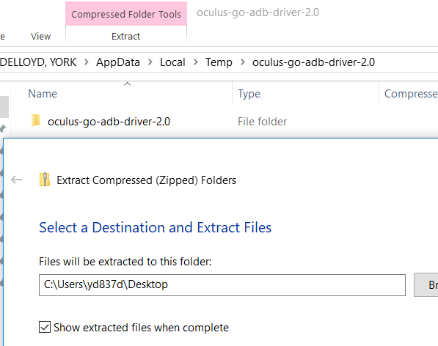
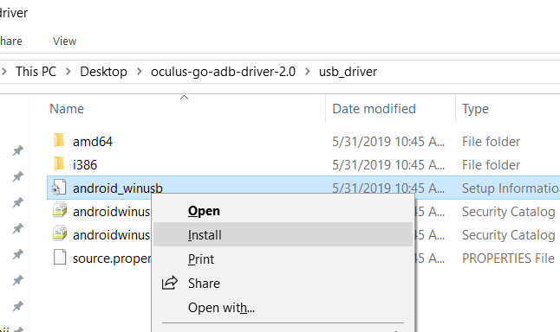
Oculus Go ADB Driver
Extract the file
Right click android_winusb to install

Slide 13
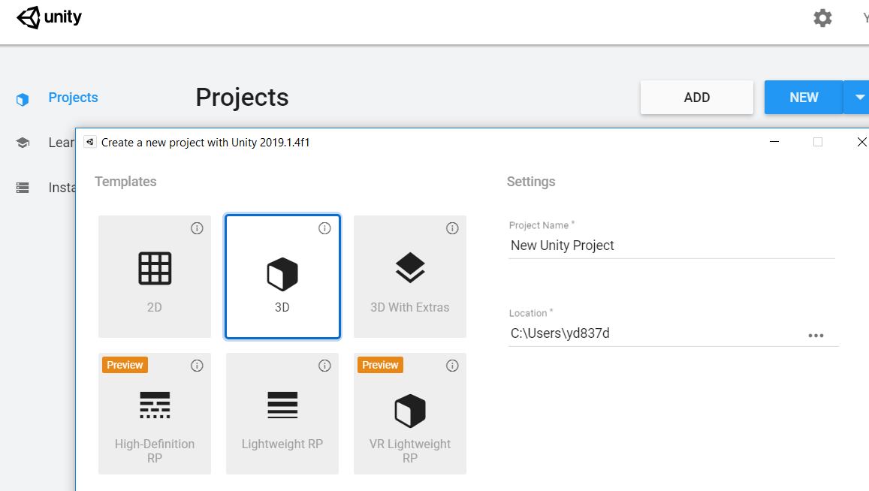

Using Unity
Open up unity
Click on new project
After pop up select 3D
Name your project
Click Create

Slide 14
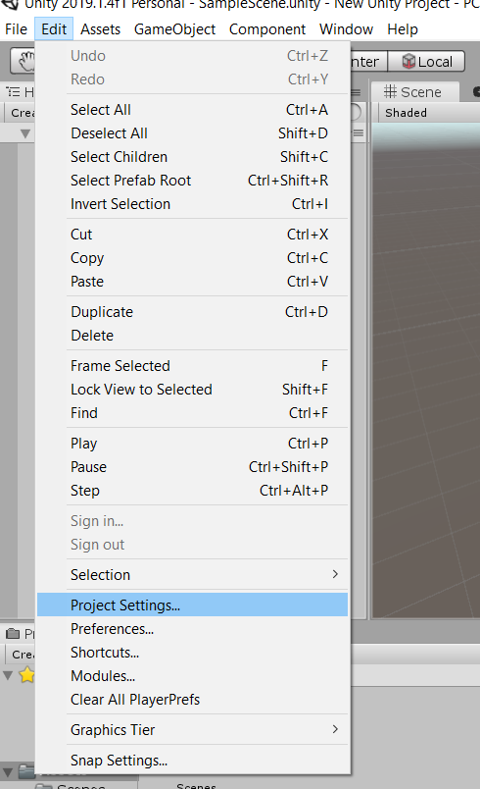
Using Unity
Click edit
Project Settings

Slide 15
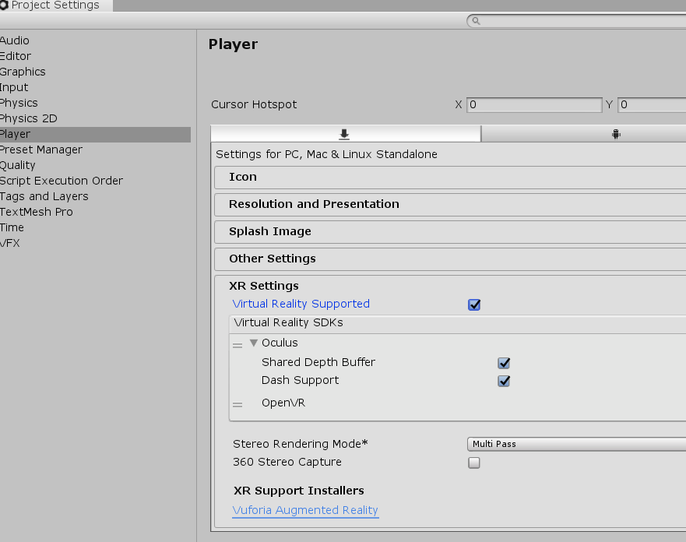
Using Unity
In Project Settings
Under Player
Select XR Settings
Virtual Reality Supported
Virtual Reality SDK

Slide 16
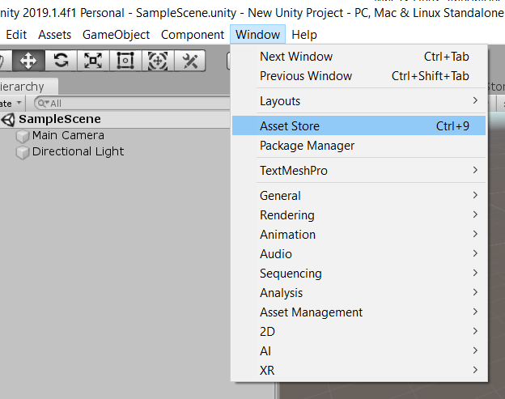
Using Unity
Go to Window
Go to Asset Store

Slide 17
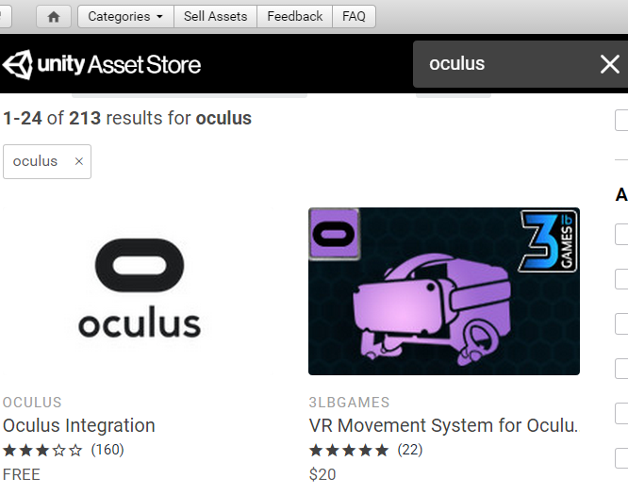
Using Unity
In the asset store
Search Oculus or Oculus Integration
Click on Oculus Integration

Slide 18
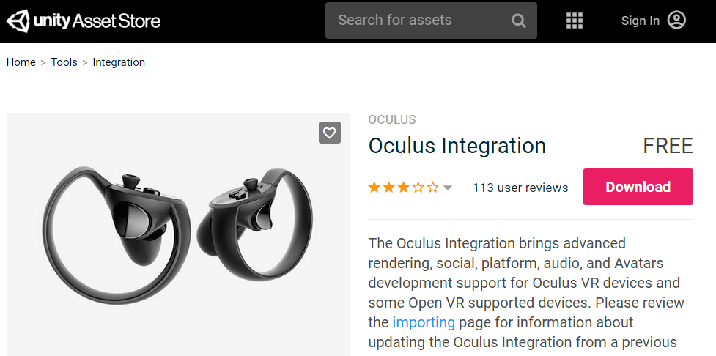
Using Unity
In the asset store
(You will need to be off company wifi again)
Download
While that’s happening, take some time to search through the asset store to see what kind of assets you can use in your project!

Slide 19
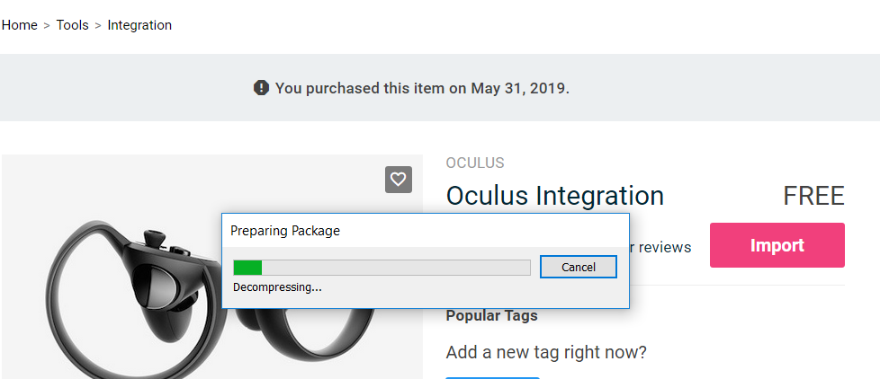
Using Unity
After Download is complete
Import
After completed, take some time to search through the asset store to see what kind of assets you can use in your project!

Slide 20
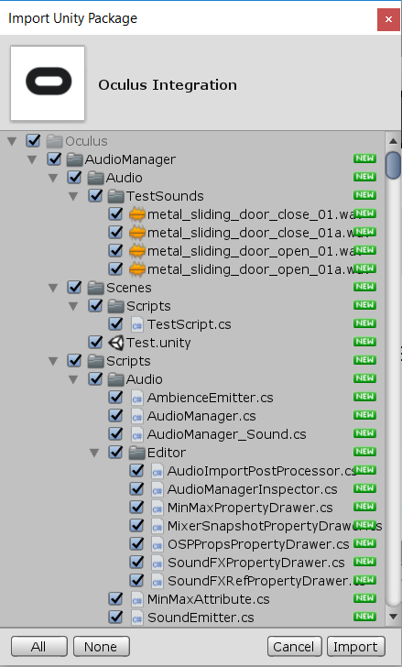
Using Unity
After import is clicked this utility will pop up.
Import again.
After completed, take some time to search through the asset store to see what kind of assets you can use in your project!

Slide 21
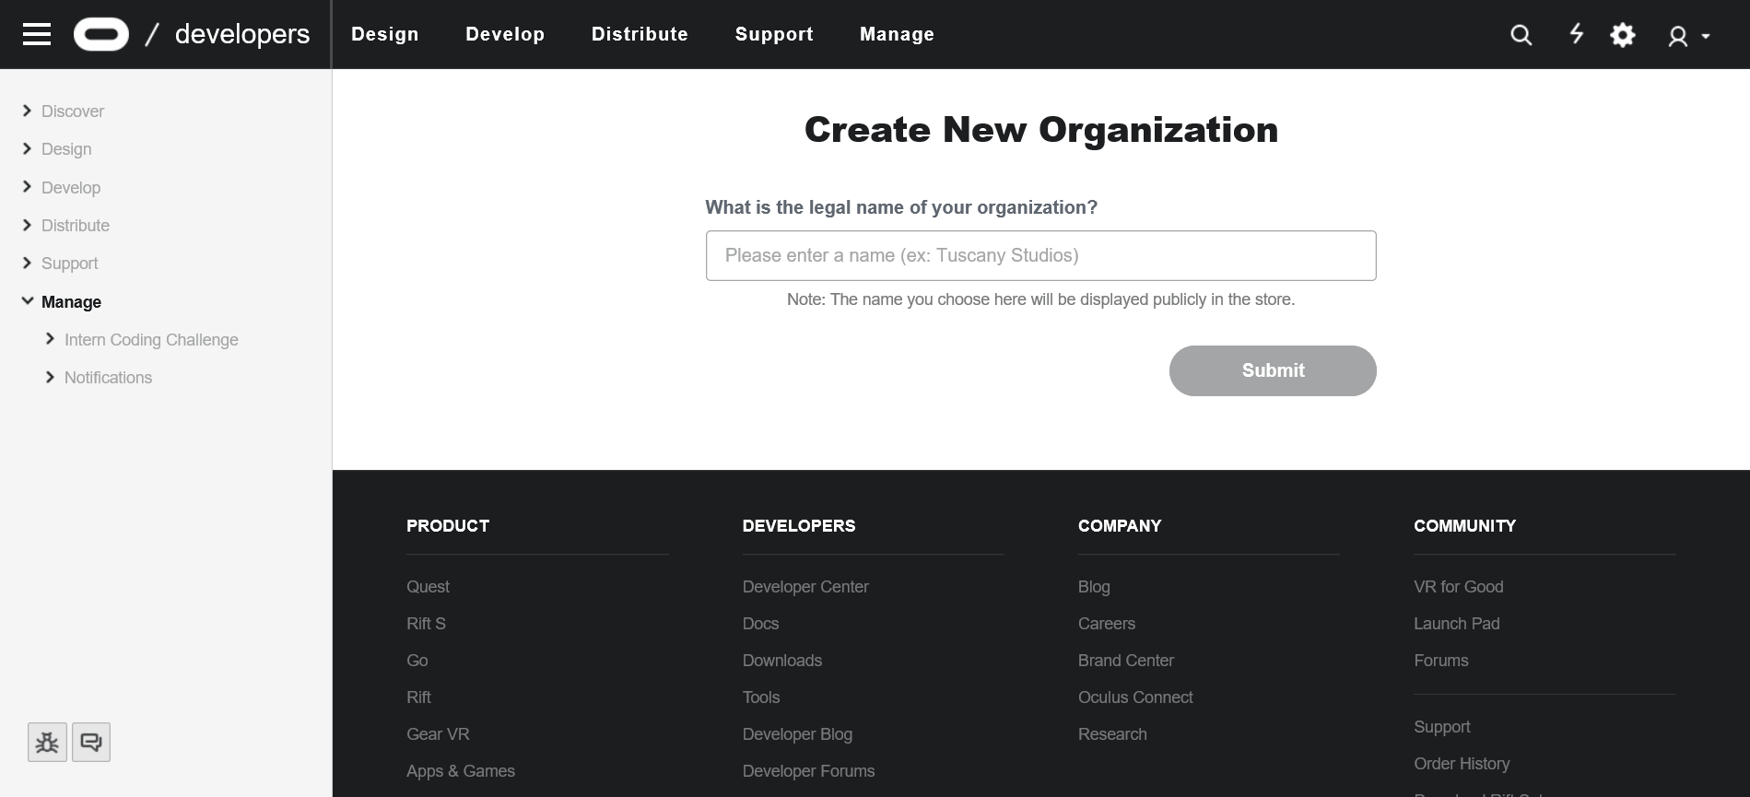
Enabling Developer Mode – Create Organization
To enable developer mode, you must first create an organization.
To create a new organization, go to the link below. (Get off of ATTCORP, otherwise webpage will not display properly)
https://dashboard.oculus.com/organization/create
Type in the name of your organization. (This can be anything)
Accept terms and conditions.

Slide 22
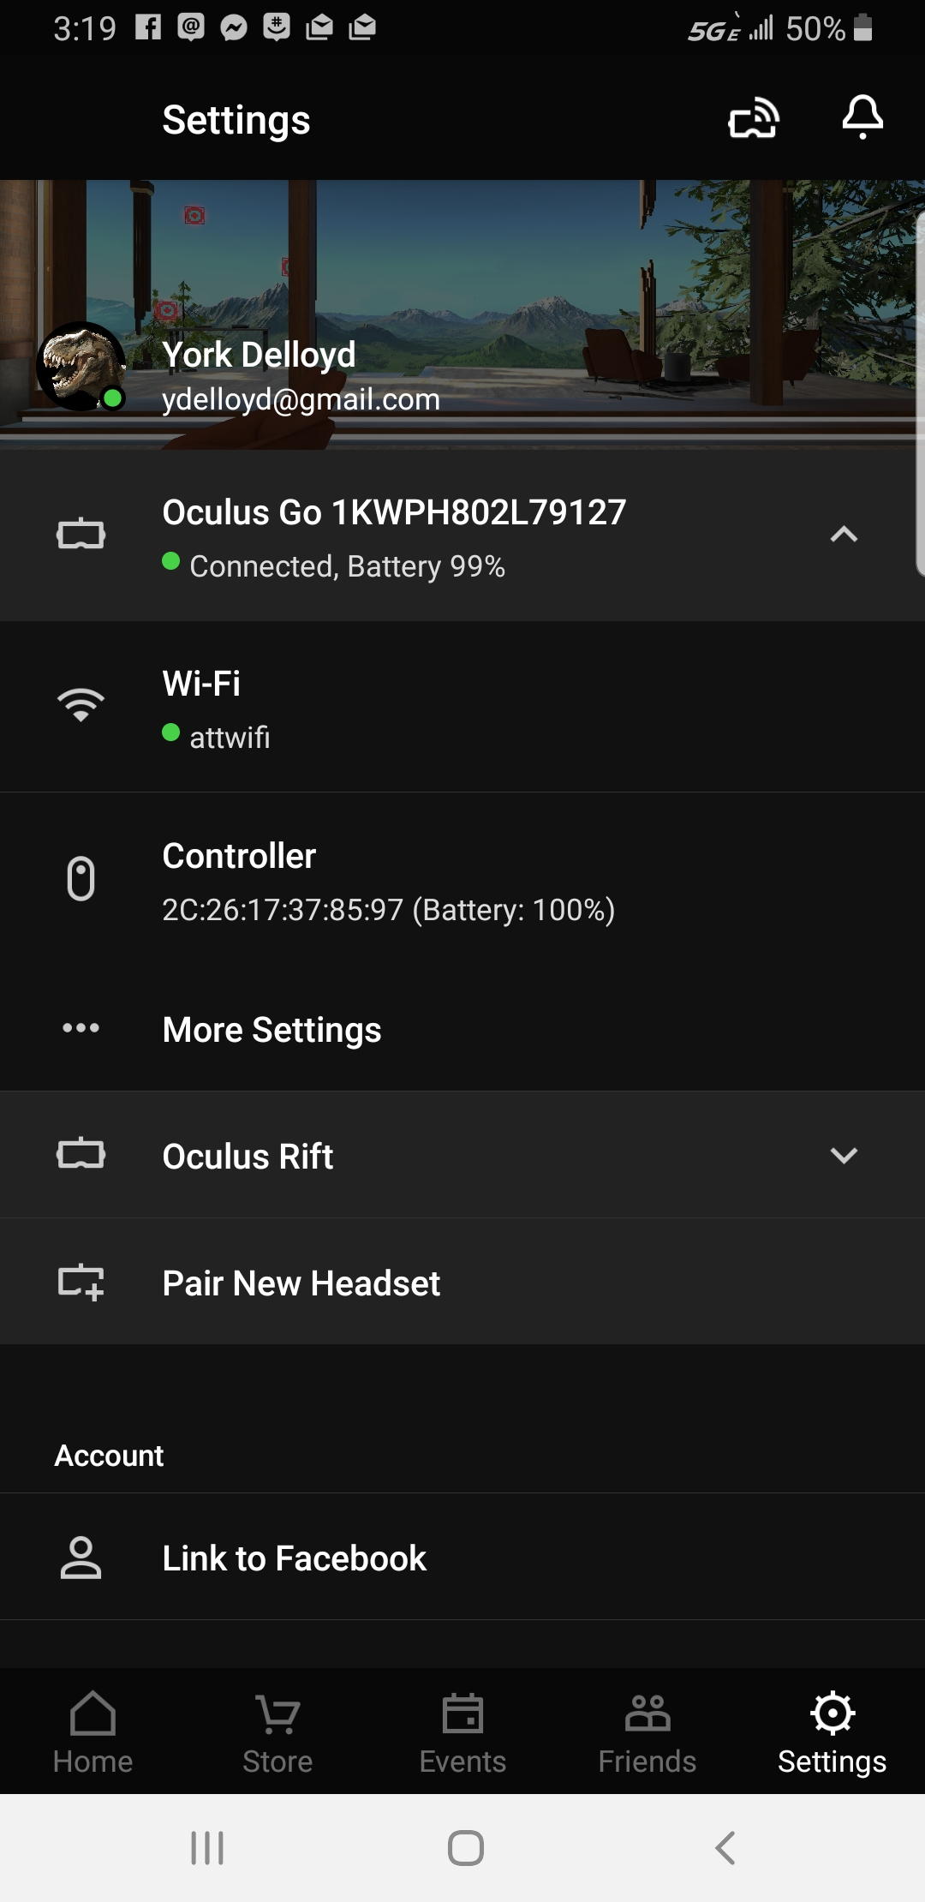
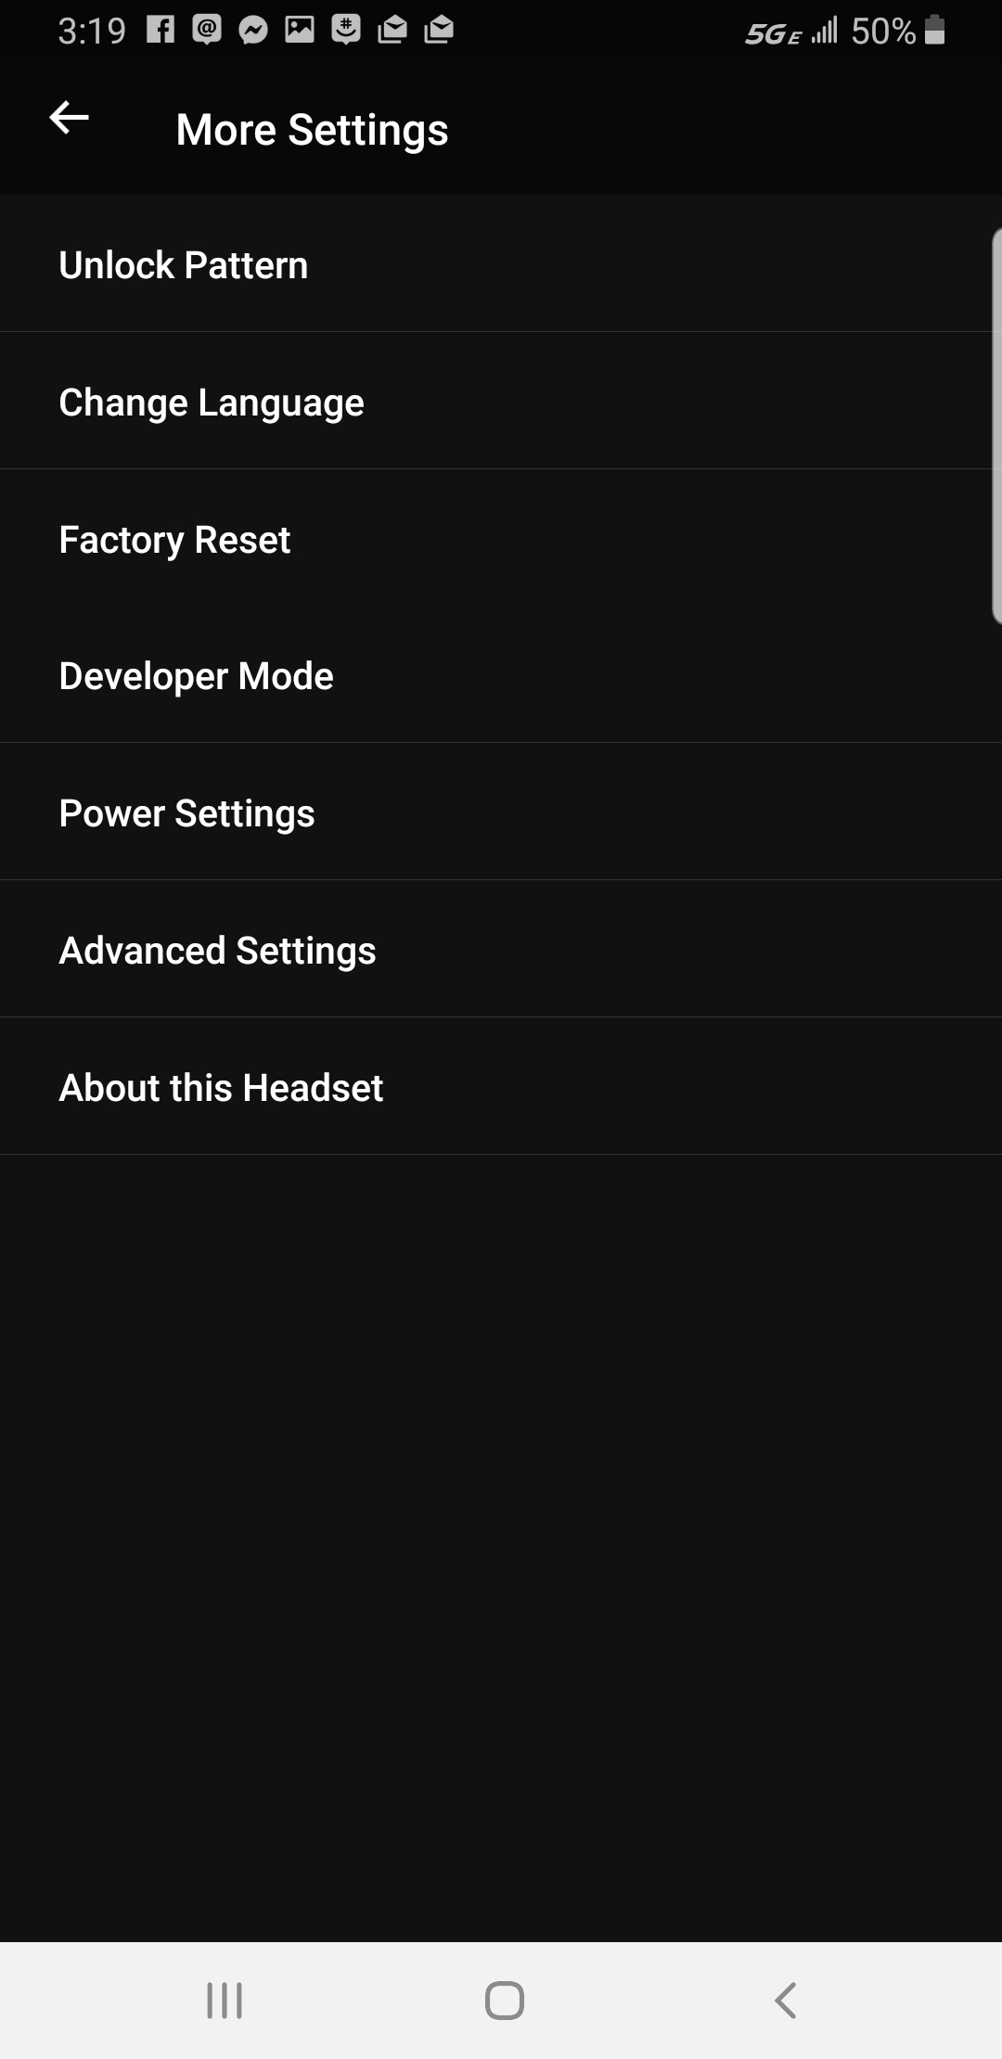
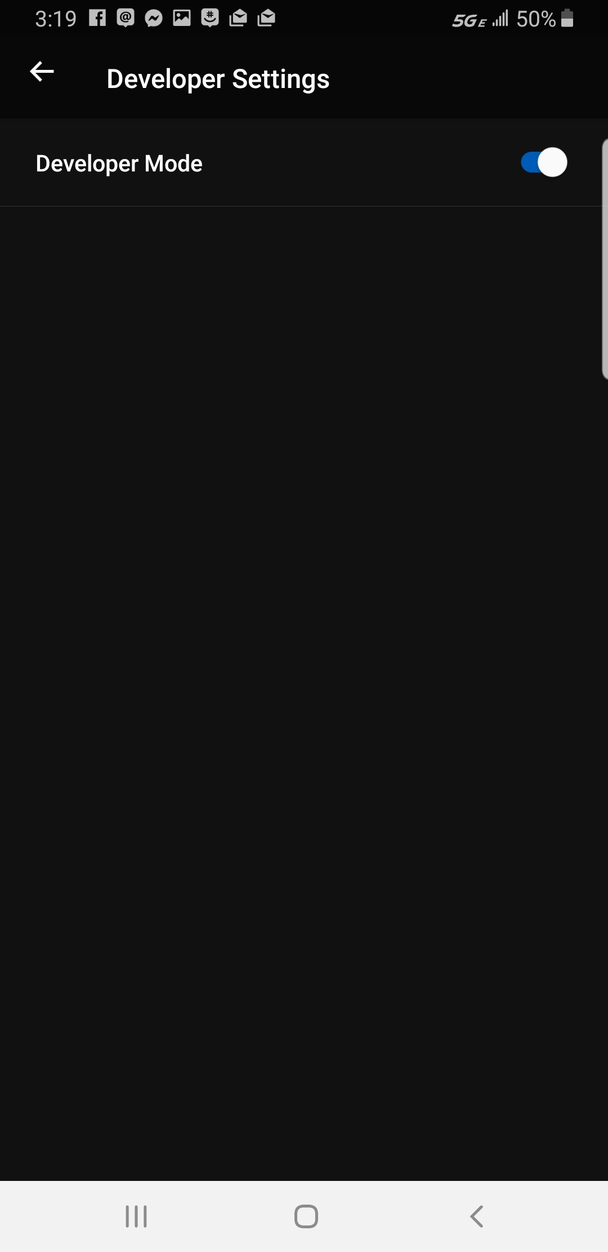
Enabling Developer Mode
Open the Oculus App on your mobile device.
Navigate to More Settings → Developer Mode to toggle developer mode on.

Slide 23
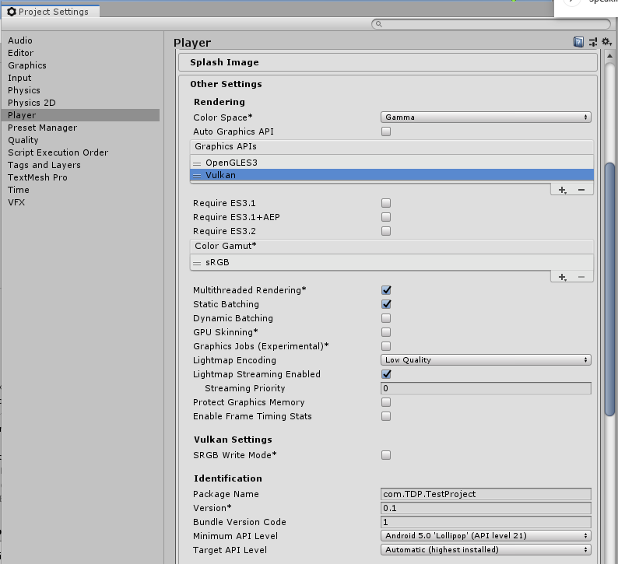
Getting Ready to Deploy
Go into your project settings
Player -> Other Settings
Under graphics APIs, select Vulcan and press the minus sign
Also Under Minimum APO Level change toit to API Level 21 Android 5.0

Slide 24
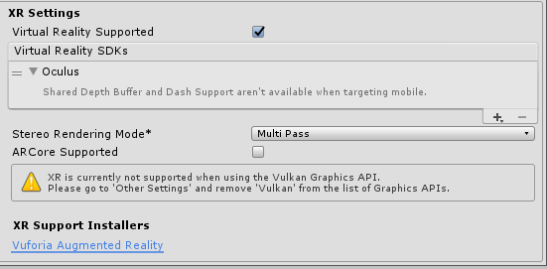
Getting Ready to Deploy
Under XR Settings –
Double check Virtual Reality Supported
Add Oculus as an SDK using the “+”

Slide 25
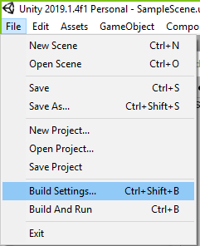
Deploying
When you’re ready to deploy
File -> Build Settings

Slide 26
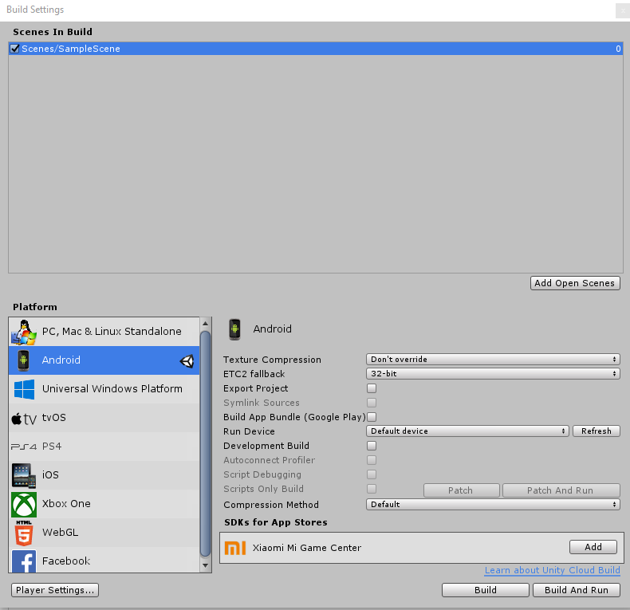
Deploying
In the Build Settings
Make sure your scene is in the Scenes to build – If not then add open scenes
Select android
(if it’s your first time, the build button will say switch platform – select that)
When you are ready to deploy click build and run
(**inside the headset**) a popup will ask to authorize the pc to build on the device. Please allow so.

Slide 27
Special Notes – things to consider
Oculus go only 3 degrees of freedom for the controller– use ray casting to your advantage
Oculus go essentially runs on a phone. Be careful to not use too many complex assets as it might not run smoothly
Debugging will require you to use the ADB, an alternative solution is to make a canvas and update the text
Unity does not play well with codecloud because of large files. You will need to add a .gitignore file (linked on tspace)

Slide 28
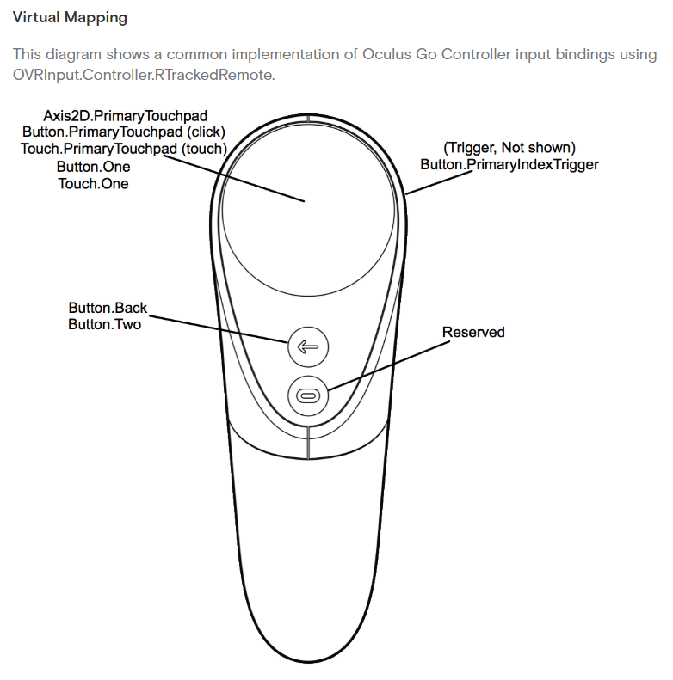
Special Notes
Inputs from the controller can be accessed globally using this style:
OVRInput.Get(OVRInput.Axis1D.PrimaryIndexTrigger)
Button mappings are listed in the image

Slide 29
Demo Project –Piccaso Simulator
Git clone https://yd837d@codecloud.web.att.com/scm/st_innovate19/piccaso-simulator-demo.git
Unity Hub → add Project → “Project Folder”
When importing project, make sure you’re off company wifi in order to get the assets correct.
Go under “Assets” → “Scenes” → Drag “SampleScene” to the Hierarchy
Switch Platform to Android (Make sure player settings are the same as above)
Build and run

